Slide 1
Title of PAR for new project
Date: 2015-04-21
Authors:
Notice: This document has been prepared to assist IEEE 802.19. It is offered as a basis for discussion and is not binding on the contributing individual(s) or organization(s). The material in this document is subject to change in form and content after further study. The contributor(s) reserve(s) the right to add, amend or withdraw material contained herein.

Slide 2
Abstract
This document shows the title of PAR for new project (new Study Group) based on discussion in the Berlin F2F meeting
Based on this discussion, we propose new title of PAR for new project
Provide “terminology” which the regulators are defined

Slide 3
Action items
From “March 2015 CUB SG Minutes” (19-15/0031r0)
Need to develop a timeline for the project
Need to decide between two approaches to the title of the PAR
List frequencies (e.g. TVWS, 3.5 GHz, 5 GHz)
Describe regulatory constraints (e.g. “database managed bands”)
Develop one to two slides giving a concise describing the need for new amendment to the current 802.19.1 standard (19-15/0032r0)
Develop a draft press release for the July plenary
Finalized the PAR and CSD

Slide 4
Title for new amendment project
Title of “IEEE Std 802.19.1 – 2014”
TV White Space Coexistence Methods
Option 1 - Proposed draft PAR (19-15/0028r0)
TV White Space, 5GHz and 3.5GHz bands Coexistence Methods
Option 2 – Discussion in Berlin F2F meeting
Coexistence Methods for Geo-location database (GLDB) enabled frequency bands

Slide 5
Discussion
Option 1
If 5GHz bands are not using GLDB like TV White Spaces, we will need to modify our PAR before submitting Sponsor Ballot
If the other band is using GLDB in future, we need to maintain the title of this standard
Option 2
Frequency bands are flexible, but this standard will be applied to the frequency bands enabled by GLDB only
If 5GHz bands are not using GLDB, this standard will become “paper standard”

Slide 6
Terminology: “Unlicensed devices”
In US, all radio frequency devices are specified by Part 15 in Title 47 of the Code of Federal Regulations (CFR)
“Unlicensed devices” are specified by following;
Subpart C: Intentional Radiators
900MHz, 2.4GHz and 5.8GHz bands
Subpart E: Unlicensed National Information Infrastructure devices
5GHz bands
Subpart H: Television Band devices
TV bands
3.5GHz SAS system will be specified by Part 96 in Title 47 the Code of Federal Regulations (CFR)
Subpart D: General Authorized Access

Slide 7
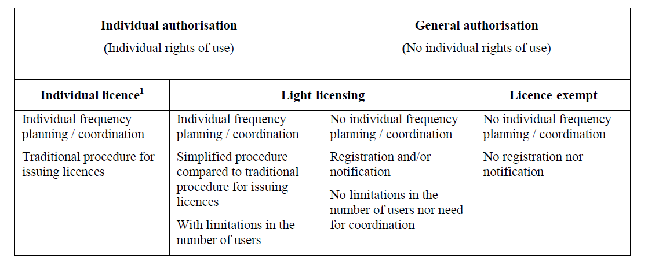
Terminology: “General authorization”
Table 1 in ECC Report 132 shows reference terminologies which are proposed in order to capture some fundamental differences between various regulatory options in EU
TVWS devices
3.5GHz SAS devices
47 C.F.R. Part 15 devices except TVWS Devices

Slide 8
Title for new amendment project
Option 3
Coexistence Methods for geo-location capable devices operating under general authorization
“general authorization” includes
license-exempt or unlicensed
5GHz, TVWS, etc.
general authorized access basis in SAS
GAA in US 3.5GHz SAS
“geo-location capable devices” intends
Coexistence information should include geo-location information of devices

Slide 9
References
“March 2015 CUB SG Minutes”, 19-15/0031r0
“The new coexistence use cases for IEEE 802.19.1”, 19-15/0032r0
Federal Communications Commission, FCC 14-49, “GN Docket No. 12-354 FUTHER NOTICE OF PROPOSED RULEMAKING”, April 23, 2014
“LIGHT LICENSING, LICENCE-EXEMPT AND COMMONS”, ECC Report 132, June 2009

