Slide 1
The new coexistence use cases for IEEE 802.19.1
Date: 2015-04-08
Authors:
Notice: This document has been prepared to assist IEEE 802.19. It is offered as a basis for discussion and is not binding on the contributing individual(s) or organization(s). The material in this document is subject to change in form and content after further study. The contributor(s) reserve(s) the right to add, amend or withdraw material contained herein.

Slide 2
Abstract
This document shows the new coexistence use cases for IEEE 802.19.1 from the view point of system architecture.

Slide 3
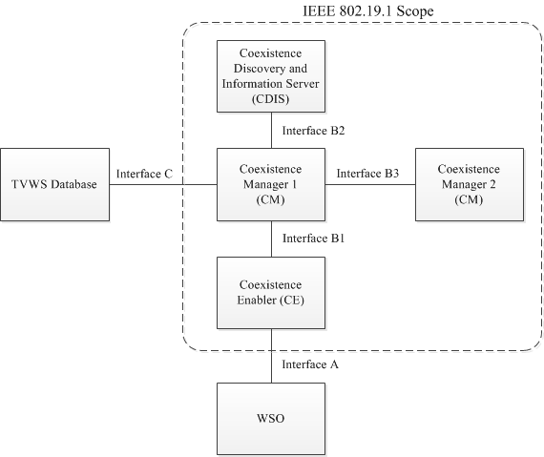
[Recap] System architecture defined in IEEE 802.19.1 [1]
coexistence discovery and information server (CDIS): An entity that is responsible for determining for coexistence managers (CMs) those white space objects (WSOs) that may affect performance of the WSOs that the CMs serve.
coexistence manager (CM): An entity that is responsible for making coexistence decisions related to reconfiguration of white space objects (WSOs) to solve coexistence problems among them.
coexistence enabler (CE): An entity that represents a white space object (WSO) in the coexistence system and serves one WSO at a time.

Slide 4
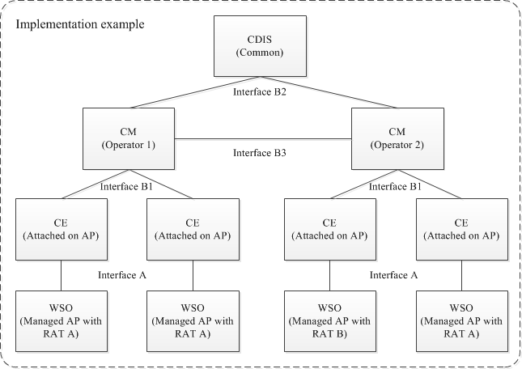
Case 1: CMs are managed by different operators using a common CDIS

Slide 5
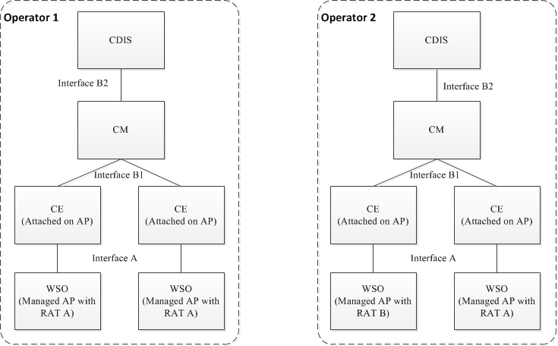
Case 2: Multiple network operators have their own CDISs for coexistence in its network
Interface between operators is required

Slide 6
Reference
[1] IEEE Standard Association, “IEEE Std 802.19.1-2014”, July 2014

