Slide 1
Considerations on Difficulty of Possible Coexistence Scenarios in Studying Solutions
Date: 2015-03-11
Authors:
Notice: This document has been prepared to assist IEEE 802.19. It is offered as a basis for discussion and is not binding on the contributing individual(s) or organization(s). The material in this document is subject to change in form and content after further study. The contributor(s) reserve(s) the right to add, amend or withdraw material contained herein.

Slide 2
Abstract
In January interim meeting, we presented coexistence scenario and use cases for license-exempt devices and networks in the following frequency bands;
5GHz U-NII bands
US 3.5GHz band
This contribution considers the difficulty of the possible scenarios in studying coexistence solutions.
Finally, we will provide suggestion according to this consideration.

Slide 3
Possible Coexistence Scenarios
There are three scenarios with different difficulty;
All the devices are independently distributed and operating autonomously.
Some devices are independently distributed and operating autonomously, and the other devices are managed.
All the devices are managed.

Slide 4
Possible scenarios
There are three scenarios with different difficulty;
All the devices are independently distributed and operating autonomously.
Some devices are independently distributed and operating autonomously, and the other devices are managed.
All the devices are managed.

Slide 5
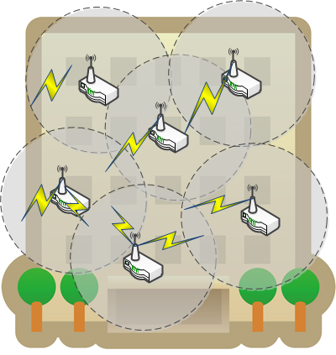
Scenario A: All the devices are independently distributed and operating autonomously
Example) Private Wi-Fi usage in a residential apartment building
Congestion among autonomously-operated Wi-Fi

Slide 6
Possible scenarios
There are three scenarios with different difficulty;
All the devices are independently distributed and operating autonomously.
Some devices are independently distributed and operating autonomously, and the other devices are managed.
All the devices are managed.

Slide 7
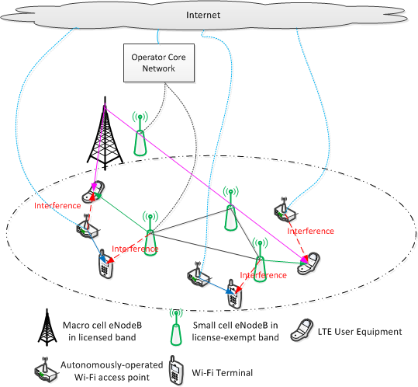
Scenario B: Some devices are independently distributed and operating autonomously, and the other devices are managed
Example) Co-channel sharing between Wi-Fi and LTE-LAA in 5GHz bands
Congestion between autonomously-operated Wi-Fi and LTE-LAA

Slide 8
Possible scenarios
There are three scenarios with different difficulty;
All the devices are independently distributed and operating autonomously.
Some devices are independently distributed and operating autonomously, and the other devices are managed.
All the devices are managed.

Slide 9
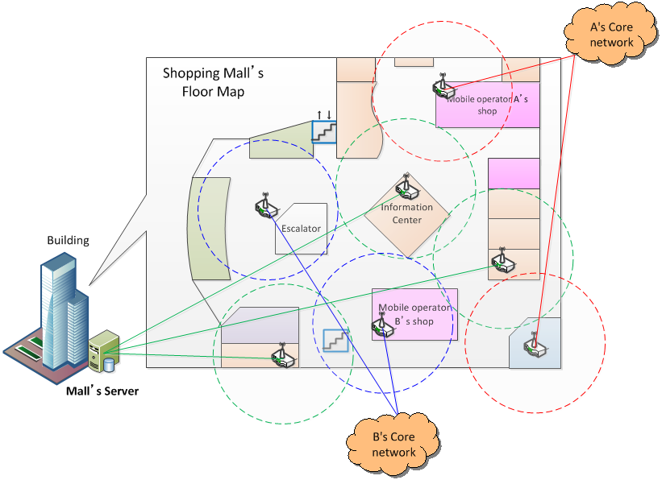
Scenario C: All the devices are managed
Example) Managed Wi-Fi usage in a building.
Congestion among managed Wi-Fi
Operator A
Operator B
Infra-administrator of shopping mall

Slide 10
Comparison of Features and Difficulty Levels for Coexistence
Features | Scenario A | Scenario B | Scenario C
Administrator | Personal | Personal/Operator/Enterprise/Public infra-provider | Operator/Enterprise/Public infra-provider
Device distribution | All are independently distributed. | Some are independently distributed. Others are designed. | Designed.
Availability of geo-location information for network coexistence | Hard | Medium | Easy
Ensuring security and privacy | Difficult | Medium | Easy
Difficulty level for network coexistence | High | Medium | Low
[Suggestion]
Step-by-step study will be better from low to high difficulty levels in order.
Scenario C → Scenario B → Scenario A

Slide 11
Corresponding Possible Use Cases (in Our Previous Contribution[1])
No use cases correspond to Scenario A.
Use case 1 corresponds to Scenario B.
Use cases 2 – 4 correspond to Scenario C.

Slide 12
Summary
This contribution considered the difficulty of the possible scenarios in studying coexistence solutions.
Difficult case: All the devices are independently distributed and operating autonomously.
Easy case: All the devices are managed.
Step-by-step study from low to high difficulty levels in order will be better to study coexistence solutions.

Slide 13
Reference
[1] IEEE 802.19-15/0010r0, “Coexistence Scenario and Use Cases”

