Slide 1
Overview of 802.15 SRU SG
Date: 2014-07-16
Authors:
Notice: This document has been prepared to assist IEEE 802.19. It is offered as a basis for discussion and is not binding on the contributing individual(s) or organization(s). The material in this document is subject to change in form and content after further study. The contributor(s) reserve(s) the right to add, amend or withdraw material contained herein.

Slide 2
Abstract
This document provides overview of the 802.15 SRU SG activity.

Slide 3
Contents
Background
SG SRU activity
Use Case Examples

Slide 4
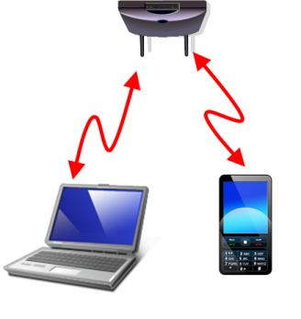
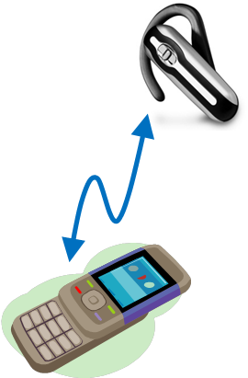
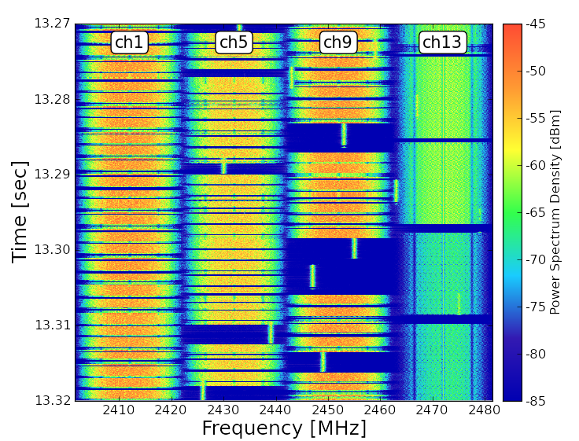
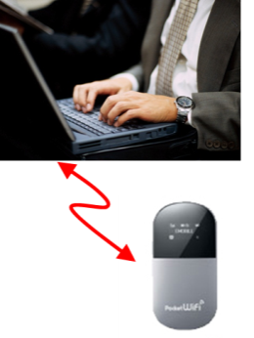

Congestion situation in the ISM band
High traffic-load situation will be caused frequently in the near future in ISM band
  degrades the efficiency of the overall communications due to inter-system interference among co-existing wireless systems
WLAN
Bluetooth
WLAN
802.15 devices
Experimental results of High traffic-load situation

Slide 5
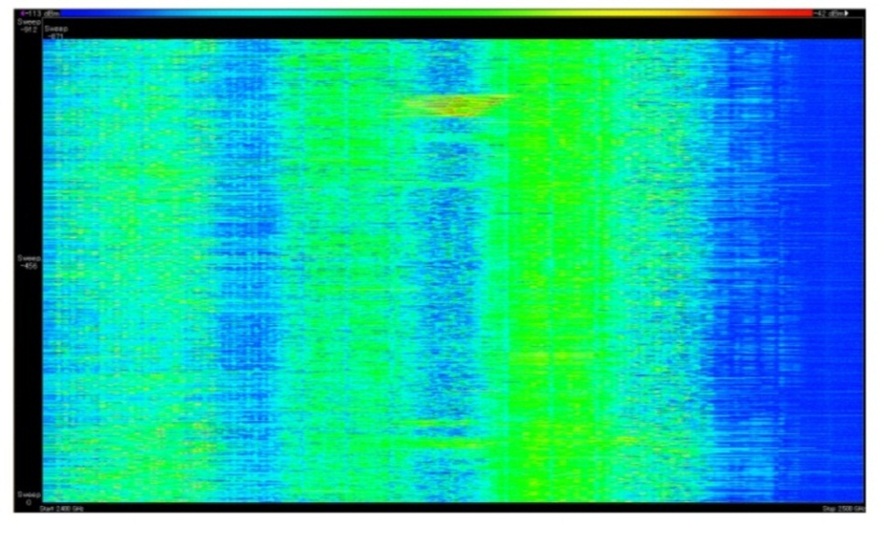
Real environment in 2.4GHz band
The following locations were selected and measured, to confirm the real situation in 2.4GHz ISM band.
  Airport
  Railroad station
  Conference room
  Residential area
  Hospital
-114dBm
Signal strength
-34dBm
10:00
Time
10:15
2.4GHz
Frequency
2.5GHz
Spectrogram at the airport

Slide 6
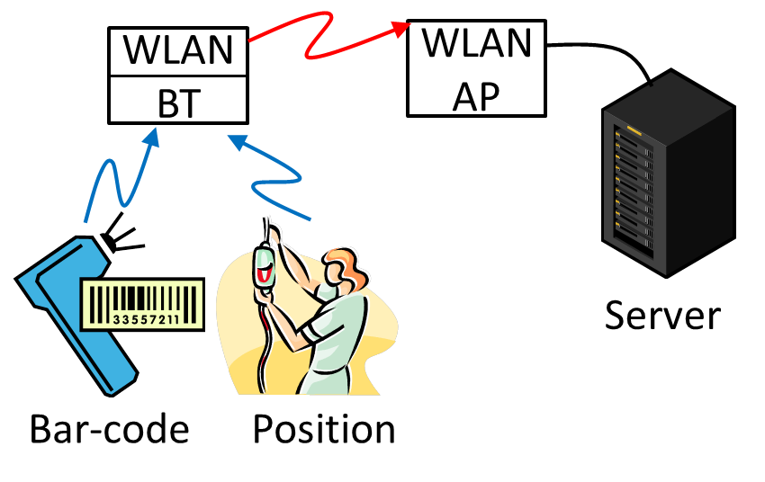
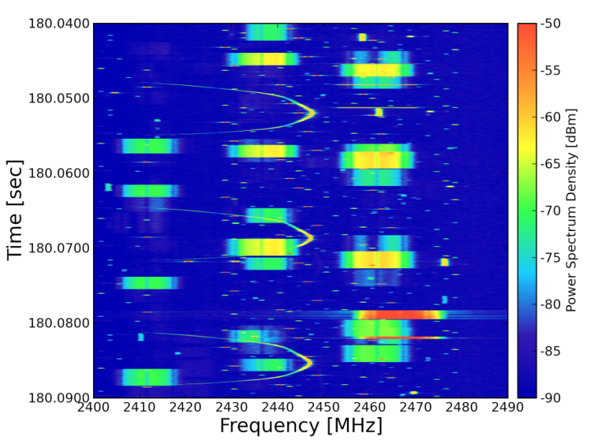
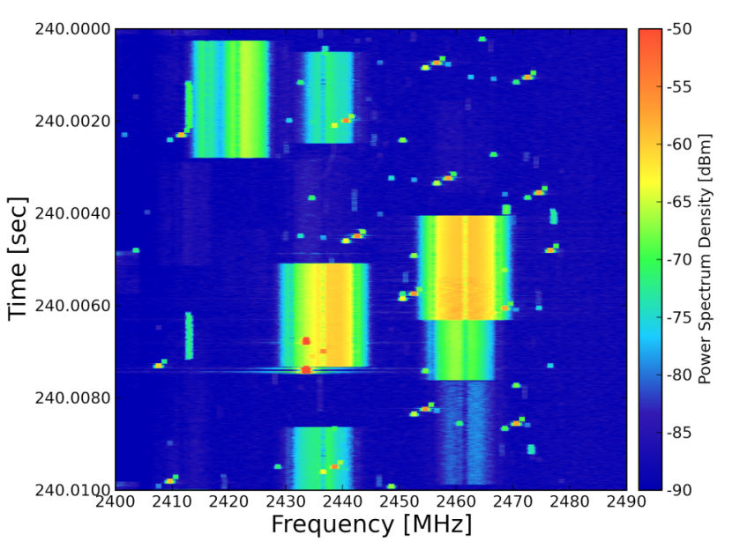
Hospital
Huge wireless medical information system deployed throughout a hospital.
  Other private devices operated on other channels
  Noise from microwave oven were observed
  WLAN and Bluetooth packets would cause collisions
50 ms
10 ms
Spectrogram

Slide 7
IG and SG SRU History
The SRU (Spectrum Resources Usage in WPANs) Interest Group started in November 2010.
  IG SRU Technical Document (15-12-184r1) has been released.
  Motion to establishing Study Group has been passed on July 2013.
Started the SRU Study Group in September 2013.
  The group decided to focus on Spectrum resource measurement
  It specifies
    spectrum resource measurements, such as packet error ratio, delay, etc,
    information elements and data structures to capture these measurements,
    procedures for collecting and exchanging spectrum resource measurement information with higher layers or other devices.
  Developed PAR (15-13-615r7) and CSD (15-14-0175r4) has been submitted to WG on May 2014.

Slide 8
PAR
Title:
Standard for Local and metropolitan area networks--Part 15.4: Low-Rate Wireless Personal Area Networks (LR-WPANs) Amendment enabling Spectrum Resource Measurement Capability
Scope of the proposed standard:
This amendment to IEEE Std 802.15.4 defines MAC related functions to enable spectrum resource management.
It specifies
- spectrum resource measurements, and network performance metrics, such as packet error ratio, delay, etc,
- information elements and data structures to capture these measurements,
- procedures for collecting and exchanging spectrum resource measurement information with higher layers or other devices.
Purpose:
The purpose of this amendment is to enable effective spectrum resource management in IEEE 802.15.4 for improved coexistence, better throughput, and improved interference mitigation among other things.
Need for the Project:
As various wireless systems are deployed in the shared and license exempt frequency bands including 2.4GHz and 915MHz bands, heavy interference has limited performance of the wireless systems. In order for these wireless systems to operate more effectively, a standardized set of spectrum resource measurements is needed that will facilitate management functions in these networks.

Slide 9
Use Case Examples
Three major use cases have been in consideration
  Hospital/Medical/Healthcare
  Industrial Automation
  Infrastructure Monitoring

Slide 10
Use case: Medical/Health-care
Numerous nodes generate a variety of application traffic in different required quality and data size.
Based on measured information about radio resources usage, the radio channels and resources are appropriately allocated so that more important applications can run in practical quality.
A Use Case of Self-Organizing Wireless Network for Medical System(15-13-0306r0)

Slide 11
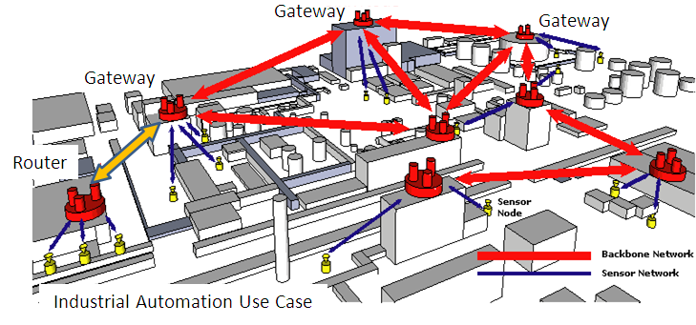
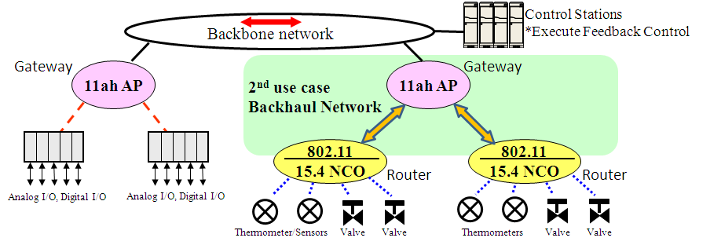
Use case: Flexible Deployment of Industrial Wireless Network
Quick additional deployment
Quick withdrawal, relocation
Inexpensive and reusable
Temporal network deployment
Episodic/Unexpected traffic
Disaster responsiveness
Emergency action
to prevent accident
Additional
Gateway
Additional use case of temporal and flexible industrial network deployment (15-13-0654r1)

Slide 12
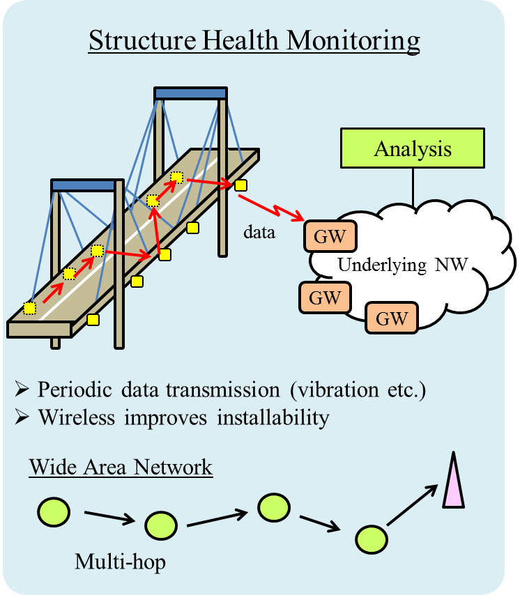
Use case: Infrastructure monitoring
Application Server
Status Management
network condition
(maximum data rate, …)
desired QoS
(data rate, delay, ...)
Radio Resource
Management Entity
Optimization Function
measurement result
(interference, battery, …)
communication parameters
(interval, topology, ...)
Wireless Node
Radio Resource
Measurement
Configuration
Modification
Proposal of radio resource management architecture(15-13-0285r1)

Slide 13
Timeline
Year |  | 2013 |  |  | 2014 |  |  |  |  |  | 2015
Month |  | 7 | 9 | 11 | 1 | 3 | 5 | 7 | 9 | 11 | 1 | 3 | …
SG Work Items | PAR development
 | Use Cases
 | Title
 | Scope & Purpose
 | 5C analyses
 | Interaction with other TG/WG (to identify relationship )
 | Submission to WG
Standard development phase (TG)
Target dates:
  PAR submission to WG in May 2014
  PAR submission to NesCom in July 2014
  SASB approval in August 2014
PAR Review

Slide 14
References
A Use Case of Self-Organizing Wireless Network for Medical System(15-13-306-0)
Additional use case of temporal and flexible industrial network deployment (15-13-0654r1)
Proposal of radio resource management architecture(15-13-0285r1)
Establishing a Study Group for a Spectrum Resource Utilization (SRU) through Radio Resource Measurement and Management for WPANs (15-13-0404-01)
Overview of SG SRU (15-13-543r0)
A Study on Radio Resource Measurement and Management(15-14-018)

