Slide 1
PICS for 802.19.1
Date: 2012-01-18
Authors:
Notice: This document has been prepared to assist IEEE 802.19. It is offered as a basis for discussion and is not binding on the contributing individual(s) or organization(s). The material in this document is subject to change in form and content after further study. The contributor(s) reserve(s) the right to add, amend or withdraw material contained herein.

Slide 2
Abstract
This contribution discusses protocol implementation conformance statement (PICS) first from general standard perspective and then from the 802.19.1 perspective with objective to convince the readers that the 802.19.1 specification needs a PICS.

Slide 3
What PICS is?
In the standards context the PICS is the mean to evaluate conformance of a particular implementation to a standard
Supplier of an implementation that is claimed to conform to a stanard provides a statement of which capabilities and options of the standard have been implemented. That statement is PICS.
The standard in question provides a PICS proforma (normative) that the supplier shall complete for the implementation in question

Slide 4
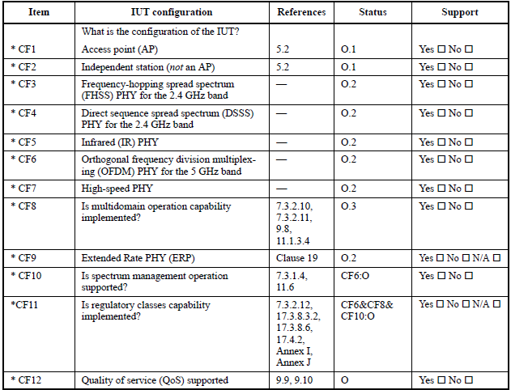
PICS proforma example from 802.11
Symbols for the Status column:
M = mandatory
O = optional
O.<n> = optional, but support of at least one of the group of options labeled by the same numeral <n> is required
pred = conditional symbol, including predicate identification
If the IUT supports the 5 GHz OFDM (CF6), it may support this feature

Slide 5
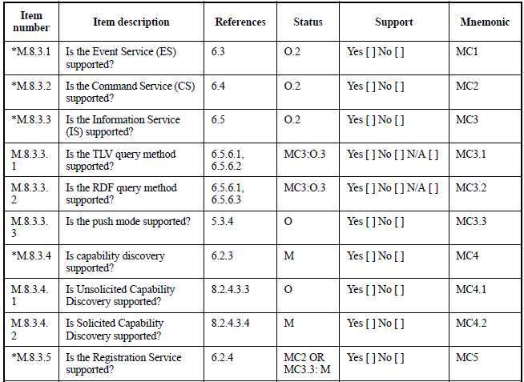
PICS proforma example from 802.21
Symbols for the Status column:
M = mandatory
O = optional
O.<n> = optional, but support of at least one of the group of options labeled by the same numeral <n> is required
pred = conditional symbol, including predicate identification
If the IUT supports the Information Service, it must support at least one of these

Slide 6
PICS for 802.19.1
We need one for our specification if we want to specify what conformance to 802.19.1 means
One basic element of interoperability
In the PICS we specify which features are mandatory and which are optional
We should use the logical elements (CE, CM, CDIS) as the basic building blocks of the PICS
IUT is either a CE, CM or CDIS
In the PICS we specify what a CE/CM/CDIS vendor needs to support and what’s optional

Slide 7
Proposals
Have a PICS in the IEEE 802.19.1 specification
Authorize the TG1 editor to prepare a PICS proposal for a normative annex to a working document based on the candidate draft DF0

