Slide 1
Comment Resolutions (CID 40, 43, 44)
Date: 2011-11-09
Authors:
Notice: This document has been prepared to assist IEEE 802.19. It is offered as a basis for discussion and is not binding on the contributing individual(s) or organization(s). The material in this document is subject to change in form and content after further study. The contributor(s) reserve(s) the right to add, amend or withdraw material contained herein.

Slide 2
Abstract
This presentation contains three proposals
Information/management service handling (CID 40)
Proposed changes in message format (CID 43)
Master CM selection algorithm normative text proposal (CID 44)

Slide 3
System Overview
CM
CM
CDIS
Network Type A
CE
CE
CM
Network Type B
CE
CE
CE
CE
CE
Network Type C
CE
CE
CE
CE
CE
CE

Slide 4
Assumptions
1 to 1 mapping between CE and TVBD network or device
The address of a CE is pre-configured for a TVBD network or device
A CE or TVBD network/device knows the address of CDIS upon start-up
  E.g., CDIS address may come from TVWS DB
A CM knows the address of CDIS upon start-up
Inter-CM neighbors are calculated by CDIS upon a request from a CM

Slide 5
Coexistence Interference Channel Map (CICM)
Internal to a CM
For each management serviced TVBD network/device, we define the following C-WSM to represent the list of available channel and occupancy of the channel
How to calculate Occupancy
  Estimated channel busy time due to intra-CM information serviced neighboring TVBD N/Ds, inter-CM information serviced neighboring TVBD N/Ds, and unregistered TVBD N/Ds
Channel Number | Occupancy (100% = 255)
21 | 100
22 | 200

Slide 6
Management serviced TVBD network or device
Information serviced TVBD network or device
Unregistered TVBD network or device
Information serviced inter-CM neighboring TVBD network or device
CDIS
CM2
CM1
Target_TVBD
Occupancy estimation
through inter-CM Query process
Occupancy estimation
through Query process
Occupancy measurement
through measurement process

Slide 7
An Example
Inter-CM neighbors
(e.g., neighbor report)
{CICM (i)}
Coexistence Decision Algorithm (BLACKBOX)
Set of CCIM per each
management serviced TVBD
{Operating CH (i)}
Intra-CM neighbors
(e.g., neighbor report)
CM

Slide 8
Occupancy Estimation
Intra-CM information serviced neighboring TVBD N/D
  Obtain occupancy information through “occupied channel query” process
CM
CE
TVBD N/D
Occupied_Channel_Query_Request
Occupied_Channel_Query.request
Occupied_Channel_Query.response
Occupied_Channel_Query_Response

Slide 9
Occupancy Estimation
Inter-CM information serviced neighboring TVBD N/D
  Obtain occupancy information through CM to CM exchange process
CM1
CM2
CE
TVBD N/D
CM_Occupied_Channel_Query_Request
Occupied_Channel_Query_Request
Occupied_Channel_Query.request
Occupied_Channel_Query.response
Occupied_Channel_Query_Response
CM_Occupied_Channel_Query_Response

Slide 10
Occupancy Estimation
Unregistered neighboring TVBD N/D
  Obtain occupancy information channel measurement
    Measure accumulated channel busy time over the measurement duration if received signal strength is greater than a threshold given in the request
    Calculate the percentage of busy time over measurement duration
CM
CE
TVBD N/D
Measurement_Request
GetMeasurement.request
GetMeasurement.response
Measurement_Response

Slide 11
Message Format Change
Change the message header format (Table 32) as follows
Information Element | Data Type | Description/Value
MsgType | Char | Message type
sourceType | CX_ID | Source type
sourceIdentifier | IA5String | Source identifier
destType | CX_ID | Destination type
destinationIdentifier | IA5String | Destination identifier
ACKPolicy | Boolean | Request to send an acknowledgement of reception by setting this field to 1
Length | Integer | The total length of payload

Slide 12
Master CM Selection
A master CM selection can be used as a reconfiguration tool
  See the example in the next slide
Three selection schemes are presented
  Load-balancing focused master/slave CM selection
    Based on computational load on each CM, master/slave CM selection is triggered and performed
  Geological coverage based Master/Slave CM Selection
    Based on overlapped coverage (calculated by CDIS), master/slave CM selection is triggered and performed
  Interference-level based Master/Slave CM Selection
    When interference level is too high, master CM selection can be triggered

Slide 13
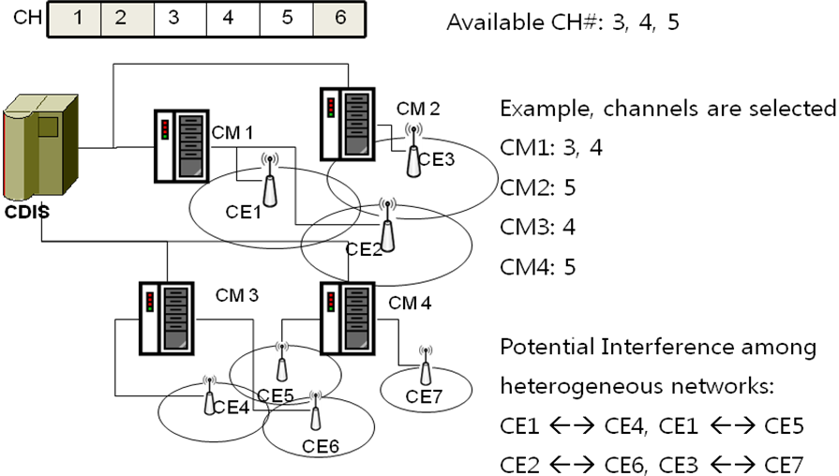
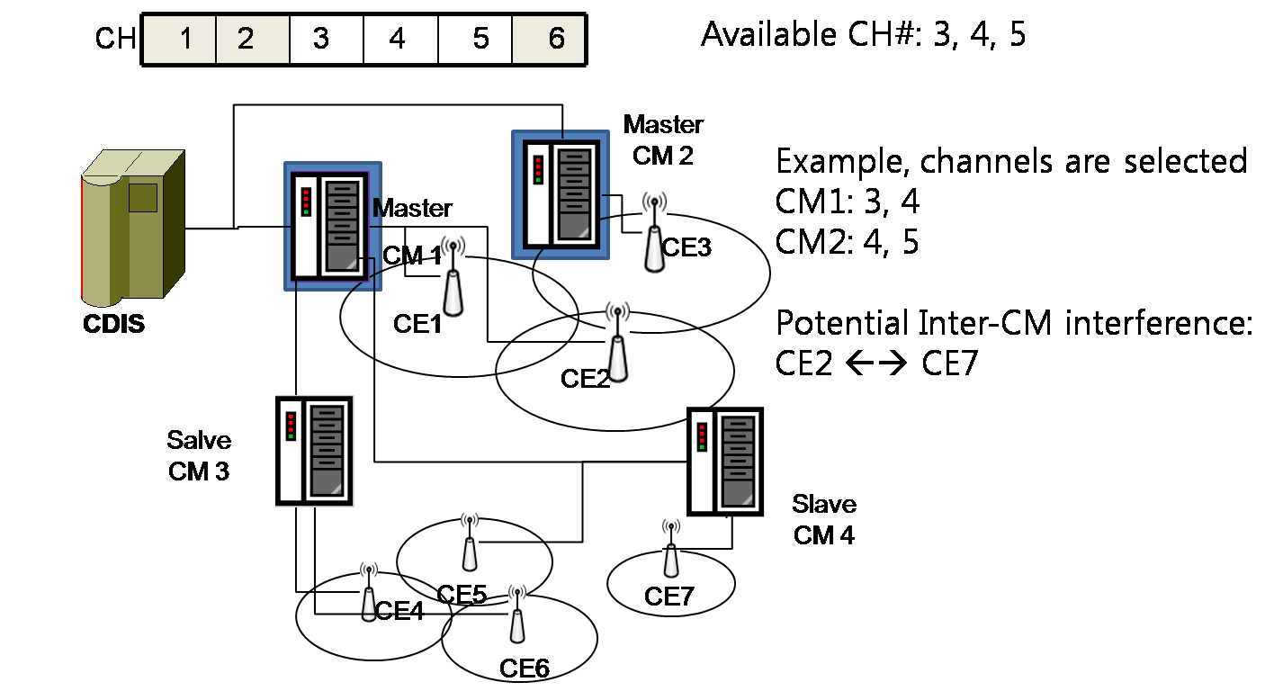
Example
  Initial coexistence topology
  Reconfigured coexistence topology
  (through Master CM selection)

