Slide 1
Geo-location Database Issues of CEPT
Date: 2011-09-20
Authors:
Notice: This document has been prepared to assist IEEE 802.19. It is offered as a basis for discussion and is not binding on the contributing individual(s) or organization(s). The material in this document is subject to change in form and content after further study. The contributor(s) reserve(s) the right to add, amend or withdraw material contained herein.
Release: The contributor grants a free, irrevocable license to the IEEE to incorporate material contained in this contribution, and any modifications thereof, in the creation of an IEEE Standards publication; to copyright in the IEEE’s name any IEEE Standards publication even though it may include portions of this contribution; and at the IEEE’s sole discretion to permit others to reproduce in whole or in part the resulting IEEE Standards publication. The contributor also acknowledges and accepts that this contribution may be made public by IEEE 802.19.
Patent Policy and Procedures: The contributor is familiar with the IEEE 802 Patent Policy and Procedures <http:// ieee802.org/guides/bylaws/sb-bylaws.pdf>, including the statement "IEEE standards may include the known use of patent(s), including patent applications, provided the IEEE receives assurance from the patent holder or applicant with respect to patents essential for compliance with both mandatory and optional portions of the standard." Early disclosure to the TAG of patent information that might be relevant to the standard is essential to reduce the possibility for delays in the development process and increase the likelihood that the draft publication will be approved for publication. Please notify the Chair <shellhammer@ieee.org> as early as possible, in written or electronic form, if patented technology (or technology under patent application) might be incorporated into a draft standard being developed within the IEEE 802.19 TAG. If you have questions, contact the IEEE Patent Committee Administrator at <patcom@ieee.org>.
Donghun Lee, et al, ETRI

Slide 2
Abstract
This material summarizes geo-location database issues of CEPT
The key issues to be addressed are given as follows:
Database topology
Database information from WSDs
Database information to WSDs
Database update frequency
Database architecture
Donghun Lee, et al, ETRI

Slide 3
Abbreviations and acronyms
CEPT : European Conference of Postal and Telecommunications
WSD : White Space Devices
PMSE : Program Making and Special Events
Donghun Lee, et al, ETRI

Slide 4
Geo-location database principles
The geo-location database is a management system that, on the basis of information on available frequencies associated with locations received from licensed users and location information received from WSD, assists these devices in selecting their operational frequencies
This approach would need to take into account the changes in the protected use and the timing of the changes, to ensure that the database has valid content and that the WSD’s have valid information about the available channels
Donghun Lee, et al, ETRI

Slide 5
Key issues of geo-location database
Key issues to be addressed in developing a geo-location approach are given as follows:
Database topology
Database information from WSDs
Database information to WSDs
Database update frequency
Database architecture
Donghun Lee, et al, ETRI

Slide 6
Database topology (CEPT)
Possible options for the management of database
It is possible to have one or more databases and they could be provided by the regulator or third parties authorized by the regulator
Single open database
One option is to have a single database for the entire country or for the whole of Europe
All WSDs consult this database using a pre-defined and standardized message format
The database would be open to all users
In practice a European database may not be practical due to differences in national approaches
Donghun Lee, et al, ETRI

Slide 7
Database topology (CEPT)
Multiple open database
Second option is to have multiple databases
In this case, WSDs could select their preferred database but there would be no difference between them in the information related to the allowed frequencies
One benefit could be an improved availability as a result of redundancy of databases
In addition, if some of the databases are operated by third parties, they could offer also other information and value-added services to the WSDs
Proprietary closed database
A third option is to have “closed” databases corresponding to different types of devices
For example, a manufacturer of WSDs might also establish a database for those devices it had made
Multiple manufactures might work together to share a single closed database or one manufacturer might “open up” its protocols and database for others to use if they wish
Donghun Lee, et al, ETRI

Slide 8
Database information from WSDs (CEPT)
The following information needs to be provided by the WSDs to the geo-location database:
Location (minimum requirement)
The location is the current position of the WSD expressed in terms of geographical coordinates
Location accuracy (minimum requirement)
The location accuracy is the absolute accuracy, with which the geographical position of the WSD is determined, which expressed in terms of an uncertainty radius around the location
Device type (minimum requirement)
Providing information about the type of device, such as the device class will allow information to be returned according to device capabilities and interference characteristics
Device model (minimum requirement)
Device ID and expected area of operation (optional)
Donghun Lee, et al, ETRI

Slide 9
Database information to WSDs (CEPT)
The following information needs to be provided by the geo-location database to the WSDs:
Available frequencies (minimum requirement)
Maximum transmit power (minimum requirement)
The appropriate national/regional database to consult (optional)
During roaming, the database may return information about which database to consult for available frequencies
Time of validity of the information provided (minimum requirement)
If sensing is required (optional)
This information flags the need of sensing in conjunction with the geo-location at a given frequency.
For example, license exempt wireless microphones that operate in some countries without being registered in the database. If sensing is needed then the database could also return details of what type of device it is necessary to sense and sensitivity level required in that country
Donghun Lee, et al, ETRI

Slide 10
Database update frequency (CEPT)
Database update frequency is the periodicity with which the database should be updated so that the information it contains remains valid
This will depend on the rate at which the assignments of the protected services/systems change and the notice provided
In general, protected services may need a rapid update as this will provide them with flexibility to make rapid changes to their assignment
WSD users, however, would prefer updates to be infrequent as possible to avoid the overheads associated with database access
Donghun Lee, et al, ETRI

Slide 11
Database architecture (CEPT)
‘Clear house’ model
The ‘clear house’ model partitions the process of providing information on available channels to WSDs, in order to facilitate the development of multiple database service providers
The key element is the clearing house, which aggregates and hosts the raw data needed to perform database calculations. Data held by the clearing house could comprise:
Essential data on television transmitters – location, power etc.
The location and extent of area where PMSE is in use, with dates and time as needed
The database service providers would use the raw data together with other required regulatory inputs (algorithms, parameters and exceptions) in the process of calculating the contents of their own databases
Donghun Lee, et al, ETRI

Slide 12
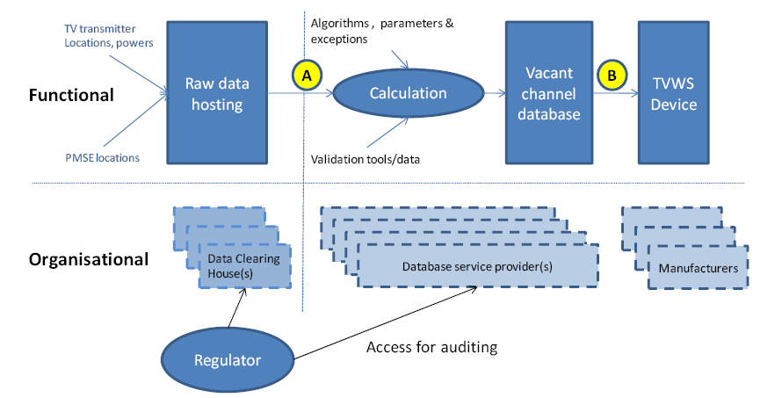
Database architecture (CEPT)
‘Clearinghouse’model
A-between the clearing house and database service providers
B-between the database service provider and WSDs
Donghun Lee, et al, ETRI

