Slide 1
Neighbor discovery simulation summary
Date: 2011-09-06
Authors:
Notice: This document has been prepared to assist IEEE 802.19. It is offered as a basis for discussion and is not binding on the contributing individual(s) or organization(s). The material in this document is subject to change in form and content after further study. The contributor(s) reserve(s) the right to add, amend or withdraw material contained herein.

Slide 2
Abstract
This presentation is a continuation to discussion about different methods to calculate which networks are neighbors to each other.

Slide 3
Decision criterion
The decision criterion for neighborhood is:
If any link between two devices of two networks (potentially) exceeds the threshold N+NF+IM, then these two networks are neighbors
N = ambient noise level
NF = noise figure of the victim receiver (agreement)
IM = Interference margin (agreement)

Slide 4
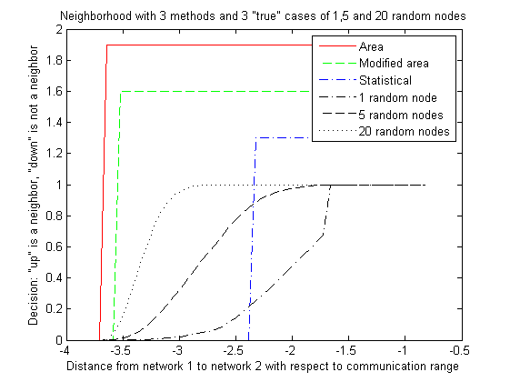
Summary of simulations with 3 different methods
Explanations in the following slides

Slide 5
Summary cont’d
Curves in the figure:
Methods
Area method (red curve)
Modified area method, area reduction of 15% (green curve)
Statistical method, confidence value of 90% (blue curve)
”True” cases (three black curves)
1 known device location and 1 randomly located device
1 known device location and 5 randomly located devices
1 known device location and 20 randomly located device

Slide 6
Summary cont’d
For each method the decisions as a function of separation distance between networks shown
Transition from ”not a neighbor” to ”a neighbor” is naturally sharp with each method
The area method gives the widest neighborhood definition
The statistical method gives the narrowest neighborhood definition
The modified area method is in between these two. This method matches with statistical method, when area reduction is 83%, which means radius reduction to 0.412.

Slide 7
Summary cont’d
”True” cases
Transition from ”not a neighbor” to ”a neighbor” is changing during a certain transition range
The higher the number of nodes in a network the closer it comes to an area method

Slide 8
Summary
We propose that the method to be used in neighborhood evaluation is the modified area method, because it is
simple
easy to scale
able to cover both other methods just by choosing the area reduction value

