Slide 1
Why a new outline for the draft?
Date: 2010-12-08
Authors:
Notice: This document has been prepared to assist IEEE 802.19. It is offered as a basis for discussion and is not binding on the contributing individual(s) or organization(s). The material in this document is subject to change in form and content after further study. The contributor(s) reserve(s) the right to add, amend or withdraw material contained herein.

Slide 2
Abstract
This presentation continues the discussion on proposed changes to the draft outline in contribution 19-10/0172r0. Reasons for the proposed changes are elaborated by comparing the 802.19.1 system with other IEEE 802 systems. Implications of the proposed new outline to the development of the draft and next steps to be taken by the TG are also discussed. The objective is to mitigate the concerns of various proposers the changes may have on their proposals.

Slide 3
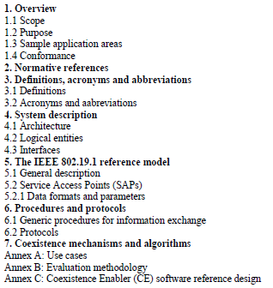
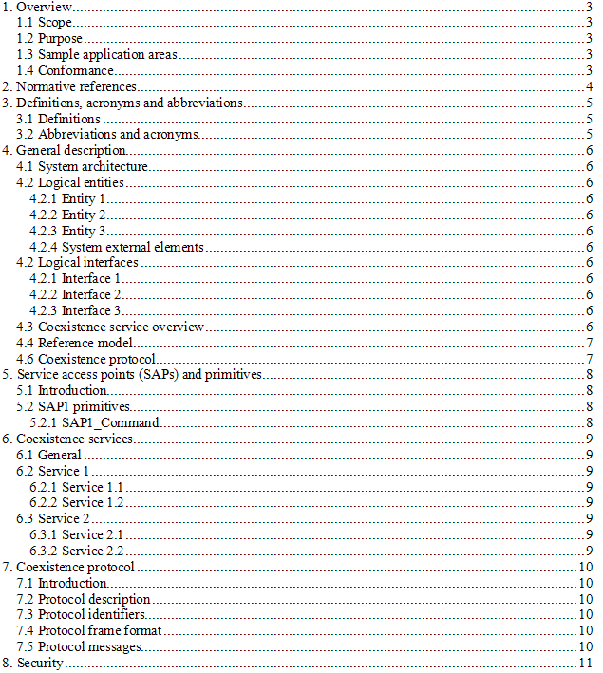
Reminder on what was proposed
Tentative outline as in the system design document Proposed draft outline in 19-10/172r0

Slide 4
What was really proposed?
No changes to clauses 1-3
Clause 4 extended to provide a more complete description of the system
Clause 5 modified to have focus on SAPs and primitives
New clause for service descriptions; could be considered as a move of the procedure descriptions to own clause
Protocol related descriptions moved to a separate clause, new clause 7
New clause for security descriptions.
So, the changes are still relatively small. Proposal was to do some regrouping in order to have a more complete system
description. The biggest change is to build the system upon services. Please take that, however, only as a term and if the
group is much more comfortable with procedure term, let’s forget the term services for the moment.

Slide 5
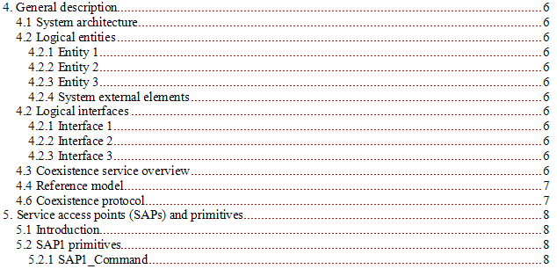
Why the changes to clauses 4 and 5?
Clause 4 is traditionally in IEEE 802 called General description
The clause should serve as the introduction to the specification with general description of the architecture, elements, interfaces and services as applicable. Additionally, typically the reference model is described in the General/System description clause.
Reference model and SAPs with primitive descriptions are typically separated in IEEE 802 specifications

Slide 6
Why to define the services (or the procedures) separately from the protocols?
The author firmly believe that it is beneficial and even necessary to provide clear description of the mechanisms that are available for a user of the coexistence system
The proposal was to define the mechanisms as services. We could call them procedures as well if that is more applicable and acceptable term.
The main point is, however, that we are in 802.19 TG1 developing a specification for a system that is very different from the IEEE 802 specifications that deal with communication system. Consequently we need to prepare a specification structure that is suitable for our system and our needs.
Protocol is not the mechanism but more like support for it and that’s why it would be more clear to define these in separate clauses

Slide 7
What would the change mean in practice?
Any update to the outline doesn’t mean that the proposals need to be rewritten
More important is to discuss what a specification and first, a draft, needs to contain
The author believes that it is not enough that we provide descriptions of the protocols, messages, etc. that are clearly in the focus of the tentative outline in the system design document
Proper description of the mechanisms (services, procedures, or alike) are needed and I’d like to see the TG to consider starting work on such descriptions

