Slide 1
Data types and information elements
Date: Sep. 13, 2010
Authors:
Name | Company | Address | Phone | email
Chen Sun | NICT | 3-4, Hikarino-oka, Yokosuka, Kanagawa, Japan, 239-0847 | +81 46 847 5062 | sun@nict.go.jp
Stanislav Filin |  |  |  | sfilin@nict.go.jp
Yohannes D. Alemseged |  |  |  | yohannes@nict.go.jp
Ha Nguyen Tran |  |  |  | haguen@nict.go.jp
Junyi Wang |  |  |  | Juyi.wang@nict.go.jp
M Azizur Rahman |  |  |  | aziz@nict.go.jp
Hiroshi Harada |  |  |  | harada@nict.go.jp
Notice: This document has been prepared to assist IEEE 802.19. It is offered as a basis for discussion and is not binding on the contributing individual(s) or organization(s). The material in this document is subject to change in form and content after further study. The contributor(s) reserve(s) the right to add, amend or withdraw material contained herein.

Slide 2
Abstract
ASN.1 definition of data types
List of information elements for 802.19.1 system

Slide 3
ASN.1 definitions of data types
Media-SAP: Coexistence information service
Service primitive
COEX_INFO_OBTAINING.request{CoexInfoParamIds}
COEX_INFO_OBTAINING.confirm{CoexInfoParams}
COEX_I_PARAM_IDs :: = SEQUENCE OF I_PARAM_ID
COEX_I_PARAMs ::= SEQUENCE OF COEX_I_PARAM
COEX_I_PARAM ::= SEQUENCE{InfoParamId I_PARAM_ID,
InfoStatus I_STATUS,
InfoParamValue I_PARAM_VALUE}
I_STATUS ::= ENUMERATED{SUCCESS,NOT_AVAILABLE_NOW,NOTSUPPORTED,
BUSY,…}
I_PARAM_ID ::= ENUMERATED{BSSID, SSID, BSSType, BeaconPeriod, DTIMPeriod, Timestamp, LocalTime, PHYParameterSet, CFParameterSet, IBSSATIMWindow, CapabilityInformation, BSSBasicRateSet, OperationalRateSet, Country, IBSSDFSRecoveryInterval, Load, TPCTransmitPower, TPCLinkMargin, NeighbourBSSSet, ListOfAvailableChannels, NetworkChannels, AntennaInfo, TVBDInfo, SysEntityID, TVBDID, ListOfNeighbours,…}

Slide 4
I_PARAM_VALUE ::= CHOICE{BSSID STRING,
SSID STRING,
BSSType ENUMERATED,
BeaconPeriod INTEGER,
DTIMPeriod INTEGER,
Timestamp INTEGER,
LocalTime INTEGER,
PHYParameterSet PHY_PARAM_SET,
CFParameterSet CF_PARAM_SET,
IBSSATIMWindow TU,
CapabilityInformation BSS_CAPA_INFO,
BSSBasicRateSet SET OF INTEGER,
OperationalRateSet SET OF INTEGER,
Country STRING,
IBSSDFSRecoveryInterval INTEGER,
Load BSS_LOAD,
TPCTransmitPower INTEGER,
TPCLinkMargin INTEGER,
NeighbourBSSSet NEIBR_BSS_SET,
ListOfAvailableChannels LIST_TV_CHANNELS,
NetworkChannels NETWORK_CHANNELS,
AntennaInfo ANTENNA_INFO,
TVBDInfo TVBD_INFO,
SysEntityID INTEGER,
TVBDID, STRING,
ListOfNeighbours LIST_NEIGHBOURS,
…}

Slide 5
ASN.1 definitions of data types
Media-SAP: Coexistence reconfiguration service
Service primitives
COEX_RCF.request(CoexReconParams)
COEX_RCF.confirm(CoexReconResults)
R_PROFILE_PARAM ::= SEQUENCE{ReconProfileParamID R_PROFILE_PARAM_ID,
ReconProfileParamValue R_PROFILE_PARAM_VALUE}
COEX_R_PROFILE ::= SEQUENCE OF R_PROFILE_PARAM
COEX_R_PARAM ::= SEQUENCE{CoexReconObjID COEX_R_OBJ_ID,
CoexReconProfile COEX_R_PROFILE}
COEX_R_PARAMs ::= SEQUENCE OF COEX_R_PARAM
COEX_R_RSULT ::= SEQUENCE{CoexReconObjID COEX_R_OBJ_ID,
ReconStatus R_STATUS,
CoexReconParams COEX_R_PARAMs OPTIONAL}
COEX_R_RSULTs ::= SEQUENCE of COEX_R_RSULT

Slide 6
ASN.1 definitions of data types
Media-SAP: Coexistence measurement service
Service primitives
COEX_MEAS.request(CoexMeasuParams)
COEX_MEAS.confirm(CoexMeasuResults)
M_PROFILE_PARAM ::= SEQUENCE{MeasuProfileParamID M_PROFILE_PARAM_ID,
MeasuProfileParamValue M_PROFILE_PARAM_VALUE}
COEX_M_PROFILE ::= SEQUENCE OF M_PROFILE_PARAM
COEX_M_PARAM ::= SEQUENCE{CoexMeasuObjID COEX_M_OBJ_ID,
CoexMeasuProfile COEX_M_PROFILE}
COEX_M_PARAMs ::= SEQUENCE OF COEX_M_PARAM
M_RESULT_PARAM ::= SEQUENCE{MeasuResultParamID M_RESULT_PARAM_ID,
MeasuResultParamValue M_RESULT_PARAM_VALUE}
M_RESULT_PARAMs ::= SEQUENCE OF M_RESULT_PARAM
COEX_M_RESULT ::= SEQUENCE{CoexMeasuObjID COEX_M_OBJ_ID,
MeasuStatus M_STATUS,
MeasuResultParams M_RESULT_PARAMs}
COEX_M_RESULTs ::= SEQUENCE of COEX_M_RESULT

Slide 7
ASN.1 definition of data types
Media-SAP: Coexistence event service
Primitive
COEX_EVENT.indicate(CoexEventParams)
COEX_E_ID ::= ENUMERATED{NewBSSStart, Interference, NewChannelAdded,
ChannelRemoved, NeighbourChange,InformationForSharing,
NetworkChannelChanged…}
E_PARAM ::= SEQUENCE{EventParamID E_PARAM_ID
EventParamValue E_PARAM_VALUE}
E_PARAMs ::= SEQUENCE OF E_PARAM
COEX_E_PARAM ::= SEQUENCE{CoexEventId COEX_E_ID
CoexEvenParams E_PARAMs}
COEX_E_PARAMs ::= SEQUENCE OF COEX_E_PARAM

Slide 8
ASN.1 definition of data types
Transport-SAP: Transport service
Primitive
CP_PACKET_SEND.request(TransportPref, SourceID, DestinationID, CoexProtocolPDU)
CP_PACKET_SEND.request(TransportPref, SourceID, DestinationID, TransportStatus)
TRANSPORT_PREF ::= ENUMERATED{
TCP,
UDP,
HTTP,
SNMP,
…
}
TRANSPORT_ADDR ::= OCTET_STRING

Slide 9
Information elements from 802.11
Information elements are obtained through the following SAPs specified in different Stds/Amendments
MLME_SAP
.11-2007
.11k
.11y
.11af
PLME_SAP
.11-2007
.11n
MSGCF_SAP
.11u

Slide 10
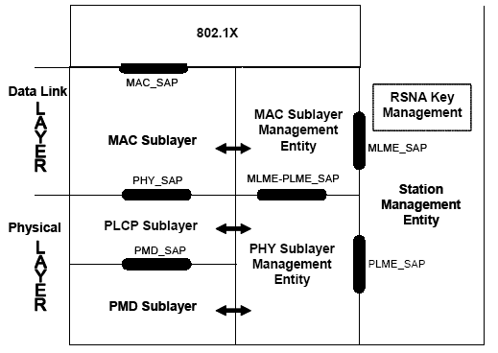
802.11-2007 reference model

Slide 11
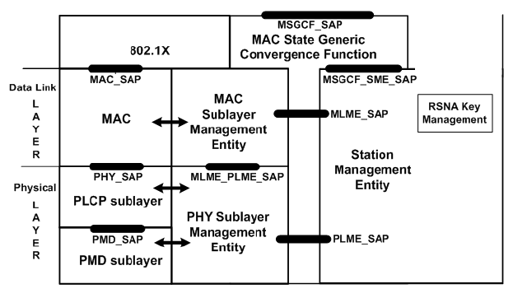
802.11u reference model

Slide 12
802.11u reference model

Slide 13
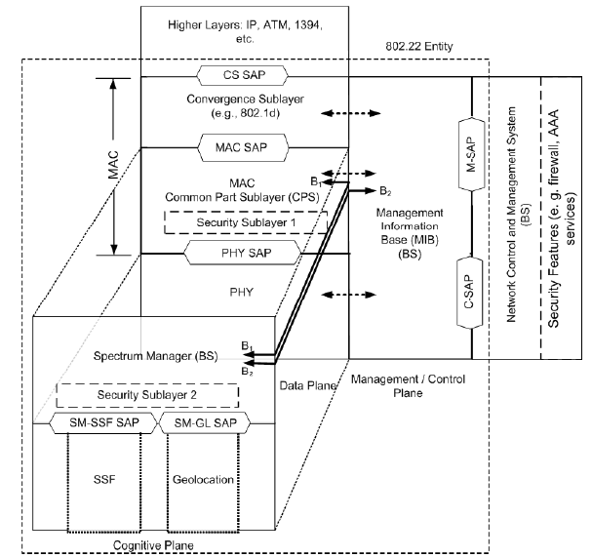
P802.22
Management SAP (M-SAP)
System configuration
Monitoring Statistics
Notifications/Triggers
Sensing and Geolocation Reporting
Communication with the database service
Control SAP (C-SAP)
Subscriber and Session Management
Radio Resource Management
AAA server signaling etc.
Full descriptions of C-SAP and M-SAP are not available
Thus, consider CE to be implemented at cognitive plane and can access information provided at SM-SSF-SAP and SM-GL-SAP.

Slide 14
Information elements from P802.22
Information elements are obtained through the following SAPs
SM-SSF-SAP
SM-GL-SAP
M-SAP
Database
BS configuration
CPE report and response
Antenna

Slide 15
Summary
ASN.1 definition of data types
Provide a list of information elements for 802.19.1 system
The list is generated with reference to IEEE 802.11-2007, P802.11u, IEEE802.11y, P802.11af and P802.22
Based on possible implementation of the media service access point (Media-SAP) of 802.19.1 in 11 and 22 systems

