Slide 1
Expectation for IEEE P802.19.1 system from a primary protection viewpoint
Date: 2010-07-16
Authors:
Name | Company | Address | Phone | email
Ryo Sawai | Sony corporation | 5-1-12, Kitashinagawa, Shinagawa-ku, Tokyo, 141-0001, Japan |  | Ryo.Sawai@jp.sony.com
Ryota Kimura | Sony corporation
Naotaka Sato | Sony corporation |  |  | Naotaka.sato@ieee.org
Guo Xin | Sony China
Notice: This document has been prepared to assist IEEE 802.19. It is offered as a basis for discussion and is not binding on the contributing individual(s) or organization(s). The material in this document is subject to change in form and content after further study. The contributor(s) reserve(s) the right to add, amend or withdraw material contained herein.

Slide 2
Introduction
Expectation for IEEE P802.19.1 system from a primary protection viewpoint is briefly summarized here
    “Interference protection requirements: (1) protected contour , (2) required separation distance ” and “TV bands database” in FCC-08-260 are focused in this contribution

Slide 3
Background #1
“Section 15.713 TV bands database” in FCC-08-260A1[1]
(3) The TVBD registration database shall contain the following information for fixed TVBDs:
(A) FCC identifier (FCC ID) of the device
(B) manufacturer’s serial number of the device
(C) device’s geographic coordinates (latitude and longitude (NAD 83) accurate to+/- 50 m)
(D) name of the individual or business that owns for the device
(E) name of a contact person responsible for the device’s operation
(F) address for the contact person
(G) email address for the contact person
(H) phone number for the contact person.
(d) Determination of available channels.
(1) The TV bands database will determine the available channels at a location using the interference protection requirements of section 15.712 of this part, the location information supplied by a TVBD, …
No registration process on TVWS channel usage information from secondary network seems to be … [2]
Co-channel transmission in neighbor multiple secondary networks will occur, when no TVWS channel management in multiple secondary networks is

Slide 4
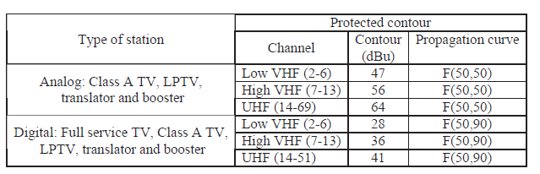
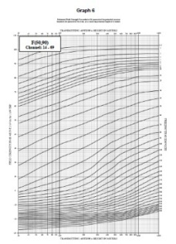
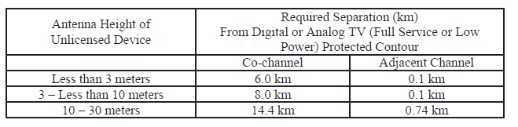
Background #2
“Section 15.712 Interference protection requirements” in FCC-08-260A1
(a) Digital television stations, and digital and analog Class A TV, low power TV, TV translator and TV booster stations:
  (1) Protected contour. TVBDs must protect digital and analog TV services within the contours shown in the following table. These contours are based on the R-6602 curves contained in Section 73.699 of this chapter.
  (2) Required separation distance. Fixed TVBDs and personal/portable TVBDs operating in Mode II must be located outside the contours indicated in paragraph (1) of this section of co-channel and adjacent channel stations by at least the minimum distances specified in the following table. Alternatively, Mode II personal/portable TVBDs may operate at closer separation distances, including inside the contour of adjacent channel stations, provided the power level is reduced as specified in Section 15.709(a)(2).
[3][4]
This design of separation distance seems to be based on a case where only single secondary transmission in a channel will occur
Interference level to primary service might practically increase more than the protected contour level,
when no interference coordination in multiple secondary networks is

Slide 5
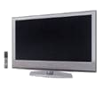
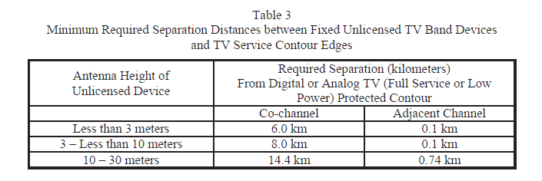
Background #3
Example figure of TV white space deployment
^{(*1)} Protected area
TV broadcaster
Frequency channel: (F1)
^{(*2)} Minimum required separation area
Protected area ^{(*1)}
Minimum required
separation area ^{(*2)}
^{(*3)} Additional requirements(Sensing, translator receive sited and so on) should be also considered
TV receiver
Secondary usage (F1)
White space area(*3)

Slide 6
Problem from a primary protection viewpoint
TV broadcaster
Protected area
①
White space area
②
Used= (F1)
Unused= (F2,F3)
Primary receiver
Simultaneous multiple secondary transmission
near the protected contour might cause harmful interference to TV receiver
Unpredictable interference !
Example of single TVWS channel usage
Secondary node using F1/F2/F3
Secondary node using F2 /F3
①
Separation distance for F2
②
Separation distance for F1

Slide 7
Possible solutions of IEEE P802.19.1 system from a primary protection viewpoint
IEEE P802.19.1 system shall include the primary protection mechanisms such as:
    coordination of TVWS channel allocation/sharing for neighbor secondary networks, so as not to cause co-channel transmission between neighbor secondary networks and to realize an efficient channel management as much as possible, and
    coordination of (maximum) transmission power distribution management for neighbor secondary networks when co-channel transmission between neighbor secondary networks is unavoidable to keep fair channel access opportunity for multiple TVWS network, so as not to exceed the allowable interference level of TV receiver in protected contour.
P802.19.1 system
RAT: Radio Access Technology
TVWS network RAT#1
TVWS network RAT#2
TVWS network RAT#3

Slide 8
References
[1] “Second report and order and memorandum option and order”, FCC 08-260, 2008
[2] “802.22 Database Service Interface”, IEEE 802.22-09/00123r14, September 2009
[3] “Part 10: Application procedures and Rules for Digital Television (DTV) Undertakings”, BPR-10, August 2009
[4] “Method for point-to-area predictions for terrestrial services in the frequency range 30MHz to 3000MHz”, Recommendation ITU-R P.1546-4, October 2009

