Slide 1
Data representation
Date: July 11, 2010
Authors:
Name | Company | Address | Phone | email
Chen Sun | NICT | 3-4, Hikarino-oka, Yokosuka, Kanagawa, Japan, 239-0847 | +81 46 847 5062 | sun@nict.go.jp
Stanislav Filin |  |  |  | sfilin@nict.go.jp
Yohannes D. Alemseged |  |  |  | yohannes@nict.go.jp
Tuncer Baykas |  |  |  | tuncerbaykas@nict.go.jp
M Azizur Rahman |  |  |  | aziz@nict.go.jp
Ha Nguyen Tran |  |  |  | haguen@nict.go.jp
Junyi Wang |  |  |  | Juyi.wang@nict.go.jp
Hiroshi Harada |  |  |  | harada@nict.go.jp
Notice: This document has been prepared to assist IEEE 802.19. It is offered as a basis for discussion and is not binding on the contributing individual(s) or organization(s). The material in this document is subject to change in form and content after further study. The contributor(s) reserve(s) the right to add, amend or withdraw material contained herein.

Slide 2
Abstract
Different standards use different ways to define data types.
We would like to know what is the best way for P802.19.1

Slide 3
General data representation P1900.6
Name: | Frequency | Phys. unit | Hz | Extends: |  | --
ID: | 001 | Size: | 1 | Type: |  | Unsigned fixed-point
Desc: | Basic unbounded frequency parameter
 | Range (min/resolution/max): |  | 0 |  | 1 Hz |  | (2³²-1)Hz
Name: | Bandwidth | Phys. unit | Hz | Extends: | --
ID: | 101 | Size: | 2 | Type: | Array(Frequency)
Desc: | Basic unbounded bandwidth parameter
.0 | Bandwidth.bandstart |  | Type: | Frequency
.1 | Bandwidth.bandstop |  | Type: | Frequency

Slide 4
Examples of very general definition of data types using ASN.1 (from 1900.4)
RadioInterfaceId ::= ENUMERATED {
umts, hsdpa, wimax, lte, wifi, gsm, ...
}
Services ::= SEQUENCE OF SEQUENCE {
serviceName PrintableString
serviceCost ANY
}

Slide 5
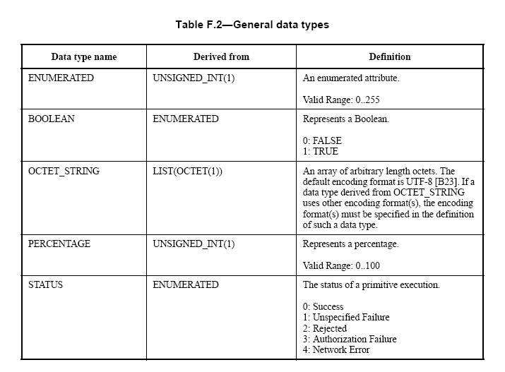
Examples from 802.21

Slide 6
Example from 802.22
Table 278— SM-SSF-SAP-CHANNEL-SENSING.confirm parameters
Name | Type | Length (bits) | Value / Description
IETF Country Code | ASCII | 16 bits | See Annex A.
Channel Number | Integer | 8 bits | The channel number which is to be sensed by the SSF. Range is specified in Table 255.
Sensing Mode | Integer | 2 bits | The sensing mode specifies which SSF outputs are valid as specified in Table 258.
Status | Enumeration | 2 bits | 0x00: INVALID_REQUEST 0x01: INVALID_SIGNAL_TYPES 0x10: RESERVED 0x11: SUCCESS The value indicates whether the sensing request was successfully generated.
Invalid Signal Type Array | Array | 32 bits | An array indicating which signal types the SSF will not be able to sense as specified in Table 256. This attribute is valid only if the Status = INVALID_SIGNAL_TYPEs

Slide 7
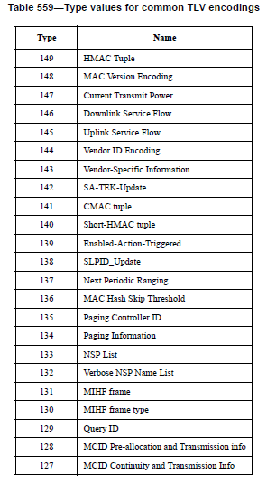
Example from 802.16

Slide 8
Conclusion
Three ways of data representation have been presented
  P1900.6 uses general data representation
  IEEE 1900.4 and IEEE 802.11 use ASN.1 in generic form
  IEEE 802.21 uses ASN.1 in detailed form
  IEEE 802.16 and P802.22 use TLV
We would like to see the working groups favor on any particular way of data representation for 802.19.1 standard.

