Slide 1
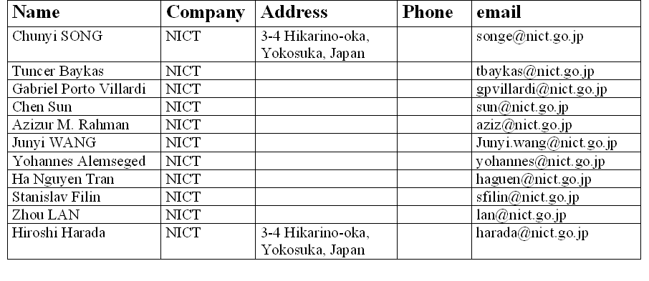
Coexistence Mechanism
Date: 2010-05-17
Authors:
Notice: This document has been prepared to assist IEEE 802.19. It is offered as a basis for discussion and is not binding on the contributing individual(s) or organization(s). The material in this document is subject to change in form and content after further study. The contributor(s) reserve(s) the right to add, amend or withdraw material contained herein.
Notes:
2. a method of realizing coexistence among TV white space network/devices;

Slide 2
Abstract
This contribution presents
A Dynamic Frequency Selection (DFS) Algorithm
A Channel Sharing Method (CSM)
Notes:
The ability of a system to switch to a different frequency (physical operating channel) based on channel measurements avoiding interference to regulatory protected devices.

Slide 3
The DFS Algorithm
Provides a self-learning process based coexistence method for 802.19.1 coexistence system

Slide 4
Basic Idea
A network of 802.19.1 coexistence system selects a frequency channel to use on the basis of the network’s past experience of using the channels

Slide 5
Rationale
Past experience is valuable:
No dynamic change of TVWS channels in most areas
Some channels are constantly vacant and not used by any TV operators;
The channels that are occupied by the TV operators will still have relatively stable vacant periods, e.g. a channel with vacant period at night.
No dynamic change of secondary networks in an area
Most networks will have relatively long and stable spectrum occupancy;
Most networks will operate in a regular manner, e.g. traffic loads.

Slide 6
How to Evaluate Past Usage Experience
This contribution only presents an example of evaluation method
Accumulative Effective Utilization Time (AEUT)
The utilization of a channel during a period is called an effective utilization
if demands on channel resources are satisfied during the period, and
if the interference level in the channel is low during the period
Accordingly, the period is called an effective utilization period (EUP)
AEUT is the sum of EUPs
T(𝒿,𝒾)=Σ [t(𝒿,𝒾)]
T(𝒿,𝒾): the accumulative effective utilization time of the j-th network in the i-th channel
t(𝒿,𝒾): an effective utilization period of the j-th network in the i-th channel
Notes:
The AEUTs could be continuous values and vary in a large range of values; if using AEUT directly as reference / basis for selection, problem of heavy
Overhead traffic may become severe when any information exchange of the AEUTs between two networks. Based on this consideration,

Slide 7
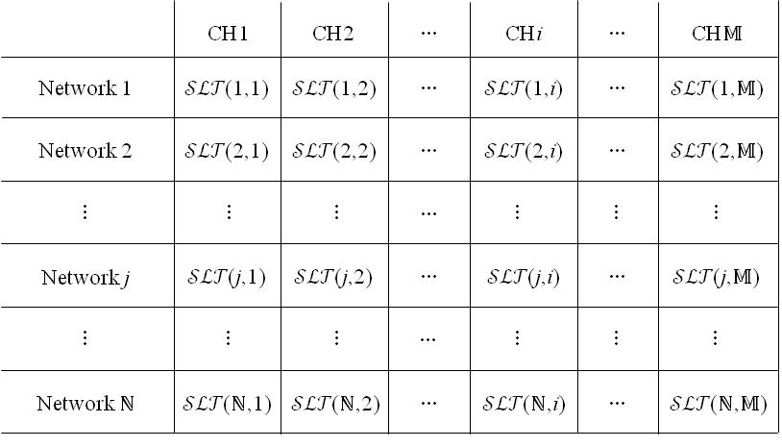
Selection Tendency
SLT is defined as the tendency of a network selecting a TVWS channel to use
𝒮ℒ𝒯(𝒿,𝒾): SLT of the j-th network for the i-th channel
The same value of SLT is set to a network for all channels at the beginning
The SLTs are decided by comparing AEUTs:
the highest SLT is given to the channel with the highest AEUT, the second highest SLT is given to the channel with the second highest AEUT, and so on;
the SLTs are discrete numbers, e.g. integers between 1~M (assuming M available channels)

Slide 8
Description of the DFS
In each selection, a network selects the one with the highest SLT among vacant channels
If the network finds more than one such channel, the network uses random selection to decide which channel to select
During operation, a network periodically evaluates its most recent utilization of the operating channel
If the utilization is an effective utilization, the network updates the AEUT and the SLTs;
Otherwise, the network switches to the one with highest SLT among the remaining vacant channels (or asks to reduce the number of operating networks in the channel )
If networks in the channel decide to reduce the number of operating networks, the network that needs to leave the channel is decided by:
comparing their SLTs for the channel, and the network of having the lowest SLT for the channel needs to leave the channel
some other means
The DFS algorithm is also called SLT-based selection

Slide 9
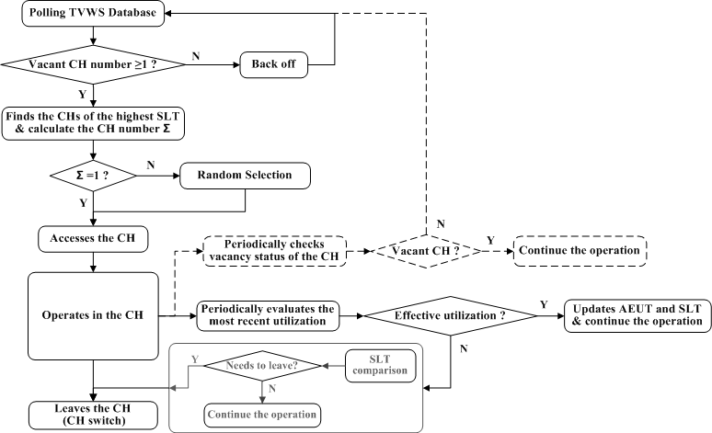
Flow Chart of Selection Procedure

Slide 10
Evaluation of the DFS by Simulation
Simulation model
Three types of TVWS channels regarding their vacant periods:
constantly vacant, vacant during day time and vacant during night time
Networks of having different traffic loads (demands on channel resource)
Available channel resource = total demands of channel resources from networks
Network number is twice of channel number
Change of operating networks in the area is not considered for simplicity
Proper selection probability (P)
P= ΣAEUT/ ΣAUT
Σ AEUT: sum of the Accumulative Effective Utilization Time by all networks in all channels
Σ AUT: sum of the Accumulative Utilization Time by all networks in all channels
Notes:
Coexistence metric: A measurable quantity that can be used to indicate how well two or more networks or devices are coexisting

Slide 11
Simulation Result
Notes:
1.Performance degradation with the increase of channel number (the number of networks is also increased)
2. The

Slide 12
The Channel Sharing Method (CSM)
Provides a solution for the case when channel resources are not enough to satisfy the demands from multiple contenders (networks)

Slide 13
Description of the CSM
A parameter called Credit is defined
The Credit of a network represents the priority of the network using the channel resources
The same value of Credit is set for all networks at the beginning
It can be stored at CDIS or CM
In a contention, the network with higher Credit has higher priority to utilize channel resources, and Credits of the contenders will be updated according to the contention results:
credits of the winner networks will be reduced
credits of the networks who made concessions will be increased
The CSM can be applied for deciding
allocation of a channel
assignment of a slot/frame within a channel

Slide 14
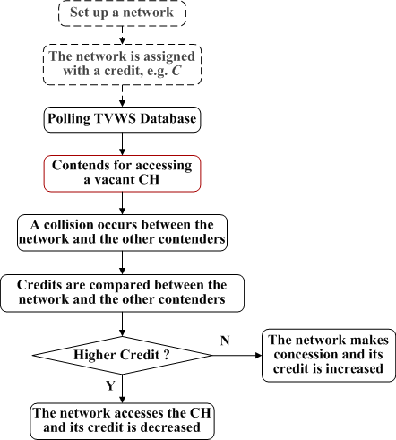
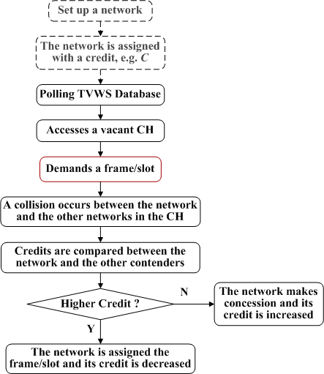
Flow Chart
Allocation of a channel
Assignment of a frame/slot

Slide 15
Conclusion
The proposed DFS achieves coexistence
based on the autonomous decision making
or only requiring the information exchange among the networks operating in the same channel. So no specific channel for information exchange is required nor heavy overhead traffic problem will be caused.
The proposed CSM achieves fairness in solving conflicts among multiple contenders for channel resources
Notes:
Principle of non discriminitory, uniform application of rules in allocating or dividing a competitive resource such as spectrum. Simple fairness is based on equal dvision of resources among all users. Rules for fairness may also consider specific user requirements (user load, QOS, priority, etc), aggregate spectral efficiency, etiquette (first come first served, etc.), and user or network policies

