Slide 1
Process Considerations
Date: 2010-02-09
Authors:
Notice: This document has been prepared to assist IEEE 802.19. It is offered as a basis for discussion and is not binding on the contributing individual(s) or organization(s). The material in this document is subject to change in form and content after further study. The contributor(s) reserve(s) the right to add, amend or withdraw material contained herein.

Slide 2
Abstract
This presentation is submitted to the process ad hoc group for discussion. It proposes some changes and clarifications for the submission 10/17r0 given last week

Slide 3
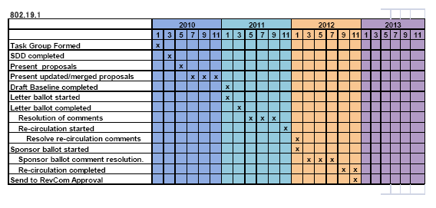
Time Plan
 | 2010
 | 1 | 2 | 3 | 4 | 5 | 6 | 7 | 8 | 9 | 10 | 11 | 12 | 1
Call for proposals |  |  | x
Phase I submissions ready |  |  |  |  |  | x
Phase II submissions ready |  |  |  |  |  |  |  | x
Start forming the working doc |  |  |  |  |  |  |  |  | x
Downselection if needed (vote) |  |  |  |  |  |  |  |  |  |  | x
Phase III submissions |  |  |  |  |  |  |  |  |  | x | x | x | x
Draft ready for Letter Ballot |  |  |  |  |  |  |  |  |  |  |  |  | x

Slide 4
Submission phases
Phase I submission: Presentations for getting feedback from group and consensus creation (merging proposals)
Phase II submission: Text format submissions for creating content to the working document.
May be partial and merged submissions.
Phase III submission: Text format submissions for proposing changes/additions to the working document.
This phase is for ensuring that working document has all the parts in place and they are correct.
75% approval needed to be added in working document.

Slide 5
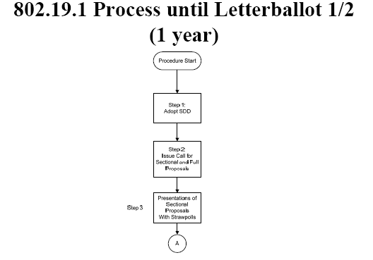
OK.
Starting point is high level architecture and outline in SDD.
Draft creation phase started with Phase I submission. – The start to form consensus in group and merging proposals.

Slide 6
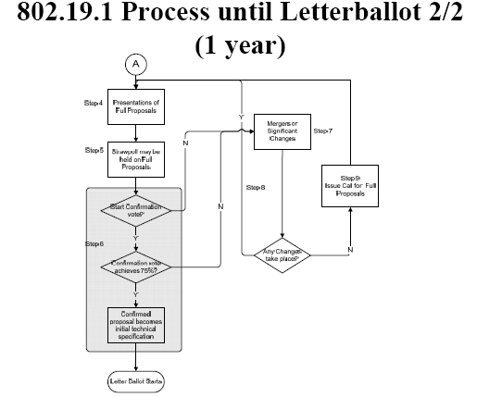
Some changes/clarifications.
Phase II submissions are presented and discussed (Sept). They can be partial and merged.
Submissions which are getting support are added in working document. (see slide 8)
Down-selection for parts which still have several submissions (Nov.) – Always drop the one which gets the least votes.
Finalize draft for Letter Ballot. – At least one comment round before LB.

Slide 7
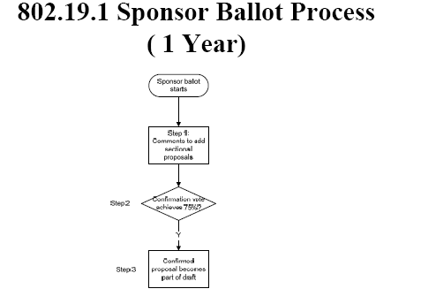
OK.
Letter Ballot and Sponsor Ballot follow standard procedures.
Goal should be to get a very mature draft for the first Letter Ballot to minimize technical changes and decrease the amount of Letter Ballots.

Slide 8
Considerations – technical editor
Technical editor tasks
Start in September by creating a working document from Phase II submissions with strong support
Working document could even be the place holder for all the Phase II submissions
Creates the draft standard from the working document (Nov-Jan).
At least one unofficial comment round within the group before first official Letter Ballot.

Slide 9
Considerations – approving submissions
Approving content for working doc
Phase II submissions which get support are taken in for working document (Sep).
Work on trying to merge submissions which relate to same section.
Down-selection in November if merging is not possible
Merging and consensus creation naturally preferred over down-selection
Possible to submit after September (after Phase II)
Phase III submissions.
In comment rounds (before Letter ballot) it is possible to propose changes.
75% needed for adding/changing.

Slide 10
Summary
In this submission we propose some changes to proposal 10/17r0 discussed in the first process ad hoc call.
Proposing starts with presenting submissions.
Submissions worked towards more mature submissions (text format).
All submissions on table (partial and merged) are considered for working document.

