Slide 1
Canada Spectrum Outlook
Innovation, Science and Economic Development Canada (ISED)
Date: 11 March 2025
Author:
Name | Company | Address | Phone | Email
Yan Losier | Innovation, Science and Economic Development Canada (ISED) | 235 Queen Street, Ottawa, Ontario |  | Yan.losier@ised-isde.gc.ca
Yan Losier (ISED)
Notes:
September 2012

Slide 2
Overview
ISED Regulatory Legal Framework
Electromagnetic Spectrum Regulated by ISED
Spectrum Outlook
Spectrum Priorities 2023-2027
Spectrum Policy Process
Domestic Standards Development Process
6 GHz Band
Dynamic Spectrum Access
Ultra-Wideband (UWB)
International Standard Activities
Notes:
September 2012
doc.: IEEE 802.11-09/0301r1
March 2009
Stephen McCann, RIM
Page 2

Slide 3
The Regulatory Legal Framework
Radiocommunication Act
Radiocommunication Regulations
Telecommunications Act
The Minister of ISED, through the Department of Industry Act,
the Radiocommunication Act and the Radiocommunication Regulations, with due regard to the objectives of the Telecommunications Act, is responsible for spectrum management in Canada.

Slide 4

Electromagnetic Spectrum from extremely low frequency to gamma rays
mobile
phone
microwave
visible light
x-rays
gamma
rays
powerline
television
smart meter
Managed by ISED
NOT managed by ISED
radio
computer
baby monitor
wi-fi
ISED regulates radio apparatus, interference causing equipment and radio sensitive equipment up to 3 000 GHz

Slide 5
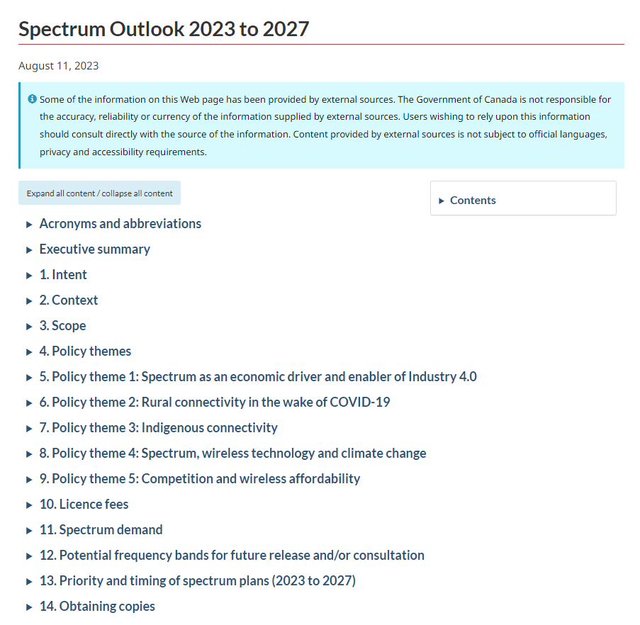
Spectrum Outlook (Reviewed Periodically by ISED)
Overview of ISED’s approach to meeting expected spectrum demand from
2023-2027
High-level plans to address licensing and technical issues raised by stakeholders
ISED’s assessment of demand and spectrum needs for services / applications
Sets priority for our planned spectrum releases and related work for 2023 to 2027
Notes:
Informed by comments received on the Consultation of the Spectrum Outlook 2022 to 2026 which took place in 2022.

Slide 6
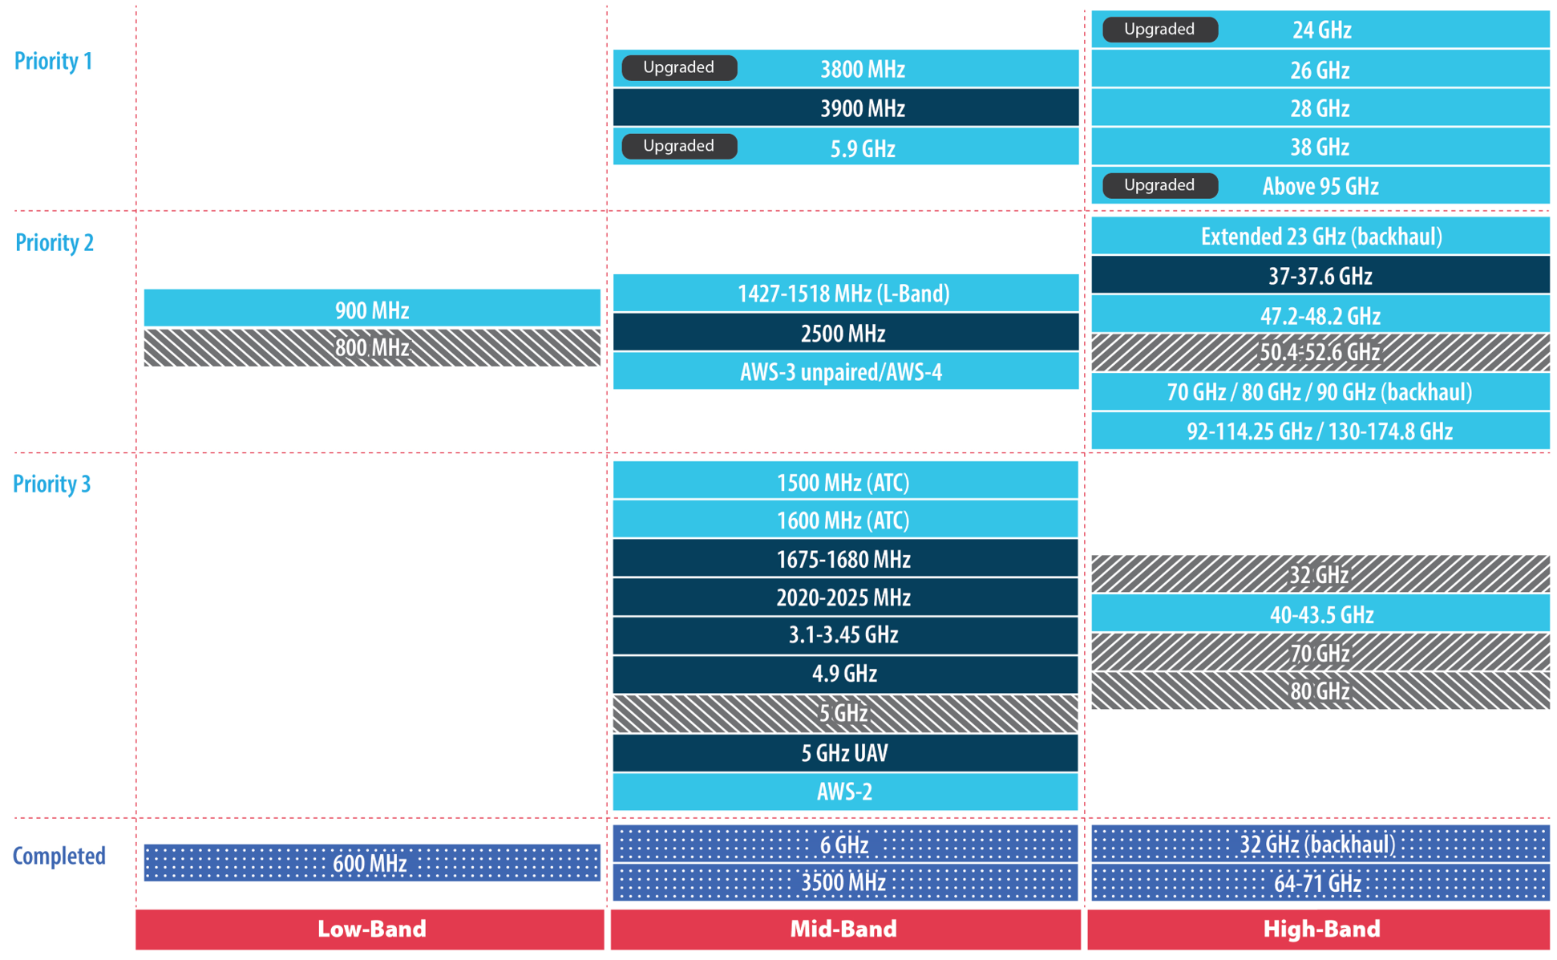
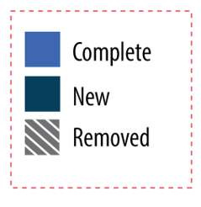
ISED Spectrum Priorities 2023-2027
Source: Spectrum Outlook 2023 to 2027
Notes:
ISED regularly monitors domestic and international developments and may alter its priorities and spectrum plans accordingly.

Slide 7
Spectrum Policy Process Overview
ISED Spectrum Outlook
Outlines ISED’s plan to make spectrum available to support services and applications requiring new spectrum in the coming years. The Spectrum Outlook is refreshed every few years.
Policy Consultations/Decisions and Industry Changes
These decisions establish technical and licensing frameworks and policies. Released directly on ISED website periodically. Depending on industry developments or spectrum outlook, these may be modified
Technical Standards and Procedures
These standards and procedures set out technical requirements for equipment to be put on the Canadian market. Modifications are made based on ISED policy decisions in consultation with the industry.
Notes:
ISED’s Spectrum Outlook outlines the overall approach and planning activities related to the release of spectrum for commercial mobile services, licence-exempt applications, satellite services and wireless backhaul services over the years.
When planning these releases and consultations, ISED considers the demand for various wireless services, international spectrum allocations, the development of equipment ecosystems and standards that would allow Canadians to access the latest technologies
Following the most recent consultation on Spectrum Outlook, which closed in November 2022, the 2023-2027 Spectrum Outlook was published on August 11th, 2023.

Slide 8




Domestic Standards Development Life Cycle for Equipment
ISED Policy Consultations & Decisions
International Standards Development Activities
New Innovative Products from Industry
New Rulemaking from Key Trade Partners
Research and analysis
Draft Standard
External Consultation
(70 days)
Approval and Publication of Final Standard
Maintenance of Standard
Triggers

Slide 9
6 GHz Band in Canada
In May 2021 ISED published the Decision on the Technical and Policy Framework for Licence-Exempt Use in the 6 GHz Band
ISED’s objectives for licence-exempt use of the 6 GHz band in Canada are:
    Fostering innovation and investment in new wireless technologies and services
    Supporting greater choice and affordability of wireless services for consumers and businesses
    Facilitating deployment and timely availability of wireless broadband Internet across the country

Slide 10
Overview of the Decisions for 6 GHz spectrum use
Allow licence-exempt RLAN use in the entire 5925-7125 MHz band
Allow licence-exempt standard–power RLANs under AFC system control in the 5925-6875 MHz frequency range
Allow licence-exempt low-power indoor-only RLANs with the use of a contention-based protocol in the 5925-7125 MHz band
Allow licence-exempt very low-power indoor and outdoor RLAN devices with the use of a contention-based protocol in the 5925-7125 MHz band
Adopt AFC system to protect incumbent fixed services and radioastronomy sites

Slide 11
Dynamic Spectrum Access (DSA) in the 6 GHz Band
Two types of DSA systems are currently authorized in Canada
  Automated Frequency Coordination (AFC)
    Database of protected licensed systems in the 5925-6875 MHz band
    Determines available frequencies and associated maximum power levels at specific time and geographic location
  White Space
    Database of unused spectrum by other licensed radio services
    Currently focused on unused over-the-air television bands

Slide 12
AFC Technical and Operational Requirements
AFC
DBS-06
RSS-248
CPC-4-1-02
  DBS-06 sets out the technical requirements for the designation of an automated frequency coordination system administrator (AFCSA) and for the operation of an AFC system capable of identifying available frequencies and associated maximum power levels for use by standard-power radio local area network (RLAN) devices operating in the 5925-6875 MHz frequency band.
  CPC-4-1-02 outlines procedures to be followed by applicants who wish to be considered by ISED for designation as AFCSAs to operate automated frequency coordination (AFC) systems.
  RSS-248 sets out the certification requirements for licence-exempt radio local area network (RLAN) devices operating in the 5925-7125 MHz frequency band (the 6 GHz band).

Slide 13
White Space Technical and Operational Requirements
White Space
DBS-01
RSS-222
CPC-4-1-01
  DBS-01 sets out the technical requirements for the designation of a database capable of identifying available channels for use by white space devices (WSDs) in the frequency bands 54-72 MHz, 76-88 MHz, 174-216 MHz, 470-608 MHz and 657-663 MHz.
  CPC-4-1-01 outlines procedures to be followed by applicants who wish to be considered by ISED for designation as a WSDBA to operate a white space database (WSDB).
  RSS-222 sets out the certification requirements for licence-exempt, radio apparatus operating in the frequency bands 54-72 MHz, 76-88 MHz, 174-216 MHz, 470-608 MHz and 657-663 MHz, known as WSDs.

Slide 14

Spectrum Management System (SMS) Data
ISED provides various tools to search for or download data related to spectrum authorizations it issues. With these tools, users can:
Search SMS data related to the different types of radio authorizations
Download SMS data for radio authorizations in the 6 GHz band
Upload spectrum licence site data

Slide 15
Ultra-Wideband
Radio Standards Specification (RSS) 220 establishes provisions for short-range devices using ultra-wideband (UWB) technology in Canada. It covers:
  Communication, measurement, location sensing and tracking devices
  Ground penetrating radar (GPR) devices
  In-wall radar imaging and through-wall radar imaging devices
  Medical radar imaging devices
  Radar surveillance devices
Since 2022, vehicular radar devices using ultra-wideband technology in the 22-29 GHz frequency is no longer permitted. This was the result of the global migration of vehicular radar to the 76-81 GHz frequency band.
There are no current plans to revise this standard or associated policies.

Slide 16




International Standards Activities
  ISED continues to be active in international standards activities within IEC (TC106, CISPR), IEEE SC34, ANSI C63, TIA and others
  Whenever possible, International Standards are leveraged within regulatory standards and domestic procedures to improve efficiency, promote fair competition and increase interoperability

Slide 17
Thank you
Questions?

