Slide 1
CEPT current work on higher power WAS/RLAN in the 6GHz lower band using a dynamic spectrum usage coordination
Date: 18 January 2024
Author:
Notes:
September 2012

Slide 2
Content
Short introduction to CEPT
Current European harmonised regulatory framework in 5945-6425 MHz band (6 GHz lower band)
CEPT current work on Higher power Wireless Access Systems including Radio Local Area Networks (WAS/RLAN) including the use of equipment with up to 4W e.i.r.p. in the 5945-6425 MHz frequency band using a dynamic spectrum usage coordination
Notes:
September 2012
doc.: IEEE 802.11-09/0301r1
March 2009
Stephen McCann, RIM
Page 2

Slide 3
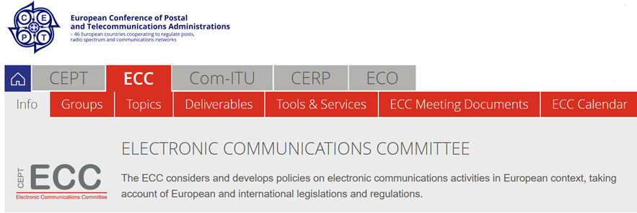
1. CEPT (European Conference of Postal and Telecommunications Administrations)
www.cept.org/ecc
Notes:
September 2012
doc.: IEEE 802.11-09/0301r1
March 2009
Stephen McCann, RIM
Page 3

Slide 4
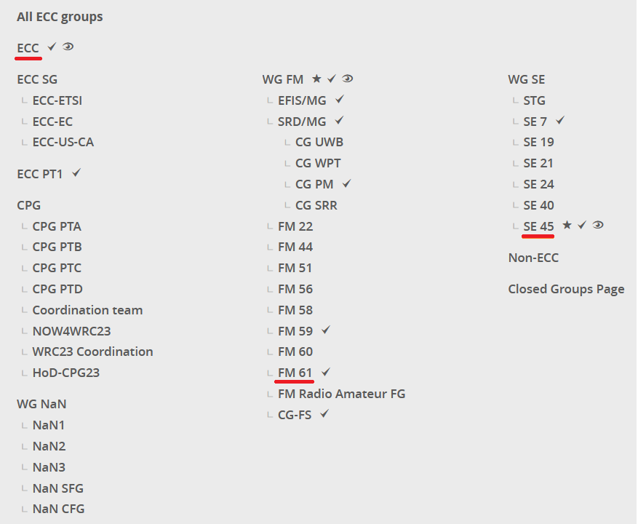
ECC (Electronic Communications Committee)
www.cept.org/ecc
Notes:
September 2012
doc.: IEEE 802.11-09/0301r1
March 2009
Stephen McCann, RIM
Page 4

Slide 5
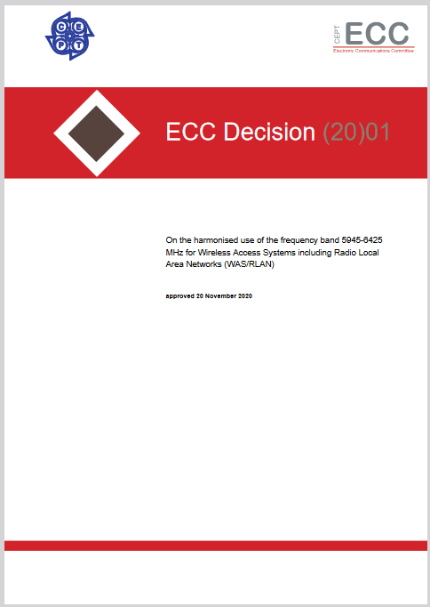
2. Current European harmonised regulatory framework for WAS/RLAN 6 GHz lower band (5945-6425 MHz)
ECC Decision (20)01 on the harmonised use of the frequency band 5945-6425 MHz for Wireless Access Systems inlcuding Radio local Area Networks (WAS/RLAN)
LPI (Low Power Indoor) : 200 mW e.i.r.p – indoor use only
VLP (Very Low Power) : 25 mW e.i.r.p - indoor and outdoor use
Related ECC Reports:
ECC Report 302 – Sharing and compatibility studies related to WAS/RLAN in the frequency
band 5925-6425 MHz
ECC Report 316 - Sharing studies assessing short-term interference from Wireless Access Systems including Radio Local Area Networks (WAS/RLAN) into Fixed Service in the frequency band 5925-6425 MHz
Notes:
September 2012
doc.: IEEE 802.11-09/0301r1
March 2009
Stephen McCann, RIM
Page 5

Slide 6
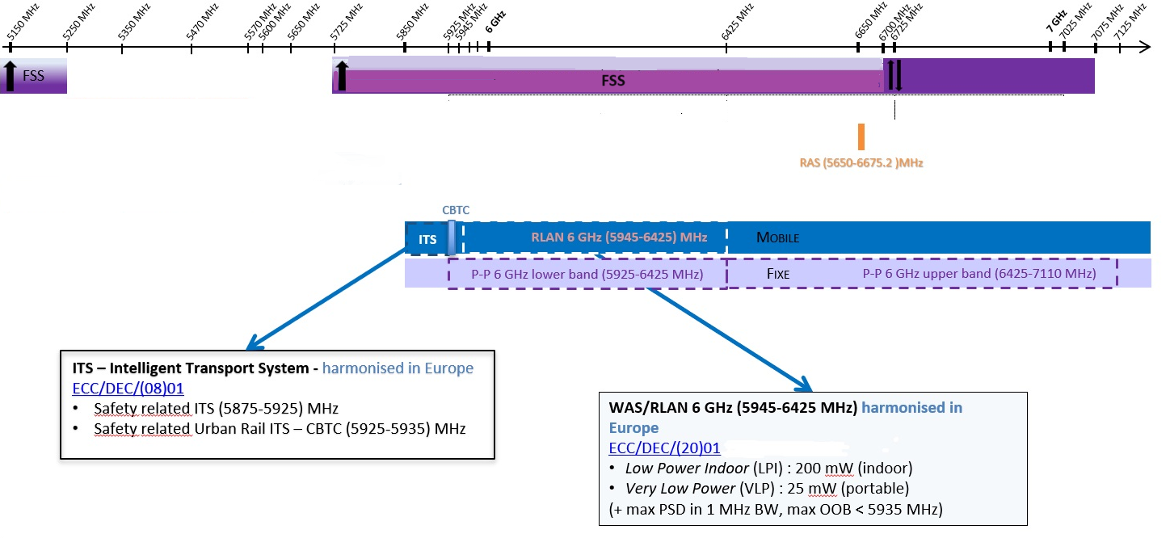
WAS/RLAN 6GHz (5945-6425 MHz) harmonised framework in Europe - Incumbents
TBD
Notes:
September 2012
doc.: IEEE 802.11-09/0301r1
March 2009
Stephen McCann, RIM
Page 6

Slide 7
High power devices at 6GHz lower band - Antecedents in ECC work
ETSI TR 103 534 v1. 1.1 (2018-10) SRdoc WAS/RLAN in the band 5925-6725 MHz
EIRP up to 1W (indoor and outdoor use)
ECC Report 302 Sharing and compatibility studies related to Wireless Access Systems including Radio Local Area Networks (WAS/RLAN) in the frequency band 5925-6425 MHz
- EIRP up to 1W (outdoor use) was considered in this Report
Need of set out restrictions for the coexistence with:
- Fixed Satellite Service (FSS) - In band
Fixed Service (FS) – In band
Intelligent Transport System (ITS)
Communication CBTC – In band and in adjacent band
High power WAS/RLAN at 6GHz lower band is not currently harmonised in Europe
Notes:
September 2012
doc.: IEEE 802.11-09/0301r1
March 2009
Stephen McCann, RIM
Page 7

Slide 8
High power devices at 6GHz lower band - Antecedents in ECC work
CEPT Report 73 Report A: Assessment and study of compatibility and coexistence scenarios for WAS/RLANs in the 5925-6425 MHz
“…future investigations may include innovative sharing solutions for geographical protection of incumbents systems.”
“Based on this risk of interference, the feasibility of outdoor WAS/RLAN deployment and high-power WAS/RLAN access points (APs) would require additional studies to address the interference to the incumbent systems, and any additional work to address the feasibility of these deployments could be studied further under a separate ECC deliverable.”
Notes:
September 2012
doc.: IEEE 802.11-09/0301r1
March 2009
Stephen McCann, RIM
Page 8

Slide 9
3. Current CEPT work on High power devices at 6GHz lower band
High power device: up to 4W e.i.r.p.
Work Item | Subject | Deliverable | Target Date
SE45_05 | Higher power Wireless Access Systems including Radio Local Area Networks (WAS/RLAN) with up to 4 W e.i.r.p. in the 5945−6425 MHz frequency band to enable dynamic spectrum access coordination | ECC Report | May 2024*
FM61_03 | Higher power Wireless Access Systems including Radio Local Area Networks (WAS/RLAN) including the use of equipment with up to 4W e.i.r.p. in the 5945-6425 MHz frequency band using a dynamic spectrum usage coordination | Other | June 2024*
Technical assessment
Regulatory framework development (depending on administrations decision)
* Probably the target date of these WI will be extended
Notes:
September 2012
doc.: IEEE 802.11-09/0301r1
March 2009
Stephen McCann, RIM
Page 9

Slide 10
Technical assessment at Project Team SE45
SE45_05 : Higher power Wireless Access Systems including Radio Local Area Networks (WAS/RLAN) with up to 4 W e.i.r.p. in the 5945−6425 MHz frequency band to enable dynamic spectrum access coordination
Scope:
Study technical conditions to enable the possible implementation of a dynamic spectrum access coordination function for WAS/RLANs in the 5945-6425 MHz frequency band, beyond what is permitted under ECC Decision (20)01.
The work should cover the possible use of WAS/RLAN equipment in a range of power levels up to 4 W e.i.r.p. and should consider the protection requirements of incumbent services in the 5945-6425 MHz frequency band (FS, FSS) and in adjacent bands (RAS, CBTC, Road ITS). The analysis should consider the aggregate effects of this additional terrestrial use along with the protection requirements of FSS uplink.
Notes:
September 2012
doc.: IEEE 802.11-09/0301r1
March 2009
Stephen McCann, RIM
Page 10

Slide 11
Technical assessment - Project Team SE45
This work should be based on the conclusions of ECC Report 302 as a starting point. The technical studies should aim to clarify suitable:
Protection criteria
Propagation models
Necessary information on stations of incumbent services to be protected
The work should also consider the technical characteristics of current equipment up to 4 W e.i.r.p. used in other Regions outside Europe and their applicability.
Notes:
September 2012
doc.: IEEE 802.11-09/0301r1
March 2009
Stephen McCann, RIM
Page 11

Slide 12
Possible work on the development of regulatory framework – Project Team FM61
FM61_03 : Higher power Wireless Access Systems including Radio Local Area Networks (WAS/RLAN) including the use of equipment with up to 4W e.i.r.p. in the 5945-6425 MHz frequency band using a dynamic spectrum usage coordination
Scope:
Study the feasibility of introducing a dynamic spectrum access coordination function under which WAS/RLAN up to 4W could operate, while ensuring the protection of incumbent services (including their possible future deployment) in the 5945-6425 MHz frequency band and in adjacent bands. This work will include:
Define the technical and operational requirements for a dynamic spectrum access coordination function that enables an efficient and safe sharing between high power output RLAN and existing services (in band and in adjacent bands)
Based on the results of compatibility and coexistence studies, propose technical conditions for high output power RLAN that ensure the protection of existing services (in band and in adjacent bands)
Propose a regulatory framework to enable European and/or national implementation
Issues related to cross border coordination
Notes:
September 2012
doc.: IEEE 802.11-09/0301r1
March 2009
Stephen McCann, RIM
Page 12

Slide 13
ECC Contact | Web www.cept.org/ecc
ECO Nyropsgade 37, 4th floor DK-1602 Copenhagen Tel:+45 33 89 63 00 E eco@eco.cept.org

