Slide 1
Questions on regulation requirements for AMP IoT
November 2022
Doc.: IEEE 802.18-22/0144r1
Date: 2022-11-16
Authors:
Name | Affiliation | Address | Phone | Email
Yinan Qi | OPPO |  |  | v-qiyinan@oppo.com
Weijie Xu |  |  |  | xuweijie@oppo.com
Steve Shellhammer | Qualcomm |  |  | sshellha@qti.qualcomm.com
Bo Sun | ZTE |  |  | sun.bo1@zte.com.cn

Slide 2
Outline
November 2022
Doc.: IEEE 802.18-22/0144r1
Recommendations of the scope for AMP IoT
Regulation requirements questions for AMP IoT
Appendix: Summary of the work in AMP TIG

Slide 3
November 2022
Doc.: IEEE 802.18-22/0144r1
Recommendations(1): The target of the study
 | RFID | AMP IoT | WLAN IoT(e.g. 802.11 ah)
Coverage | <10 m | 10m~30m (RF power); Up to 200m(other ambient power) | >=1000m
Power Source | RF power only | Various ambient power | Battery
Techniques | RF power harvesting Backscattering | Backscattering/Active transmitter WUR receiver Enhanced power saving Power management | OFDM Narrow bandwidth Relaxed processing eDRX(TWT) PS-Poll
Power Consumption | 1uw~10uw | <1mw | 100x mw
Device Cost (Relatively) | Low | Medium | Hgh
Maintenance/operation cost | Labor cost for operation | Maintenance-free Automated operation | Update the battery/Automated operation
Slide 3
Weijie Xu (OPPO)

Slide 4
November 2022
Doc.: IEEE 802.18-22/0144r1
Recommendations(2): Study scope for AMP IoT SG
  To specify an ultra-low power consumption AMP device, e.g. lower than 1mw.
    PHY: WUR(100x uw) + Simplified UL PHY (10x uw~100x uw)
      In the DL, WUR(802.11ba) as the starting point.
      In the UL, specify OOK/FSK for the UL PHY.
        OOK has already been thoroughly studied in WUR SG
        Both Active OOK/FSK transmitter and backscattered OOK/FSK can be supported.
          The carrier for backscattering shall be specified considering the regulation requirement
    MAC: Simplified MAC + Enhanced power saving/ power management
Backscattering is one important candidate technique for AMP IoT to achieve low complexity and low power consumption.
Slide 4
Weijie Xu (OPPO)

Slide 5
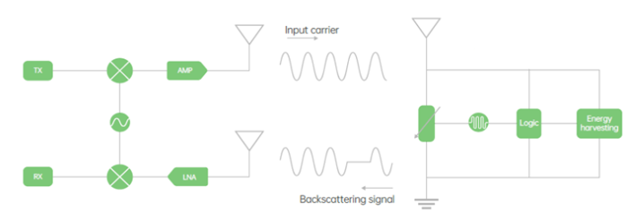
November 2022
Doc.: IEEE 802.18-22/0144r1
Questions (1)
    Q1:A carrier signal need to be transmitted to the AMP device from the AP. What are the regulations requirements for the carrier signal?
  When the carrier signal is used to provide RF power, it may be modulated or not modulated.
  When the carrier signal is used to provide the carrier for backscattering, it may be modulated or not modulated (depending on the backscattering scheme).
Slide 5
Weijie Xu (OPPO)

Slide 6
November 2022
Doc.: IEEE 802.18-22/0144r1
Questions (2)
    Q2: The total transmission power and the PSD requirements for the carrier signal? Can it follow the current regulation in each countries and regions?
    For 2.4GHz
        e.g., there is PSD restricted by regulation, e.g. 10 dBm/MHz or 17dBm(with high gain antenna in CN) at 2.4GHz.
        e.g., the maximum transmission power (EIRP) of WiFi devices, e.g. 20dBm or 27dBm(with high gain antenna in CN)
    For S1G?
      There is total transmission power requirements for S1G. Is there PSD requirement for S1G?
Slide 6
Weijie Xu (OPPO)

Slide 7
November 2022
Doc.: IEEE 802.18-22/0144r1
Questions (3)
    Q3: For the backscattering uplink signal (i.e., from the AMP device to the AP), what are the requirements?
      The AMP IoT device may has no power storage or has limited power storage.
        For device has power storage, the backscattering signal can be amplified with a reflection amplifier.
Backscattering Mode | Power storage of the device | Backscattering loss | Reflection gain
Mode 1: Passive mode | No | e.g. 5-10dB | None
Mode 2-1: Semi-passive without reflection amplifier | limited( e.g., with a capacitor) | e.g. 5-10dB | None
Mode 2-2: Semi-passive with reflection amplifier | limited( e.g., with a capacitor) | e.g. 5-10dB | e.g. from 15~30dB
Slide 7
Weijie Xu (OPPO)

Slide 8
November 2022
Doc.: IEEE 802.18-22/0144r1
Appendix:
Summary of the work in AMP TIG
Slide 8
Weijie Xu (OPPO)

Slide 9

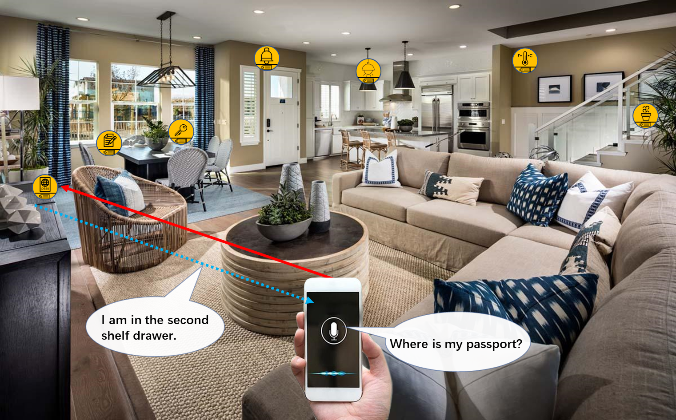
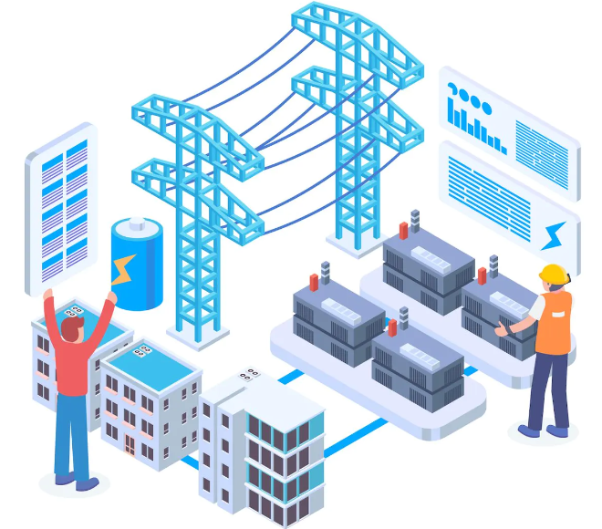
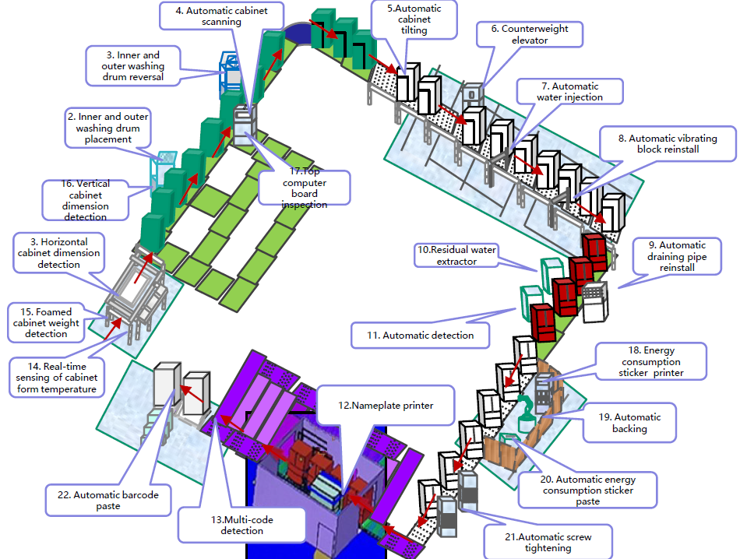
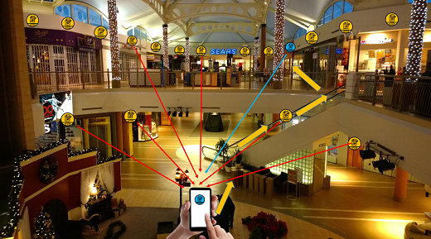
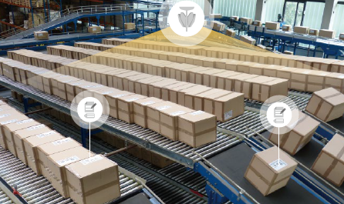
November 2022
Doc.: IEEE 802.18-22/0144r1
Summary(1): Use Cases
  Use case 1 Smart manufacturing: inventory, asset tracking/positioning, and environment/production line sensing and monitoring
  Use case 2 Data Center: environmental monitoring, facility monitoring and asset management
  Use case 3 Smart home: asset management, home environment monitoring and home security.
  Use case 4 Logistics and warehouse: goods tracking and inventory check
  Use case 5 Smart agriculture: monitoring of soil moisture, soil fertility, temperature, wind speed, plant growth etc., and controlling of the agricultural facilities
  Use case 6 Indoor positioning: positioning in giant shopping mall, factories, warehouses, etc.
  Use case 7 Smart Power Grid: Sensing of sound, heat, pressure, etc., smart meter to achieve awareness of device/equipment status
Slide 9
Weijie Xu (OPPO)

Slide 10
November 2022
Doc.: IEEE 802.18-22/0144r1
Summary(2): Requirements of the Use Cases
Use case | Coverage | Peak Data rate | Positioning accuracy | Other requirements
#1Smart manufacturing | 30m indoor 100m outdoor | 100kbps | 1~3 m Horizontal indoor | Battery-less Maintenance-free
#2 Data center | 30m indoor 100moutdoor | 100kbps | - | Battery-less Maintenance-free
#3 Logistics/Warehouse | 10-30 m for indoor case | - | 1~3 m Horizontal indoor | Battery-less, Maintenance-free 99.5% identification accuracy Ultra-low cost and ultra-small size
#4 Smart Home | 10m | - | 1~3 m Horizontal | maintenance-free Battery-less Long service life., e.g., more than 10 years Low complexity and small size
#5 Smart Agriculture | 30m indoor, 200m outdoor | - | - | Battery-less, Low complexity and small size, Processing (i.e., reading IDs) hundreds to thousands of devices per second
#6 Indoor positioning | 10-30 meters indoor | - | 1~3 m horizontal accuracy and 1~2 m vertical accuracy | Small size, maintenance-free, battery-free, and ultra-low-cost IoT devices; Moving speed: 1.5-2 m/s
#7 Smart Grid | 10-30 m indoor, up to 200 m outdoor | 20kbps for sub-station, 3kbps for high voltage transmission line. | - | Maintenance-free and battery-less
Slide 10
Weijie Xu (OPPO)

Slide 11
November 2022
Doc.: IEEE 802.18-22/0144r1
Summary(3): Gap analysis for the Use Cases
Use cases | Issues for state-of-the-art solutions | Benefits of AMP IoT
#1 Smart manufacturing #2 Data center #3Logistics/Warehouse | 1. Manual scanning of labels of barcode or RFID tags for inventory/attendance check 2. Massive deployment of readers due to short communication distance 3. Limited performance on communication distance, system efficiency | 1. Automatic scanning 2. Lower density deployment of APs 3. Improved performance in terms of communication distance, sensitivity and system efficiency 4. Battery-less and Maintenance free
#4 Smart Home | 1. Need to replace battery for many devices 2. High cost/ larger size for applications such as finding small items at home | 1. Battery-less and Maintenance free 2. Small size/low cost to support more applications 3. Support positioning 4. Enable communication between non-AP STA (e.g., smart phone) and AMP IoT devices
#6 Indoor positioning | 1. High deployment cost for indoor navigation and positioning systems 2. High maintenance cost | 1. Small size/low deployment cost 2. Enable positioning by non-AP STA (e.g., smart phone), with 1~3m horizontal positioning accuracy 3. Battery-less and Maintenance free
#5 Smart Agriculture #7 Smart Grid | 1. Power supply with wire cable or battery is needed for sensors 2. High maintenance cost 3. Inaccessible in case of and hazardous operation conditions | 1. Battery-less so that deployment of AMP IoT devices can be flexible and low deployment cost 2. Maintenance free 3. Lower device cost
Slide 11
Weijie Xu (OPPO)

Slide 12
November 2022
Doc.: IEEE 802.18-22/0144r1
Summary(4): Device types
    AMP-only IoT device
    Ultra-low complexity, ultra-power consumption, very small form factor
    Battery-less (i.e., not using conventional battery) and may not need power storage or has limited power storage only (e.g., a capacitor).
    AMP-assisted IoT device
    Higher power storage capability than AMP-only IoT device
    Similar as legacy 802.11 (e.g., 802.11n/11ah) device and can reuse the current PHY design but with enhanced MAC features to well adapt to operation with a specific kind of ambient power.
    Optimized for the power consumption and sustainability to adapt to ambient power usage and achieve maintenance-free
Slide 12
Weijie Xu (OPPO)

Slide 13
November 2022
Doc.: IEEE 802.18-22/0144r1
Summary(5) :Candidate Techniques
    Candidate Techniques
      Narrow bandwidth operation
      Simpler waveform/modulation/coding scheme: OOK/FSK, Manchester coding, etc.
      Backscattering
      Light-weight MAC protocol design and enhanced power saving/management:
      Coexistence schemes with legacy devices
    Potential Techniques combinations:
      AMP-only IoT devices: Ultra-low power receiver + Backscattering/Ultra-low power active transmitter + Simplified MAC+ Enhance power saving
      AMP-assisted IoT devices: Legacy PHY design with MAC enhancement
Slide 13
Weijie Xu (OPPO)

Slide 14
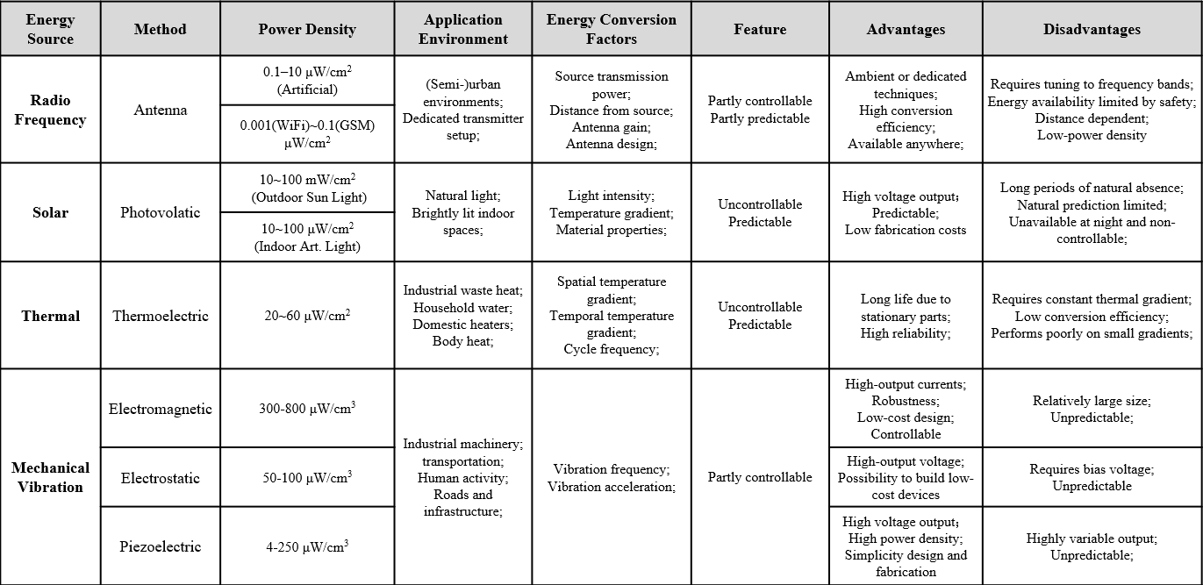
November 2022
Doc.: IEEE 802.18-22/0144r1
Summary(6): Ambient Power and Energy Storage
    Ambient power
      RF
      Solar
      Thermal
      Vibration
    The ambient power lacks of stability and the power density is limited.
      Energy storage element is needed for some AMP IoT devices.
    Capacitor and solid-state battery can be considered as the possible energy storage elements.
Slide 14
Weijie Xu (OPPO)

Slide 15
November 2022
Doc.: IEEE 802.18-22/0144r1
Summary(7): Feasibility of support AMP IoT in WLAN
    Link budget for different AMP IoT device types
      Communication distance of up to 180 meters can be achieved in S1G and up to 50 meters for 2.4GHz
    Co-existence with legacy 802.11 systems
      AMP device can well coexist with legacy devices in both S1G and 2.4Ghz
    Carrier generation for backscattering
      Wideband carrier signal spanning the whole channel bandwidth, e.g., the signal spanning across the 20MHz channel bandwidth at 2.4GHz
Slide 15
Weijie Xu (OPPO)

Slide 16
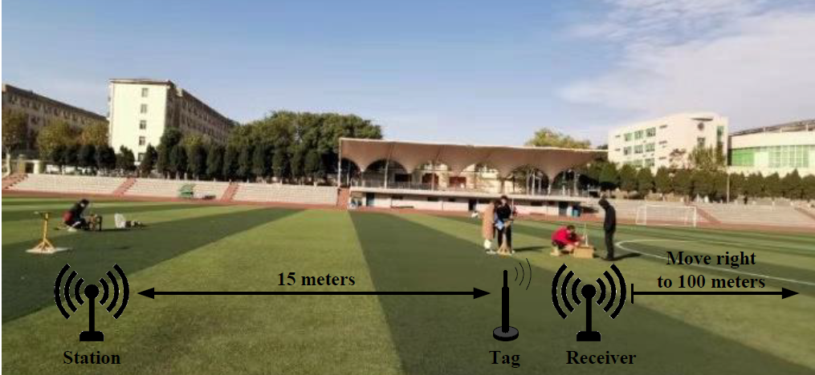
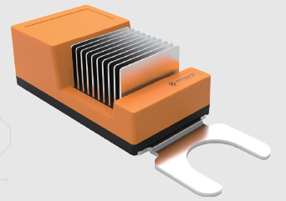
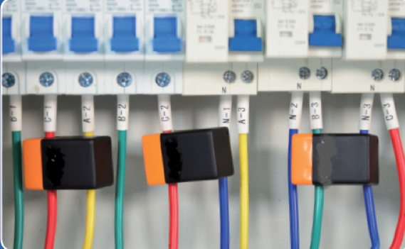
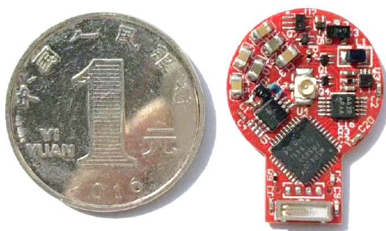
Summary(8): Prototype Presentation
November 2022
Doc.: IEEE 802.18-22/0144r1
  Several prototypes are collected to show the potential communication techniques, the applicable ambient powers and the achieved performance.
    Prototype using RF power and backscattering
    (Figure 2)
    Prototype using thermal energy (Figure 3)
    Prototype using induced current (Figure 4)
    Figure 3 Figure 4
Figure 2

Slide 17
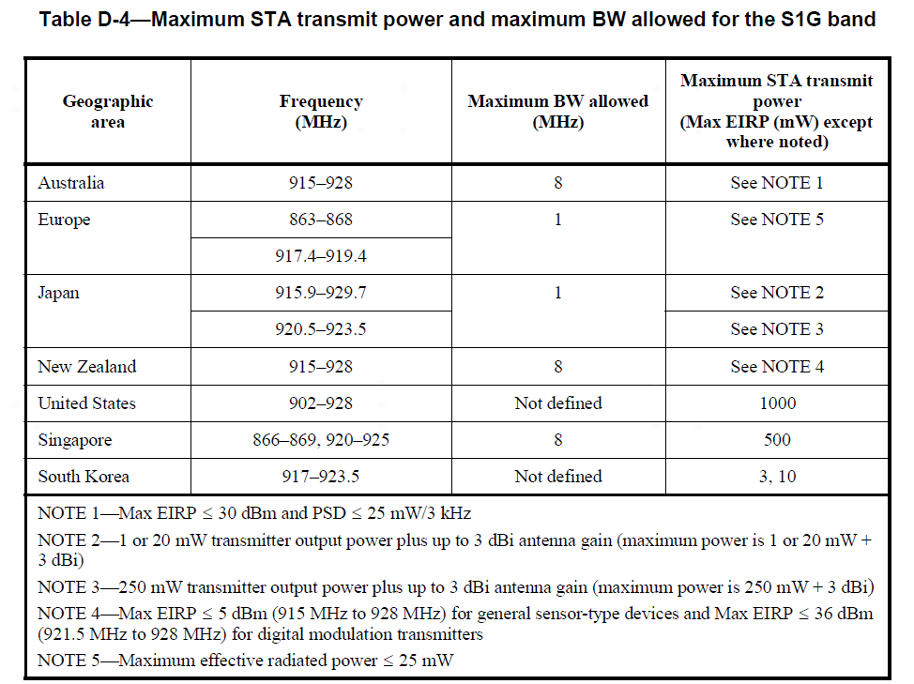
November 2022
Doc.: IEEE 802.18-22/0144r1

Slide 18
Reference
November 2022
Doc.: IEEE 802.18-22/0144r1
IEEE 802.1122/1339r0, Use Cases of smart manufacturing
IEEE 802.1122/1341r1, Use Cases of Data Center Infrastructure Management.
IEEE 802.11-22/0963r0, Use Cases for AMP IoT Devices.
IEEE 802.11-22/1559, Updated Use Cases for AMP IoT Devices.
IEEE 802.11-22/0962r0, Potential Techniques to Support AMP IoT Devices in WLAN
IEEE 802.11-22/970r0, Feasibility of supporting AMP IoT devices in WLAN
IEEE 802.11-22/1560r0, Ambient powers and energy storage
IEEE 802.11-22/1561r0, Further discussion on feasibility of supporting AMP IoT devices in WLAN
IEEE 802.11-22/1799r0, On energy harvesting and the differentiation with RFID
IEEE 802.11-22/1800r0, New Use Case for AMP IoT Devices: Smart Grid
IEEE 802.11-22/1961r0, Prototype presentations for AMP IoT
IEEE 802.11-22/1562r3, Draft Technical Report on support of AMP IoT devices in WLAN
Slide 18
Weijie Xu (OPPO)

