Slide 1
IEEE 802.18 RR-TAG New UWB Regulation Framework in Europe
Date: 11 November 2022
Authors:

Slide 2
UWB emission masks and related mitigations / requirements for UWB below 10,6 GHz Assessment of ECC/DEC/(06)04 and ECC/DEC/(07)01 11/2022
2

Slide 3
General case based on ECC/DEC/(06)04
The technical requirements below are not applicable to:
devices and infrastructure used at a fixed outdoor location or connected to a fixed outdoor antenna;
devices installed in flying models, aircraft and other aviation;
devices installed in road and rail vehicles.

Slide 4
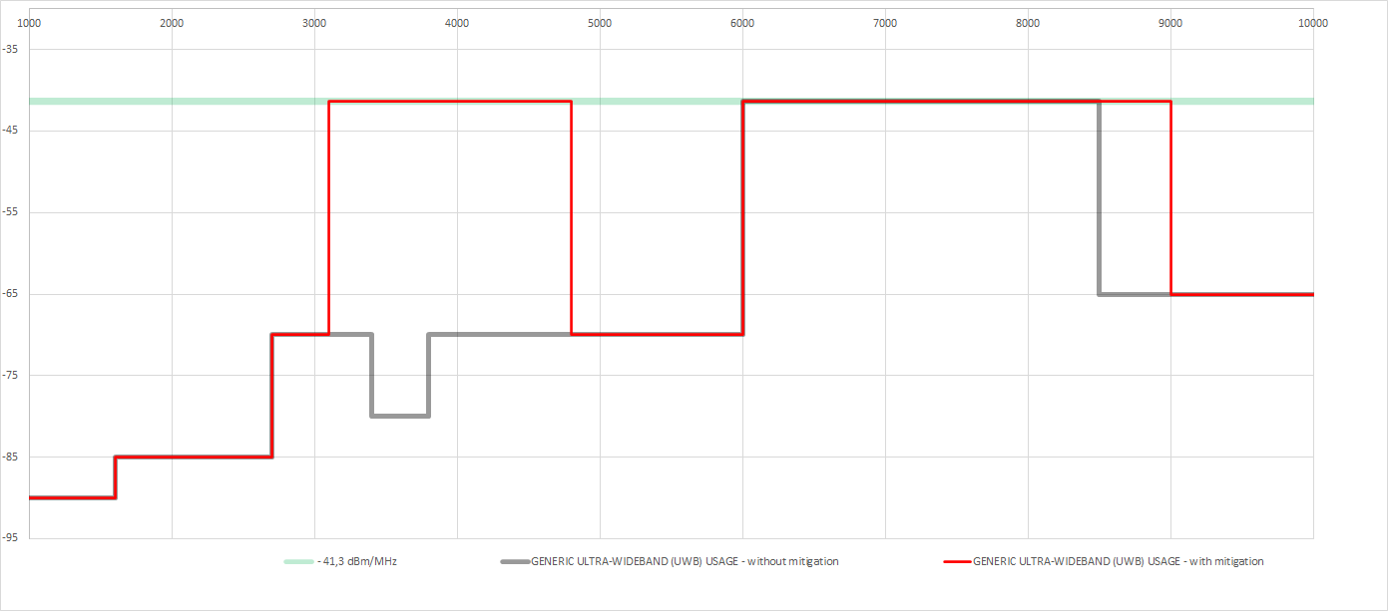
ECC/DEC/(06)04, table 1; generic case
A1.1 General case for UWB devices
Mitigation based on:
Note 1: LDC
or
Note 2: DAA
required
Mitigation based on
Note 2: DAA required

Slide 5
Vehicular applications based on ECC/DEC/(06)04

Slide 6
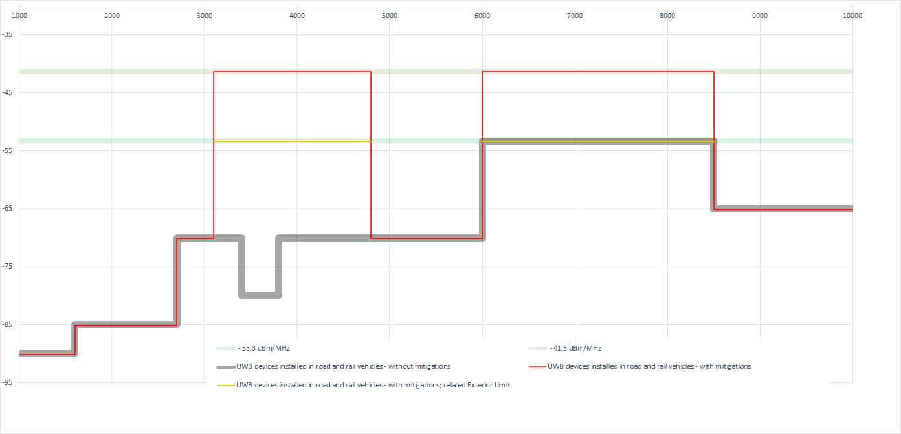
ECC/DEC/(06)04, table 2; generic vehicle
A1.2.1 General case for UWB devices installed in road and rail vehicles
Mitigation based on:
Note 1: LDC + exterior limit
or
Note 2: DAA + exterior limit
required
Mitigation based on
Note 1: LDC + exterior limit
or
Note 2: DAA + exterior limit
or
Note 3: TPC + exterior limit
required

Slide 7
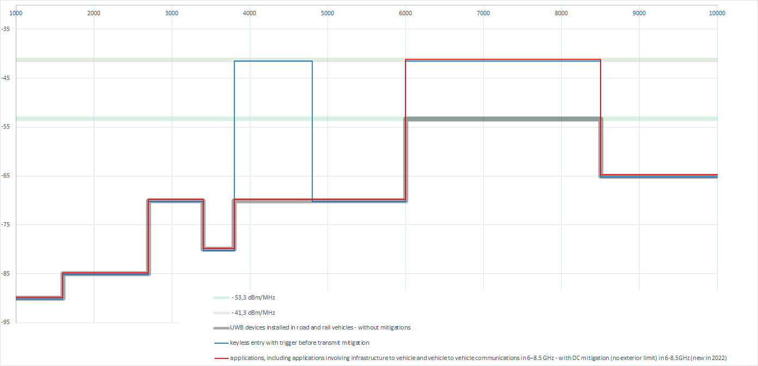
ECC/DEC/(06)04, table 2 generic vehicle without mitigations
A1.2.2 Specific vehicular access systems using trigger-before-transmit (table 3)
New: A.1.2.3 applications involving V2X and V2V communications in 6–8.5 GHz (table 4)
Access systems with
Trigger-before-transmit and LDC ≤ 0,5% / hr
Access systems with
Trigger-before-transmit
and LDC ≤ 0,5% / hr
V2X / V2V with
installation requirements: antenna height (fixed 10m , vehicle 4m)
DC for fixed 5%/s; vehicle 1%/s
Note 1: Within the band 6-8.5 GHz, the following additional requirements apply to fixed outdoor installations supporting communication with UWB devices installed in road and rail vehicles:
Antennas are directive (5 dBi or TRP_{sd} requirement out of ECC report 327), down tilted and installed at a maximum height of 10 m;
The duty cycle is limited to maximum 5% per second.
Note 2: Within the band 6-8.5 GHz, the following additional requirements apply to UWB devices installed in road and rail vehicles:
Antennas are installed at a maximum height of 4 m;
The duty cycle is limited to maximum 1% per second.

Slide 8
Specific RADIODETERMINATION, LOCATION TRACKING, TRACING AND DATA ACQUISITION APPLICATIONS in 6-8.5 GHz;

Slide 9
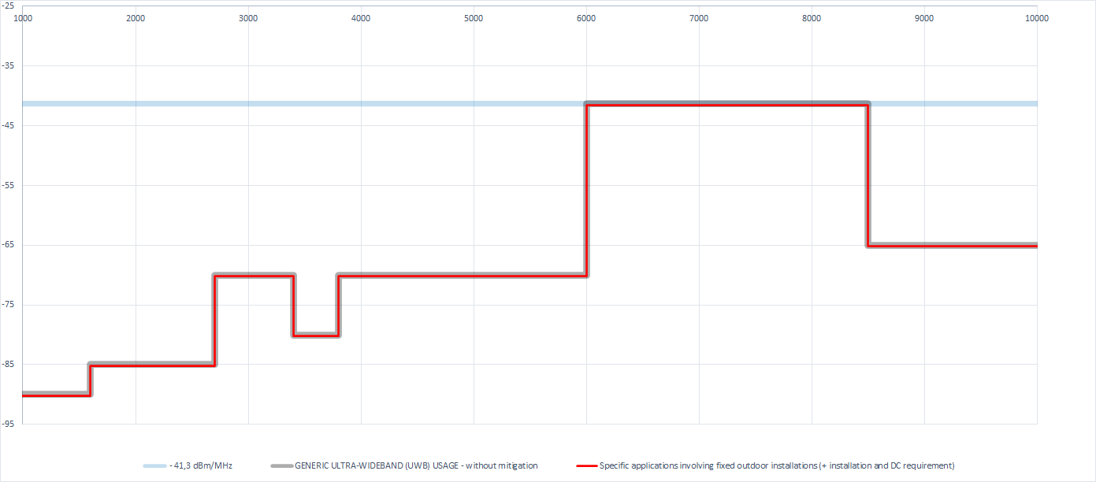
ECC/DEC/(06)04, table 1 generic case; without mitigations
New: A.1.3.1 Specific applications involving fixed outdoor installations (table 5)
Specific RADIODETERMINATION, LOCATION TRACKING, TRACING AND DATA ACQUISITION APPLICATIONS in 6-8.5 GHz
Fixed outdoor is possible with mitigations
5%/s (for all heights)
10m max installation height + antennas down tilted
For heights between 2,5 to 10m a TRP_{sd} of -46,3dBm/MHz
required
Antennas for data acquisition for authentication/access control (PACS) are excluded from the antenna directivity requirements → ETSI has to consider in “specific” EN or based different device categories

Slide 10
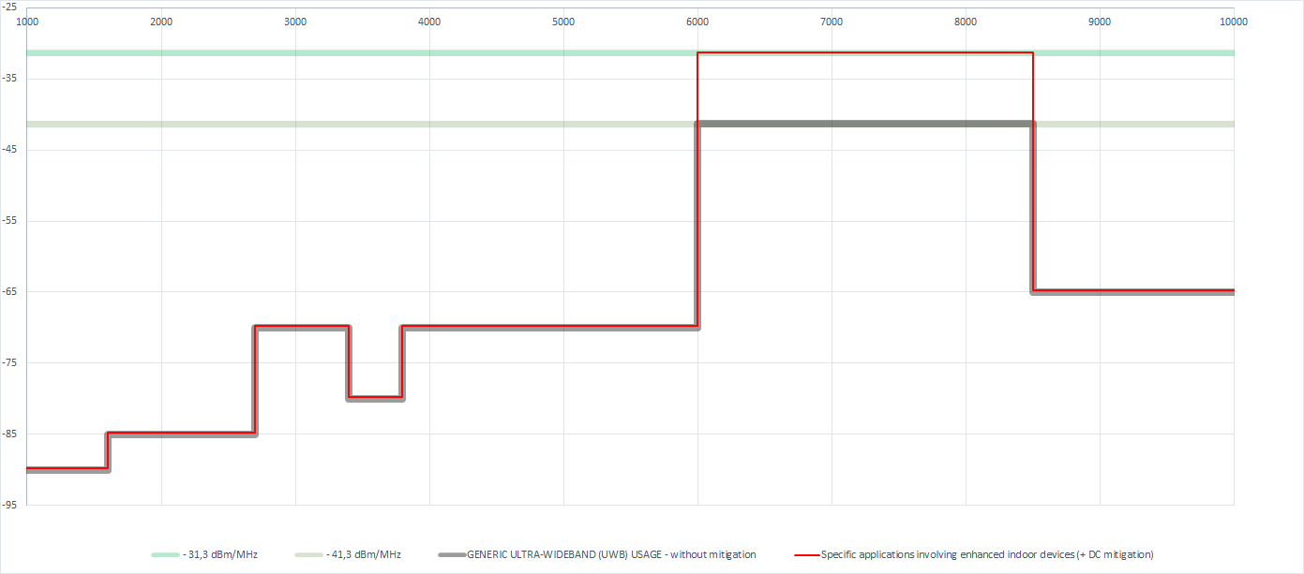
ECC/DEC/(06)04, table 1 generic case; without mitigations
New: A.1.3.2 Specific applications involving enhanced indoor devices (table 6)
Specific RADIODETERMINATION, LOCATION TRACKING, TRACING AND DATA ACQUISITION APPLICATIONS in 6-8.5 GHz
Enhanced power is possible with mitigations based on NOTE 1
Portables:
5%/s
and
if controlled by an indoor infrastructure
Fixed indoor:
- 5%/s
→ ETSI has to consider, t.b.d: how to test / solve (e.g. based on EN scope limitation)

Slide 11
Annex: Sensor UWB Regulation

Slide 12
Limits for contact based UWB material sensing devices; based on ECC/DEC/(07)01
Contact-based sensors and imaging devices.
→ The UWB transmitter is only switched on when in direct contact with the material under investigation;

Slide 13
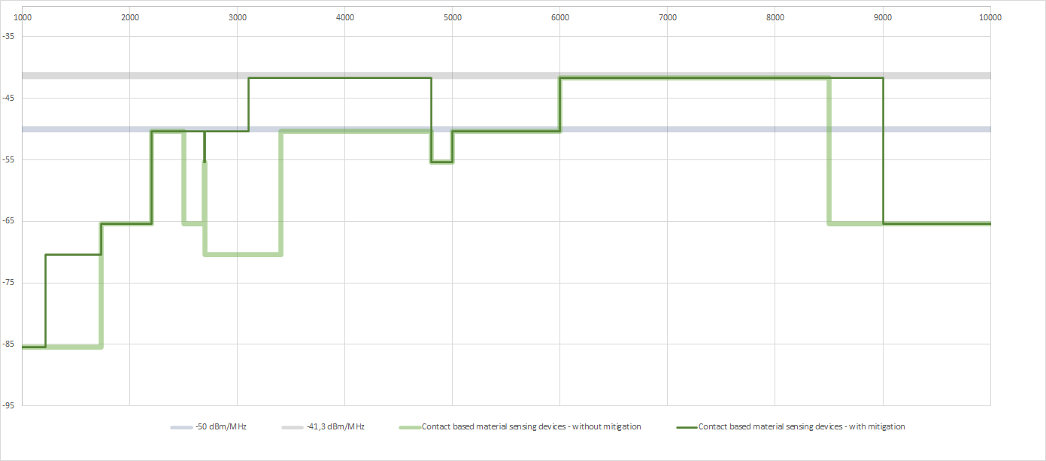
ECC/DEC/(07)01, table 1; Limits for contact based UWB material sensing devices
→ All emissions (e.i.r.p) & mitigations will be tested based on a “test scenario” reflecting the intended use (EUT in contact with representative material) as specified in the related specific EN
Mitigation based on:
Note 5: LDC
or
Note 5*: DAA
required for e.i.r.p > 50dBm/MHz
3.1 – 3.4 GHz: Instead LBT also LDC or DCC (based on generic regulation) would be possible
Mitigation based on:
Note 5*: DAA
based on NOTE 4
For “all” EUT (independent on implemented mitigation)
No fixed outdoor permitted
based on NOTE 2
For “all” EUT (independent on implemented mitigation)
Total Radiated Power spectral density below max spectral density
2,5 – 2,69
2,69 – 2,7 (+ DC in range of 10%/s; NOTE 3)
4,8 – 5 (+ DC in range of 10%/s; NOTE 3)
3,4 – 3,8 GHz (+ DC in range of 10%/s; NOTE 3)
Fixed outdoor could be possible under EC/DEC/(06)04,
A1.3 SPECIFIC RADIODETERMINATION….. Or
< -50dBm/MHz (see former versions of ECC/DEC/(07)01) as justification
Mitigation based on NOTE 1
and based on EUT “needs”
LBT in
1,215 – 1,73
2,5 – 2,69
2,7 – 3,4 GHz
fixed outdoor possible
fixed outdoor possible
fixed outdoor possible
fixed outdoor possible
fixed outdoor possible
If mitigations (NOTE 5 or 5*) are implemented NOTE 4 applies
No fixed outdoor permitted
Fixed outdoor in 3.1 - .48GHz is possible if emissions will be < -50dBm/MHz* (see former version of ECC/DCEC/(07)01 for justification)

Slide 14
Limits for non-contact based UWB material sensing devices; based on ECC/DEC/(07)01
Non-contact-based sensor and imaging devices.
The UWB transmitter is only switched on when in close proximity with the investigated material and the UWB transmitter is directed into the direction of the material under investigation (e.g. manually, by using a proximity sensor or by mechanical design).

Slide 15
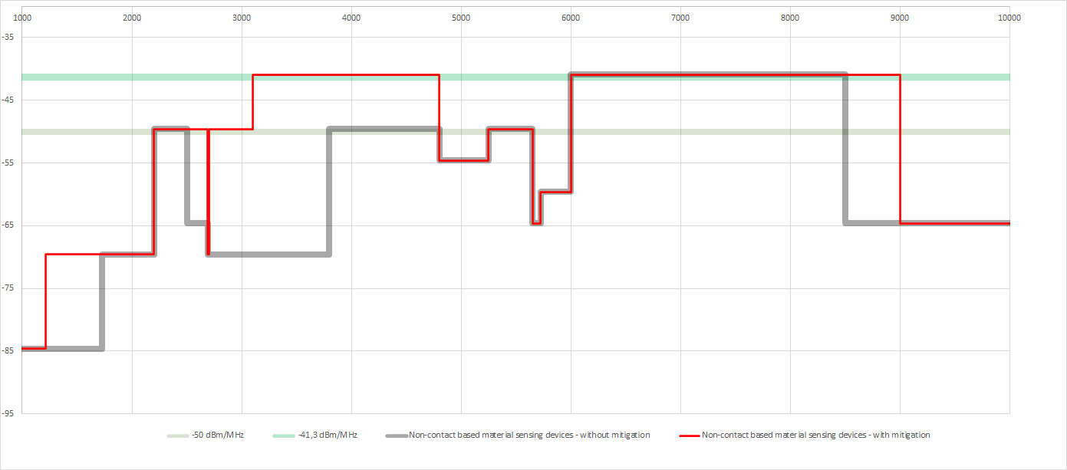
ECC/DEC/(07)01, table 1; Limits for non-contact based UWB material sensing devices
→ All emissions (e.i.r.p) & mitigations will be tested based on a “test scenario” reflecting the intended use (EUT in contact with representative material) as specified in the related specific EN
Mitigation based on:
Note 5: LDC
or
Note 5*: DAA
required
3.1 – 3.4 GHz: Instead LBT also LDC or DCC (based on generic regulation) would be possible
Mitigation based on:
Note 5*: DAA
based on NOTE 2 and NOTE 2*
For “all” EUT (independent on implemented mitigation)
Total Radiated Power spectral density below max spectral density
2,5 – 2,69
2,69 – 2,7 (+ DC in range of 10%/s; NOTE 3)
4,8 – 5 (+ DC in range of 10%/s; NOTE 3)
3,4 – 3,8 GHz (+ DC in range of 10%/s; NOTE 3)
NOTE 3 could clash with NOTE 5 for measurement → NOTE 5 is over OFR, NOTE 3 is in 3,4 to 3,8GHz
Mitigation based on NOTE 1
and based on EUT “needs”
LBT in
1,215 – 1,73
2,5 – 2,69
2,7 – 3,4 GHz
Fixed outdoor could be possible under EC/DEC/(06)04,
A1.3 SPECIFIC RADIODETERMINATION…..
and generic surveillance radiodetermination with enhanced power under A.1.3.2
based on NOTE 4
For “all” EUT (independent on implemented mitigation)
No fixed outdoor permitted
fixed outdoor possible
fixed outdoor possible
fixed outdoor possible
fixed outdoor possible
fixed outdoor possible
If mitigations (NOTE 5 or 5*) are implemented NOTE 4 applies
No fixed outdoor permitted
Fixed outdoor is possible if emissions will be < -50dBm/MHz* ( see former version of ECC/DCEC/(07)01

