Slide 1
IEEE 802.18 mmWave Ad Hoc Agenda
Date: 2022-09-27
Authors:
Notes:
September 2012

Slide 2
Abstract
This agenda is for the fourth meeting of the 802.18 mmWave Ad Hoc Committee.
Notes:
September 2012
doc.: IEEE 802.11-09/0301r1
March 2009
Stephen McCann, RIM
Page 2

Slide 3
Meeting called to order
Ad-hoc Leader:
Chair: Rich Kennedy (Unlicensed Spectrum Advocates)
Attendance:
  Stuart Kerry (OK-Brit)
Secretary
  Chair [agenda + decisions + action items]
Notes:
3

Slide 4
IEEE 802 required notices
Affiliation: https://standards.ieee.org/faqs/affiliation/
Be sure to announce your name, affiliation, employer, and clients the first time you speak.
Anti-Trust: https://standards.ieee.org/wp-content/uploads/2022/02/antitrust.pdf
IEEE 802 WG Policies and Procedures: http://www.ieee802.org/devdocs.shtml
Patent & administration: https://standards.ieee.org/about/sasb/patcom/materials.html
Copyright notice: https://standards.ieee.org/faqs/copyrights/#1
Call for essential patents & copyright notice: the RR-TAG does not do standards, though all should be aware.
IEEE SA Standards Board Operations Manual: https://standards.ieee.org/about/policies/opman/
Notes:
4

Slide 5
Other Guidelines for IEEE WG Meetings
All IEEE SA standards meetings shall be conducted in compliance with all applicable laws, including antitrust and competition laws.
  Don’t discuss the interpretation, validity, or essentiality of patents/patent claims.
  Don’t discuss specific license rates, terms, or conditions.
    Relative costs of different technical approaches that include relative costs of patent licensing terms may be discussed in standards development meetings.
      Technical considerations remain the primary focus
  Don’t discuss or engage in the fixing of product prices, allocation of customers, or division of sales markets.
  Don’t discuss the status or substance of ongoing or threatened litigation.
  Don't be silent if inappropriate topics are discussed. Formally object to the discussion immediately.
---------------------------------------------------------------
For more details, see IEEE SA Standards Board Operations Manual, clause 5.3.10 and Antitrust and Competition Policy: What You Need to Know at https://standards.ieee.org/wp-content/uploads/2022/02/antitrust.pdf
If you have questions, contact the IEEE SA Standards Board Patent Committee Administrator
at patcom@ieee.org
Notes:
5

Slide 6
Participant behavior in IEEE SA activities is guided by the IEEE Codes of Ethics & Conduct
All participants in IEEE SA activities are expected to adhere to the core principles underlying the:
  IEEE Code of Ethics
  IEEE Code of Conduct
The core principles of the IEEE Codes of Ethics & Conduct are to:
  Uphold the highest standards of integrity, responsible behavior, and ethical and professional conduct
  Treat people fairly and with respect, to not engage in harassment, discrimination, or retaliation, and to protect people's privacy.
  Avoid injuring others, their property, reputation, or employment by false or malicious action
The most recent versions of these Codes are available at http://www.ieee.org/about/corporate/governance

Slide 7
Participants in the IEEE SA “individual process” shall act independently of others, including employers
The IEEE SA Standards Board Bylaws require that “participants in the IEEE standards development individual process shall act based on their qualifications and experience”
This means participants:
  Shall act & vote based on their personal & independent opinions derived from their expertise, knowledge, and qualifications
  Shall not act or vote based on any obligation to or any direction from any other person or organization, including an employer or client, regardless of any external commitments, agreements, contracts, or orders
  Shall not direct the actions or votes of other participants or retaliate against other participants for fulfilling their responsibility to act & vote based on their personal & independently developed opinions
By participating in standards activities using the “individual process”, you are deemed to accept these requirements; if you are unable to satisfy these requirements then you shall immediately cease any participation (and would ask you to please leave the call or meeting.)

Slide 8
IEEE-SA standards activities shall allow the fair & equitable consideration of all viewpoints
The IEEE SA Standards Board Bylaws (clause 5.2.1.3) specifies that “the standards development process shall not be dominated by any single interest category, individual, or organization”
– This means no participant may exercise “authority, leadership, or influence by reason of superior leverage, strength, or representation to the exclusion of fair and equitable consideration of other viewpoints” or “to hinder the progress of the standards development activity”
This rule applies equally to those participating in a standards development project and to that project’s leadership group
Any person who reasonably suspects that dominance is occurring in a standards development project is encouraged to bring the issue to the attention of the Standards Committee or the project’s IEEE SA Program Manager

Slide 9
Housekeeping reminder
Weekly meeting reminders:
  IMAT is NOT being used for this session
  Please ensure that the following information is listed correctly when joining the call: “FIRST NAME LAST NAME, Affiliation” (e.g., Stuart Kerry, OK-Brit; Self)
  Remember to state your name and affiliation the FIRST TIME you speak
  When you want to be on the queue, please type “Q” or “q” in the chat window
  Remember to mute when not speaking, thank you

Slide 10
Agenda
Approve the minutes from the third meeting (posted September 12, 2022)
  18-22/113r01
Review the results from the third meeting
Review the presentation at the UHR SG meeting in Waikoloa
  11-22/1398r3
45 GHz band Incumbent details (based on prior experience in other bands)
Recommendations
Adjourn

Slide 11
Third Meeting Review
Reviewed the meeting from the prior week
Reviewed, edited and achieved the go ahead for RR-TAG vote on the UHR SG introduction to the mmWave Ad Hoc
  11-22/1398r2 > 11-22/1398r3
Discussed when to present information about this group to the UHR SG
  In Waikoloa (preferred) or Bangkok
  The sooner the better

Slide 12
UHR SG Introduction
The group reached consensus on this introduction to the UHR SG at the third meeting
  The full RR-TAG approved the r4 (11-22/1398r4) during the IEEE 802.18 face-to-face meeting on September 13th in Waikoloa
Vote in IEEE 802.18
  Motion #3 (External): Move to approve forwarding the document 11-22/1398r4 to the IEEE 802.11 Ultra High Reliability Study Group for presentation and discussion.
  Moved: Rich Kennedy
  Seconded: Stuart Kerry
  Discussion? None.
  Attendees: 16 Voters: 14
  Vote: 10 Y, 2 N, 2 A (The Chair did not vote) Passed.
The mmWave Ad Hoc Chair presented this at the UHR SG meeting in Waikoloa
  Questions about the listed standards only – agreed more study required to select appropriate documents to base it on

Slide 13
45 GHz Band – Incumbent Details
FIXED
  Point-to-Point with multiple applications
    Typically, high power, high reliability (five 9s - service at 99.999% of the time), significant receiver margin, narrow beam systems
    Licensed, must be protected, i.e., minimal (not zero) interference
    Licensees opposed to ANY sharing
  6 GHz band studies dedicated significant time and resources to demonstrate safe sharing with the FS
    Summarized in ECC Reports 302 and 316 based primarily on studies by RKF Engineering Solutions, LLC
      https://www.ecodocdb.dk/download/cc03c766-35f8/ECC%20Report%20302.pdf
      https://docdb.cept.org/download/8951af9e-1932/ECC%20Report%20316.pdf
    See “Frequency Sharing for Radio Local Area Networks in the 6 GHz Band”
      https://s3.amazonaws.com/rkfengineering-web/6USC+Report+Release+-+24Jan2018.pdf
    Also see “Frequency Sharing for Radio Local Area Networks in the 6 GHz Band in India“
      https://broadbandindiaforum.in/wp-content/uploads/2021/11/Frequency-Sharing-for-RLANs-in-the-6GHz-band-in-India_Accessible.pdf

Slide 14
45 GHz Band – Incumbent Details [2]
FIXED-SATELLITE (Earth-to-Space)
  Ground station (high power) transmitters and satellites to be protected
    ECC Report 302 studied aggregate interference from WAS/RLAN into FSS receivers in space

Slide 15
45 GHz Band – Incumbent Details [3]
MOBILE except aeronautical mobile (see Note 5.550B)
  “The frequency band 37-43.5 GHz, or portions thereof, is identified for use by administrations wishing to implement the terrestrial component of International Mobile Telecommunications (IMT)”

Slide 16
45 GHz Band – Incumbent Details [4]
RADIOASTRONOMY

Slide 17
45 GHz Band – Incumbent Details [5]
MOBILE

Slide 18
45 GHz Band – Incumbent Details [6]
MOBILE-SATELLITE

Slide 19
45 GHz Band – Incumbent Details [7]
RADIONAVIGATION

Slide 20
45 GHz Band – Incumbent Details [8]
RADIONAVIGATION-SATELLITE

Slide 21
45 GHz Band – Incumbent Details [9]
AMATEUR

Slide 22
45 GHz Band – Incumbent Details [10]
AMATEUR-SATELLITE

Slide 23
45 GHz Band – Incumbent Details [11]
FIXED-SATELLITE (Space-to-Earth)
  Ground station (sensitive) receivers to be protected

Slide 24
Considerations
The US FCC rules are typically followed all or in part by many other regulatory domains, especially in the Americas
ETSI rules are typically followed all or in part by much of EMEA and Australia/New Zealand

Slide 25
Next Steps
Acquire China regulatory data for these bands
  Edward has offered to obtain and translate (or have translated).
Begin the review looking for obvious trouble spots, i.e., allocations that we may not be able to share with
Add the 60 GHz band (57 – 71 GHz)

Slide 26
Recommendations?

Slide 27
Volunteers?

Slide 28
References
ITU-R Radio Regulations
  https://www.itu.int/pub/R-REG-RR
US FCC Table of Frequencies
  https://transition.fcc.gov/oet/spectrum/table/fcctable.docx
European Table of Frequency Allocations
  https://efis.cept.org/ [search by frequency, country, etc.]
  https://efis.cept.org/sitecontent.jsp?sitecontent=ecatable
European National Frequency Tables
  https://efis.cept.org/views2/national_frequency_table.jsp

Slide 29
Backup slides

Slide 30
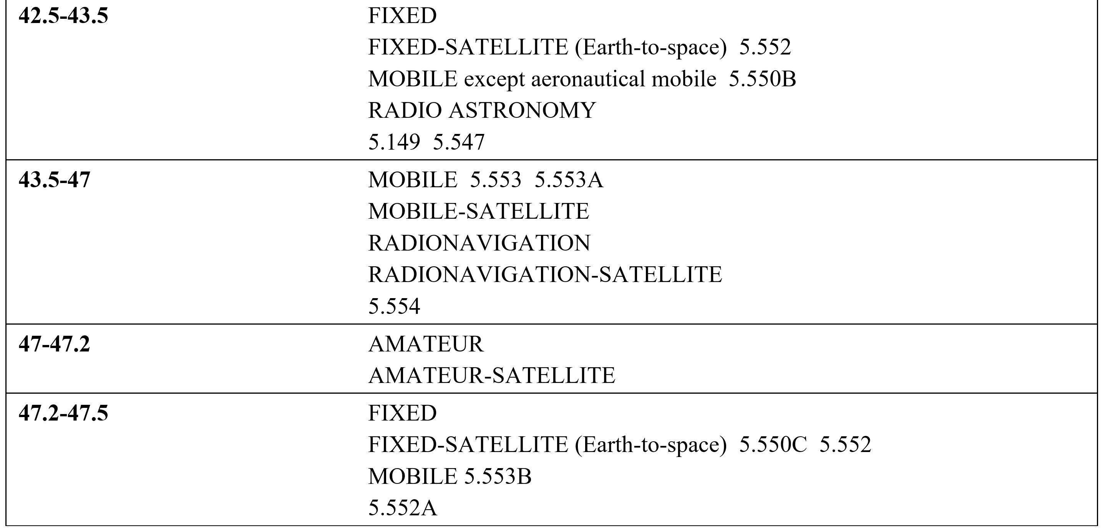
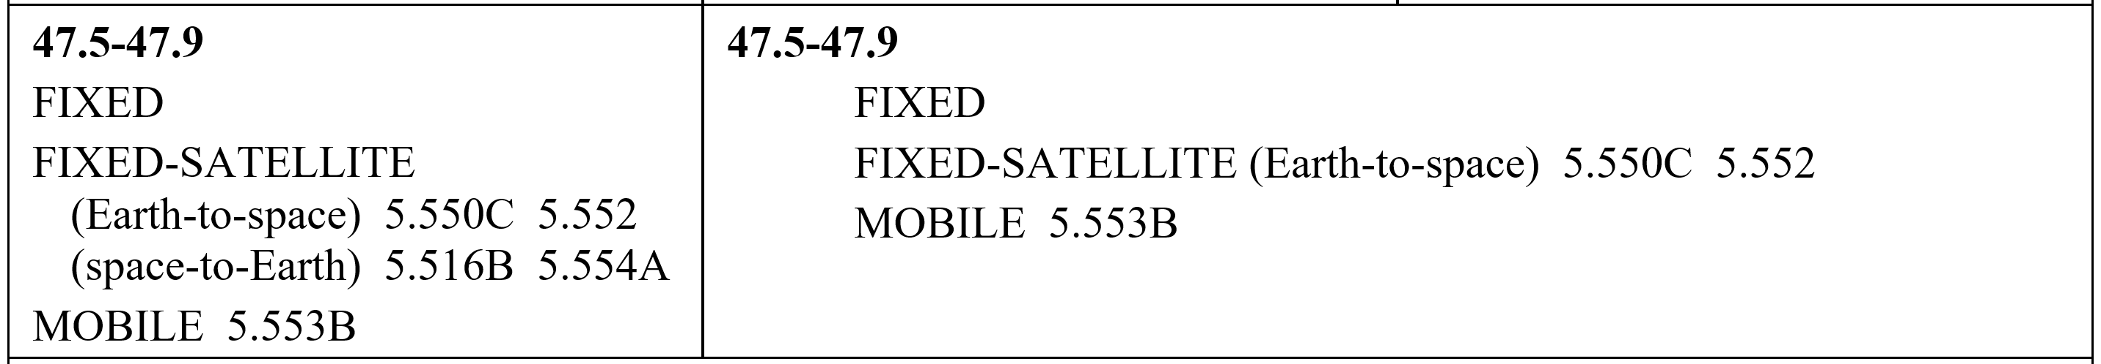
First Look: 45 GHz (42.5 – 48 GHz) ITU-R
5.552 The allocation of the spectrum for the fixed-satellite service in the bands 42.5-43.5 GHz and 47.2-50.2 GHz for Earth-to-space transmission is greater than that in the band 37.5-39.5 GHz for space-to-Earth transmission in order to accommodate feeder links to broadcasting satellites. Administrations are urged to take all practicable steps to reserve the band 47.2-49.2 GHz for feeder links for the broadcasting-satellite service operating in the band 40.5-42.5 GHz.
5.550B The frequency band 37-43.5 GHz, or portions thereof, is identified for use by administrations wishing to implement the terrestrial component of International Mobile Telecommunications (IMT). This identification does not preclude the use of this frequency band by any application of the services to which it is allocated and does not establish priority in the Radio Regulations. Because of the potential deployment of FSS earth stations within the frequency range 37.5-42.5 GHz and high-density applications in the fixed-satellite service in the frequency bands 39.5-40 GHz in Region 1, 40-40.5 GHz in all Regions and 40.5-42 GHz in Region 2 (see No. 5.516B), administrations should further take into account potential constraints to IMT in these frequency bands, as appropriate. Resolution 243 (WRC 19) applies. (WRC 19)
5.149 In making assignments to stations of other services to which the bands: [only showing band in range]
42.5-43.5 GHz
5.547 The bands 31.8-33.4 GHz, 37-40 GHz, 40.5-43.5 GHz, 51.4-52.6 GHz, 55.78-59 GHz and 64-66 GHz are available for high-density applications in the fixed service (see Resolution 75 (WRC-2000)*). Administrations should take this into account when considering regulatory provisions in relation to these bands. Because of the potential deployment of high-density applications in the fixed-satellite service in the bands 39.5-40 GHz and 40.5-42 GHz (see No. 5.516B), administrations should further take into account potential constraints to high-density applications in the fixed service, as appropriate. (WRC 07)

Slide 31
First Look: 45 GHz (42.5 – 47.9 GHz) ITU-R [2]
5.553 In the bands 43.5-47 GHz and 66-71 GHz, stations in the land mobile service may be operated subject to not causing harmful interference to the space radiocommunication services to which these bands are allocated (see No. 5.43). (WRC 2000)
5.553A In Algeria, Angola, Bahrain, Belarus, Benin, Botswana, Brazil, Burkina Faso, Cabo Verde, Korea (Rep. of), Côte d’Ivoire, Croatia, United Arab Emirates, Estonia, Eswatini, Gabon, Gambia, Ghana, Greece, Guinea, Guinea-Bissau, Hungary, Iran (Islamic Republic of), Iraq, Jordan, Kuwait, Lesotho, Latvia, Liberia, Lithuania, Madagascar, Malawi, Mali, Morocco, Mauritius, Mauritania, Mozambique, Namibia, Niger, Nigeria, Oman, Qatar, Senegal, Seychelles, Sierra Leone, Slovenia, Sudan, South Africa, Sweden, Tanzania, Togo, Tunisia, Zambia and Zimbabwe, the frequency band 45.5-47 GHz is identified for use by administrations wishing to implement the terrestrial component of International Mobile Telecommunications (IMT), taking into account No. 5.553. With respect to the aeronautical mobile service and radionavigation service, the use of this frequency band for the implementation of IMT is subject to agreement obtained under No. 9.21 with concerned administrations and shall not cause harmful interference to, or claim protection from these services. This identification does not preclude the use of this frequency band by any application of the services to which it is allocated and does not establish priority in the Radio Regulations. Resolution 244 (WRC 19) applies. (WRC 19)
5.554 In the bands 43.5-47 GHz, 66-71 GHz, 95-100 GHz, 123-130 GHz, 191.8-200 GHz and 252-265 GHz, satellite links connecting land stations at specified fixed points are also authorized when used in conjunction with the mobile-satellite service or the radionavigation-satellite service. (WRC 2000)
5.550C The use of the frequency bands 37.5-39.5 GHz (space-to-Earth), 39.5-42.5 GHz (space to Earth), 47.2-50.2 GHz (Earth-to-space) and 50.4-51.4 GHz (Earth-to-space) by a non-geostationary satellite system in the fixed-satellite service is subject to the application of the provisions of No. 9.12 for coordination with other non-geostationary-satellite systems in the fixed-satellite service but not with non-geostationary-satellite systems in other services. Resolution 770 (WRC 19) shall also apply, and No. 22.2 shall continue to apply. (WRC 19)
5.552 The allocation of the spectrum for the fixed-satellite service in the bands 42.5-43.5 GHz and 47.2-50.2 GHz for Earth-to-space transmission is greater than that in the band 37.5-39.5 GHz for space-to-Earth transmission in order to accommodate feeder links to broadcasting satellites. Administrations are urged to take all practicable steps to reserve the band 47.2-49.2 GHz for feeder links for the broadcasting-satellite service operating in the band 40.5-42.5 GHz.
5.553B In Region 2 and Algeria, Angola, Saudi Arabia, Australia, Bahrain, Benin, Botswana, Burkina Faso, Burundi, Cameroon, Central African Rep., Comoros, Congo (Rep. of the), Korea (Rep. of), Côte d’Ivoire, Djibouti, Egypt, United Arab Emirates, Eswatini, Ethiopia, Gabon, Gambia, Ghana, Guinea, Guinea-Bissau, Equatorial Guinea, India, Iran (Islamic Republic of), Iraq, Japan, Jordan, Kenya, Kuwait, Lesotho, Liberia, Libya, Lithuania, Madagascar, Malaysia, Malawi, Mali, Morocco, Mauritius, Mauritania, Mozambique, Namibia, Niger, Nigeria, Oman, Uganda, Qatar, the Syrian Arab Republic, the Dem. Rep. of the Congo, Rwanda, Sao Tome and Principe, Senegal, Seychelles, Sierra Leone, Singapore, Slovenia, Somalia, Sudan, South Sudan, South Africa, Sweden, Tanzania, Chad, Togo, Tunisia, Zambia and Zimbabwe, the frequency band 47.2-48.2 GHz is identified for use by administrations wishing to implement International Mobile Telecommunications (IMT). This identification does not preclude the use of this frequency band by any application of the services to which it is allocated, and does not establish any priority in the Radio Regulations. Resolution 243 (WRC 19) applies. (WRC-19)
5.552A The allocation to the fixed service in the frequency bands 47.2-47.5 GHz and 47.9-48.2 GHz is identified for use by high-altitude platform stations (HAPS). This identification does not preclude the use of this frequency band by any application of the services to which it is allocated on a co-primary basis, and does not establish priority in the Radio Regulations. Such use of the fixed-service allocation in the frequency bands 47.2-47.5 GHz and 47.9-48.2 GHz by HAPS shall be in accordance with the provisions of Resolution 122 (Rev.WRC 19). (WRC 19)
5.516B The following bands are identified for use by high-density applications in the fixed-satellite service: [only showing band in range]
47.5-47.9 GHz (space-to-Earth) in Region 1
5.554A The use of the bands 47.5-47.9 GHz, 48.2-48.54 GHz and 49.44-50.2 GHz by the fixed-satellite service (space-to-Earth) is limited to geostationary satellites. (WRC-03)

Slide 32
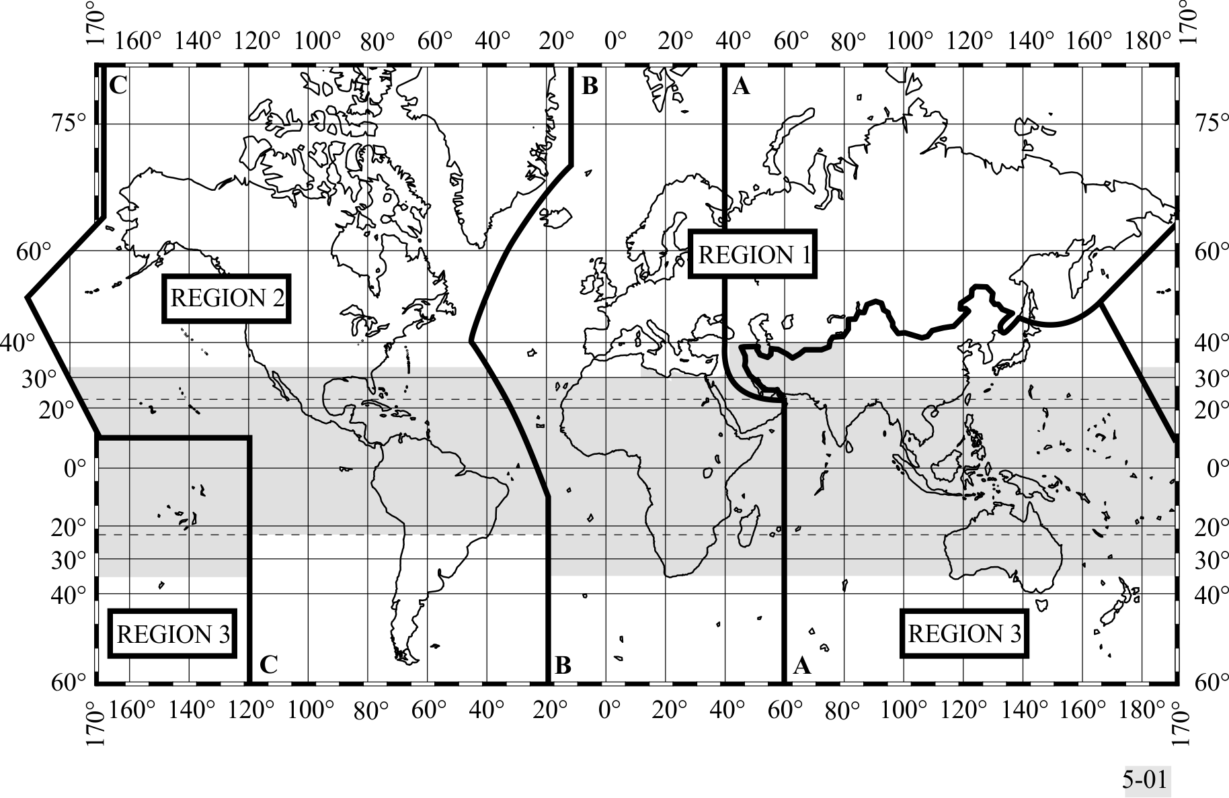
The ITU-R Region Map
5.16 1) The “Tropical Zone” (see map in No. 5.2) is defined as:
5.17 a) the whole of that area in Region 2 between the Tropics of Cancer and Capricorn;
5.18 b) the whole of that area in Regions 1 and 3 contained between the parallels 30° North and 35° South with the addition of:
5.19 i) The area contained between the meridians 40° East and 80° East of Greenwich and the parallels 30° North and 40° North;
5.20 ii) that part of Libya north of parallel 30° North.
5.21 2) In Region 2, the Tropical Zone may be extended to parallel 33° North, subject to special agreements between the countries concerned in that Region (see Article 6).
The shaded part represents the Tropical Zones as defined in Nos. 5.16 to 5.20 and 5.21

Slide 33
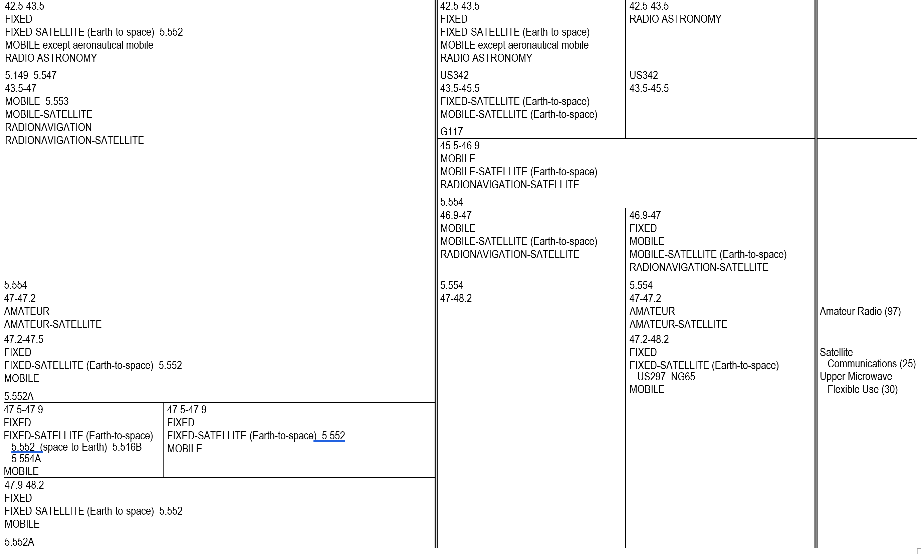
First Look: 45 GHz (42.5 – 48.2 GHz) FCC
5.552 The allocation of the spectrum for the fixed-satellite service in the bands 42.5-43.5 GHz and 47.2 50.2 GHz for Earth-to-space transmission is greater than that in the band 37.5-39.5 GHz for space to-Earth transmission in order to accommodate feeder links to broadcasting satellites. Administrations are urged to take all practicable steps to reserve the band 47.2-49.2 GHz for feeder links for the broadcasting-satellite service operating in the band 40.5-42.5 GHz.
5.149 In making assignments to stations of other services to which the bands:
42.5-43.5 GHz
5.547 The bands 31.8-33.4 GHz, 37-40 GHz, 40.5-43.5 GHz, 51.4-52.6 GHz, 55.78-59 GHz and 64 66 GHz are available for high-density applications in the fixed service (see Resolution 75 (WRC 12)). Administrations should take this into account when considering regulatory provisions in relation to these bands. Because of the potential deployment of high-density applications in the fixed-satellite service in the bands 39.5-40 GHz and 40.5-42 GHz (see No. 5.516B), administrations should further take into account potential constraints to high-density applications in the fixed service, as appropriate. (FCC)
US342 In making assignments to stations of other services to which the bands:
42.77-42.87 GHz, 43.07-43.17 GHz, 43.37-43.47 GHz
5.553 In the bands 43.5-47 GHz and 66-71 GHz, stations in the land mobile service may be operated subject to not causing harmful interference to the space radiocommunication services to which these bands are allocated (see No. 5.43).
5.554 In the bands 43.5-47 GHz, 66-71 GHz, 95-100 GHz, 123-130 GHz, 191.8-200 GHz and 252 265 GHz, satellite links connecting land stations at specified fixed points are also authorized when used in conjunction with the mobile-satellite service or the radionavigation-satellite service.

Slide 34
First Look: 45 GHz (42.5 – 48.2 GHz) FCC [2]
5.552 The allocation of the spectrum for the fixed-satellite service in the bands 42.5-43.5 GHz and 47.2 50.2 GHz for Earth-to-space transmission is greater than that in the band 37.5-39.5 GHz for space to-Earth transmission in order to accommodate feeder links to broadcasting satellites. Administrations are urged to take all practicable steps to reserve the band 47.2-49.2 GHz for feeder links for the broadcasting-satellite service operating in the band 40.5-42.5 GHz.
5.552A The allocation to the fixed service in the bands 47.2-47.5 GHz and 47.9-48.2 GHz is designated for use by high altitude platform stations. The use of the bands 47.2-47.5 GHz and 47.9 48.2 GHz is subject to the provisions of Resolution 122 (Rev.WRC 07). (WRC-07)
5.554A The use of the bands 47.5-47.9 GHz, 48.2-48.54 GHz and 49.44-50.2 GHz by the fixed-satellite service (space-to-Earth) is limited to geostationary satellites.
US297 The bands 47.2-49.2 GHz and 81-82.5 GHz are also available for feeder links for the broadcasting-satellite service.
NG65 In the bands 24.75-25.25 GHz, 47.2-48.2 GHz, and 50.4-51.4 GHz, stations in the fixed and mobile services may not claim protection from individually licensed earth stations authorized pursuant to 47 CFR 25.136. However, nothing in this footnote shall limit the right of Upper Microwave Flexible Use Service licensees to operate in conformance with the technical rules contained in 47 CFR part 30. The Commission reserves the right to monitor developments and to undertake further action concerning interference between Upper Microwave Flexible Use Service and Fixed-Satellite Service, including aggregate interference to satellite receivers, if appropriate.

Slide 35
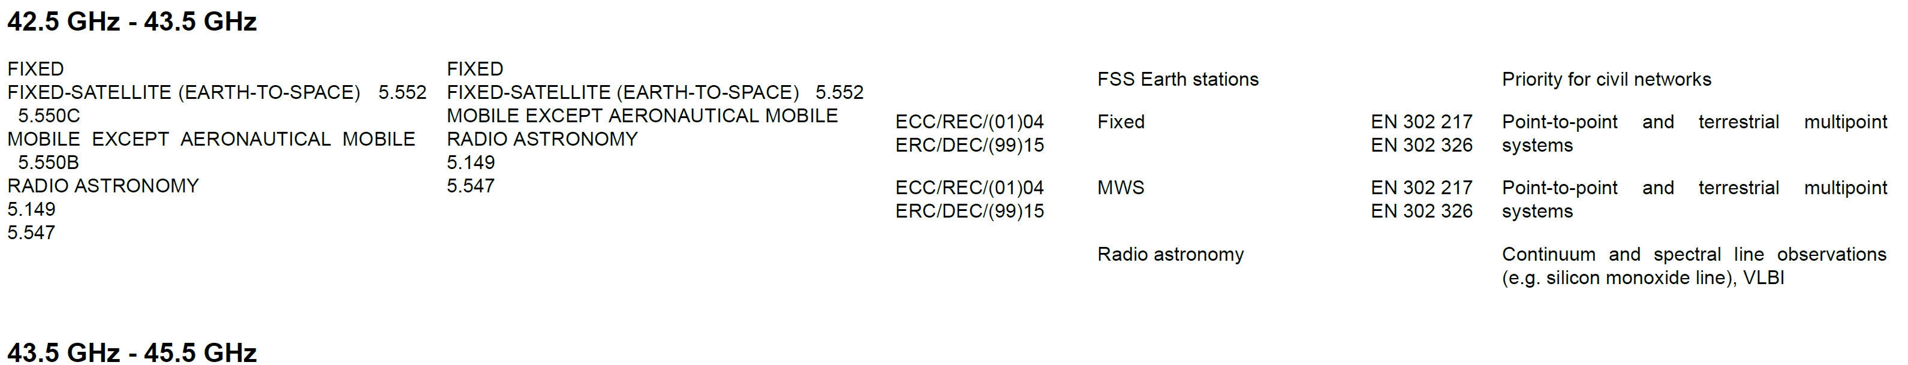
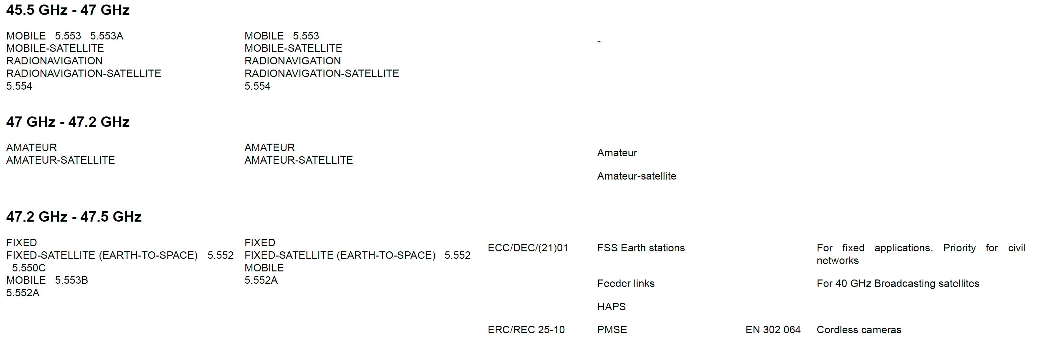
First Look: 45 GHz (42.5 – 47.9 GHz) ECC
5.552 The allocation of the spectrum for the fixed-satellite service in the bands 42.5-43.5 GHz and 47.2-50.2 GHz for Earth-to-space transmission is greater than that in the band 37.5-39.5 GHz for space-to-Earth transmission in order to accommodate feeder links to broadcasting satellites. Administrations are urged to take all practicable steps to reserve the band 47.2-49.2 GHz for feeder links for the broadcasting-satellite service operating in the band 40.5-42.5 GHz.
5.550C The use of the frequency bands 37.5-39.5 GHz (space-to-Earth), 39.5-42.5 GHz (space to Earth), 47.2-50.2 GHz (Earth-to-space) and 50.4-51.4 GHz (Earth-to-space) by a non-geostationary satellite system in the fixed-satellite service is subject to the application of the provisions of No. 9.12 for coordination with other non-geostationary-satellite systems in the fixed-satellite service but not with non-geostationary-satellite systems in other services. Resolution 770 (WRC 19) shall also apply, and No. 22.2 shall continue to apply. (WRC 19)
5.550B The frequency band 37-43.5 GHz, or portions thereof, is identified for use by administrations wishing to implement the terrestrial component of International Mobile Telecommunications (IMT). This identification does not preclude the use of this frequency band by any application of the services to which it is allocated and does not establish priority in the Radio Regulations. Because of the potential deployment of FSS earth stations within the frequency range 37.5-42.5 GHz and high-density applications in the fixed-satellite service in the frequency bands 39.5-40 GHz in Region 1, 40-40.5 GHz in all Regions and 40.5-42 GHz in Region 2 (see No. 5.516B), administrations should further take into account potential constraints to IMT in these frequency bands, as appropriate. Resolution 243 (WRC 19) applies. (WRC 19)
5.149 In making assignments to stations of other services to which the bands: [only showing band in range]
42.5-43.5 GHz

Slide 36
First Look: 45 GHz (42.5 – 47.9 GHz) ECC [2]
5.149 In making assignments to stations of other services to which the bands: 13360-13410 kHz, 25550-25670 kHz, 37.5-38.25 MHz, 73-74.6 MHz in Regions 1 and 3, 150.05-153 MHz in Region 1, 322-328.6 MHz, 406.1-410 MHz, 608-614 MHz in Regions 1 and 3, 1330-1400 MHz, 1610.6-1613.8 MHz, 1660-1670 MHz, 1718.8-1722.2 MHz, 2655-2690 MHz, 3260-3267 MHz, 3332-3339 MHz, 3345.8-3352.5 MHz, 4825-4835 MHz, 4950-4990 MHz, 4990-5000 MHz, 6650-6675.2 MHz, 10.6-10.68 GHz, 14.47-14.5 GHz, 22.01-22.21 GHz, 22.21-22.5 GHz, 22.81-22.86 GHz, 23.07-23.12 GHz, 31.2-31.3 GHz, 31.5-31.8 GHz in Regions 1 and 3, 36.43-36.5 GHz, 42.5-43.5 GHz, 48.94-49.04 GHz, 76-86 GHz, 92-94 GHz, 94.1-100 GHz, 102-109.5 GHz, 111.8-114.25 GHz, 128.33-128.59 GHz, 129.23-129.49 GHz, 130-134 GHz, 136-148.5 GHz, 151.5-158.5 GHz, 168.59-168.93 GHz, 171.11-171.45 GHz, 172.31-172.65 GHz, 173.52-173.85 GHz, 195.75-196.15 GHz, 209-226 GHz, 241-250 GHz, 252-275 GHz are allocated, administrations are urged to take all practicable steps to protect the radio astronomy service from harmful interference. Emissions from spaceborne or airborne stations can be particularly serious sources of interference to the radio astronomy service (see Nos. 4.5 and 4.6 and Article 29). (WRC-07)
5.547 The bands 31.8-33.4 GHz, 37-40 GHz, 40.5-43.5 GHz, 51.4-52.6 GHz, 55.78-59 GHz and 64-66 GHz are available for high-density applications in the fixed service (see Resolution 75 (WRC-2000)*). Administrations should take this into account when considering regulatory provisions in relation to these bands. Because of the potential deployment of high-density applications in the fixed-satellite service in the bands 39.5-40 GHz and 40.5-42 GHz (see No. 5.516B), administrations should further take into account potential constraints to high-density applications in the fixed service, as appropriate. (WRC 07)
5.553 In the bands 43.5-47 GHz and 66-71 GHz, stations in the land mobile service may be operated subject to not causing harmful interference to the space radiocommunication services to which these bands are allocated (see No. 5.43). (WRC 2000)
5.553A In Algeria, Angola, Bahrain, Belarus, Benin, Botswana, Brazil, Burkina Faso, Cabo Verde, Korea (Rep. of), Côte d’Ivoire, Croatia, United Arab Emirates, Estonia, Eswatini, Gabon, Gambia, Ghana, Greece, Guinea, Guinea-Bissau, Hungary, Iran (Islamic Republic of), Iraq, Jordan, Kuwait, Lesotho, Latvia, Liberia, Lithuania, Madagascar, Malawi, Mali, Morocco, Mauritius, Mauritania, Mozambique, Namibia, Niger, Nigeria, Oman, Qatar, Senegal, Seychelles, Sierra Leone, Slovenia, Sudan, South Africa, Sweden, Tanzania, Togo, Tunisia, Zambia and Zimbabwe, the frequency band 45.5-47 GHz is identified for use by administrations wishing to implement the terrestrial component of International Mobile Telecommunications (IMT), taking into account No. 5.553. With respect to the aeronautical mobile service and radionavigation service, the use of this frequency band for the implementation of IMT is subject to agreement obtained under No. 9.21 with concerned administrations and shall not cause harmful interference to, or claim protection from these services. This identification does not preclude the use of this frequency band by any application of the services to which it is allocated and does not establish priority in the Radio Regulations. Resolution 244 (WRC 19) applies. (WRC 19)
5.554 In the bands 43.5-47 GHz, 66-71 GHz, 95-100 GHz, 123-130 GHz, 191.8-200 GHz and 252-265 GHz, satellite links connecting land stations at specified fixed points are also authorized when used in conjunction with the mobile-satellite service or the radionavigation-satellite service. (WRC 2000)
ECA36 A frequency band, which has been harmonised by NATO and NATO member nations for military use as defined in the NATO Joint Civil/Military Frequency Agreement (NJFA) 2014. Note: NATO Joint Civil/Military Frequency Agreement (NJFA) – Extract for Public Disclosure – 14 February 2017
5.552A The allocation to the fixed service in the frequency bands 47.2-47.5 GHz and 47.9-48.2 GHz is identified for use by high-altitude platform stations (HAPS). This identification does not preclude the use of this frequency band by any application of the services to which it is allocated on a co-primary basis, and does not establish priority in the Radio Regulations. Such use of the fixed-service allocation in the frequency bands 47.2-47.5 GHz and 47.9-48.2 GHz by HAPS shall be in accordance with the provisions of Resolution 122 (Rev.WRC 19). (WRC 19)
5.516B The following bands are identified for use by high-density applications in the fixed-satellite service: 17.3-17.7 GHz (space-to-Earth) in Region 1, 18.3-19.3 GHz (space-to-Earth) in Region 2, 19.7-20.2 GHz (space-to-Earth) in all Regions, 39.5-40 GHz (space-to-Earth) in Region 1, 40-40.5 GHz (space-to-Earth) in all Regions, 40.5-42 GHz (space-to-Earth) in Region 2, 47.5-47.9 GHz (space-to-Earth) in Region 1, 48.2-48.54 GHz (space-to-Earth) in Region 1, 49.44-50.2 GHz (space-to-Earth) in Region 1, and 27.5-27.82 GHz (Earth-to-space) in Region 1, 28.35-28.45 GHz (Earth-to-space) in Region 2, 28.45-28.94 GHz (Earth-to-space) in all Regions, 28.94-29.1 GHz (Earth-to-space) in Region 2 and 3, 29.25-29.46 GHz (Earth-to-space) in Region 2, 29.46-30 GHz (Earth-to-space) in all Regions, 48.2-50.2 GHz (Earth-to-space) in Region 2. ART5 – 37 – This identification does not preclude the use of these frequency bands by other fixed-satellite service applications or by other services to which these frequency bands are allocated on a co-primary basis and does not establish priority in these Radio Regulations among users of the frequency bands. Administrations should take this into account when considering regulatory provisions in relation to these frequency bands. See Resolution 143 (Rev.WRC-19). (WRC-19)

