Slide 1
IEEE 802.18 mmWave Ad Hoc Agenda
Date: 2022-08-30
Authors:
Notes:
September 2012

Slide 2
Abstract
This agenda is for the second meeting of the 802.18 mmWave Ad Hoc Committee.
Notes:
September 2012
doc.: IEEE 802.11-09/0301r1
March 2009
Stephen McCann, RIM
Page 2

Slide 3
Meeting called to order
Ad-hoc Leader:
Chair: Rich Kennedy (Unlicensed Spectrum Advocates)
Attendance:
  Stuart Kerry (OK-Brit, Self)
Secretary
  Chair [agenda + decisions + action items]
Notes:
3

Slide 4
IEEE 802 required notices
Affiliation: https://standards.ieee.org/faqs/affiliation/
Be sure to announce your name, affiliation, employer, and clients the first time you speak.
Anti-Trust: https://standards.ieee.org/wp-content/uploads/2022/02/antitrust.pdf
IEEE 802 WG Policies and Procedures: http://www.ieee802.org/devdocs.shtml
Patent & administration: https://standards.ieee.org/about/sasb/patcom/materials.html
Copyright notice: https://standards.ieee.org/faqs/copyrights/#1
Call for essential patents & copyright notice: the RR-TAG does not do standards, though all should be aware.
IEEE SA Standards Board Operations Manual: https://standards.ieee.org/about/policies/opman/
Notes:
4

Slide 5
Other Guidelines for IEEE WG Meetings
All IEEE SA standards meetings shall be conducted in compliance with all applicable laws, including antitrust and competition laws.
  Don’t discuss the interpretation, validity, or essentiality of patents/patent claims.
  Don’t discuss specific license rates, terms, or conditions.
    Relative costs of different technical approaches that include relative costs of patent licensing terms may be discussed in standards development meetings.
      Technical considerations remain the primary focus
  Don’t discuss or engage in the fixing of product prices, allocation of customers, or division of sales markets.
  Don’t discuss the status or substance of ongoing or threatened litigation.
  Don't be silent if inappropriate topics are discussed. Formally object to the discussion immediately.
---------------------------------------------------------------
For more details, see IEEE SA Standards Board Operations Manual, clause 5.3.10 and Antitrust and Competition Policy: What You Need to Know at https://standards.ieee.org/wp-content/uploads/2022/02/antitrust.pdf
If you have questions, contact the IEEE SA Standards Board Patent Committee Administrator
at patcom@ieee.org
Notes:
5

Slide 6
Participant behavior in IEEE SA activities is guided by the IEEE Codes of Ethics & Conduct
All participants in IEEE SA activities are expected to adhere to the core principles underlying the:
  IEEE Code of Ethics
  IEEE Code of Conduct
The core principles of the IEEE Codes of Ethics & Conduct are to:
  Uphold the highest standards of integrity, responsible behavior, and ethical and professional conduct
  Treat people fairly and with respect, to not engage in harassment, discrimination, or retaliation, and to protect people's privacy.
  Avoid injuring others, their property, reputation, or employment by false or malicious action
The most recent versions of these Codes are available at http://www.ieee.org/about/corporate/governance

Slide 7
Participants in the IEEE SA “individual process” shall act independently of others, including employers
The IEEE SA Standards Board Bylaws require that “participants in the IEEE standards development individual process shall act based on their qualifications and experience”
This means participants:
  Shall act & vote based on their personal & independent opinions derived from their expertise, knowledge, and qualifications
  Shall not act or vote based on any obligation to or any direction from any other person or organization, including an employer or client, regardless of any external commitments, agreements, contracts, or orders
  Shall not direct the actions or votes of other participants or retaliate against other participants for fulfilling their responsibility to act & vote based on their personal & independently developed opinions
By participating in standards activities using the “individual process”, you are deemed to accept these requirements; if you are unable to satisfy these requirements then you shall immediately cease any participation (and would ask you to please leave the call or meeting.)

Slide 8
IEEE-SA standards activities shall allow the fair & equitable consideration of all viewpoints
The IEEE SA Standards Board Bylaws (clause 5.2.1.3) specifies that “the standards development process shall not be dominated by any single interest category, individual, or organization”
– This means no participant may exercise “authority, leadership, or influence by reason of superior leverage, strength, or representation to the exclusion of fair and equitable consideration of other viewpoints” or “to hinder the progress of the standards development activity”
This rule applies equally to those participating in a standards development project and to that project’s leadership group
Any person who reasonably suspects that dominance is occurring in a standards development project is encouraged to bring the issue to the attention of the Standards Committee or the project’s IEEE SA Program Manager

Slide 9
Housekeeping reminder
Weekly meeting reminders:
  IMAT is NOT being used for this session
  Please ensure that the following information is listed correctly when joining the call: “FIRST NAME LAST NAME, Affiliation” (e.g., Stuart Kerry, OK-Brit; Self)
  Remember to state your name and affiliation the FIRST TIME you speak
  When you want to be on the queue, please type “Q” or “q” in the chat window
  Remember to mute when not speaking, thank you

Slide 10
Agenda
Approve the minutes from last week (posted August 29, 2022)
  18-22/104r1
Review the results from last week
Review and edit presentation for the UHR SG meeting in Waikoloa
  11-22/1398r0
  45 GHz band First Look
Recommendations
Adjourn

Slide 11
Initial Meeting Review
Introduced the plan, its purpose, the work involved and the outcomes
Separated the efforts in the two band to get started, with volunteers for the two major components:
  45 GHz: Rich Kennedy (Unlicensed Spectrum Advocates)
  60 GHz: Hassan Yaghoobi (Intel)
  Other: Ben Rolfe (Blind Creek Associates) – notified via email
    Ben has a timeslot conflict
  Additional volunteers pending approval by employers
Discussed presenting information about this group to the UHR SG
  In Waikoloa or Bangkok

Slide 12
Proposed Intro to the UHR SG
Preliminary document in 11-22/1398r0
Once this group approves it, will request timeslot in September
Comments?

Slide 13
Considerations
The US FCC rules are typically followed all or in part by many other regulatory domains, especially in the Americas
ETSI rules are typically followed all or in part by much of EMEA and Australia/New Zealand

Slide 14
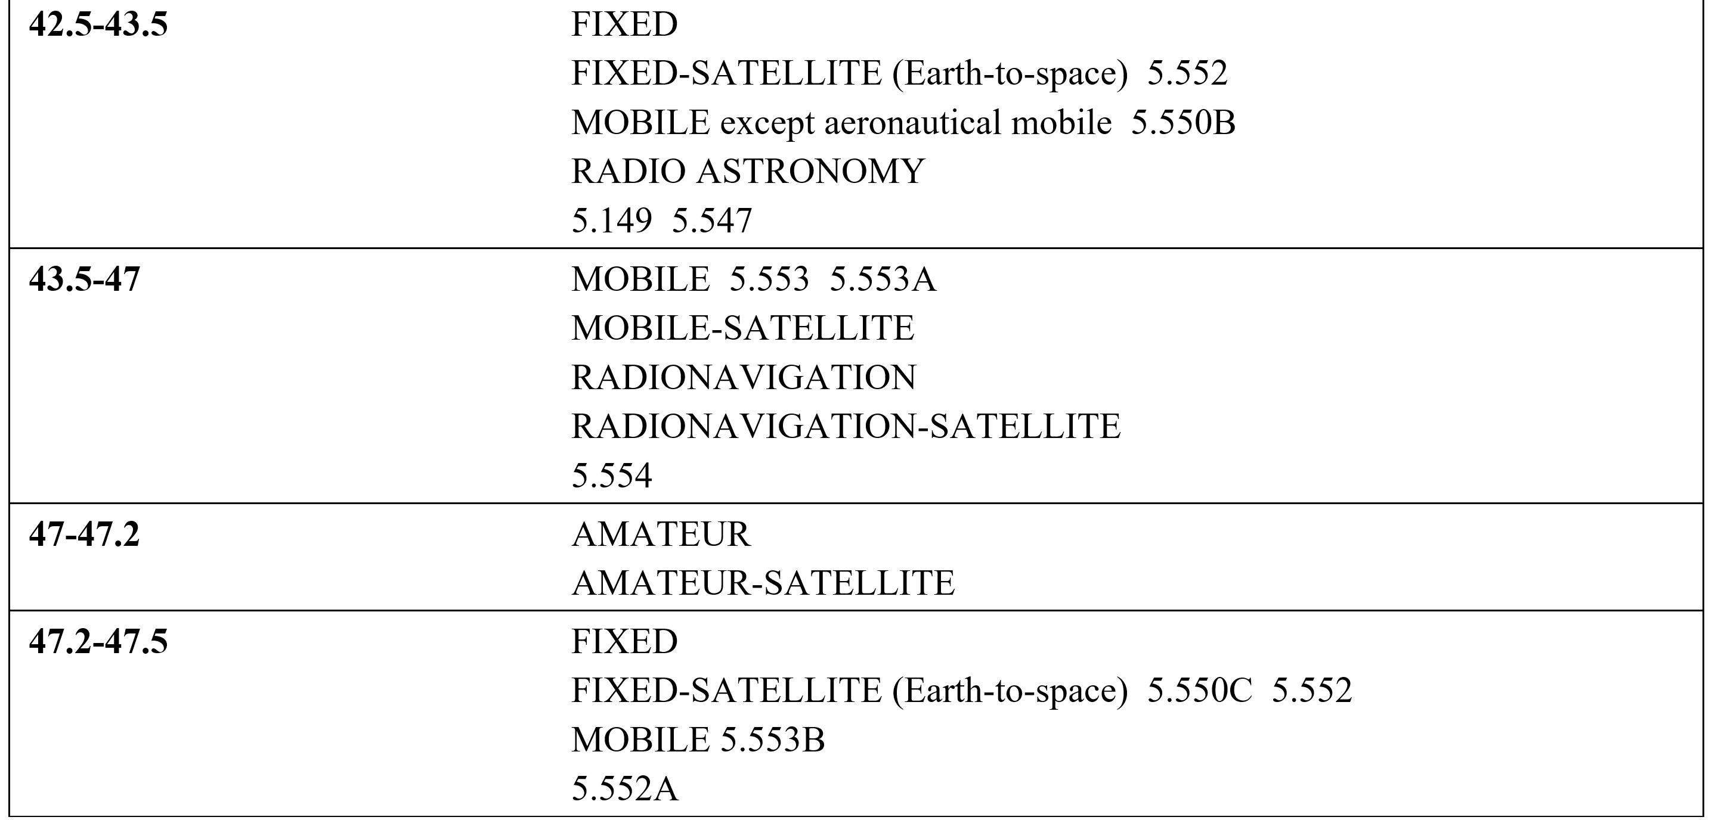
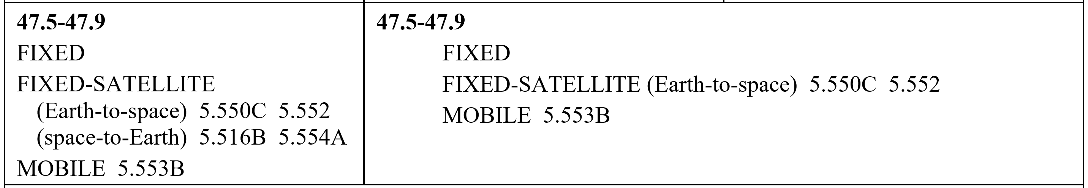
First Look: 45 GHz (42.5 – 48 GHz) ITU-R
5.552 The allocation of the spectrum for the fixed-satellite service in the bands 42.5-43.5 GHz and 47.2-50.2 GHz for Earth-to-space transmission is greater than that in the band 37.5-39.5 GHz for space-to-Earth transmission in order to accommodate feeder links to broadcasting satellites. Administrations are urged to take all practicable steps to reserve the band 47.2-49.2 GHz for feeder links for the broadcasting-satellite service operating in the band 40.5-42.5 GHz.
5.550B The frequency band 37-43.5 GHz, or portions thereof, is identified for use by administrations wishing to implement the terrestrial component of International Mobile Telecommunications (IMT). This identification does not preclude the use of this frequency band by any application of the services to which it is allocated and does not establish priority in the Radio Regulations. Because of the potential deployment of FSS earth stations within the frequency range 37.5-42.5 GHz and high-density applications in the fixed-satellite service in the frequency bands 39.5-40 GHz in Region 1, 40-40.5 GHz in all Regions and 40.5-42 GHz in Region 2 (see No. 5.516B), administrations should further take into account potential constraints to IMT in these frequency bands, as appropriate. Resolution 243 (WRC 19) applies. (WRC 19)
5.149 In making assignments to stations of other services to which the bands: [only showing band in range]
42.5-43.5 GHz
5.547 The bands 31.8-33.4 GHz, 37-40 GHz, 40.5-43.5 GHz, 51.4-52.6 GHz, 55.78-59 GHz and 64-66 GHz are available for high-density applications in the fixed service (see Resolution 75 (WRC-2000)*). Administrations should take this into account when considering regulatory provisions in relation to these bands. Because of the potential deployment of high-density applications in the fixed-satellite service in the bands 39.5-40 GHz and 40.5-42 GHz (see No. 5.516B), administrations should further take into account potential constraints to high-density applications in the fixed service, as appropriate. (WRC 07)

Slide 15
First Look: 45 GHz (42.5 – 47.9 GHz) ITU-R [2]
5.553 In the bands 43.5-47 GHz and 66-71 GHz, stations in the land mobile service may be operated subject to not causing harmful interference to the space radiocommunication services to which these bands are allocated (see No. 5.43). (WRC 2000)
5.553A In Algeria, Angola, Bahrain, Belarus, Benin, Botswana, Brazil, Burkina Faso, Cabo Verde, Korea (Rep. of), Côte d’Ivoire, Croatia, United Arab Emirates, Estonia, Eswatini, Gabon, Gambia, Ghana, Greece, Guinea, Guinea-Bissau, Hungary, Iran (Islamic Republic of), Iraq, Jordan, Kuwait, Lesotho, Latvia, Liberia, Lithuania, Madagascar, Malawi, Mali, Morocco, Mauritius, Mauritania, Mozambique, Namibia, Niger, Nigeria, Oman, Qatar, Senegal, Seychelles, Sierra Leone, Slovenia, Sudan, South Africa, Sweden, Tanzania, Togo, Tunisia, Zambia and Zimbabwe, the frequency band 45.5-47 GHz is identified for use by administrations wishing to implement the terrestrial component of International Mobile Telecommunications (IMT), taking into account No. 5.553. With respect to the aeronautical mobile service and radionavigation service, the use of this frequency band for the implementation of IMT is subject to agreement obtained under No. 9.21 with concerned administrations and shall not cause harmful interference to, or claim protection from these services. This identification does not preclude the use of this frequency band by any application of the services to which it is allocated and does not establish priority in the Radio Regulations. Resolution 244 (WRC 19) applies. (WRC 19)
5.554 In the bands 43.5-47 GHz, 66-71 GHz, 95-100 GHz, 123-130 GHz, 191.8-200 GHz and 252-265 GHz, satellite links connecting land stations at specified fixed points are also authorized when used in conjunction with the mobile-satellite service or the radionavigation-satellite service. (WRC 2000)
5.550C The use of the frequency bands 37.5-39.5 GHz (space-to-Earth), 39.5-42.5 GHz (space to Earth), 47.2-50.2 GHz (Earth-to-space) and 50.4-51.4 GHz (Earth-to-space) by a non-geostationary satellite system in the fixed-satellite service is subject to the application of the provisions of No. 9.12 for coordination with other non-geostationary-satellite systems in the fixed-satellite service but not with non-geostationary-satellite systems in other services. Resolution 770 (WRC 19) shall also apply, and No. 22.2 shall continue to apply. (WRC 19)
5.552 The allocation of the spectrum for the fixed-satellite service in the bands 42.5-43.5 GHz and 47.2-50.2 GHz for Earth-to-space transmission is greater than that in the band 37.5-39.5 GHz for space-to-Earth transmission in order to accommodate feeder links to broadcasting satellites. Administrations are urged to take all practicable steps to reserve the band 47.2-49.2 GHz for feeder links for the broadcasting-satellite service operating in the band 40.5-42.5 GHz.
5.553B In Region 2 and Algeria, Angola, Saudi Arabia, Australia, Bahrain, Benin, Botswana, Burkina Faso, Burundi, Cameroon, Central African Rep., Comoros, Congo (Rep. of the), Korea (Rep. of), Côte d’Ivoire, Djibouti, Egypt, United Arab Emirates, Eswatini, Ethiopia, Gabon, Gambia, Ghana, Guinea, Guinea-Bissau, Equatorial Guinea, India, Iran (Islamic Republic of), Iraq, Japan, Jordan, Kenya, Kuwait, Lesotho, Liberia, Libya, Lithuania, Madagascar, Malaysia, Malawi, Mali, Morocco, Mauritius, Mauritania, Mozambique, Namibia, Niger, Nigeria, Oman, Uganda, Qatar, the Syrian Arab Republic, the Dem. Rep. of the Congo, Rwanda, Sao Tome and Principe, Senegal, Seychelles, Sierra Leone, Singapore, Slovenia, Somalia, Sudan, South Sudan, South Africa, Sweden, Tanzania, Chad, Togo, Tunisia, Zambia and Zimbabwe, the frequency band 47.2-48.2 GHz is identified for use by administrations wishing to implement International Mobile Telecommunications (IMT). This identification does not preclude the use of this frequency band by any application of the services to which it is allocated, and does not establish any priority in the Radio Regulations. Resolution 243 (WRC 19) applies. (WRC-19)
5.552A The allocation to the fixed service in the frequency bands 47.2-47.5 GHz and 47.9-48.2 GHz is identified for use by high-altitude platform stations (HAPS). This identification does not preclude the use of this frequency band by any application of the services to which it is allocated on a co-primary basis, and does not establish priority in the Radio Regulations. Such use of the fixed-service allocation in the frequency bands 47.2-47.5 GHz and 47.9-48.2 GHz by HAPS shall be in accordance with the provisions of Resolution 122 (Rev.WRC 19). (WRC 19)
5.516B The following bands are identified for use by high-density applications in the fixed-satellite service: [only showing band in range]
47.5-47.9 GHz (space-to-Earth) in Region 1
5.554A The use of the bands 47.5-47.9 GHz, 48.2-48.54 GHz and 49.44-50.2 GHz by the fixed-satellite service (space-to-Earth) is limited to geostationary satellites. (WRC-03)

Slide 16
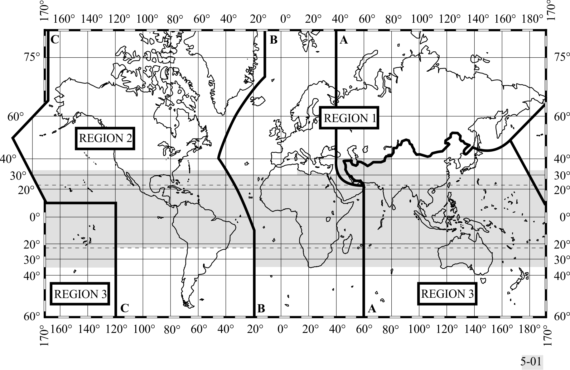
The ITU-R Region Map
5.16 1) The “Tropical Zone” (see map in No. 5.2) is defined as:
5.17 a) the whole of that area in Region 2 between the Tropics of Cancer and Capricorn;
5.18 b) the whole of that area in Regions 1 and 3 contained between the parallels 30° North and 35° South with the addition of:
5.19 i) The area contained between the meridians 40° East and 80° East of Greenwich and the parallels 30° North and 40° North;
5.20 ii) that part of Libya north of parallel 30° North.
5.21 2) In Region 2, the Tropical Zone may be extended to parallel 33° North, subject to special agreements between the countries concerned in that Region (see Article 6).
The shaded part represents the Tropical Zones as defined in Nos. 5.16 to 5.20 and 5.21

Slide 17
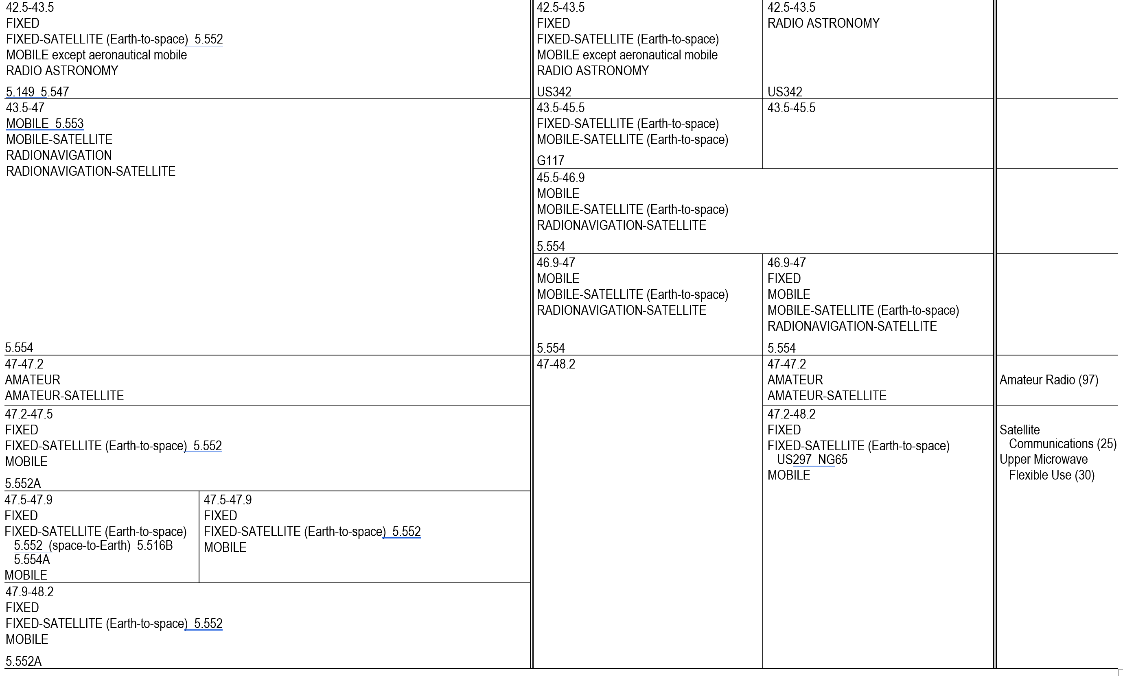
First Look: 45 GHz (42.5 – 48.2 GHz) FCC
5.552 The allocation of the spectrum for the fixed-satellite service in the bands 42.5-43.5 GHz and 47.2 50.2 GHz for Earth-to-space transmission is greater than that in the band 37.5-39.5 GHz for space to-Earth transmission in order to accommodate feeder links to broadcasting satellites. Administrations are urged to take all practicable steps to reserve the band 47.2-49.2 GHz for feeder links for the broadcasting-satellite service operating in the band 40.5-42.5 GHz.
5.149 In making assignments to stations of other services to which the bands:
42.5-43.5 GHz
5.547 The bands 31.8-33.4 GHz, 37-40 GHz, 40.5-43.5 GHz, 51.4-52.6 GHz, 55.78-59 GHz and 64 66 GHz are available for high-density applications in the fixed service (see Resolution 75 (WRC 12)). Administrations should take this into account when considering regulatory provisions in relation to these bands. Because of the potential deployment of high-density applications in the fixed-satellite service in the bands 39.5-40 GHz and 40.5-42 GHz (see No. 5.516B), administrations should further take into account potential constraints to high-density applications in the fixed service, as appropriate. (FCC)
US342 In making assignments to stations of other services to which the bands:
42.77-42.87 GHz, 43.07-43.17 GHz, 43.37-43.47 GHz
5.553 In the bands 43.5-47 GHz and 66-71 GHz, stations in the land mobile service may be operated subject to not causing harmful interference to the space radiocommunication services to which these bands are allocated (see No. 5.43).
5.554 In the bands 43.5-47 GHz, 66-71 GHz, 95-100 GHz, 123-130 GHz, 191.8-200 GHz and 252 265 GHz, satellite links connecting land stations at specified fixed points are also authorized when used in conjunction with the mobile-satellite service or the radionavigation-satellite service.

Slide 18
First Look: 45 GHz (42.5 – 48.2 GHz) FCC [2]
5.552 The allocation of the spectrum for the fixed-satellite service in the bands 42.5-43.5 GHz and 47.2 50.2 GHz for Earth-to-space transmission is greater than that in the band 37.5-39.5 GHz for space to-Earth transmission in order to accommodate feeder links to broadcasting satellites. Administrations are urged to take all practicable steps to reserve the band 47.2-49.2 GHz for feeder links for the broadcasting-satellite service operating in the band 40.5-42.5 GHz.
5.552A The allocation to the fixed service in the bands 47.2-47.5 GHz and 47.9-48.2 GHz is designated for use by high altitude platform stations. The use of the bands 47.2-47.5 GHz and 47.9 48.2 GHz is subject to the provisions of Resolution 122 (Rev.WRC 07). (WRC-07)
5.554A The use of the bands 47.5-47.9 GHz, 48.2-48.54 GHz and 49.44-50.2 GHz by the fixed-satellite service (space-to-Earth) is limited to geostationary satellites.
US297 The bands 47.2-49.2 GHz and 81-82.5 GHz are also available for feeder links for the broadcasting-satellite service.
NG65 In the bands 24.75-25.25 GHz, 47.2-48.2 GHz, and 50.4-51.4 GHz, stations in the fixed and mobile services may not claim protection from individually licensed earth stations authorized pursuant to 47 CFR 25.136. However, nothing in this footnote shall limit the right of Upper Microwave Flexible Use Service licensees to operate in conformance with the technical rules contained in 47 CFR part 30. The Commission reserves the right to monitor developments and to undertake further action concerning interference between Upper Microwave Flexible Use Service and Fixed-Satellite Service, including aggregate interference to satellite receivers, if appropriate.

Slide 19
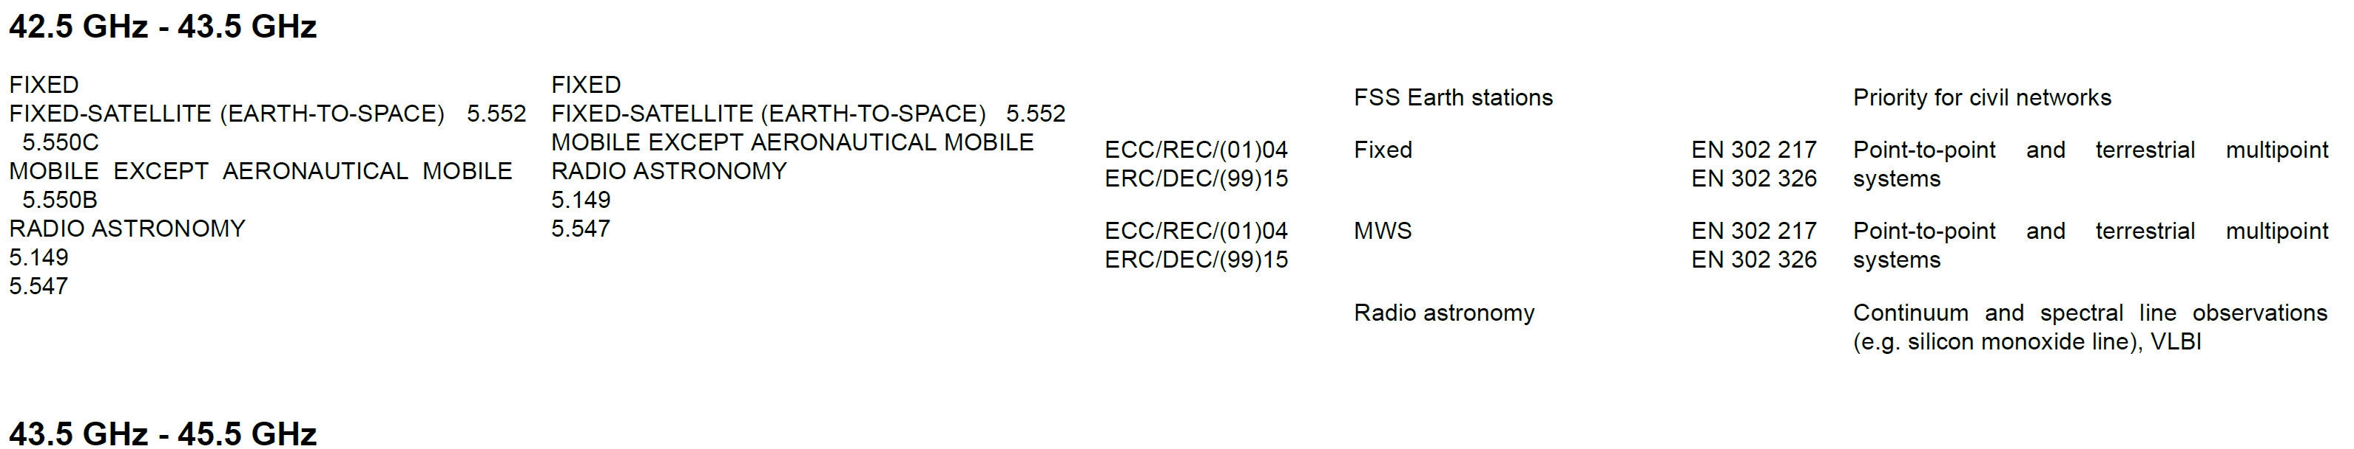
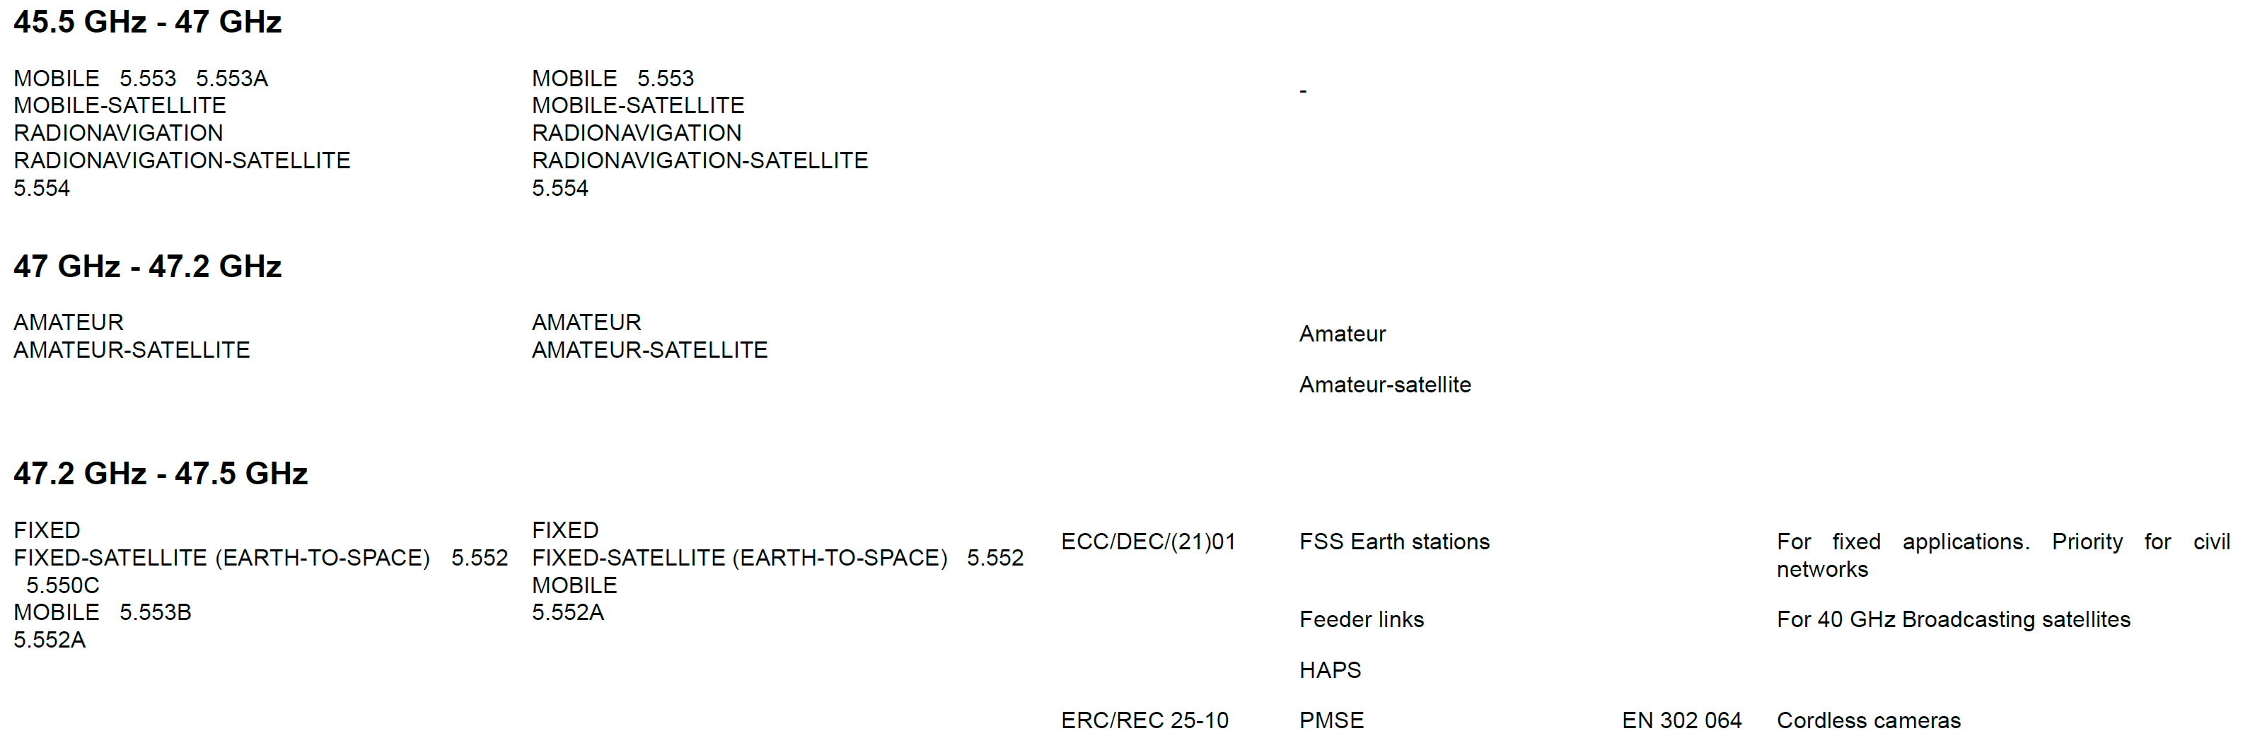
First Look: 45 GHz (42.5 – 47.9 GHz) ECC
5.552 The allocation of the spectrum for the fixed-satellite service in the bands 42.5-43.5 GHz and 47.2-50.2 GHz for Earth-to-space transmission is greater than that in the band 37.5-39.5 GHz for space-to-Earth transmission in order to accommodate feeder links to broadcasting satellites. Administrations are urged to take all practicable steps to reserve the band 47.2-49.2 GHz for feeder links for the broadcasting-satellite service operating in the band 40.5-42.5 GHz.
5.550C The use of the frequency bands 37.5-39.5 GHz (space-to-Earth), 39.5-42.5 GHz (space to Earth), 47.2-50.2 GHz (Earth-to-space) and 50.4-51.4 GHz (Earth-to-space) by a non-geostationary satellite system in the fixed-satellite service is subject to the application of the provisions of No. 9.12 for coordination with other non-geostationary-satellite systems in the fixed-satellite service but not with non-geostationary-satellite systems in other services. Resolution 770 (WRC 19) shall also apply, and No. 22.2 shall continue to apply. (WRC 19)
5.550B The frequency band 37-43.5 GHz, or portions thereof, is identified for use by administrations wishing to implement the terrestrial component of International Mobile Telecommunications (IMT). This identification does not preclude the use of this frequency band by any application of the services to which it is allocated and does not establish priority in the Radio Regulations. Because of the potential deployment of FSS earth stations within the frequency range 37.5-42.5 GHz and high-density applications in the fixed-satellite service in the frequency bands 39.5-40 GHz in Region 1, 40-40.5 GHz in all Regions and 40.5-42 GHz in Region 2 (see No. 5.516B), administrations should further take into account potential constraints to IMT in these frequency bands, as appropriate. Resolution 243 (WRC 19) applies. (WRC 19)
5.149 In making assignments to stations of other services to which the bands: [only showing band in range]
42.5-43.5 GHz

Slide 20
First Look: 45 GHz (42.5 – 47.9 GHz) ECC [2]
5.149 In making assignments to stations of other services to which the bands: 13360-13410 kHz, 25550-25670 kHz, 37.5-38.25 MHz, 73-74.6 MHz in Regions 1 and 3, 150.05-153 MHz in Region 1, 322-328.6 MHz, 406.1-410 MHz, 608-614 MHz in Regions 1 and 3, 1330-1400 MHz, 1610.6-1613.8 MHz, 1660-1670 MHz, 1718.8-1722.2 MHz, 2655-2690 MHz, 3260-3267 MHz, 3332-3339 MHz, 3345.8-3352.5 MHz, 4825-4835 MHz, 4950-4990 MHz, 4990-5000 MHz, 6650-6675.2 MHz, 10.6-10.68 GHz, 14.47-14.5 GHz, 22.01-22.21 GHz, 22.21-22.5 GHz, 22.81-22.86 GHz, 23.07-23.12 GHz, 31.2-31.3 GHz, 31.5-31.8 GHz in Regions 1 and 3, 36.43-36.5 GHz, 42.5-43.5 GHz, 48.94-49.04 GHz, 76-86 GHz, 92-94 GHz, 94.1-100 GHz, 102-109.5 GHz, 111.8-114.25 GHz, 128.33-128.59 GHz, 129.23-129.49 GHz, 130-134 GHz, 136-148.5 GHz, 151.5-158.5 GHz, 168.59-168.93 GHz, 171.11-171.45 GHz, 172.31-172.65 GHz, 173.52-173.85 GHz, 195.75-196.15 GHz, 209-226 GHz, 241-250 GHz, 252-275 GHz are allocated, administrations are urged to take all practicable steps to protect the radio astronomy service from harmful interference. Emissions from spaceborne or airborne stations can be particularly serious sources of interference to the radio astronomy service (see Nos. 4.5 and 4.6 and Article 29). (WRC-07)
5.547 The bands 31.8-33.4 GHz, 37-40 GHz, 40.5-43.5 GHz, 51.4-52.6 GHz, 55.78-59 GHz and 64-66 GHz are available for high-density applications in the fixed service (see Resolution 75 (WRC-2000)*). Administrations should take this into account when considering regulatory provisions in relation to these bands. Because of the potential deployment of high-density applications in the fixed-satellite service in the bands 39.5-40 GHz and 40.5-42 GHz (see No. 5.516B), administrations should further take into account potential constraints to high-density applications in the fixed service, as appropriate. (WRC 07)
5.553 In the bands 43.5-47 GHz and 66-71 GHz, stations in the land mobile service may be operated subject to not causing harmful interference to the space radiocommunication services to which these bands are allocated (see No. 5.43). (WRC 2000)
5.553A In Algeria, Angola, Bahrain, Belarus, Benin, Botswana, Brazil, Burkina Faso, Cabo Verde, Korea (Rep. of), Côte d’Ivoire, Croatia, United Arab Emirates, Estonia, Eswatini, Gabon, Gambia, Ghana, Greece, Guinea, Guinea-Bissau, Hungary, Iran (Islamic Republic of), Iraq, Jordan, Kuwait, Lesotho, Latvia, Liberia, Lithuania, Madagascar, Malawi, Mali, Morocco, Mauritius, Mauritania, Mozambique, Namibia, Niger, Nigeria, Oman, Qatar, Senegal, Seychelles, Sierra Leone, Slovenia, Sudan, South Africa, Sweden, Tanzania, Togo, Tunisia, Zambia and Zimbabwe, the frequency band 45.5-47 GHz is identified for use by administrations wishing to implement the terrestrial component of International Mobile Telecommunications (IMT), taking into account No. 5.553. With respect to the aeronautical mobile service and radionavigation service, the use of this frequency band for the implementation of IMT is subject to agreement obtained under No. 9.21 with concerned administrations and shall not cause harmful interference to, or claim protection from these services. This identification does not preclude the use of this frequency band by any application of the services to which it is allocated and does not establish priority in the Radio Regulations. Resolution 244 (WRC 19) applies. (WRC 19)
5.554 In the bands 43.5-47 GHz, 66-71 GHz, 95-100 GHz, 123-130 GHz, 191.8-200 GHz and 252-265 GHz, satellite links connecting land stations at specified fixed points are also authorized when used in conjunction with the mobile-satellite service or the radionavigation-satellite service. (WRC 2000)
ECA36 A frequency band, which has been harmonised by NATO and NATO member nations for military use as defined in the NATO Joint Civil/Military Frequency Agreement (NJFA) 2014. Note: NATO Joint Civil/Military Frequency Agreement (NJFA) – Extract for Public Disclosure – 14 February 2017
5.552A The allocation to the fixed service in the frequency bands 47.2-47.5 GHz and 47.9-48.2 GHz is identified for use by high-altitude platform stations (HAPS). This identification does not preclude the use of this frequency band by any application of the services to which it is allocated on a co-primary basis, and does not establish priority in the Radio Regulations. Such use of the fixed-service allocation in the frequency bands 47.2-47.5 GHz and 47.9-48.2 GHz by HAPS shall be in accordance with the provisions of Resolution 122 (Rev.WRC 19). (WRC 19)
5.516B The following bands are identified for use by high-density applications in the fixed-satellite service: 17.3-17.7 GHz (space-to-Earth) in Region 1, 18.3-19.3 GHz (space-to-Earth) in Region 2, 19.7-20.2 GHz (space-to-Earth) in all Regions, 39.5-40 GHz (space-to-Earth) in Region 1, 40-40.5 GHz (space-to-Earth) in all Regions, 40.5-42 GHz (space-to-Earth) in Region 2, 47.5-47.9 GHz (space-to-Earth) in Region 1, 48.2-48.54 GHz (space-to-Earth) in Region 1, 49.44-50.2 GHz (space-to-Earth) in Region 1, and 27.5-27.82 GHz (Earth-to-space) in Region 1, 28.35-28.45 GHz (Earth-to-space) in Region 2, 28.45-28.94 GHz (Earth-to-space) in all Regions, 28.94-29.1 GHz (Earth-to-space) in Region 2 and 3, 29.25-29.46 GHz (Earth-to-space) in Region 2, 29.46-30 GHz (Earth-to-space) in all Regions, 48.2-50.2 GHz (Earth-to-space) in Region 2. ART5 – 37 – This identification does not preclude the use of these frequency bands by other fixed-satellite service applications or by other services to which these frequency bands are allocated on a co-primary basis and does not establish priority in these Radio Regulations among users of the frequency bands. Administrations should take this into account when considering regulatory provisions in relation to these frequency bands. See Resolution 143 (Rev.WRC-19). (WRC-19)

Slide 21
Next Steps
Acquire China regulatory data for these bands
Begin the review looking for obvious trouble spots, i.e., allocations that we may not be able to share with
Add the 60 GHz band (57 – 71 GHz)

Slide 22
Recommendations?
Process
  Two documents: 45 GHz and 60 GHz
  Collecting information
  Determination of complexity for global acceptance
Document to be the final outcomes of the studies
  Results of studies
  Recommendations for each band

Slide 23
Volunteers?
Edward – China regulations

Slide 24
References
ITU-R Radio Regulations
  https://www.itu.int/pub/R-REG-RR
US FCC Table of Frequencies
  https://transition.fcc.gov/oet/spectrum/table/fcctable.docx
European Table of Frequency Allocations
  https://efis.cept.org/ [search by frequency, country, etc.]
  https://efis.cept.org/sitecontent.jsp?sitecontent=ecatable
European National Frequency Tables
  https://efis.cept.org/views2/national_frequency_table.jsp

