Slide 1
IEEE 802.18 RR-TAG
Recent liaison from ETSI TC ERM related to the worldwide UWB regulation
Date: 12 July 2022
Authors:

Slide 2
European Regulatory Framework
National administrations
CEPT & ECC
European Parliament and Commission
ETSI

Slide 3
National administrations
Spectrum regulations are a national authority
Voluntary coordination between 48(-2) countries in CEPT/ECC
Single market member states shall implement Directives from the European Parliament and Decisions from the European Commission

Slide 4
CEPT & ECC
CEPT - European Conference of Postal and Telecommunications Administrations
ECC – Electronic Communications Committee
Coordination between national administrations
  WG-SE (spectrum engineering)
  WG-FM (frequency management)
ECC Decisions and Recommendations
ECC Reports, CEPT Reports

Slide 5
UWB in CEPT
ECC Decisions and Recommendations
  ECC/DEC/(06)04,
  ECC/DEC/(07)01,
  ECC/REC/(11)02
ECC and CEPT Reports
  See https://docdb.cept.org/
Currently: Public consultation on draft revision of ECC/DEC/(06)04 and draft ECC/DEC/(22)03
  (deadline 11 August)

Slide 6
European Commission and Parliament
European Parliament Directives
  Radio Equipment Directive (RED), EMC Directive (EMCD), Low Voltage Directive (LVD)
European Commission Decisions
  Commission Implementing Decision (EU) 2019/785 on the harmonisation of radio spectrum for equipment using ultra-wideband technology
Mandates to CEPT/ECC and ETSI
  Permanent Mandate to CEPT to identify the technical conditions relating to the harmonised introduction of radio applications based on Ultra-Wideband (UWB) technology

Slide 7
ETSI
European Telecommunications Standards Institute
European Standards Organization (ESO) responsible for Information and Communication Technologies
Provides European Standards (ENs) to support EU legislation and policies
Harmonised Standards - presumption of conformity if listed in OJEU

Slide 8
ETSI TC ERM
Technical Committee EMC and Radio spectrum Matters
Standards for radio products and EMC
Coordination on radio spectrum matters

Slide 9
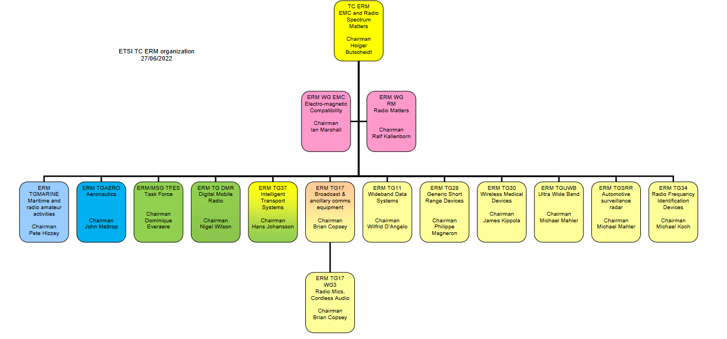
ETSI TC ERM Organigram

Slide 10
ETSI TC ERM TGUWB
Revision of Harmonised Standards
  UWB below 10.6 GHz (EN 302 065 series)
  (Tank) Level Probing Radar (EN 302 372, EN 302 729 series)
  Ground Probing Radar (EN 302 066)
  Short Range Devices in 40 GHz to 260 GHz (EN 305 550 series)
  Security scanners
Supporting Technical Specifications (TS) and Reports (TR)
  Including System Reference Documents

Slide 11
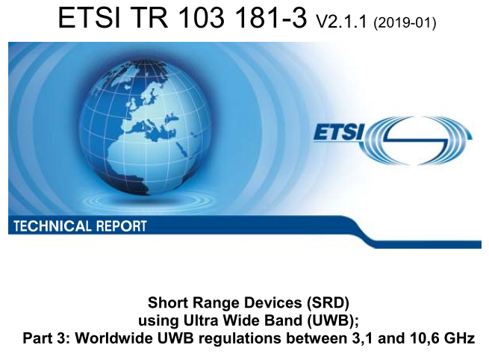

Slide 12
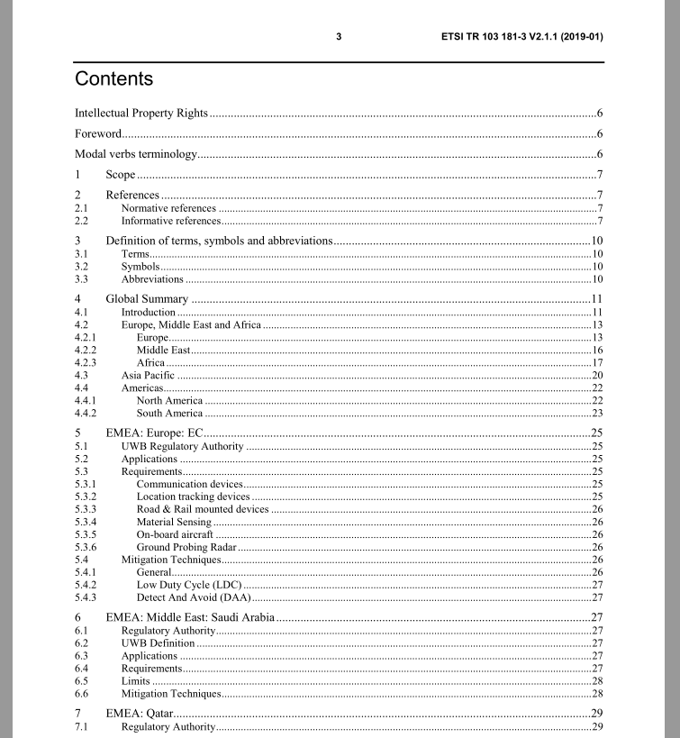
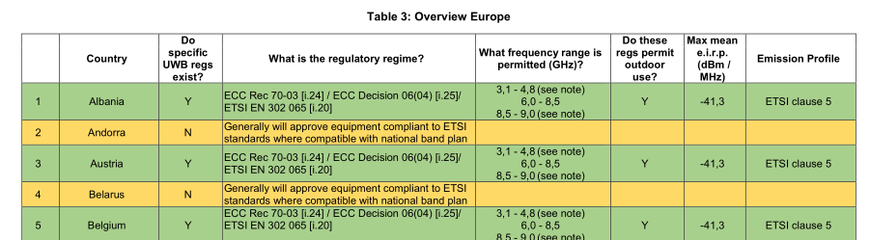

Slide 13
UWB Alliance growth projection

Slide 14
TR 103 181-3 revision
ETSI TGUWB work item RTR/ERM-TGUWB-611
Liaison statements via ETSI TC ERM:
  ITU
  APT
  CITEL
  ATU
  IEEE 802.18: see 802.18-22/0060r0

Slide 15
Liaison Statement Extract
ETSI TC ERM TGUWB has previously published ETSI TR 103 181-3 (V2.1.1, 2019-01), an overview of UWB regulations between 3.1 – 10.6 GHz worldwide. Since then, many states have introduced UWB regulations. In this context, ETSI TC ERM TGUWB is now working on a revision of TR 103 181-3 and we would appreciate if any IEEE member could contribute to this revision.
From our side, ETSI TC ERM TGUWB would be happy to provide any information you may require on the applicable CEPT/EC spectrum regulations and the corresponding ETSI standards. We will also inform you once the revision of TR 103 181-3 has been published.
(see 802.18-22/0060r0)

