Slide 1
IEEE 802.18 RR-TAG
Weekly Teleconference Agenda
Date: 17 February 2022
Authors:

Slide 2
Call to Order / Administrative Items
Officers for the RR-TAG / IEEE 802.18:
  Chair is Jay Holcomb (Itron)
  Co-Vice-chairs are Al Petrick (Skyworks Solutions) and Stuart Kerry (OK-Brit/Self)
  Secretary, need someone
Voters: 40 (8 on LMSC); Nearly Voters: 6; Aspirant members: 5
  A quorum is met since this is an announced Wireless Interim and Thursdays 15:00et meetings were announced more than 45 days ago.
IEEE 802.18, RR-TAG website: https://www.ieee802.org/18/
IEEE 802 Required notices:
  Affiliation - http://standards.ieee.org/faqs/affiliationFAQ.html
> Be sure to announce you name, affiliation, employer and clients the first time you speak.
  Anti-Trust - http://standards.ieee.org/resources/antitrust-guidelines.pdf
  IEEE 802 WG Policies and Procedures - http://www.ieee802.org/devdocs.shtml
  Patent & administration slides, → jun21 https://standards.ieee.org/about/sasb/patcom/materials.html
  Copyright notice slides, → nov19 https://standards.ieee.org/faqs/copyrights/index.html#1
  (note; call for essential patents & copy right notice: the RR-TAG does not do standards, though all should be aware.)
  For reference: IEEE-SA Standards Board Operations Manual is available at: http://standards.ieee.org/develop/policies/opman/sb_om.pdf
  https://standards.ieee.org/about/sasb/patcom/materials.html

Slide 3
Other Guidelines for IEEE WG Meetings
All IEEE-SA standards meetings shall be conducted in compliance with all applicable laws, including antitrust and competition laws.
  Don’t discuss the interpretation, validity, or essentiality of patents/patent claims.
  Don’t discuss specific license rates, terms, or conditions.
    Relative costs of different technical approaches that include relative costs of patent licensing terms may be discussed in standards development meetings.
      Technical considerations remain the primary focus
  Don’t discuss or engage in the fixing of product prices, allocation of customers, or division of sales markets.
  Don’t discuss the status or substance of ongoing or threatened litigation.
  Don't be silent if inappropriate topics are discussed. Formally object to the discussion immediately.
---------------------------------------------------------------
For more details, see IEEE-SA Standards Board Operations Manual, clause 5.3.10 and
Antitrust and Competition Policy: What You Need to Know at http://standards.ieee.org/develop/policies/antitrust.pdf
Notes:
3

Slide 4
Participant behavior in IEEE-SA activities is guided by the IEEE Codes of Ethics & Conduct
All participants in IEEE-SA activities are expected to adhere to the core principles underlying the:
  IEEE Code of Ethics
  IEEE Code of Conduct
The core principles of the IEEE Codes of Ethics & Conduct are to:
  Uphold the highest standards of integrity, responsible behavior, and ethical and professional conduct
  Treat people fairly and with respect, to not engage in harassment, discrimination, or retaliation, and to protect people's privacy.
  Avoid injuring others, their property, reputation, or employment by false or malicious action
The most recent versions of these Codes are available at http://www.ieee.org/about/corporate/governance

Slide 5
Participants in the IEEE-SA “individual process” shall act independently of others, including employers
The IEEE-SA Standards Board Bylaws require that “participants in the IEEE standards development individual process shall act based on their qualifications and experience”
This means participants:
  Shall act & vote based on their personal & independent opinions derived from their expertise, knowledge, and qualifications
  Shall not act or vote based on any obligation to or any direction from any other person or organization, including an employer or client, regardless of any external commitments, agreements, contracts, or orders
  Shall not direct the actions or votes of other participants or retaliate against other participants for fulfilling their responsibility to act & vote based on their personal & independently developed opinions
By participating in standards activities using the “individual process”, you are deemed to accept these requirements; if you are unable to satisfy these requirements then you shall immediately cease any participation (and would ask you to please leave the call or meeting.)

Slide 6
IEEE-SA standards activities shall allow the fair & equitable consideration of all viewpoints
The IEEE-SA Standards Board Bylaws (clause 5.2.1.3) specifies that “the standards development process shall not be dominated by any single interest category, individual, or organization”
– This means no participant may exercise “authority, leadership, or influence by reason of superior leverage, strength, or representation to the exclusion of fair and equitable consideration of other viewpoints” or “to hinder the progress of the standards development activity”
This rule applies equally to those participating in a standards development project and to that project’s leadership group
Any person who reasonably suspects that dominance is occurring in a standards development project is encouraged to bring the issue to the attention of the Standards Committee or the project’s IEEE-SA Program Manager

Slide 7
Agenda
Call to Order
  Attendance is not on IMAT (VC & webex)
  Remember to mute when not speaking, thanks.
  Please request Q in the chat window.
Administrative items
  Someone to take some notes, _Peter E_
  Attendance & monitor chat window, Stuart K
Approve agenda, last minutes then administration items
Discussion items
  EU Items
  Other Regions Items
  ITU-R Items
  General Discussion Items
Actions required
  Anything new today
  ongoing: WRC-23 AI Viewpoints & Stds. freq. table fill in
AOB
Adjourn
Discussion items, few more details:
EU Items
  BRAN update
  General items, ETSI, CEPT, etc.
Other Regions Items
  General items,
ITU-R Items
  General items
  ongoing: IEEE 802 viewpoints on WRC-23 AIs
General discussion items
  ongoing: 6GHz MSGs & Stds frequency table
note:
Normal input and process has covered USA items as they come up. Please speak up if an item is not brought up.

Slide 8
Administrative – motions and more
Motion: To approve the agenda as presented on previous slide
Moved by: Stuart K
Seconded by: Hassan Y
Discussion? None
  Vote: Approved by unanimous consent
Motion: To approve the minutes in document https://mentor.ieee.org/802.18/dcn/22/18-22-0016-00-0000-minutes-10feb22-rrtag-teleconference.docx 13-Feb-2022 19:27:49 ET, with editorial privilege for the 802.18 chair.
Moved by: Al P
Seconded by: Stuart K
Discussion? None
  Vote: Approved by unanimous consent

Slide 9
Administrative–moving forward
For March 2022 Plenary (was Orlando)
  Decision point was on LMSC/EC call Tuesday/07dec21, and Plenary will stay electronic:
  However, contract negotiations on the March 2022 cancellation will result in a significant penalty fee not anticipated on December 7th, 2021.
  Registration for the March 2022 Plenary was suspended immediately until the new Fee Structure for the plenary to address the high penalty fee was determined this week at the 04jan21 LMSC/EC call.
    $400 until Friday, January 28, 2022 (fully refundable. until January 28th)
    $600 until Friday, February 25, 2022 (refundable w/cancellation fee. January 28th to February 25th)
    $800 after Friday, February 25, 2022 (non-refundable. after February 25th)
    note: Those individuals who had previously registered will be contacted directly by the IEEE 802 EC Executive Secretary for further instructions.
  Plenary info: http://802world.org/plenary/
  Face to Face Registration Website: https://cvent.me/yG5GY2
  Plenary dates to be 04-18 March (Avoids conflict with IEEE-SA Meetings March 22-24.)
    .18 will be our normal weekly times and call-in, Thursday’s 10th and 17th March2022.
For the 8-13 May 2022 Wireless Interim in Warsaw, Poland, the WCSC voted (02feb22) to head in the direction of mixed-mode (9-1-0). More details will be worked on at the 02mar22 WCSC call.

Slide 10
Administrative–elections in March - reminder
LMSC P&P sections 3.1: 802 EC election/appointments
  All 802 executive committee members are elected or appointed and confirmed at the first Plenary session of each even numbered year.
For anyone to be considered for the 802.18 Chair, Vice Chairs or the appointed positions
  Please send nominations or self nominations to the .18 Chair before Wednesday 02 March 2022 - end of day aoe.
  802.18 elections will be at the first 802.18 meeting of the Plenary, 10mar22.
The .18 Chair position is open;
The .18 Vice-Chairs Stuart Kerry and Al Petrick are seeking re-election.
All potential EC members, Chair and Vice Chairs
  Please remember to submit your letters of endorsement and disclosure of affiliation to the IEEE 802 Recording Secretary, John D’Ambrosia, as soon as possible, but no later than the call to order of the March 2022 opening LMSC meeting. (Letters received from Stuart Kerry)
  For Chair, Vice Chair and Secretary, you need to be a member of the IEEE SA
  The TAG/WG chair & vice chairs are subject to confirmation by IEEE 802 EC.
Responsibilities / expectations for all offices are in the back up slides in this slide deck

Slide 11
EU items to share
General EU info: <ojeu> <HStds> https://www.etsi.org/deliver/etsi_en/
Remember – BRAN documents can be found in the 802.11 private area documents (daily refresh)
  for reference, ad hoc meetings can make decisions, rapporteur meetings cannot.
ETSI – <BRAN> next call #113, 04-14feb22 #114 03-10june22, Sophia-Antipolis, FR
  Looks like about 11 ad hocs setup over the next few months. (ad hocs can make decisions)
  10feb: Have been meeting since last Friday, have accepted 16 docs of 39 discussed, all good progress.
    EN 301 893 5 GHz, review basically completed of draft, the quality has greatly improved, thanks to rapporteur.
    The EN 303 687 6GHz std, will benefit from what was done on the 5 GHz update.
    6 GHz 2 topics still going; NBFH (getting settled) and Client to Client comms which a proposal is available. (however still some concern on protection levels, working to overcome.)
      Not seeing it go to ENAP out of this meeting.
    Have advanced on TS 103 754 on mesh comms, close to being ready.
    EN 303 753-3rd 60GHz std, accepted many inputs, not ready for next stage just yet.
    Did received from WGFM just now, spectrum for airplane use for entertainment @5.8GHz. is it still needed? basically, the technology has gone away.
    EC assessment of stds before going to OJEU, still a funding question… Originally was voluntary and did not need to send all stds through them. However, has been treated as mandatory and is out of EC budget Euros,.
      BRAN will turn stds in and give the EC a chance, but will move on even if not assessed, so released but not in OJEU. (generally, from ETSI draft HS + 320 days to publication)
    Monday, 14feb22, is closing plenary - A liaison statement on ITU-R M-1450 recommendation will be addressed,
Notes:
ETSI <ERM> next meeting #74b 23jun21-25oct21, correspondence ; #75 26-29oct21
04mar: ERM sent a Liaison Statement, ERM(21)000006r2, to SE21 on their work on a draft ECC Recommendation on “Receiver resilience to transmission on adjacent frequency ranges” (may add burden to some receivers for limited or no benefit.)
https://portal.etsi.org/tb.aspx?tbid=286&SubTB=286#/50610-contributions
ETSI - ERM - <TG-11> next meeting #57
ETSI – ERM <TG-UWB> next call, meeting #54, 22-23Jul20
nothing to share today
BRAN; Broadband Radio Access Networks
Hiertz GuidoChairmanEricsson GmbH, Eurolab
Zhou HaiVice ChairmanHuawei Tech.(UK) Co., Ltd
Boldy DavidVice ChairmanBROADCOM CORPORATION
Minaev IgorTechnical OfficerETSI
ERM; EMC and Radio Spectrum Matters
Butscheidt HolgerChairmanBMWi
Marshall IanVice ChairmanRuckus
Mouquet AntoineTechnical OfficerETSIVietti GuillermoTechnical OfficerETSIPagnozzi MarcelloTechnical OfficerETSIMinaev IgorTechnical OfficerETSIForina MarlèneSupport AssistantETSISchmidt HeleneSupport AssistantETSI
Mahler MichaelLiaison OfficerROBERT BOSCH GmbH
Chiara DonatellaLiaison OfficerTELECOM ITALIA S.p.A.
Blue ScottLiaison OfficerMicrosoft Europe SARL
Vangeel EdgardLiaison OfficerCisco Systems Belgium
TG-11; Wideband Data Systems note doc drafts are on the ERM page.
Vangeel EdgardChairmanCisco Systems Belgium
Prats JoseSecretaryROBERT BOSCH GmbH
Minaev IgorTechnical OfficerETSI
TG-UWB; Ultra Wide Band
Mahler MichaelChairmanROBERT BOSCH GmbH
Harrington TimothyVice ChairmanUWB Alliance
Neirynck DriesSecretaryDecaWave Ltd
Minaev IgorTechnical OfficerETSI
TG37; Intelligent Transport Systems
Johansson HansChairmanKapsch TrafficCom AB
Lorelli AndreaTechnical OfficerETSI

Slide 12
EU items to share -2
CEPT – <ECC> (and general items) next call #58 28feb-04mar22, web meeting
CEPT – ECC <SE45> next call #15 03-04mar22, web-meeting
  03feb: WI_4 has been assigned on 6425 – 7125 Std. Power
CEPT – ECC <WGFM> next meeting #102 06-10jun22
  10feb: Did not pass along the WI on high power outdoor 6425-7125MHz (different one from above), so pushed to the next meeting, June 2022.
    RF Crossing (French) borders is the reason for the push.
nice site: CEPT 6 GHz status across the countries: https://docdb.cept.org/implementation/16737
  16dec: showing 3 -4 countries note, updating this site is very slow, beware.
Notes:
CEPT–ECC <ECC> 53rd plenary, 30Jun-03Jul, Belgrade, Serbia
CEPT – ECC <SE19> next call #88 30Sep-01Oct21
15jul: Some looking at UWB and fixed services interference mitigation. Sweden is pushing the issue, very political discussion
CEPT – ECC <SE21> next call #113, 14-16Jul21
CEPT–ECC <SE24> next virtual meeting, #M105 10-12Jan22
02sep: Looking at UWB radiodetermination applications in 116 – 260GHz for vehicular use.
15jul: SE-24-UWB working on new regulations by end of year for >6GHz. Includes items, fixed outdoor, okay in vehicles, higher power (-31.2dBm/MHz indoor), etc. See ECC report 327. This could be significant changes. More to come.
ECC Report 316: Sharing studies assessing short-term interference from Wireless Access Systems including Radio Local Area Networks (WAS/RLAN) into Fixed Service in the frequency band 5925-6425 MHz
ECC Report 302 - Sharing and compatibility studies related to Wireless Access Systems including Radio Local Area Networks (WAS/RLAN) in the frequency band 5925-6425 MHz
Report from CEPT to the European Commission in response to the Mandate
“to study feasibility and identify harmonised technical conditions for Wireless Access Systems including Radio Local Area Networks in the 5925-6425 MHz band for the provision of wireless broadband services”
CEPT Report B on WAS/RLAN use in 5 925-6 425 MHz band , harmonised technical conditions
Task 2: Harmonised technical parameters for WAS/RLANs operating on a coexistence basis with appropriate mitigation techniques and/or operational compatibility/coexistence conditions, operating on the basis of a general authorisation.
CEPT Report A: Assessment and study of compatibility and coexistence scenarios in the band 5925-6425 MHz
ECC - ELECTRONIC COMMUNICATIONS COMMITTEE
The ECC considers and develops policies on electronic communications activities in European context, taking account of European and international legislations and regulations.
ECO -EUROPEAN COMMUNICATIONS OFFICE
ECO provides advice and support to CEPT to help it to develop and deliver its policies and decisions in an effective and transparent way.
SE 45 - WAS/RLANs in the frequency band 5925 – 6425 MHz
Chairman Ivica Stevanovic Federal Office of Communications OFCOM
ECO contact Doriana Guiducci
FM 57 - WAS/RLAN above 5 GHz
Chairman Stephen Talbot Ofcom
ECO contact Doriana Guiducci
(SE45-specs; FM57-policies and EC decisions; have different regulators between them)
The ECC Working Group Spectrum Engineering (WG SE) is responsible for developing technical guidelines and sharing and compatibility arrangements for radio spectrum use by various radiocommunications services using the same or different frequency bands respectively.
Chairman Jerome Andre Agence Nationale des Fréquences
Vice Chairman Ivica Stevanovic Federal Office of Communications OFCOM
Vice Chairman Krunoslav Bejuk HAKOM
Secretary Technical Rabie Oularbi Agence Nationale des Fréquences
The ECC's Working Group Frequency Management (WG FM) is responsible for developing strategies, plans and implementation advice for the management of the radio spectrum.
Chairman Thomas Weilacher BNetzA
Vice Chairman Stephen Talbot Ofcom
Vice Chairman Vincent Durepaire ANFR
Secretary Technical Silvio Schwarz BNetzA
Secretary Administrative Ali Daheur Bundesnetzagentur
ECO contact Robin Donoghue ECO

Slide 13
Other regions (outside EU-Stds and USA), items to share
UK-Ofcom Discussion paper: Ofcom’s future approach to mobile markets
  Start: 09 February 2022; Status: Open ; End: 08 April 2022; this is the big one, heading toward 6G
  https://www.ofcom.org.uk/consultations-and-statements/category-3/ofcoms-future-approach-to-mobile-markets
  It includes 5 different files, they are zip’d up in:
  https://mentor.ieee.org/802.18/dcn/22/18-22-0019-00-0000-uk-ofcom-mobile-strategy-consultation.zip
Anything else to share today? none heard

Slide 14
ITU-R items to share -
Anything to share today?
      10feb: Looking toward WRC-23: The next CTEL is on 25-29 April – hosted by Mexico
        FCC WAC meets next week, to look at a couple of USA draft proposals on AI 1.2; 3, 6 (top ½ of the band) and 10 GHz for IMT identification.
          Proposal is no change for the 6 GHz band, 6425 -7125.
        Region 1 - 6425-7125 MHZ, different countries/telcoms looking what they need, may not follow recommendations.
        Region 2, 3 study is with 6425-7025 and 7025-7125 MHz.
standing by for this spring (2022): Additional WP 1A light communications and 2 WP 5A submissions from IEEE 802.
ongoing: WRC-23 agenda items, the list is on the ITU-R website at:
    https://www.itu.int/en/ITU-R/study-groups/rcpm/Pages/wrc-23-studies.aspx (updated 26Aug20)
    https://www.itu.int/dms_pub/itu-r/oth/0c/0a/R0C0A00000D0041PDFE.pdf
  https://mentor.ieee.org/802.18/dcn/20/18-20-0107-01-0000-res-811-wrc-19-wrc-23-agenda-items.docx
  IEEE 802 viewpoints on WRC-23 agenda items.
    Doc for viewpoints updated (actions items in notes on this slide):
    https://mentor.ieee.org/802.18/dcn/21/18-21-0039-01-0000-ieee-802-viewpoints-on-wrc-23-agenda-items.pptx
  Sometime, will review actions noted at the July Plenary.
For miscellaneous links for ITU-R , SGs, WPs and calendars, see back up slides later.
Notes:
For miscellaneous links for ITU-R , SGs, WPs and calendars, see back up slides later.
AI 1.2 - We could point to FCC rules now for the unlicensed over the entire band, and other countries are also.
Australia-ACMA, New Zealand-RSM, etc., (and Saudi Arabia (CITC) that is coming… )
Best to add some justification of why FCC and other countries are looking at the entire band for WLAN.
Start by looking at today’s FCC 6 GHz R&O, knowing FNPRMs and updates will be coming over time.
Watch for other countries when they announce rules for the entire 6 GHz band-then look at their filing(s) for their justification.
AI 1.5 - Could SG15.15 help with some input on this one, with some of the bands in the 802.15.4 standard?
The narrow band PHYs in 802.15.4 are in some of these bands and going to be referenced in the 15.15 standard and there is an active SG (moving to TG) working on this standard.
This AI also includes TVWS bands, which .11, .15, .19 and .22 (15.22) are in some of these bands. Could these WGs help with some input on this one?
Send request to .11, .15 (SG15.15 & 15.22 (for .22)) and .19 for any contributions they can provide to help develop IEEE 802 viewpoints on WRC-23 AI 1.5.
AI 10 - Send request to .15 THz SC (active group heading for 802.15.3d revision) for any contributions they can provide to held develop IEEE 802 viewpoints on WRC-23 AI 1.10 – preliminary agenda for future conferences.)
Watch for regulatory bodies working on THz also and how their actions relate to our standards and a possible AI for future WRCs..
WRC-23 agenda items, the list is on the ITU-R website at:
https://www.itu.int/en/ITU-R/study-groups/rcpm/Pages/wrc-23-studies.aspx (updated 26Aug20)
https://www.itu.int/dms_pub/itu-r/oth/0c/0a/R0C0A00000D0041PDFE.pdf
With 18-20/0107, we will over time ID the Agenda Items of interest to IEEE 802, to form viewpoints.
Note: will fill in at end of calls working through the list, when time permits.
Reference:
Updated WRC-23 AI list: https://mentor.ieee.org/802.18/dcn/20/18-20-0107-01-0000-res-811-wrc-19-wrc-23-agenda-items.docx
btw- the initial AIs to consider IEEE 802 viewpoints:
1.1 -800-4 990 MHz and Resolution 223. Connection w/ITS going there?
1.2 -300-3 400MHz, 3 600-3 800MHz, 6 425-7 025MHz, 7 025-7 125MHz and 10.0-10.5GHz for International Mobile Telecommunications (IMT) and resolution 245.
1.5 -470-960 MHz in Region 1-consider possible regulatory actions, Resolution 235.
10 -recommend to the Council items for inclusion in the agenda for the next WRC

Slide 15
General Discussion Items

Slide 16
General Discussion Items – ongoing fyi - MSGs 6 GHz & FCC
1. The WInnforum “6 GHz Committee”, all groups meet every 2 weeks except Incumbent Information, interference and Test & Certification - weekly; some docs: https://6ghz.wirelessinnovation.org/work-group-products
    https://www.wirelessinnovation.org/6ghz-multistakeholder-committee
      1) AFC Functional Specification -WG – includes: Interference-TG, Incumbent Info-TG, security and Protocols 3GPP-TG
      2) AFC Test and Certification-WG
    10feb: AFC lab test .vs. field test, 5 papers on this yesterday; getting 3rd party to run some tests, Discussion includes test vectors, etc. Discussions picking up on what tests will be needed and how it will work, by different entities with different ideas.
2. From the FCC R&O, an informal MSG (“Group”) has also been formed.
  https://groups.wirelessinnovation.org/wg/6MSG/dashboard.
      Work stream 1 - interference protection and resolution (CableLabs, EPRI, Lake Cty, APCO) Meets biweekly, from 28Jan21-10:00 et,
      Work stream 2 - correct incumbent data (ULS) (Comsearch, APCO)
      Work stream 3 - AFC and how it provides protection, etc. (Charter, Google, UTC)
      Overall Co-chairs: NPSTC, UTC, WFA, WISPA.
    10feb: Incumbents want some statements with some documents on the participation and how we got to where the MSG is today – published; the other side has not responded. This will be hard to get consensus.
General:
  03feb: FCC getting inputs and setting up interviews on companies for the AFC accreditation.
  16dec: A public notice is expected in January about work needed on improving the ULS data.

Slide 17
General Discussion Items – ongoing fyi - IEEE 802 Wireless Stds Table of Frequency Ranges
Problem statement
  It is difficult for 802 wireless standards developers to quickly and accurately identify all the frequency bands by the family of 802 wireless standards in a regularly maintained database.
  The primary application is to simplify identification of potential frequency bands for coexistence assessment.
Initial Audiences:
  1) 802 wireless standards developers & 2) 802.19 wireless coexistence working group
Ad hoc calls:
  The spreadsheet is going, always look for latest:
  https://mentor.ieee.org/802.18/dcn/21/18-21-0036-10-0000-frequency-table-template.xlsx
Was touched on at the WCSC 02feb22 call, working on a comment collection from IEEE 802 membership.
From ad hoc call on 11jan22
    Filled in a few spots for 802.11 and added an index column on the main tables.
    Moving forward have copied into a new 2022 document, https://mentor.ieee.org/802.18/dcn/22/18-22-0009-00-0000-ieee-802-wireless-standards-table-of-frequency-ranges.xlsx
    And, working on a process to get comment collection on the spreadsheet from other IEEE 802 members.
The next meeting will be 22feb22. (call-in in agenda backup slides)

Slide 18
Actions Required
all – send .18 chair any nominations for chair or vice-chair for 802.18 for next 2 years.
all/anyone – nominations/self nominations for .18 march chair/vice chairs elections to .18 chair by 02mar22
ongoing:
  For IEEE 802 viewpoints on WRC-23 AIs, reach out to those identified, looking for input on the viewpoints.
Proactive Spectrum Sharing – Contact Rich Kennedy if you can help or have inputs or want to join the task force.
Monitor:
  WPT use of license-exempt bands and UWB in cell phones
  Digital Divide, how can we help?
General Info:
  Latest Cisco Annual Internet Report,
    https://www.cisco.com/c/en/us/solutions/executive-perspectives/annual-internet-report/air-highlights.html
  Latest World Economic Outlook. (October’s 2020, twice a year) <click for oct2020 spreadsheet>
  https://www.imf.org/en/Publications/WEO/Issues/2020/09/30/world-economic-outlook-october-2020

Slide 19
Any Other Business

Slide 20
Adjourn
Attendance on-line today: __ and voters on-line: __
Next “weekly” teleconference (sched’d to 19may22): 24feb22 –15:00–<15:55 et
  Call in info: https://mentor.ieee.org/802.18/dcn/16/18-16-0038-20-0000-teleconference-call-in-info.pptx
  Also, see back up slides in this agenda.
  All late changes/cancellations will be sent out to the 802.18 list server.
Overall IEEE 802 schedule: http://ieee802.org/802tele_calendar.html
  or only 802.18: IEEE 802.18 TAG Calendar
Adjourn:
  Any objection to Adjourn.
  None heard, we are Adjourned at 15:__________________55et
The next IEEE 802.18 Plenary will be electronic 4-18March 2022
The next IEEE 802.18 Wireless Interim will be 8-13May 2022, venue direction is mixed-mode.
Thank You

Slide 21
Thank You
Back up and/or previous slides follow

Slide 22
802.18 weekly teleconference call-in, 20jan22-19may22
Subject: [EXTERNAL] Webex meeting invitation: 802.18 RR-TAG weekly teleconference
When: Occurs every Thursday effective 20-Jan-22 until 19-May-22 from 15:00 to 16:00 America/New_York.
Where: https://ieeesa.webex.com/ieeesa/j.php?MTID=m91b36f4c80de69b002c6b1e7296833ef
Jay Holcomb is inviting you to a scheduled Webex meeting.
Occurs every Thursday effective Thursday, January 20, 2022 until Thursday, May 19, 2022 from 3:00 PM to 4:00 PM, (UTC-05:00) Eastern Time (US & Canada)
3:00 PM | (UTC-05:00) Eastern Time (US & Canada) | 1 hr
Join meeting
More ways to join:
Join from the meeting link
https://ieeesa.webex.com/ieeesa/j.php?MTID=m91b36f4c80de69b002c6b1e7296833ef
Join by meeting number
Meeting number (access code): 2348 296 5390
Meeting password: rrtag22a
Tap to join from a mobile device (attendees only)
+1-646-992-2010,,23482965390## United States Toll (New York City)
+1-213-306-3065,,23482965390## United States Toll (Los Angeles)
Join by phone
+1-646-992-2010 United States Toll (New York City)
+1-213-306-3065 United States Toll (Los Angeles)
Global call-in numbers
Join from a video system or application
Dial 23482965390@ieeesa.webex.com
You can also dial 173.243.2.68 and enter your meeting number.
Need help? Go to https://help.webex.com
IMPORTANT NOTICE: Please note that this Webex service allows audio and other information sent during the session to be recorded, which may be discoverable in a legal matter. By joining this session, you automatically consent to such recordings. If you do not consent to being recorded, discuss your concerns with the host or do not join the session.

Slide 23
802.18/19 freq. table ad hoc_telecon. call-in, 22feb-27dec22
Subject: [EXTERNAL] Webex meeting invitation: 802.18-.19 frequency table ad hoc
When: Occurs the fourth Tuesday of every 1 month(s) effective 22-Feb-22 until 27-Dec-22 from 15:00 to 16:00 America/New_York.
Where: https://ieeesa.webex.com/ieeesa/j.php?MTID=m55ca5484c290321aba5a38f8837afa0b
Jay Holcomb is inviting you to a scheduled Webex meeting.
Occurs the fourth Tuesday of every month effective Tuesday, February 22, 2022 until Tuesday, December 27, 2022 from 3:00 PM to 4:00 PM, (UTC-05:00) Eastern Time (US & Canada)
3:00 PM | (UTC-05:00) Eastern Time (US & Canada) | 1 hr
Join meeting
More ways to join:
Join from the meeting link
https://ieeesa.webex.com/ieeesa/j.php?MTID=m55ca5484c290321aba5a38f8837afa0b
Join by meeting number
Meeting number (access code): 2337 483 6851
Meeting password: freqtable8
Tap to join from a mobile device (attendees only)
+1-646-992-2010,,23374836851## United States Toll (New York City)
+1-213-306-3065,,23374836851## United States Toll (Los Angeles)
Join by phone
+1-646-992-2010 United States Toll (New York City)
+1-213-306-3065 United States Toll (Los Angeles)
Global call-in numbers
Join from a video system or application
Dial 23374836851@ieeesa.webex.com
You can also dial 173.243.2.68 and enter your meeting number.
Need help? Go to https://help.webex.com
IMPORTANT NOTICE: Please note that this Webex service allows audio and other information sent during the session to be recorded, which may be discoverable in a legal matter. By joining this session, you automatically consent to such recordings. If you do not consent to being recorded, discuss your concerns with the host or do not join the session.

Slide 24
Responsibilities of WG Chair
3.4.1 Chair
The responsibilities of the Chair or his or her designee shall include
a) Leading the activity according to all of the relevant Policies and Procedures.
b) Being objective.
c) Entertaining motions, but not making motions.
d) Not biasing discussions.
e) Delegating necessary functions.
f) Ensuring that all parties have the opportunity to express their views.
g) Setting goals and deadlines and adhere to them.
h) Being knowledgeable in IEEE standards processes and parliamentary procedures and
ensuring that the processes and procedures are followed.
i) Seeking consensus as a means of resolving issues.
j) Prioritizing work to best serve the group and its goals.
k) Complying with the IEEE-SA Intellectual Property Policies, including but not limited to IEEE-SA Patent Policy (see IEEE-SA Standards Board Operations Manual 6.3.2,
http://standards.ieee.org/board/pat/index.html) and IEEE-SA Copyright Policy (see IEEE-SA Standards Board Bylaws 7, http://standards.ieee.org/guides/bylaws/sect6-
7.html#7).
l) Fulfilling any financial repor ting requirements of the IEEE, in the absence of a Treasurer.
m) Participating as needed in meetings of the Sponsor to represent the Working Group and, in the case of a “Directed Position”, vote the will of the Working Group in accordance with the Directed Position Procedure (See “Procedure for establishing a directed position” subclause of the IEEE 802 LMSC OM [5]).

Slide 25
Responsibilities of WG Chair – cont.
3.4.1 Chair – cont.
n) Being familiar with training materials available through IEEE Standards Development Online.
o) Call meetings and issue a notice for each meeting at least 30 calendar days prior to the meeting
p) Ensure agendas are published at least 14 calendar days before a meeting
q) Ensure important requested documents are issued to members of the Working Group, the Sponsor, and liaison groups.
r) Ensure a membership roster is created and maintained
s) Ensure participant attendance is recorded at each meeting
t) Be responsible for the management and distribution of Working Group documentation in compliance with IEEE-SA guidelines, including but not limited to guidelines with regard to posting and distribution of drafts and approved IEEE standards.
u) Maintain liaison with other organizations at the direction of the Sponsor or at the discretion of the Working Group Chair with the approval of the Sponsor
v) Ensure that any financial operations of the Working Group comply with the requirements of the IEEE 802 LMSC Operations Manual
w) Assign/unassign subtasks and task leaders (e.g., secretary, subgroup chair, etc.)
x) Determine if the Working Group is dominated by an organization and, if so, treat that organizations’ vote as one (with the approval of the Sponsor)
y) Manage balloting of projects
z) Decide which matters are procedural and which matters are technical
aa) Decide procedural matters or defer them to a vote by the Working Group
bb) Place issues to a vote by Working Group members
cc) Preside over Working Group meetings and activities of the Working Group according to all of the relevant policies and procedures

Slide 26
Responsibilities of WG Vice Chair
3.4.2 Vice Chair(s)
The responsibilities of the Vice Chair(s) shall include:
  a) Carrying out the Chair's duties if the Chair is temporarily unable to do so or chooses to recuse himself or herself (i.e., to give a technical opinion) or chooses to delegate specific duties.
  b) Being knowledgeable in IEEE standards processes and parliamentary procedures and assisting the Chair in ensuring that the processes and procedures are followed.
  c) Being familiar with training materials available through IEEE Standards Development Online.
Needs to be a member of the IEEE SA.
Declaration of term commitment and affiliation letters to the EC.
Expected to be in attendance at all face to face meetings and most all the teleconferences.
  Should consider to attend sunday wireless chair meeting and rules, EC open and EC close meetings during a plenary.
Stand in for the Chair or Secretary if one of them is not able to attend a meeting or call or activity
  e.g. at the Plenary EC opening and closing meetings if the Chair can not make it.
  Learn how and be able to update the website and attendance / approved voters process.
Support the Chair and secretary in general
  Including feedback to the chair and secretary on improved processes, e.g. meetings, calls, docs, procedures, etc.
Currently amount of time is not anticipated too much on the day to day basis
  Though busier if some research is needed for a topic, help on comments, etc.
    Maybe once a month or so. It will vary.
  There may be helping/supporting the Chair with prep for the face to faces and occasionally for teleconferences.
  Would look at a periodic touch point with the chair depending on activity.

Slide 27
Responsibilities of WG Secretary
3.4.3 Secretary
The responsibilities of the Secretary include:
  a) Scheduling meetings in coordination with the Chair and distributing meeting notices.
  b) Distributing meeting agenda (as per 6.0). Notification of the potential for action shall be included on any distributed agendas for meetings.
  c) Recording minutes of each meeting according to Clause 6.5 and IEEE guidelines (see http://standards.ieee.org/develop/policies/stdslaw.pdf), and publishing them within 60 calendar days of the end of the meeting.
  d) Creating and maintaining the Working Group membership roster and submitting it to the IEEE Standards Association annually.
  e) Being responsible for the management and distribution of Working Group documentation.
  f) Maintaining lists of unresolved issues, action items, and assignments.
  g) Recording attendance of all attendees.
  h) Maintaining a current list of the names of the voting members and distributing it to the members upon request.
  i) Forwarding all changes to the roster of voting members to the Chair.
  j) Being familiar with training materials available through IEEE Standards Development Online.
Expected to be in attendance at all face to face meetings and most all the teleconferences.
Support the Chair and Vice Char in general
  Including feedback to the chair and vice chair on improved processes, e.g. meetings, calls, docs, procedures, etc.
Currently amount of time is not anticipated too much on the day to day basis
  Though busier if after a meeting to do minutes.
  There may be helping/supporting the Chair with prep for the face to faces and occasionally for teleconferences.
  Would look at a periodic touch point with the chair depending on activity.

Slide 28
Responsibilities of Working Group Officers
3.0 Officers
There shall be a Chair and a Secretary, and there should be a Vice Chair. The office of Treasurer is suggested if significant funds are involved in the operation of the Working Group and/or its subgroups or if the group has multiple financial reports to supply to the IEEE Standards Association. A person may simultaneously hold the positions of Secretary and Treasurer.
The Chair and Vice Chair(s) shall each be IEEE members of any grade, except Student grade, or IEEE Society affiliates, and also be members of IEEE-SA.
3.4 Responsibilities of Working Group Officers
When carrying out the duties of an officer described in IEEE’s policies and procedures, officers of the Working Group:
a) shall not act:
1) in bad faith;
2) to the detriment of IEEE-SA;
3) to further the interest of any party outside IEEE over the interest of IEEE; or
4) in a manner that is inconsistent with the purposes or objectives of IEEE, and;
b) shall use best efforts to ensure that participants of the working group conduct themselves in accordance with applicable policies and procedures including, but not limited to, SASB Bylaws 5.2.1.
The officers of the Working Group shall manage the day-to-day operations of the Working Group. The officers are responsible for implementing the decisions of the Working Group and managing the activities that result from those decisions. And, it works well when the officers are organized, consistent and predictable.

Slide 29
ITU-R links & general info
Chair to confirm where WRC-23 agenda items are on the ITU Site:
  https://www.itu.int/en/ITU-R/study-groups/rcpm/Pages/wrc-23-studies.aspx
  https://www.itu.int/dms_pub/itu-r/oth/0c/0a/R0C0A00000D0041PDFE.pdf
  https://mentor.ieee.org/802.18/dcn/20/18-20-0107-00-0000-res-811-wrc-19-wrc-23-agenda-items.docx
An IEEE SA staff member, has been assigned to help IEEE 802 with ITU-R interface, participating in ITU-R calls and etc. Purva Rajkotia <p.rajkotia@ieee.org>.
Final WRC-19 ACTs available to all for download with no registration
WRC-19 is over, links with updates and final acts. (will hold on this for a bit)
  https://cept.org/ecc/groups/ecc/cpg/page/weekly-report-from-wrc-19/
  https://www.itu.int/en/ITU-R/conferences/wrc/2019/Documents/PFA-WRC19-E.pdf
  Our viewpoints/watch list: 1.12, 1.13, 1.15, 1.16, 9.1.5, 10 <click here>
  Comparison of our last views points to WRC-19 final acts. <click here>
  Over time will work on a summary spreadsheet on comparison
WRC-23 Agenda Items are at the end of <19-0152>, will go through them as time permits.
ITU published Radio Regulations (2020 edition), free to download!
  https://www.itu.int/en/myitu/Publications/2020/09/02/14/23/Radio-Regulations-2020
Calendar: https://www.itu.int/en/events/Pages/Calendar-Events.aspx?sector=ITU-R
Study Group 1 (SG 1) Spectrum management
  Working Party 1A (WP 1A) - Spectrum engineering techniques and Working Party 1C (WP 1C) - Spectrum monitoring​​
Study Group 5 (SG 5) Terrestrial services (chair on mailing list for these two)
  Working Party 5A (WP 5A) - Land mobile service above 30 MHz* (excluding IMT); wireless access in the fixed service; amateur and amateur-satellite services
  Working Party 5D (WP 5D) - IMT Systems Monday 2019-12-09 - Friday 2019-12-13

Slide 30
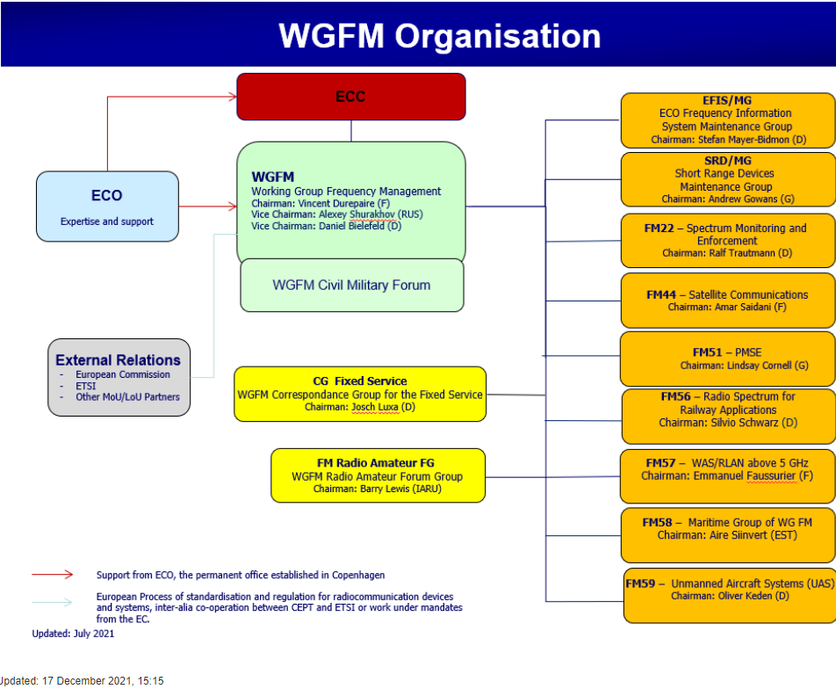
The ECC's Working Group Frequency Management (WG FM) is responsible for developing strategies, plans and implementation advice for the management of the radio spectrum.
WG FM
  EFIS/MG
  SRD/MG
    CG NBN
    CG UWB
    CG WPT
  FM 22
  FM 44
  FM 51
  FM 56
  FM 58
  FM 59
  FM Radio Amateur FG
  CG-FS

Slide 31
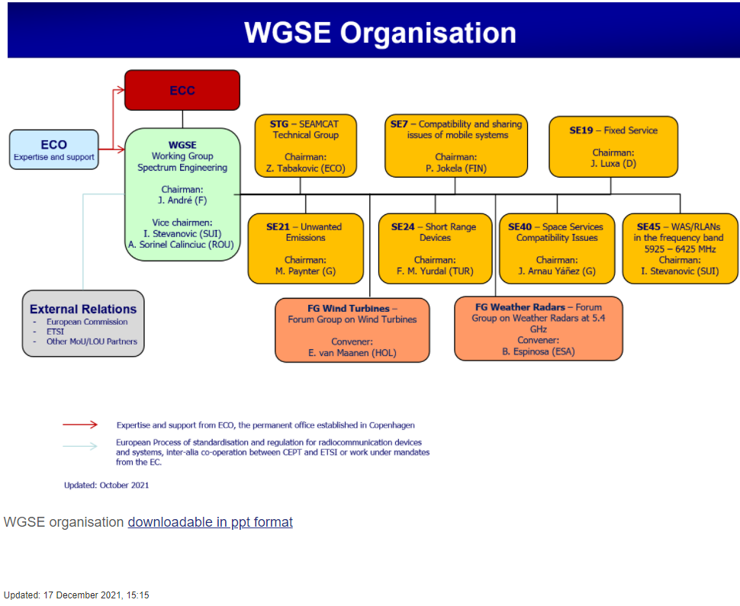
The ECC Working Group Spectrum Engineering (WG SE) is responsible for developing technical guidelines and sharing and compatibility arrangements for radio spectrum use by various radiocommunications services using the same or different frequency bands respectively.
WG SE
  STG
  SE 7
  SE 19
  SE 21
  SE 24
  SE 40
  SE 45
  FG on Wind Turbines
  FG on weather radars at 5.4 GHz
Non-ECC

Slide 32
ECC Terms of Reference https://cept.org/ecc/groups/ecc/client/introduction/
(Last update: 2 November 2012)
The Electronic Communications Committee (ECC)
shall:
consider and develop policies on electronic communications(1) activities in a European context, taking account of European and international legislation and regulations;
develop European common positions and proposals, as appropriate, for use in the framework of international and regional bodies;
forward plan and harmonise within Europe the efficient use of the radio spectrum, satellite orbits and numbering resources, so as to satisfy the requirements of users and industry;
take decisions on the management of the work of the ECC;
approve Decisions and other deliverables;
implement the strategic decisions of the Assembly;
seek guidance from the Assembly, as and when necessary, and propose issues for consideration by the Assembly;
where relevant, establish contacts with equivalent organisations outside of Europe;
report to the CEPT Assembly on the progress of its work.
In carrying out these activities, the ECC shall establish close cooperation and consultation with relevant European bodies, in particular the European Commission and the European Free Trade Association
(1) ‘electronic communications’ means transmission, and, where applicable, switching or routing, which permits the conveyance of signals by wire, radio, optical or other electromagnetic means, irrespective of the type of information conveyed.
Updated: 17 December 2021, 15:15
ECC
ECC SG
  ECC-ETSI
  ECC-EC
  ECC-US-CA
ECC PT1
CPG
  CPG PTA
  CPG PTB
  CPG PTC
  CPG PTD
  Coordination team
  NOW4WRC23
WG NaN
  NaN1
  NaN2
  NaN3
  NaN4
  NaN SFG

Slide 33
https://ec.europa.eu/info/index_en
Strategy: The EU's overall political goals are developed collectively by its institutions. Find out how the EU's strategy is developed and translated into policies and initiatives by the European Commission.
The European Commission's priorities
6 Commission priorities for 2019-2024
A European Green Deal
A Europe fit for the digital age
An economy that works for people
A stronger Europe in the world
Promoting our European way of life
A new push for European democracy
Recovery plan for Europe
Recovery plan for Europe
Leading the way out of the crisis and building a greener, more digital and more resilient Europe

Slide 34
Planning, implementing, and reporting
Decision-making process
How decisions are made
Decision-making during weekly meetings
Contribute to decision-making
Have your say on Commission initiatives
Track law-making
EU budget
Overview of the EU budgetary system, plus latest news, results and figures from the budget department.
Strategic planning
State of the Union addresses
Commission work programme
Delivering on the political priorities
Strategic foresight
The joint priorities of the EU institutions for 2021-2024
Strategic plans 2020-2024
Management plans
Reporting
Annual activity reports
Annual management and performance reports
Relations with non-EU countries
Types of relations and partnerships
By country
Regional strategies and agreements
Relations with the United Kingdom
International strategies
Organisations and partners
Sustainable Development Goals
Priorities
The European Commission’s priorities include the European Green deal, a digital future, an economy that works for people, promoting and strengthening European democracy.

