Slide 1
Proposed Frequency Table Format
Date: 2021-02-23
Authors:
Name | Affiliations | Email
Steve Shellhammer | Qualcomm | shellhammer@ieee.org
Ben Rolfe | Blind Creek Associates | ben@blindcreek.com

Slide 2
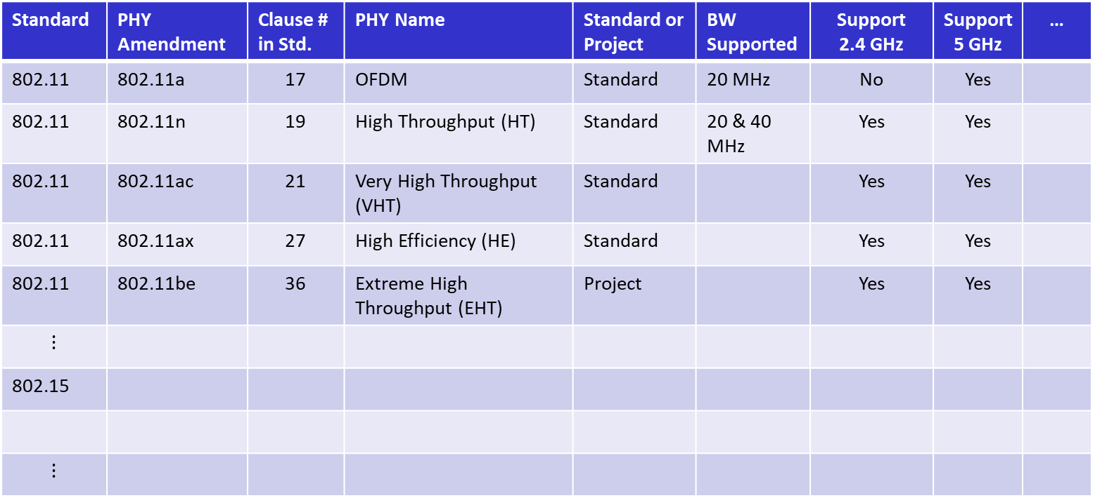
Proposed Frequency Table Format
Standard | PHY Amendment | Clause # in Std. | PHY Name | Standard or Project | BW Supported | Support 2.4 GHz | Support 5 GHz | …
802.11 | 802.11a | 17 | OFDM | Standard | 20 MHz | No | Yes
802.11 | 802.11n | 19 | High Throughput (HT) | Standard | 20 & 40 MHz | Yes | Yes
802.11 | 802.11ac | 21 | Very High Throughput (VHT) | Standard |  | Yes | Yes
802.11 | 802.11ax | 27 | High Efficiency (HE) | Standard |  | Yes | Yes
802.11 | 802.11be | 36 | Extreme High Throughput (EHT) | Project |  | Yes | Yes
$$⋮$$
802.15
$$⋮$$
Here we have just shown shorthand notion for the frequency bands (e.g., 2.4 GHz)
In the actual table we can provide the actual lower and upper frequency band edges
Maybe we add names for frequency bands, or that could be in another table/figure.

Slide 3
Notes
Include a citation to the appropriate annex in each standard where the supported frequency bands are listed
There is a frequency designation table in 802.15
Is this “Table” a spreadsheet or a database?
For now, it is a spreadsheet
It could be converted into a database after an initial version is ready
Hold off on countries and regions, for now
Point to the regulator specification for details of the frequency bands
This would work well in a database
Keep notes on regions/counties for next version
Focus on the frequency bands listed in the standards
Specify a frequency band with start and stop frequencies

