Slide 1
Proposed Frequency Table Format
Date: 2021-02-22
Authors:
Name | Affiliations | Email
Steve Shellhammer | Qualcomm | shellhammer@ieee.org
Ben Rolfe | Blind Creek Associates | ben@blindcreek.com

Slide 2
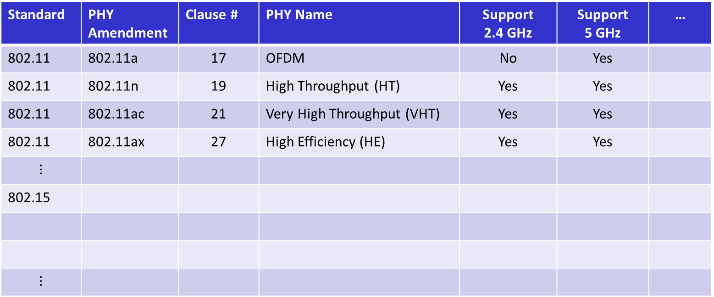
Proposed Frequency Table Format
Standard | PHY Amendment | Clause # | PHY Name | Support 2.4 GHz | Support 5 GHz | …
802.11 | 802.11a | 17 | OFDM | No | Yes
802.11 | 802.11n | 19 | High Throughput (HT) | Yes | Yes
802.11 | 802.11ac | 21 | Very High Throughput (VHT) | Yes | Yes
802.11 | 802.11ax | 27 | High Efficiency (HE) | Yes | Yes
$$⋮$$
802.15
$$⋮$$
Here we have just shown shorthand notion for the frequency bands (e.g., 2.4 GHz)
  In the actual table we can provide the actual lower and upper frequency band edges
Maybe we add names for frequency bands, or that could be in another table/figure.

