Slide 1
APAC update – May 2020
Author:

Slide 2
Background
This slide deck provides a high-level overview of the activities in APAC (related to Wi-Fi and WPAN) between March and May 2020.

Slide 3
Asia-Pacific Telecommunity (APT)
Calendar of events in 2020 is further revised
  https://www.apt.int/sites/default/files/2020/03/CALENDAR_OF_APT_EVENTS_FOR_THE_YEAR_2020-v2.4.pdf
  Of possible interest to us includes:
    The 26th Meeting of the APT Wireless Group (AWG-26)
      Tentatively postponed to Q3 2020, Bangkok, Thailand
    The 1st Meeting of the APT Conference Preparatory Group for WRC-23 (APG23-1)
      Tentatively held on Q4 2020, Xi’an, China

Slide 4
Australia ACMA
Consultation: Amendment to EME arrangements
  Closed on March 12, 2020
  https://www.acma.gov.au/consultations/2020-01/amendment-eme-arrangements-consultation-042020
  To ask for public opinions in adopting IEC TR 63170 into the ACMA Standard as a measurement method for devices operating between 6 GHz and 100 GHz.
    IEC TR 63170 is a technical report that describes measurement techniques and test approaches for evaluating the local and spatial average incident power density of wireless devices operating in close proximity to the user between 6 GHz and 100 GHz

Slide 5
Australia ACMA
Consultation: Amendment to EME arrangements (Cont’d)
  On April 9 2020, the ACMA made the Radiocommunications (Electromagnetic Radiation – Human Exposure) Amendment Standard 2020 (No. 1) under the Radiocommunications Act 1992 with the IEC TR 63170 being incorporated:
    https://www.legislation.gov.au/Details/F2020L00423

Slide 6
Australia ACMA
Consultation: Five-year spectrum outlook 2020-2024
  Comments due on June 24, 2020
  https://www.acma.gov.au/consultations/2020-04/draft-five-year-spectrum-outlook-2020-24-consultation-092020
  In this draft spectrum outlook, ACMA:
    revise and update the forward allocation plan
    plan for private long-term evolution networks
    explore new bands for monitoring
    set out a detailed work plan for the coming year, including the program of upcoming spectrum auctions.
  Next few slides extract portions of the draft text that are of interest to the TAG.

Slide 7
Australia ACMA
Consultation: Five-year spectrum outlook 2020-2024 (cont’d)
  Key priorities in 2020-2021:
    identify and implement relevant outcomes from the WRC-19 in domestic planning arrangements
  5 specific questions:
    What are the expected impacts of the COVID-19 pandemic on the short- and medium-term capacity of your industry?
    Do you have any feedback on the ACMA’s approach to its spectrum work program in the current environment? Do you have alternative proposals or priorities?
    Are there other technology developments or sources of spectrum demand that the ACMA should be aware of in considering spectrum management over the next five years?
    Do you have any other feedback on the ACMA’s plans for monitoring, initial investigation, preliminary replanning or replanning of bands?
    Do you have any comments about the ACMA’s approach to forward allocations?

Slide 8
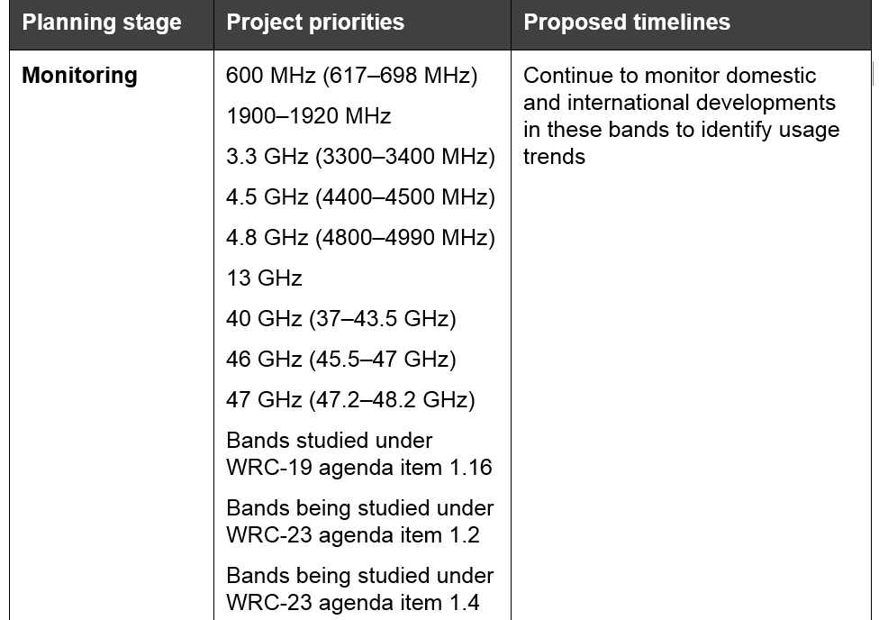
Australia ACMA
Consultation: Five-year spectrum outlook 2020-2024 (cont’d)
  Table 1: Planning – major band planning and replanning activities
5150 – 5925 MHz band
to consider identification of the frequency bands 3300-3 400 MHz, 3 600-3800 MHz, 6425-7025 MHz, 7 025-7125 MHz and 10.0-10.5 GHz for International Mobile Telecommunications (IMT), including possible additional allocations to the mobile service on a primary basis, in accordance with Resolution 245 (WRC-19)

Slide 9
Australia ACMA
Consultation: Five-year spectrum outlook 2020-2024 (cont’d)
  Table 1: Planning – major band planning and replanning activities
    Replanning: 5.6 GHz, Q2–3 2020: Consult on revised arrangements
      Current arrangements in place for fixed wireless access shared with weather radar
  Table 2: Planning – optimising established planning frameworks
    LIPD: Monitor developments, including updates on low duty cycle 900 MHz changes and 26 GHz (as per planning decisions), Ongoing—(annual) update planned for Q3 2020
    Spectrum sharing approaches: Ongoing consideration of new approaches to spectrum sharing, Q2–3 2020: Paper setting out next steps

Slide 10
Australia ACMA
Consultation: Five-year spectrum outlook 2020-2024 (cont’d)
  Spectrum sharing
    the ACMA has not received any detailed sharing proposals for consideration. Therefore, the development of a formal, ongoing DSA regime has not been prioritised by the ACMA at this time
  Class license: LIPD
    ACMA will continue to review class-licensing arrangements to assess whether regulatory settings can be changed to support RLANs and wi-fi. Considerations will include whether more spectrum is required and if changes to existing arrangements are necessary.
      For example, ACMA can consider whether existing class licence conditions, such as power levels and other operating conditions (for example, indoor usage limitations in some frequency ranges), should be reviewed.
    6 GHz: ACMA will monitor the progress of this issue—particularly the matter of coexistence between possible wi-fi and similar uses of the band with other uses, such as satellite uplinks and fixed links.

Slide 11
Australia ACMA
Consultation: Five-year spectrum outlook 2020-2024 (cont’d)
  Implementing outcomes of WRC-19
    When WRC changes come into effect (typically approximately one year after the WRC), it is expected that the ACMA will commence scoping this work in Q3 2020.
    Engage into meetings of APT APG23 meetings when the WRC-23 study cycle is started

Slide 12
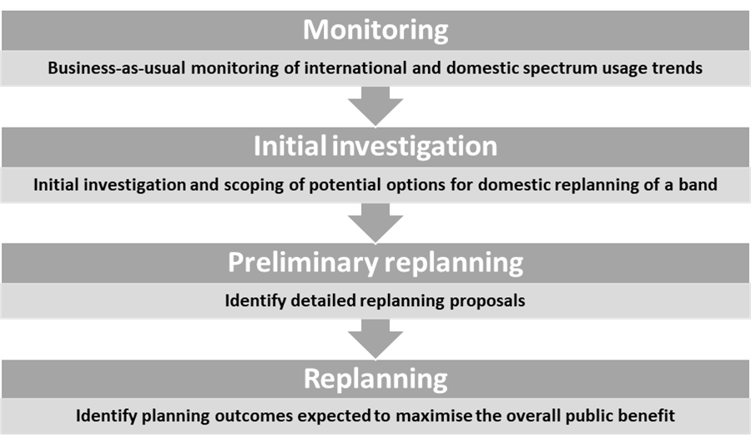
Australia ACMA
Consultation: Five-year spectrum outlook 2020-2024 (cont’d)
  Four stages in spectrum management band planning

Slide 13
Australia ACMA
Consultation: Five-year spectrum outlook 2020-2024 (cont’d)
  Monitoring: Bands studied under WRC-19 agenda item 1.16 (5150–5350 MHz (to enable outdoor usage), 5350–5470 MHz, 5725–5850 MHz and 5850–5925 MHz)
    Existing situations in Australia:
      Arrangements already exist for RLANs in the 5150–5350 MHz band (low power indoor use only) and the 5725–5850 MHz band
      The ACMA made the Radiocommunications (Intelligent Transport Systems) Standard 2018 to support the use of complying wireless ITS technologies and devices in the frequency range 5855–5925 MHz
    Next step of ACMA:
      Continue to monitor development post WRC-19’s decision that permit indoor and outdoor operation of stations in the 5250–5350 MHz and 5470–5725 MHz frequency bands under a range of operating conditions, including various combinations of EIRP limits and elevation-dependent EIRP masks.

Slide 14
Australia ACMA
Consultation: Five-year spectrum outlook 2020-2024 (cont’d)
  Monitoring: Bands being studied under WRC-23 agenda item 1.2 (3300–3400 MHz, 3600–3800 MHz, 6425–7025 MHz, 7025–7125 MHz and 10.0–10.5 GHz)
    Next step of ACMA:
      The ACMA will continue to engage with stakeholders via the usual international preparatory process to develop Australian positions on WRC‑23 agenda item 1.2. Developments in Europe and other regions and countries (such as the US) will be monitored.

Slide 15
Australia ACMA
Consultation: Five-year spectrum outlook 2020-2024 (cont’d)
  Optimizing established planning frameworks: LIPD
    ACMA is currently monitoring developments and plan to consult on the next update of the LIPD class licence in Q3 2020.
  Future band planning priorities
    Should the ACMA prioritise reviewing the 1.5 GHz band or the 40 GHz, 47 GHz and 48.2-52.4 GHz bands. Are there any other bands that should be prioritised over these ones?

Slide 16
China MIIT
Consultation: Regulations on the Management of Radio Transmission Equipment
  Comments due on April 16, 2020
  http://www.miit.gov.cn/opinion/noticedetail.do?method=notice_detail_show&noticeid=2201
  Majority of the contents are related to approval of the types of equipment, supervision/inspection of equipment, and liability, except Chapter 3 (articles 18 – 24) that focuses on specific proposed provisions related to micro-power short range radio transmission equipment.

Slide 17
China MIIT
Legislative notice: Change of usage of 700 MHz band
  Released on April 1, 2020
  http://www.miit.gov.cn/n1146295/n1652858/n1652930/n3757020/c7845702/content.html
  703 – 743 MHz and 758 – 798 MHz are dedicated for FDD-based mobile communications systems effective immediately
  No longer process and authorize any broadcast-related applications in the 702 – 798 MHz band.

Slide 18
Japan MIC
Consultation: Frequency reorganization action plan after WRC-19
  Closed on April 10, 2020
  https://www.soumu.go.jp/menu_news/s-news/01kiban09_02000338.html

Slide 19
Japan MIC
Consultation: Frequency reorganization action plan after WRC-19 (cont’d)
  A few points that maybe of useful are listed as follows:
    Consider relaxing the requirement at 5.2 GHz so that it can be used in automobiles
    Consider developing an environment that allows flexible use of IoT devices at 915-935 MHz
    In response to future traffic increase of Wi-Fi by IoT, advance on technical considerations (e.g., sharing) with other existing wireless systems
    Consider technical conditions that UWB can be used not only indoor, but also outdoor in the 7 - 10 GHz band
    Consider introducing V2X in the 5.9 GHz band
    Next generation radar at 5 GHz: start technical inspections, such as narrowing the band with weather radar

Slide 20
Japan MIC
Consultation: Frequency reorganization action plan after WRC-19 (cont’d)
  60 comments received and posted at:
    https://www.soumu.go.jp/menu_news/s-news/01kiban09_02000351.html
  Revised frequency reorganization action plan is published on May 13:
    https://www.soumu.go.jp/main_content/000685970.pdf

Slide 21
Japan MIC
Consultation: Frequency reorganization action plan after WRC-19 (cont’d)
  Selected highlights of the revised frequency reorganization action plan is published on May 13:
    Focused initiatives
      Support for 5 GHz WLAN: proceed with technical studies such as sharing conditions with other wireless systems and whether to allow 5.2 GHz band for use in vehicles
      Initiatives for an autonomous driving society: consider frequency sharing when introducing V2X communication in 5.9 GHz band
      Promotion of dynamic frequency sharing: dynamic frequency using a database etc. that enables the realization of advanced frequency sharing will be considered

Slide 22
Japan MIC
Consultation: Frequency reorganization action plan after WRC-19 (cont’d)
  Selected highlights of the revised frequency reorganization action plan is published on May 13: (cont’d)
    Frequency reorganization
      714 MHz - 960 MHz, 960 MHz–3.4 GHz, 4.4 GHz - 5.8 GHz: support measures against spectrum shortage due to increase in transmission data volume in wireless LAN and IoT system
      4.4 GHz - 5.8 GHz: support future traffic increase with a view to expand the use of wireless LAN by IoT and/or frequency sharing
      5.85 GHz - 23.6 GHz: consider allowing the outdoor use of UWB in some of the frequency bands between 7 GHz and 10 GHz other than the bands between 7.587 GHz and 8.4 GHz that have been approved for outdoor use, consider narrowing the band of weather radar and channel plan of high-performance weather radar in 5 GHz band
      Promote R&D on ultra-high-speed transmission of several tens of Gbps by using terahertz waves,

Slide 23
Singapore IMDA
Consultation: Security Requirements for Residential Gateways
  Comments due on May 15, 2020 (extended deadline)
  https://www.imda.gov.sg/regulations-and-licensing/Regulations/consultations/Consultation-Papers/2020/Security-Requirements-for-Residential-Gateways
  For this consultation, paragraphs 4.4 (Wireless Access Protection) and 4.5 (Data Protection) maybe of interest to Wi-Fi community:
    E.g., 4.4b: The Residential Gateway shall use AES encryption, with at least WPA2 protection by default. If weaker security protection such as WEP or WPA is chosen by users, warning(s) of the higher security risk to use these encryption algorithms shall be displayed.

