Slide 1
An update on the Recommendation ITU-R M.1450-5
Author:

Slide 2
Background
This slide deck provides an information update on Recommendation ITU-R M.1450-5 that IEEE 802.18 would consider working with IEEE 802.11 and any interested parties.

Slide 3
Recommendation ITU-R M.1450-5
Scope:
  Provides the characteristics of broadband radio local area networks (RLANs) including technical parameters, and information on RLAN standards and operational characteristics.
  Address basic characteristics of broadband RLANs and general guideline for their system design
Last update:
  February 2014
Available for public to download at:
  https://www.itu.int/rec/R-REC-M.1450-5-201404-I/en

Slide 4
Recommendation ITU-R M.1450-5
This recommendation recommends the following 3 items (c.f., page 1 of the recommendation):

Slide 5
There are items that need to be updated (1)
The information in Table 2 does not contain the latest information about IEEE 802.11ac* and the later standards and amendments, e.g., see the snapshot below:
*Transmit spectral mask for IEEE 802.11ac channel do exist in pages 10-12 of the recommendation, but all the other characteristics of IEEE 802.11ac are missing.

Slide 6
There are items that need to be updated (2)
Per Resolution 229 (Rev. WRC-19), operation in the 5 150 – 5 250 MHz may allow controlled and/or limited outdoor use (c.f., pages 273-277 of the WRC-19 Provisional Final Act)

Slide 7
There are items that need to be updated (3)
The information in Annex I, Annex 2 and Table 3 are also outdated.

Slide 8
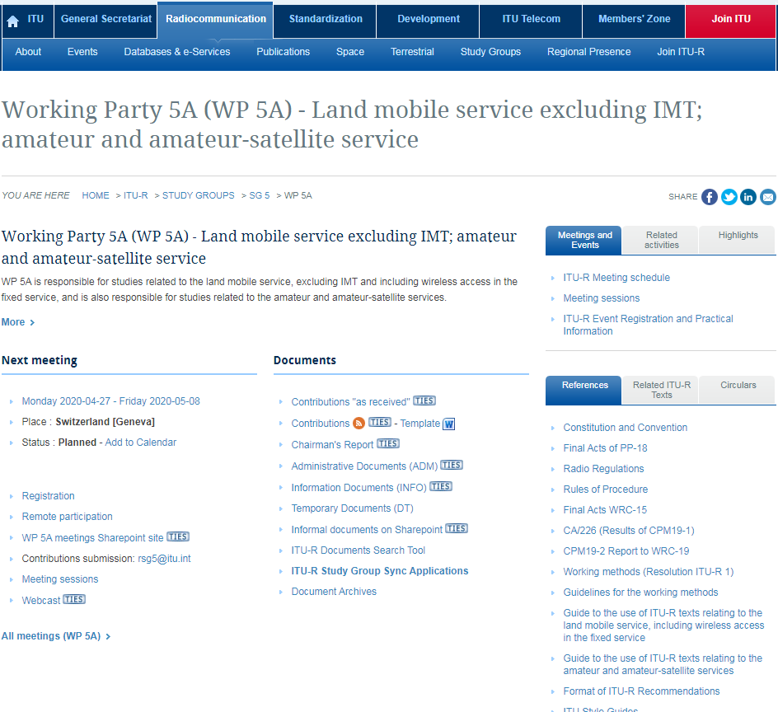
Suggestion
IEEE 802.18 discusses with IEEE 802.11 and all interested parties on whether there is an interest to prepare a submission to ITU-R Working Group 5A
  The next meeting is from April 27 to May 8.
  Typically the submission deadline is 2 weeks in advance.
Disclaimer:
  My intention is to provide an information update about this topic to IEEE 802.18 and I have no intention in pushing any related future activity.

