Slide 1
IEEE 802.xx Increasing the Efficient and Effective Use of Part 101 Licensed Spectrum
Date: May 17, 2018

Slide 2
A Perfect Point-To-Point Antenna has a Very Narrow Beam Width and No Sidelobes
Radiates/Receives Power only in One Direction

Slide 3
In Reality All Point-To-Point Antennas have Sidelobes
In Reality Power is radiated in All Directions

Slide 4
All Point-To-Point Antennas Radiate and Receive Power in All Directions
Equivalent Isotropically Radiated Power (EIRP)

Slide 5
FCC Category A Antenna Pattern
Log Polar Plot EIRP
dBm

Slide 6
Linear Distance Plot of the Interference Contour
FCC Category A Antenna
It was believed by industry that no new stations could operate within this area without causing or receiving harmful interference.
This area was not considered usable.
It Was Wasted.
Primary Station
Interference Contour

Slide 7
Linear Distance Plot of the Interference Contour
FCC Category A Antenna
This Wasted Spectrum can be put to Productive Use
by making it possible for the Licensee to Safely Deploy Additional Stations within the
Interference Contour – the “Safe Area”.
Primary Station
Interference Contour

Slide 8
The Solution – Emulated Area Licensed Footprint
The innovation is to use the existing FCC rules to operate PtMP in licensed frequency bands by ensuring that the interference from all stations within the Safe Area arriving at licensed or proposed stations outside the Safe Area is less than the interference from the licensee’s Primary Stations – which emulates an area license, making Licensed PtMP Networks possible under existing rules with a seamless path to nomadic (Wi-Fi) and 5G mobile.*
*Requires an FCC Rule Change from Operational Fixed to Mixed Use.

Slide 9
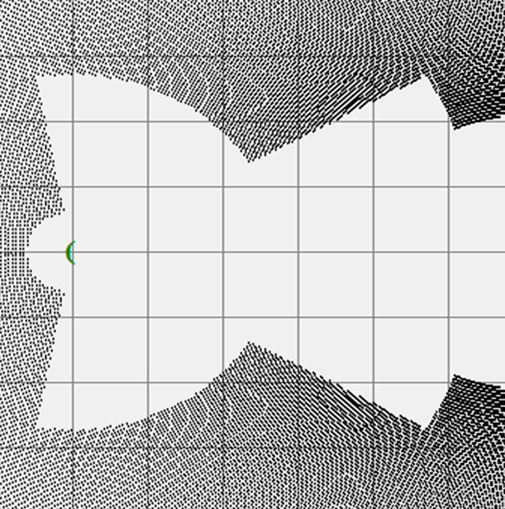
Defining and Optimizing the Safe Area
Antenna Interference Contours
By using a computer program it is possible to analyze billions of future new applicant locations so as to define the Interference Contour. A Licensee can Deploy New (Secondary) Stations inside the contour (the Safe Area) because stations at these locations cause less interference than the licensees stations.

Slide 10
Interference Contour
(Omni through Multiple Sectored Hub)
Antenna Interference Contours
Interference Contour around a Licensed Hub Station – within which a New Applicant will Not Prior Coordinate since it will Cause or Receive harmful interference, but where a Licensee can Deploy New Stations and put the previously Wasted Spectrum to Productive Use.
The Operating Radius from the PtMP Hub Station to Secondary Stations is less than the Radius to the Interference Contour.

Slide 11
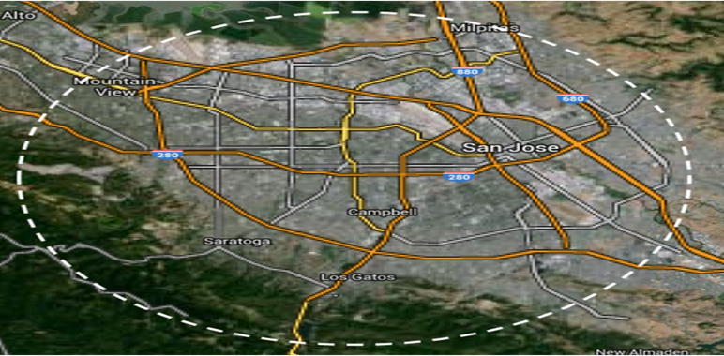
Emulated Area Licensed Footprint

