Slide 1
IEEE 802.18 RR-TAG February 1st Teleconference Agenda
Date: 2018-02-01
Authors:

Slide 2
Agenda
Approve the agenda
Discussion items
ISED Canada Spectrum Outlook consultation
Ofcom consultation for 6 and 60 GHz
Actions required
Approve the response to the ISED consultation
AOB and Adjourn
Agenda

Slide 3
Administrative Items
Required notices
Affiliation FAQ - http://standards.ieee.org/faqs/affiliationFAQ.html
Anti-Trust FAQ - http://standards.ieee.org/resources/antitrust-guidelines.pdf
Ethics - http://www.ieee.org/portal/cms_docs/about/CoE_poster.pdf
IEEE 802 WG Policies and Procedures - http://www.ieee802.org/devdocs.shtml
Officers
Chair is Rich Kennedy (HP Enterprise)
Vice-chair is Jay Holcomb (Itron)
Secretary: Allan Zhu (Huawei)

Slide 4
Participants have a duty to inform the IEEE
Participants shall inform the IEEE (or cause the IEEE to be informed) of the identity of each holder of any potential Essential Patent Claims of which they are personally aware if the claims are owned or controlled by the participant or the entity the participant is from, employed by, or otherwise represents
Participants should inform the IEEE (or cause the IEEE to be informed) of the identity of any other holders of potential Essential Patent Claims
Early identification of holders of potential Essential Patent Claims is encouraged

Slide 5
Ways to inform IEEE
Cause an LOA to be submitted to the IEEE-SA (patcom@ieee.org); or
Provide the chair of this group with the identity of the holder(s) of any and all such claims as soon as possible; or
Speak up now and respond to this Call for Potentially Essential Patents
If anyone in this meeting is personally aware of the holder of any patent claims that are potentially essential to implementation of the proposed standard(s) under consideration by this group and that are not already the subject of an Accepted Letter of Assurance, please respond at this time by providing relevant information to the WG Chair

Slide 6
Other guidelines for IEEE WG meetings
All IEEE-SA standards meetings shall be conducted in compliance with all applicable laws, including antitrust and competition laws.
Don’t discuss the interpretation, validity, or essentiality of patents/patent claims.
Don’t discuss specific license rates, terms, or conditions.
Relative costs of different technical approaches that include relative costs of patent licensing terms may be discussed in standards development meetings.
Technical considerations remain the primary focus
Don’t discuss or engage in the fixing of product prices, allocation of customers, or division of sales markets.
Don’t discuss the status or substance of ongoing or threatened litigation.
Don’t be silent if inappropriate topics are discussed … do formally object.
---------------------------------------------------------------
For more details, see IEEE-SA Standards Board Operations Manual, clause 5.3.10 and Antitrust and Competition Policy: What You Need to Know at http://standards.ieee.org/develop/policies/antitrust.pdf

Slide 7
Patent-related information
The patent policy and the procedures used to execute that policy are documented in the:
IEEE-SA Standards Board Bylaws (http://standards.ieee.org/develop/policies/bylaws/sect6-7.html#6)
IEEE-SA Standards Board Operations Manual (http://standards.ieee.org/develop/policies/opman/sect6.html#6.3)
Material about the patent policy is available at
http://standards.ieee.org/about/sasb/patcom/materials.html
If you have questions, contact the IEEE-SA Standards Board Patent Committee Administrator at patcom@ieee.org

Slide 8
Participation in IEEE 802 Meetings
Participation in any IEEE 802 meeting (Sponsor, Sponsor subgroup, Working Group, Working Group subgroup, etc.) is on an individual basis
Participants in the IEEE standards development individual process shall act based on their qualifications and experience. (https://standards.ieee.org/develop/policies/bylaws/sb_bylaws.pdf section 5.2.1)
IEEE 802 Working Group membership is by individual; “Working Group members shall participate in the consensus process in a manner consistent with their professional expert opinion as individuals, and not as organizational representatives”. (subclause 4.2.1 “Establishment”, of the IEEE 802 LMSC Working Group Policies and Procedures)
Participants have an obligation to act and vote as an individual and not under the direction of any other individual or group. A Participant’s obligation to act and vote as an individual applies in all cases, regardless of any external commitments, agreements, contracts, or orders.
Participants shall not direct the actions or votes of any other member of an IEEE 802 Working Group or retaliate against any other member for their actions or votes within IEEE 802 Working Group meetings, see https://standards.ieee.org/develop/policies/bylaws/sb_bylaws.pdf section 5.2.1.3 and the IEEE 802 LMSC Working Group Policies and Procedures, subclause 3.4.1 “Chair”, list item x.
By participating in IEEE 802 meetings, you accept these requirements. If you do not agree to these policies then you shall not participate.
(Latest revision of IEEE 802 LMSC Working Group Policies and Procedures: http://www.ieee802.org/devdocs.shtml)
Slide 8
Notes:
8
doc.: ec-16-0149-00-00EC
November 2016
Dorothy Stanley, HP Enterprise
Page 8

Slide 9
Discussion Items
ISED Canada Spectrum Outlook consultation
Ofcom consultation for 6 and 60 GHz
Review of Irvine meeting

Slide 10
ISED Spectrum Outlook
http://www.ic.gc.ca/eic/site/smt-gst.nsf/eng/sf11359.html
In support of Canada’s Innovation and Skills Plan, and with a focus on ensuring that Canadians can benefit from world-class networks and advancements in new digital technologies and services, ISED acknowledges that as the demand for digital connectivity grows, so will the demand for spectrum. Through the release of this document, ISED, on behalf of the Minister, is hereby initiating a consultation on the overall approach and planning activities related to the release of spectrum for commercial mobile services, licence-exempt applications, satellite services and wireless backhaul services over the years 2018 to 2022.
Comment period ends February 16, 2018
Reply Comment period ends March 16, 2018

Slide 11
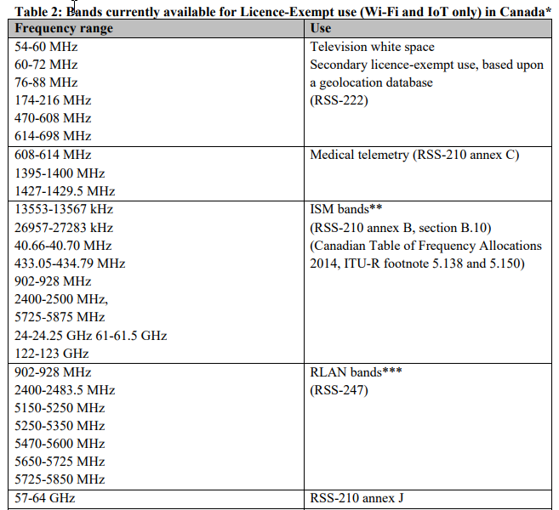

Slide 12
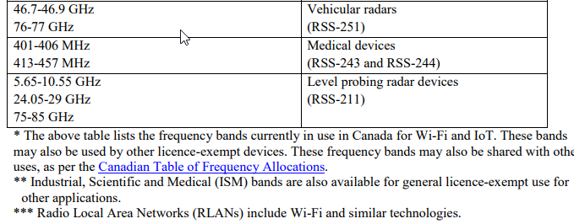

Slide 13
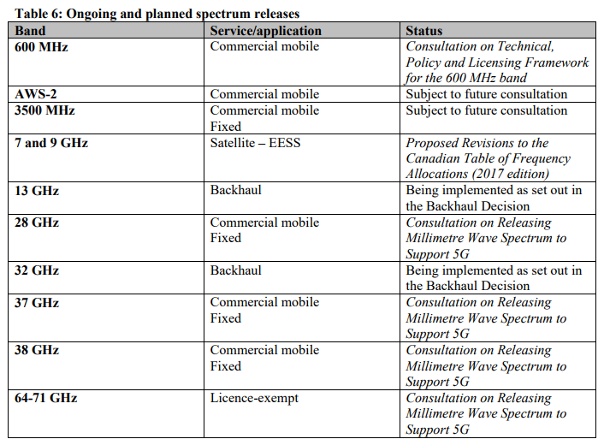

Slide 14
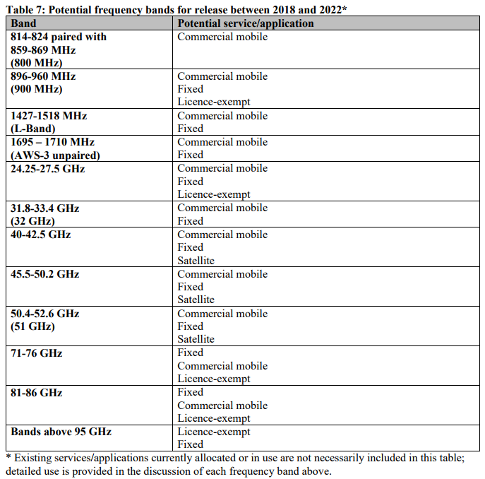

Slide 15
ISED Spectrum Outlook Response
https://mentor.ieee.org/802.18/dcn/18/18-18-0014-00-0000-response-to-ised-2018-2022-consultation.pptx

Slide 16
Ofcom Consultation
Ofcom consultation looking at 6 and 60 GHz
https://www.ofcom.org.uk/consultations-and-statements/category-2/fixed-wireless-spectrum-strategy
https://mentor.ieee.org/802.18/dcn/18/18-18-0003-00-0000-ofcom-fixed-wireless-spectrum-strategy.pdf
The document consults on changing the authorisation regime in the 64 – 66 GHz band to licence exempt and seeks views on a revised technical condition across the 57-66 GHz, commonly known as V band, in order to enable new fixed wireless access use cases. We are also seeking views on the adjacent 66 - 71 GHz band given that it could be part of the same ecosystem as V band.
We also wish to further explore small channels based on CEPT channel plans at 6 GHz as potential replacement option for low capacity links in the 1.4 GHz band noting that spectrum at 6 GHz is also currently being considered for radio local area network (RLAN) within Europe9.
Given the current use of the 6 GHz band for long range high capacity connectivity, particularly between remote islands and between oil platforms, we are of the view that the international co-existence studies will first need to be completed to understand the feasibility of sharing before any decisions are taken regarding the use of RLANs in these frequency bands.
Closing Date for Responses: 1 February 2018 FILED

Slide 17
Review of Irvine Meeting
Walked quickly through the ISED spectrum outlook consultation 23 questions.
ID’d ones IEEE 802 may have interest to comment on.
Approved response to Ofcom consultation on fixed wireless outlook
Reviewed/commented/approved orecent draft of the IEEE SA Board of Governors Position Statement on Additional Spectrum Needed (for IEEE).
Andy Gowans from Ofcom had a presentation on what is going on at Ofcom.
And the normal review of the many activities going in the EU, with many on 6 and 60 GHz.

Slide 18
Actions [Required]
ISED 2018-2022 Spectrum Outlook response

Slide 19
Any Other Business
Next meeting: February 8, 2018 via teleconference

