Slide 1
ISED 2018-2022 Spectrum Outlook Consultation Response
Date: 25 January 2018
Authors:

Slide 2
Abstract
This presentation is intended to be the IEEE 802 response to the ISED (Canada) consultation on Spectrum Outlook for 2018-2022.
Also included at the end of the deck are the instructions for filing the responses with ISED. The filing deadline is 16 February 2018 at 5:00pm EST

Slide 3
ISED Spectrum Outlook Consultation
https://mentor.ieee.org/802.18/dcn/17/18-17-0148-00-0000-ised-consultation-on-the-spectrum-outlook-2018-to-2022.pdf
“…on the overall approach and planning activities related to the release of spectrum for commercial mobile services, licence-exempt applications, satellite services and wireless backhaul services over the years 2018 to 2022.”
This consultation closes on 15 February 2018.
Submit for EC approval no later than 5 February
To be finalized during our 1 February teleconference

Slide 4
Consultation Question 1
Q1 – What future changes, if any, should ISED examine with regard to the existing licensing regime to better plan for innovative new technologies and applications and allow for benefits that new technology can offer, such as improved spectrum efficiency.

Slide 5
Consultation Questions 2-4
Commercial mobile services
Q2 –Do you agree with the above assessment on demand for commercial mobile services in the next few years? Is there additional information on demand, which is not covered above, that should be considered? If so, please explain in detail.
Q3 – What new technology developments and/or usage trends are expected to address traffic pressures and spectrum demand for commercial mobile services? When are these technologies expected to become available?
Q4 – Recognizing the trend of increasing commercial mobile traffic, what operational measures (e.g. densification, small cells or advanced traffic management) are being taken to respond to, and support, increasing traffic? To what extent are these measures effective?
IEEE 802 is not involved with commercial mobile standards, so could refrain from commenting on these questions.

Slide 6
Data for Questions 2-4
“…ISED considered three factors to assess the future spectrum requirements for commercial mobile services: subscribership, traffic growth and technology advancements.”
“…the percentage of Canadians who subscribed to wireless services has increased from 80% to 82% from 2010 to 2015.”
“The Cisco VNI forecasts that national monthly mobile data traffic in Canada will grow five-fold between 2016 and 2021, from 73.2 PB/month to over 340.9 million PB/month.”
“Forecasted use cases include enhanced/ultra-fast mobile broadband, massive machine type communications, and ultrareliable/low latency communications…”
“A number of other new technologies to support these use cases are emerging or are being researched as part of 5G standards development. These emerging technologies include, among others, the use of massive multiple input, multiple output (MIMO) technology, full-duplexing, and carrier aggregation techniques.”

Slide 7
Consultation Question 5
Q5 – Do you agree with the above assessment of demand for licence-exempt spectrum in the next few years? Is there additional information regarding demand, which is not covered above, that should be considered? If so, please explain in detail.

Slide 8
Data for Question 5
“According to the Cisco VNI, the number of public Wi-Fi hotspots deployed globally is expected to grow from 94.0 million in 2016 to 541.6 million by 2021, representing a five-fold increase.”
“In Canada, Cisco estimates that 71% of mobile data traffic was offloaded to Wi-Fi in 2016 and it is expected to reach 75% by 2021.”
“Wi-Fi traffic was approximately 698 PB/month in Canada in 2015, and it is predicted that it will reach 2.1 EB/month in 2020.”
“According to the Cisco VNI, in 2016, M2M devices alone represented 50% of the 230M networked devices in Canada, and are expected to account for 67% of the 405.2M networked devices in 2020.”

Slide 9
Consultation Question 6
Q6 – What new technologies and/or sharing techniques are expected to aid in relieving traffic pressures and addressing spectrum demand for licence-exempt applications? When are these technologies expected to become available?

Slide 10
Consultation Question 7
Q7 – What existing licence-exempt frequency bands will see the most evolution in the next five years? Are there any IoT applications that will have a large impact on the existing licence exempt bands? If so, what bands will see the most impact from these applications?

Slide 11
Consultation Question 8
Q8 – Will the trend for offering carrier-grade or managed Wi-Fi services continue to increase over the next five years? If so, will this impact congestion in Wi-Fi bands and which bands would be most affected?

Slide 12
Consultation Questions 9-12
Satellite services
Q9 – ISED is seeking comments on the above demand assessment for MSS and earth observation applications for the period 2018-2022. Is there additional information on demand, which is not covered above, that should be considered?
Q10 – ISED is seeking comments on the above demand assessment for FSS/BSS for the period 2018-2022. Is there additional information on demand, which is not covered above, that should be considered with regards to the below bands? a) C-band b) Ku-band c) Ka-band
Q11 – What and how will technology developments and/or usage trends aid in relieving traffic pressures and addressing spectrum demand for satellite services? When are these technologies expected to become available?
Q12 – What satellite applications (e.g. broadband Internet, video broadcasting, backhaul, etc.) do you consider a priority for the period 2018-2022?

Slide 13
Consultation Questions 13-15
Backhaul services
Q13 – Do you agree with the above assessment on demand for backhaul in the next five years? Is there additional information on demand, which is not covered above, that should be considered? If so, please explain in detail.
Q14 – Backhaul service in Canada is delivered using a variety of solutions, including fibre optics, microwave radio and satellites. What changes, if any, are anticipated to the mix of backhaul solutions employed?
Q15 – What and how will technology developments and/or usage trends aid in relieving traffic pressures and addressing spectrum demand for backhaul services? When are these technologies expected to become available?
We have no comments on these questions. Backhaul related to license exempt is in Question 16

Slide 14
Consultation Question 16
Q16 – Will the demand for commercial mobile, licence-exempt, satellite, or fixed wireless services/applications impact the demand for backhaul spectrum? If so, how and which of these services/applications will create the most impact?

Slide 15
Consultation Question 17
Q17 – Is there a range or ranges of frequencies that will be in higher demand over the next five years? Why is higher demand anticipated for these frequency

Slide 16
Consultation Question 18
Q18 – Will allowing flexible fixed and mobile services within the same frequency band change how backhaul is planned and used?

Slide 17
Consultation Question 19
Q19 – Provide, with rationale, your view of the above assessments on the bands being considered internationally for commercial mobile, fixed, satellite, or licence-exempt.

Slide 18
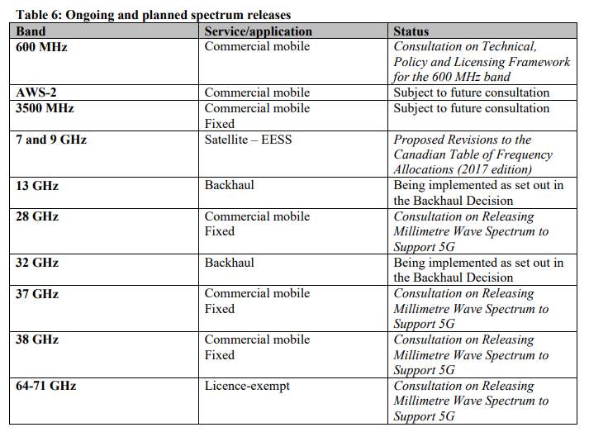

Slide 19
Consultation Question 20
Q20 – ISED is seeking comments on the potential frequency bands for release in table 7: a) the proposed services and/or applications for each frequency band b) the potential timing of releasing for each frequency band c) the priority of the release of the frequency bands

Slide 20
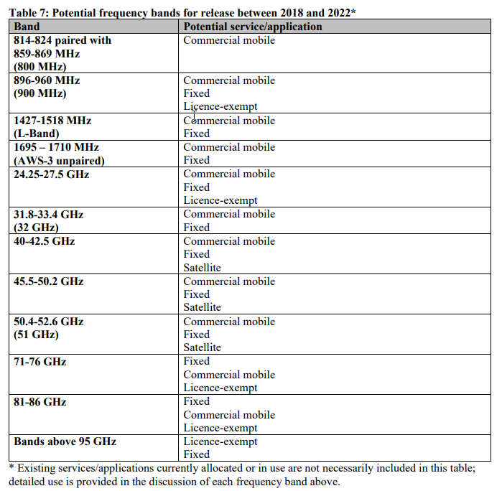

Slide 21
Consultation Question 21
Q21 – Are there any other bands that should be considered for release in the next five years for commercial mobile, fixed, satellite, or licence-exempt that are not discussed above? Provide rationale for your response.
For the past year the Wi-Fi industry, recognizing that spectrum congestion, and the end to consideration of sharing the 5350 MHz to 5470 MHz band, will lead to not only a deterioration of the usability of the 5 GHz band, but also the extreme shortage of 160 MHz channels needed to support advanced applications, e.g. Virtual Reality/Augmented Reality. In response, studies have been undertaken to assess the feasibility of sharing in the 6 GHz band. This is also under study in the EU in ECC CEPT SE45 and FM57, established specifically for this activity.
The US study has been published, and can be found at: https://s3.amazonaws.com/rkfengineering-web/6USC+Report+Release+-+24Jan2018.pdf
In order to maintain the viability of Wi-Fi in the future, for all of the use cases recognized in this consultation, we believe ISED should consider similar activity for Canada

Slide 22
Consultation Question 22
Q22 – Are there specific frequency ranges/spectrum bands that should be made available for specific applications?
IEEE 802 believes that application specific spectrum allocations are less efficient than dynamic sharing can be, but recognize that it is required in some cases. As such we recommend that before allocating spectrum for specific applications, alternate approaches should be fully assessed.

Slide 23
Consultation Question 23
Q23 – Are there any factors that would impact the potential release of these frequency bands between 2018 and 2022?

Slide 24
Instructions for Filing

