Slide 1
IEEE 802.18 RR-TAG
Irvine Interim Meeting Agenda
Dates: 16 Jan 18
18 Jan 18
Authors:

Slide 2
Call to Order / Administrative Items
Number of voters: 40 (9 on EC); Nearly voters: 2; Aspirant members: 14
Required notices
  Affiliation FAQ - http://standards.ieee.org/faqs/affiliationFAQ.html
  > Be sure to announce you name, affiliation, employer and clients the first time you speak.
  Anti-Trust FAQ - http://standards.ieee.org/resources/antitrust-guidelines.pdf
  Ethics - https://www.ieee.org/about/corporate/governance/p7-8.html
  IEEE 802 WG Policies and Procedures - http://www.ieee802.org/devdocs.shtml
  The 4 administration slides, reminder from your WG opening plenary ➔ new 02jan18
  (note: call for essential patents is n/a, as the RR-TAG does not do standards)
Officers or the RR-TAG / IEEE 802.18:
  Chair is Rich Kennedy (Self)
  Vice-chair is Jay Holcomb (Itron) - Presiding at this week’s f2f.
  Secretary: Allan Zhu (Huawei)

Slide 3
Other Guidelines for IEEE WG Meetings
All IEEE-SA standards meetings shall be conducted in compliance with all applicable laws, including antitrust and competition laws.
  Don’t discuss the interpretation, validity, or essentiality of patents/patent claims.
  Don’t discuss specific license rates, terms, or conditions.
    Relative costs of different technical approaches that include relative costs of patent licensing terms may be discussed in standards development meetings.
      Technical considerations remain the primary focus
  Don’t discuss or engage in the fixing of product prices, allocation of customers, or division of sales markets.
  Don’t discuss the status or substance of ongoing or threatened litigation.
  Don’t be silent if inappropriate topics are discussed … do formally object.
---------------------------------------------------------------
For more details, see IEEE-SA Standards Board Operations Manual, clause 5.3.10 and
Antitrust and Competition Policy: What You Need to Know at http://standards.ieee.org/develop/policies/antitrust.pdf
Notes:
3

Slide 4
Participation in IEEE 802 Meetings
Participation in any IEEE 802 meeting (Sponsor, Sponsor subgroup, Working Group, Working Group subgroup, etc.) is on an individual basis
Participants in the IEEE standards development individual process shall act based on their qualifications and experience. (https://standards.ieee.org/develop/policies/bylaws/sb_bylaws.pdf section 5.2.1)
IEEE 802 Working Group membership is by individual; “Working Group members shall participate in the consensus process in a manner consistent with their professional expert opinion as individuals, and not as organizational representatives”. (subclause 4.2.1 “Establishment”, of the IEEE 802 LMSC Working Group Policies and Procedures)
Participants have an obligation to act and vote as an individual and not under the direction of any other individual or group. A Participant’s obligation to act and vote as an individual applies in all cases, regardless of any external commitments, agreements, contracts, or orders.
Participants shall not direct the actions or votes of any other member of an IEEE 802 Working Group or retaliate against any other member for their actions or votes within IEEE 802 Working Group meetings, see https://standards.ieee.org/develop/policies/bylaws/sb_bylaws.pdf section 5.2.1.3 and the IEEE 802 LMSC Working Group Policies and Procedures, subclause 3.4.1 “Chair”, list item x.
By participating in IEEE 802 meetings, you accept these requirements. If you do not agree to these policies then you shall not participate. (and pleases leave the room.)

Slide 5
Agenda
Call to Order (attendance server is open)
Administrative Items
Approve Agenda
Approve last f2f minutes
Approve last teleconference minutes
Discussion items
  Americas
  EMEA
  APAC
Actions required
  TBD (decided by the TAG on Tuesday)
AOB and Adjourn
Agenda

Slide 6
Motions #1 and #2
Motion: To approve the agenda as presented on previous slide
Moved by: Stuart K.
  Seconded by: John N.
  Discussion?
  Vote: Unanimous consent
Motion: To approve the minutes from the IEEE 802.18 meeting at the Orlando Wireless Plenary in document https://mentor.ieee.org/802.18/dcn/17/18-17-0140-01-0000-meeting-minutes-nov-2017-orlando.docx
Posted: 13-Nov-2017 00:20:36 ET
  Moved by: John N.
  Seconded by: Stuart K.
  Discussion?
  Vote: Unanimous consent

Slide 7
Motion #3
Motion: To approve minutes from the IEEE 802.18 Teleconferences since the Orlando Plenary.
  https://mentor.ieee.org/802.18/dcn/17/18-17-0142-00-0000-minutes-30nov17-rr-tag-teleconference.doc
  https://mentor.ieee.org/802.18/dcn/17/18-17-0147-00-0000-minutes-14dec17-rr-tag-teleconference.doc
  https://mentor.ieee.org/802.18/dcn/18/18-18-0005-00-0000-minutes-11jan18-rr-tag-teleconference.doc
  Moved by: Tim J.
  Seconded by: Jim L.
  Discussion?
  Vote: Unanimous consent

Slide 8
Discussion Items
Americas updates
    S.1682 - Airwaves Act
    ISED TVWS consultation
    ISED Spectrum Outlook consultation
EMEA updates
    6 and 60 GHz
    Ofcom
    ETSI standards
    ITU-R
APAC updates
    ACMA LIPD update
    Hong Kong 920-925MHz SRD

Slide 9
Americas - 1
New spectrum bill proposed (S.1682)
  https://www.congress.gov/bill/115th-congress/senate-bill/1682/text
  https://mentor.ieee.org/802.18/dcn/17/18-17-0133-00-0000-s-1682-bill-to-facilitate-national-pipeline-of-spectrum-for-commercial-and-other-purposes.pdf
  Section 6(b):
    Rule Making On The Unlicensed Use Of The Frequency Band Between 5925 Megahertz And 7125 Megahertz.—Not later than 180 days after the date of enactment of this Act, the Commission, in consultation with the NTIA, shall issue a notice of proposed rule making with respect to creating opportunities for the unlicensed use of spectrum in the frequencies between 5925 and 7125 megahertz without causing harmful interference with any incumbents in that band
Appears to have gone nowhere, no action yet.

Slide 10
Americas - 2
ISED Harmonizing TVWS rules with the US
  https://www.ic.gc.ca/eic/site/smt-gst.nsf/vwapj/Consultation-WhiteSpace-eng.pdf/$FILE/Consultation-WhiteSpace-eng.pdf
  https://mentor.ieee.org/802.18/dcn/17/18-17-0145-00-0000-isesd-consultation-whitespace.pdf
  Allowing fixed white space devices on channels 3 and 4
  Operation of personal portable TVWS devices on channels 13-20
  Now permit operation below 608 MHz
  Preclude the use of channels 37 to 51
    US allows low power use on 37
Comments moved:
  Note 1: The deadline for submission of comments has been extended to February 15, 2018 and the deadline for submission of reply comments has been extended to March 2, 2018.

Slide 11
Americas – 3a
ISED Spectrum Outlook 2018 to 2022
  http://www.ic.gc.ca/eic/site/smt-gst.nsf/eng/sf11333.html
  https://mentor.ieee.org/802.18/dcn/17/18-17-0148-00-0000-ised-consultation-on-the-spectrum-outlook-2018-to-2022.pdf
  In support of Canada’s Innovation and Skills Plan, and with a focus on ensuring that Canadians can benefit from world-class networks and advancements in new digital technologies and services, ISED acknowledges that as the demand for digital connectivity grows, so will the demand for spectrum. Through the release of this document, ISED, on behalf of the Minister, is hereby initiating a consultation on the overall approach and planning activities related to the release of spectrum for commercial mobile services, licence-exempt applications, satellite services and wireless backhaul services over the years 2018 to 2022.

Slide 12
Americas – 3b
ISED Spectrum Outlook 2018 to 2022
The purpose of the present notice is to advise all interested parties that based on the merits of several requests for additional time to respond, the deadline for submission of comments has been extended to February 16, 2018, and the deadline for reply comments has been extended to March 16, 2018. All comments received will be posted on ISED’s Spectrum Management and Telecommunications Web site.
Canada should consider the band 5925 MHz to 7125 MHz for unlicensed sharing
  FCC is in the process of looking at this band; could be open by late 2019
  EU has begun studies required for their process
    SE45 created specifically to perform studies of 6 GHz
    FM57 created to designate the spectrum
  This is a major push from both the Wi-Fi and LTEu industries

Slide 13
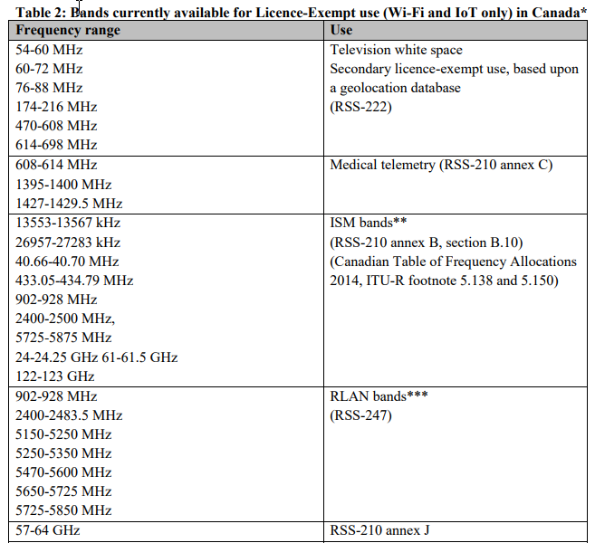

Slide 14
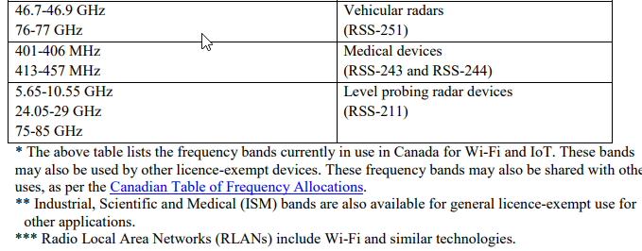

Slide 15
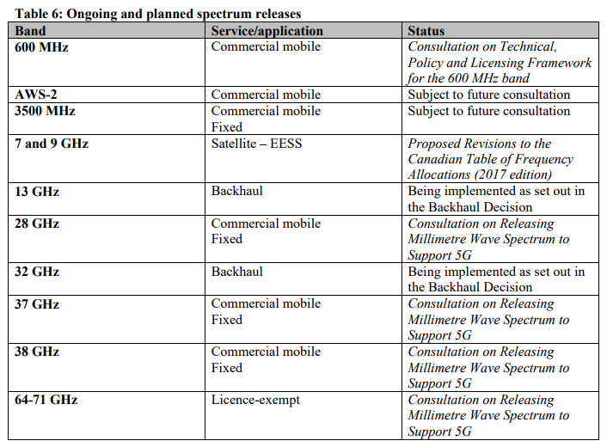

Slide 16
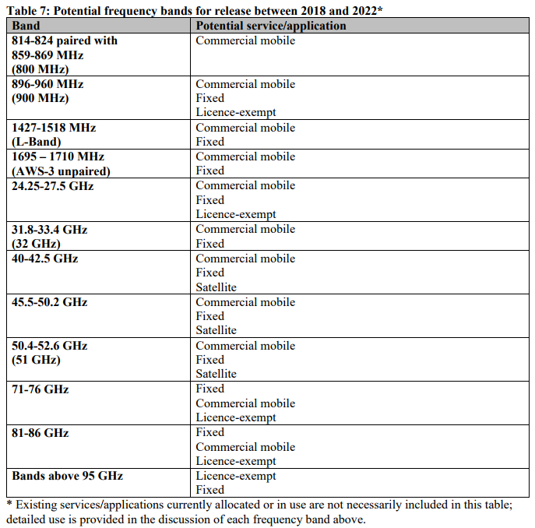

Slide 17
Americas – 3c
ISED Spectrum Outlook 2018 to 2022
Q1 – What future changes, if any, should ISED examine with regard to the existing licensing regime to better plan for innovative new technologies and applications and allow for benefits that new technology can offer, such as improved spectrum efficiency?
If licensing regime allows for 6GHz, we should look at this.
What is ISED considering for 6GHz?
  Our comments will need to be reviewed by 802.11 and 802.15, like the FCC NOI responses.
Q2 –Do you agree with the above assessment on demand for commercial mobile services in the next few years? Is there additional information on demand, which is not covered above, that should be considered? If so, please explain in detail.
We are interested.

Slide 18
Americas – 3d
ISED Spectrum Outlook 2018 to 2022
Q3 – What new technology developments and/or usage trends are expected to address traffic pressures and spectrum demand for commercial mobile services? When are these technologies expected to become available?
Need to respond.
Q4 – Recognizing the trend of increasing commercial mobile traffic, what operational measures (e.g. densification, small cells or advanced traffic management) are being taken to respond to, and support, increasing traffic? To what extent are these measures effective?
ISED should redefine quality and outage as RF not the same as copper.

Slide 19
Americas – 3e
ISED Spectrum Outlook 2018 to 2022
Q5 – Do you agree with the above assessment of demand for licence-exempt spectrum in the next few years? Is there additional information regarding demand, which is not covered above, that should be considered? If so, please explain in detail.
We have interest in this.
Q6 – What new technologies and/or sharing techniques are expected to aid in relieving traffic pressures and addressing spectrum demand for licence-exempt applications? When are these technologies expected to become available?
We have interest in this.

Slide 20
Americas – 3f
ISED Spectrum Outlook 2018 to 2022
Q7 – What existing licence-exempt frequency bands will see the most evolution in the next five years? Are there any IoT applications that will have a large impact on the existing licence-exempt bands? If so, what bands will see the most impact from these applications?
We have interest in this.
Q8 – Will the trend for offering carrier-grade or managed Wi-Fi services continue to increase over the next five years? If so, will this impact congestion in Wi-Fi bands and which bands would be most affected?
We have interest in this.

Slide 21
Americas – 3g
ISED Spectrum Outlook 2018 to 2022
Q9 – ISED is seeking comments on the above demand assessment for MSS and earth observation applications for the period 2018-2022. Is there additional information on demand, which is not covered above, that should be considered?
_n/a__
Q10 – ISED is seeking comments on the above demand assessment for FSS/BSS for the period 2018-2022. Is there additional information on demand, which is not covered above, that should be considered with regards to the below bands? a) C-band b) Ku-band c) Ka-band
_n/a __

Slide 22
Americas – 3h
ISED Spectrum Outlook 2018 to 2022
Q11 – What and how will technology developments and/or usage trends aid in relieving traffic pressures and addressing spectrum demand for satellite services? When are these technologies expected to become available?
_n/a__
Q12 – What satellite applications (e.g. broadband Internet, video broadcasting, backhaul, etc.) do you consider a priority for the period 2018-2022?
_n/a__

Slide 23
Americas – 3i
ISED Spectrum Outlook 2018 to 2022
Q13 – Do you agree with the above assessment on demand for backhaul in the next five years? Is there additional information on demand, which is not covered above, that should be considered? If so, please explain in detail.
We have interest, though need more discussion.
Q14 – Backhaul service in Canada is delivered using a variety of solutions, including fibre optics, microwave radio and satellites. What changes, if any, are anticipated to the mix of backhaul solutions employed?
We have interest, though need more discussion.

Slide 24
Americas – 3j
ISED Spectrum Outlook 2018 to 2022
Q15 – What and how will technology developments and/or usage trends aid in relieving traffic pressures and addressing spectrum demand for backhaul services? When are these technologies expected to become available?
We need to review the consultation more to understand this better.
  Backhaul considerations: 802.16h… 802.11ay… 802.11ad? )
Q16 – Will the demand for commercial mobile, licence-exempt, satellite, or fixed wireless services/applications impact the demand for backhaul spectrum? If so, how and which of these services/applications will create the most impact?
We need to review the consultation more to understand this better.

Slide 25
Americas – 3k
ISED Spectrum Outlook 2018 to 2022
Q17 – Is there a range or ranges of frequencies that will be in higher demand over the next five years? Why is higher demand anticipated for these frequency ranges?
We have interest in this.
Q18 –Will allowing flexible fixed and mobile services within the same frequency band change how backhaul is planned and used?
We need to review the consultation more to understand this better.

Slide 26
Americas – 3l
ISED Spectrum Outlook 2018 to 2022
Q19 – Provide, with rationale, your view of the above assessments on the bands being considered internationally for commercial mobile, fixed, satellite, or licence-exempt.
We have interest in this.
Q20 – ISED is seeking comments on the potential frequency bands for release in table 7:
  a) the proposed services and/or applications for each frequency band
  b) the potential timing of releasing for each frequency band
  c) the priority of the release of the frequency bands
We have interest in this.

Slide 27
Americas – 3m
ISED Spectrum Outlook 2018 to 2022
Provide supporting rationale for your responses.
Q21 – Are there any other bands that should be considered for release in the next five years for commercial mobile, fixed, satellite, or licence-exempt that are not discussed above? Provide rationale for your response.
We have interest in this.
Q22 – Are there specific frequency ranges/spectrum bands that should be made available for specific applications?
We have interest in this.
What is ISED considering for 6GHz?
  Our comments will need to be reviewed by 802.11 and 802.15, like the FCC NOI responses.
What about 915MHz? … and global harmonization e.g. 802.11ah…
Q23 – Are there any factors that would impact the potential release of these frequency bands between 2018 and 2022?
We have interest in this.

Slide 28
EMEA-1
6 GHz activity
  EC mandate, RSCOM17-53rev1, now final and is limited to 5925-6425MHz.
    Did not go to 7125MHz, too much opposition.
  ERM SR Doc, TR 103 524 has some opposition, still expecting to get published end of January
    Ian Marshal (Ruckus/ARRIS) is rapporteur; DTR/ERM-570 (TR 103 524).
    More worse case use scenarios; more clarity on power out levels, few more.
  3GPPP RAN#78 (RP-172804) study item, looking at 5925 – 7125GHz also.
    The objective of this Study Item is to investigate the existing regulatory framework in different regions for the band 5.925-7.125 GHz and to monitor the ongoing work within the regulatory organisations on this band. This will provide useful information for consideration of this band for potential LTE operations and NR operations if this band becomes available for operation

Slide 29
EMEA-2
6 GHz activity – cont.
  CEPT ECC SE45 and FM57 had their first meetings.
    SE45 updated the draft ECC Report formerly developed under WI SE24_62. In particular, SE45 introduced RLAN parameters as contained in the SRDoc ETSI TR 103 524 currently under approval.
    FM57 discussed the opportunity to prepare a questionnaire and obtain information on the actual deployment and technical and operational parameters of FS in the 6 GHz range. Initial views were expressed by the meeting including the ongoing work in SE19 on the revision of ECC Report 173 on FS usage. FM57 agreed to ask for guidance to next WG FM meeting with respect to the workings of the group.

Slide 30
EMEA-3
60 GHz activity
  60GHz ETSI SR doc being worked on with some points on ITS channelization.
    Scott Blue (Microsoft) is the rapporteur; DTR/ERM-575 (TR 103 583)
    1) To provide information on the intended applications of multiple gigabit wireless systems (MGWS) in radio spectrum between 57GHz and 71GHz including outdoor applications; 2) To detail Millimetre Wave communication for Intelligent Transport Systems (mmW-ITS) and propose moving the existing mmW-ITS allocation to a single MGWS channel; 3) To include technical parameters, mitigation techniques, the relation to the existing spectrum regulation, additional new radio spectrum requirements and expected compatibility issues; 4) This document is intended to update and replace TR 102 555 and TR 102 400.

Slide 31
EMEA-4a
Ofcom consultation looking at 6 and 60 GHz
  https://www.ofcom.org.uk/consultations-and-statements/category-2/fixed-wireless-spectrum-strategy
  https://mentor.ieee.org/802.18/dcn/18/18-18-0003-00-0000-ofcom-fixed-wireless-spectrum-strategy.pdf
  The document consults on changing the authorisation regime in the 64 – 66 GHz band to licence exempt and seeks views on a revised technical condition across the 57-66 GHz, commonly known as V band, in order to enable new fixed wireless access use cases. We are also seeking views on the adjacent 66 - 71 GHz band given that it could be part of the same ecosystem as V band.

Slide 32
EMEA-4b
Ofcom consultation looking at 6 and 60 GHz
  We also wish to further explore small channels based on CEPT channel plans at 6 GHz as potential replacement option for low capacity links in the 1.4 GHz band noting that spectrum at 6 GHz is also currently being considered for radio local area network (RLAN) within Europe.
  Given the current use of the 6 GHz band for long range high capacity connectivity, particularly between remote islands and between oil platforms, we are of the view that the international co-existence studies will first need to be completed to understand the feasibility of sharing before any decisions are taken regarding the use of RLANs in these frequency bands.
  Closing Date for Responses: 1 February 2018

Slide 33
EMEA-4c
Ofcom consultation looking at 6 and 60 GHz, questions.
Question 1:
Do you agree that we have identified the key drivers likely to have a significant impact on the spectrum demand for fixed wireless links? If not, please provide further detail and evidence to support your answer.
We agree with them.
Do you have other comments to make/points to raise with us on these issues?
Should add some.

Slide 34
EMEA-4d
Ofcom consultation looking at 6 and 60 GHz, questions.
Question 2:
Do you agree with our conclusions on spectrum implications and our proposed strategy/next steps for each band?
Depends on what Ofcom is thinking on 6GHz, hard for us to answer.
Need to review consultation text more. We may not agree with them.
Are there any other considerations of significance that you feel we should have included or do you have other comments to make/points to raise with us on these issues?
Will come out of reviewing consolation text more.
Please provide as much detail as possible to support your answer.
Will come out of reviewing consolation text more.

Slide 35
EMEA-4e
Ofcom consultation looking at 6 and 60 GHz, questions.
Question 3:
Do you agree with the items we’ve identified for further consideration?
Need to review consultation text.
Are there any other significant areas that you believe should be included?
Need to review consultation text.
If so, please include all necessary evidence to support your view.
Need to review consultation text.

Slide 36
EMEA-4f
Ofcom consultation looking at 6 and 60 GHz, questions.
Question 4:
Do you agree with our proposal to change the authorisation regime in the 64 – 66 GHz band to licence exempt to create a common authorisation approach across the 57 – 66 GHz band for fixed outdoor installation use and that this would be a benefit to UK citizens and consumers?
Yes, scale in 802.11ay.

Slide 37
EMEA-4g
Ofcom consultation looking at 6 and 60 GHz, questions.
Question 5:
Do you agree with the proposed new technical conditions in Table 6 to facilitate equipment intended for fixed outdoor installation in the 57 – 66 GHz band? Please provide evidenced views /alternatives if you disagree with our proposal. Do you consider any additional conditions should be mandated as part of a licence exemption to manage the interference environment?
We need to look at what the ECC is doing and align with others.
b) Do you agree with our assessment that the proposed changes in technical conditions will have minimal impact on existing use and are appropriate to manage the future outdoor interference environment?
_p/o above__
c) Are there likely to be any fixed outdoor installation use cases that will require operation at eirp levels above 55 dBm? If so, please provide evidence of how the coexistence with the different outdoor users could be ensured?
_n/a_

Slide 38
EMEA-4h
Ofcom consultation looking at 6 and 60 GHz, questions.
Question 6:
What are the use cases and technical parameters envisaged for the 66 - 71 GHz band? Are they likely to be similar to those in the 57 – 66 GHz band? If so, what are your views on extending the same or similar technical conditions as described above for the 57 - 66 GHz band (both existing wideband data transmission (SRD) and new fixed outdoor technical conditions) to the 66 – 71 GHz band to facilitate both fixed and mobile use cases.
See 802.11-2016 11ac / ad.
b) Please provide your view on whether the technical parameters of wideband data transmission (SRD) as shown in Figure 4 are suitable to facilitate mobile/portable equipment including use outdoor? If you do not consider they are suitable, what alternative technical parameters do you think should be considered?
We can explain why we need the spectrum, talk to someone from 802.11ay (Edward) to get some details.
Please provide as much detail to your answer as possible and your considerations on the co-existence aspects.
_p/o above__

Slide 39
EMEA-4i
Ofcom consultation looking at 6 and 60 GHz, questions.
Question 7:
Do you agree that there is a continued need for future low capacity fixed link applications?
Yes - command and control.
If so, please provide information to support your view and what alternatives you would consider appropriate should the upper 1.4 GHz band no longer be available.
We want to understand how the 1.4 GHz users would be placed into the 6GHz band, and understand their use cases.
Need to remember these are fixed links
Please provide clear evidence to support the reasons for your views.
_p/o above__

Slide 40
EMEA-4j
Ofcom consultation looking at 6 and 60 GHz, questions.
Question 8:
Do you consider there is merit in considering making the bands 52 GHz and 55 GHz available under alternative authorisation approach(es)such as block assignment? If so, what would you consider to be the best approach(es)? Please provide detailed views to support your response.
China 802.11aj, has bands near here.
How it is used or will be used in the future globally needs to be considered. If all of the EU could be enough justification even if not in NAM.
What about adjacent bands in other countries?
Question 9:
Do you think we should review our authorisation approach to any other band used for fixed wireless links?
Yes, can make comments on this.

Slide 41
EMEA-4k
Ofcom consultation looking at 6 and 60 GHz, questions.
Question 10:
How do you envisage W band and D band will be used for mobile backhaul provision and the likely timescales? Please provide as much detail as possible on deployment scenarios and whether this would include indoor use. Are there any other types of applications (other than mobile backhaul) that could be suited for these bands?
_n/a__
b) What are your views on the most appropriate authorisation approach for the W and D bands? Please provide as much detail and technical evidence as possible in your answer.
_n/a__

Slide 42
EMEA-4l
Ofcom consultation looking at 6 and 60 GHz, questions.
Question 11:
Which capacity enhancing technique(s) are you using or planning to use?
Yes, we can have something for this. (e.g. bandwidth, phase noise, …..)
Please provide detail / evidence and clearly explain why and how each technique is planned to be used and if you consider there are any other aspects that should be considered.
_p/o above_

Slide 43
EMEA-5
ETSI standards
  EN 301 893 has a new work item looking at several things.
    (1) To consider the possible inclusion of the band 5 725 MHz to 5 850 MHz together with appropriate mitigation techniques for operation in this band; (2) To revise clause 4.2.7.3.2.5 on Energy Detection Threshold (ED) and other sections of Adaptivity related to detection; (3) To revise clause 4.2.8 on Receiver Blocking and to consider the need to include additional receiver requirements; (4) To consider improving existing text throughout the entire document without changing requirements other than those identified in (1) to (3) above; (5) To revise/improve existing test methods where appropriate.

Slide 44
EMEA-6
ETSI standards – cont.
  EN 302 567, 60GHz, not in OJEU yet, possibly by end of February
    It is harmonized with the note:
    This harmonised standard does not address requirements relating to receiver performance parameters and does not confer a presumption of conformity as regards those parameters
    From the work item: (1) to revise the OOB/Mask, (2) to consider inclusion of RX Sensitivity, (3) to revise existing receiver requirements, (4) where appropriate, to revise/improve the test methods.

Slide 45
EMEA-7a
IMT (International Mobile Telecommunication) 2020
  ITU-R WP5D has issued a circular letter (https://www.itu.int/md/meetingdoc.asp?lang=en&parent=R00-SG05-CIR-0059)
  https://mentor.ieee.org/802.18/dcn/18/18-18-0006-00-0000-imt-2020-radio-interface-tech-r00-sg05-cir-0059.docx
  https://mentor.ieee.org/802.18/dcn/18/18-18-0007-00-0000-imt-2020-radio-interface-tech-r00-sg05-cir-0059-support.zip
    For more information on the IMT-2020 process please see: http://www.itu.int/en/ITU-R/study-groups/rsg5/rwp5d/imt-2020/Pages/ws-20171004.aspx and/or http://www.itu.int/en/ITU-R/study-groups/rsg5/rwp5d/imt-2020/Pages/default.aspx
    And
    https://www.itu.int/en/ITU-R/study-groups/rsg5/rwp5d/imt-2020/Pages/submission-eval.aspx

Slide 46
EMEA-7b
IMT 2020 – cont.
  The purpose of this Circular Letter is to invite the submission of proposals for candidate radio interface technologies (RITs) or a set of RITs (SRITs) for the terrestrial components of IMT‑2020.
  The Working Party 5D timeline shows that the submission of proposals is scheduled to begin at meeting #28 (October 2017) and end at meeting #32 (mid-2019)
  802.11 AANI SC meetings this week will be working on a response to get to ITU-R WP5D by their meeting on 31 January 2018.
    Mon PM1, Mon Eve, Tue PM1, Tue Eve, Wed PM2, Thu AM2,
    The 802.11 start of a contribution:
    https://mentor.ieee.org/802.11/dcn/17/11-17-1889-02-AANI-skeleton-for-a-candidate-imt-2020-rit-based-on-ieee-802-11.docx
  As of Tuesday, not everyone in the 802.11 group are in agreement. There is a question if there will be a submission this week. Also learned, the schedule of 31 January was set internally, not from the ITU-R.
    Looking to be a 802.11 submission, though 802.18 can help with format, process and submittal to our IEEE 802 ITU Liasion.

Slide 47
APAC-1a
ACMA LIPD class licensing:
    https://www.legislation.gov.au/Details/F2016C00432/Html/Text#primary-nav
    https://www.acma.gov.au/theACMA/Consultations/Consultations
    https://www.acma.gov.au/theACMA/variations-to-the-lipd-class-licence-2
  https://mentor.ieee.org/802.18/dcn/18/18-18-0001-00-0000-acma-proposed-variation-to-lipd-licensing-3-docs.docx
  A class licence sets out the conditions under which any person is permitted to operate any device to which the class licence is applicable—it is not issued to an individual user and does not involve the payment of licence fees

Slide 48
APAC-1b
ACMA LIPD class licensing:
  In summary, the proposed variation to the LIPD Class Licence consists of:
    adding the frequency range 122–122.25 GHz to arrangements for all transmitters, aligning with European arrangements
    supporting the operation of endoscopy capsules in the frequency range 430–440 MHz
    supporting wireless medical telemetry devices operating in the frequency range 2483.5–2500 MHz
    revising technical limitations on existing arrangements for data communication transmitters operating in the 57–66 GHz band to align with changes by the United States Federal Communications Commission (FCC).
  The ACMA invites comment from interested parties on the proposed variation by COB, Friday 19 January 2018

Slide 49
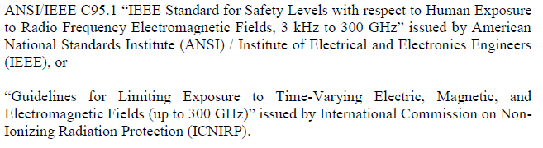
APAC-2a
HKCA: Performance specification for radio equipment operating in the 920-925 MHz band for the provision of public tele services
  https://www.ofca.gov.hk/filemanager/ofca/en/content_401/hkca1078.pdf
  https://mentor.ieee.org/802.18/dcn/18/18-18-0002-00-0000-performance-specs-920-925mhz-equipment.pdf

Slide 50
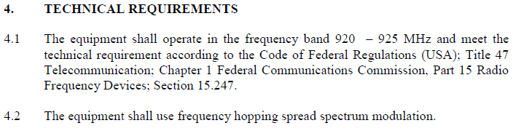
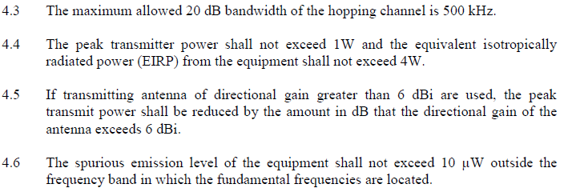
APAC-2b
HKCA: Performance specification for radio equipment operating in the 920-925 MHz band for the provision of public tele services

Slide 51
Thursday Agenda
Reminder of IEEE policies we are under
Items from Tuesday.
  Presentation from Andy Gowen from Ofcom.
  Vote on Ofcom consultation, if available.
  Review ITU-R IMT 2020 Circular Letter submission on RITs, if available.
AOB
Adjourn

Slide 52
Actions Required
Ofcom fixed wireless consultation, this week.
ISED spectrum consultation the next couple of teleconferences.

Slide 53
Any Other Business
How IEEE 802 can connect with the EU Commission on a letter that they sent to sent to ETSI on 5G standardization. Reviewing with the IEEE 802 chair.

Slide 54
Adjourn
Next teleconference: 25 January at 14:30 ET
    Note: updated call in info: https://mentor.ieee.org/802.18/dcn/16/18-16-0038-08-0000-teleconference-call-in-info.pptx
Adjourn:
  Agenda is complete, Motion to Adjourn.
  Moved by:
  Seconded by:
  We are adjourned.
Thank You

Slide 55
Safe Travels
Back up slides follow

Slide 56
S.1682
This bill requires the Federal Communications Commission (FCC) to complete auctions during each of the next three calendar years that will grant new broadcast licenses for specified frequency spectrum bands.
The FCC and the National Telecommunications and Information Administration are directed to identify frequencies in specified spectrum bands that may be utilized for: (1) non-federal unlicensed use; and (2) commercial licensed use.
The FCC must allocate 10% of proceeds from each of the spectrum band auctions specified in the bill to expand wireless infrastructure in rural areas that are underserved or unserved.
The FCC shall conduct a study on how unlicensed frequency spectrum bands can be utilized for: (1) the provision of healthcare in rural areas, (2) distance learning, and (3) facilitating innovations in agriculture.

Slide 57
5.2 Commercial mobile services ISED
25. The evolution of mobile communications has had a significant impact on all sectors of the economy and continues to contribute to the economic and social well-being of Canadians. Canadians want high-quality services, ubiquitous coverage and affordable prices from their telecommunication service providers. Smartphones, tablets, wearable devices, machine-to-machine (M2M) devices and the applications that run on them are changing the way that Canadians work, live and play. Mobile communications have become integrated into the daily lives of Canadians as they increasingly rely on mobile services to access a variety of mobile applications, such as multi-media services, social networking and Internet browsing, on a day-to-day basis to do business, connect with others, and to manage finances, health and homes.

Slide 58
26. Commercial mobile services are becoming the preferred communication tool for many Canadians. The Canadian Radio-television and Telecommunications Commission’s Communications Monitoring Report 2015 showed for the first time that more Canadian households subscribed exclusively to mobile wireless services (20.4%) than exclusively to wireline telephone services (14.4%). The Communications Monitoring Report 2016 shows this trend increasing, with 23.7% of Canadian households subscribed exclusively to mobile wireless services, and only 13.6% subscribed exclusively to wireline telephone services. In addition, the 2016 report indicates that while the majority of Canadians still own and use wireline phones, the data confirms the steady shift away from this technology in favour of wireless services. More Canadian households have mobile phones (85.6%) than landlines (75.5 %) – a big change from only ten years ago, when just over half of Canadian households subscribed to mobile phones (62.9%) and almost all subscribed to landlines (94.0%).

Slide 59
IMT 2020:
The buzz in the industry on future steps in mobile technology — 5G — has seen a sharp increase, with attention now focused on enabling a seamlessly connected society in the 2020 timeframe and beyond that brings together people along with things, data, applications, transport systems and cities in a smart networked communications environment. In this context, ITU and its partners, sharing a common community of interest, have recognized the relationship between IMT — International Mobile Telecommunication system — and 5G and are working towards realizing the future vision of mobile broadband communications.
In early 2012, ITU-R embarked on a programme to develop “IMT for 2020 and beyond”, setting the stage for 5G research activities that are emerging around the world.
Through the leading role of Working Party 5D, ITU’s Radiocommunication Sector (ITU-R) has finalized its view of a timeline towards IMT-2020. The detailed investigation of the key elements of 5G are already well underway, once again utilizing the highly successful partnership ITU-R has with the mobile broadband industry and the wide range of stakeholders in the 5G community.

Slide 60
IMT 2020-cont:
In September 2015, ITU-R has finalized its “Vision” of the 5G mobile broadband connected society. This view of the horizon for the future of mobile technology will be instrumental in setting the agenda for the World Radiocommunication Conference 2019, where deliberations on additional spectrum are taking place in support of the future growth of IMT.
ITU has a rich history in the development of radio interface standards for mobile communications. The framework of standards for International Mobile Telecommunications (IMT), encompassing IMT-2000 and IMT-Advanced, spans the 3G and 4G industry perspectives and will continue to evolve as 5G with IMT-2020.
https://www.itu.int/en/ITU-R/study-groups/rsg5/rwp5d/imt-2020/Pages/default.aspx

Slide 61
Ofcom:
1.1 A fixed wireless link, also referred to as a microwave link, is the wireless transmission of information between two or more fixed locations using electromagnetic waves.
1.2 Fixed wireless links complement other transmission media such as connections provided by fixed networks e.g. fibre. Fixed wireless links are used where fibre is not available or cost effective for a variety of applications including:
• backhaul provision for mobile network base stations;
• distributing TV signals from studios to broadcast transmitter sites;
• connecting nodes within private or corporate communication networks;
• enabling the safe and secure supply of water, electricity and gas in the UK;
• emergency services communications backhaul; and
• provision of fixed wireless broadband for last mile connectivity commonly known as fixed wireless access.
1.3 In the UK, the radio spectrum used to deploy fixed wireless links consists of specific bands currently ranging from 1.3 GHz to 86 GHz. The choice of frequency band is dependent on various factors including range, resilience to rain and availability of spectrum. The bands are also, in most cases, harmonised across Europe and shared with other services.

Slide 62
Motion: Approve 18-18/00__r_ for submission to the EC for review and approval, for uploading onto the Ofcom web page for the Fixed Wireless Spectrum consultation, before 01 February 2018. The chair of 802.18 is empowered to make editorial changes as necessary.
Move by:
Second by:
Discussion: None
Vote: ___ Yes ___ No __ Abstain
Motion: Passed

