Slide 1
IEEE 802.18 RR-TAG December 14th Teleconference Agenda
Date: 2017-11-30
Authors:

Slide 2
Agenda
Approve the agenda
Discussion items
ATSC 3.0 FNPRM
ISED Canada TVWS consultation
ISED Canada Spectrum Outlook consultation
Actions required
TBD
AOB and Adjourn
Agenda

Slide 3
Administrative Items
Required notices
Affiliation FAQ - http://standards.ieee.org/faqs/affiliationFAQ.html
Anti-Trust FAQ - http://standards.ieee.org/resources/antitrust-guidelines.pdf
Ethics - http://www.ieee.org/portal/cms_docs/about/CoE_poster.pdf
IEEE 802 WG Policies and Procedures - http://www.ieee802.org/devdocs.shtml
Officers
Chair is Rich Kennedy (HP Enterprise)
Vice-chair is Jay Holcomb (Itron)
Secretary: Allan Zhu (Huawei)

Slide 4
Other Guidelines for IEEE WG Meetings
All IEEE-SA standards meetings shall be conducted in compliance with all applicable laws, including antitrust and competition laws.
Don’t discuss the interpretation, validity, or essentiality of patents/patent claims.
Don’t discuss specific license rates, terms, or conditions.
Relative costs, including licensing costs of essential patent claims, of different technical approaches may be discussed in standards development meetings.
Technical considerations remain primary focus
Don’t discuss or engage in the fixing of product prices, allocation of customers, or division of sales markets.
Don’t discuss the status or substance of ongoing or threatened litigation.
Don’t be silent if inappropriate topics are discussed … do formally object.
---------------------------------------------------------------
See IEEE-SA Standards Board Operations Manual, clause 5.3.10 and “Promoting Competition and Innovation: What You Need to Know about the IEEE Standards Association's Antitrust and Competition Policy” for more details.
Notes:
4

Slide 5
Participation in IEEE 802 Meetings
Participation in any IEEE 802 meeting (Sponsor, Sponsor subgroup, Working Group, Working Group subgroup, etc.) is on an individual basis
Participants in the IEEE standards development individual process shall act based on their qualifications and experience. (https://standards.ieee.org/develop/policies/bylaws/sb_bylaws.pdf section 5.2.1)
IEEE 802 Working Group membership is by individual; “Working Group members shall participate in the consensus process in a manner consistent with their professional expert opinion as individuals, and not as organizational representatives”. (subclause 4.2.1 “Establishment”, of the IEEE 802 LMSC Working Group Policies and Procedures)
Participants have an obligation to act and vote as an individual and not under the direction of any other individual or group. A Participant’s obligation to act and vote as an individual applies in all cases, regardless of any external commitments, agreements, contracts, or orders.
Participants shall not direct the actions or votes of any other member of an IEEE 802 Working Group or retaliate against any other member for their actions or votes within IEEE 802 Working Group meetings, see https://standards.ieee.org/develop/policies/bylaws/sb_bylaws.pdf section 5.2.1.3 and the IEEE 802 LMSC Working Group Policies and Procedures, subclause 3.4.1 “Chair”, list item x.
By participating in IEEE 802 meetings, you accept these requirements. If you do not agree to these policies then you shall not participate.
(Latest revision of IEEE 802 LMSC Working Group Policies and Procedures: http://www.ieee802.org/devdocs.shtml)
Slide 5
Notes:
5
doc.: ec-16-0149-00-00EC
November 2016
Dorothy Stanley, HP Enterprise
Page 5

Slide 6
Discussion Items
ATSC 3.0 FNPRM
ISED Canada TVWS consultation
ISED Canada Spectrum Outlook consultation

Slide 7
ATSC 3.0 FNPRM
http://transition.fcc.gov/Daily_Releases/Daily_Business/2017/db1120/FCC-17-158A1.pdf
“…we authorize television broadcasters to use the “Next Generation” broadcast television (Next Gen TV) transmission standard, also called “ATSC 3.0” or “3.0,” on a voluntary, market-driven basis.”
“…subject to broadcasters continuing to deliver current-generation digital television (DTV) service, using the ATSC 1.0 transmission standard, also called “ATSC 1.0” or “1.0,” to their viewers.”
“…we seek further comment on three topics related to the rules adopted in the companion Report and Order.”
we seek further comment on issues related to exceptions to and waivers of the local simulcasting requirement
we seek comment on whether we should let full power broadcasters use channels in the television broadcast band that are vacant to facilitate the transition to 3.0.
we tentatively conclude that local simulcasting should not change the significantly viewed status of a Next Gen TV station.

Slide 8
ISED Canada TVWS consultation
Harmonizing TVWS rules with the US
https://www.ic.gc.ca/eic/site/smt-gst.nsf/vwapj/Consultation-WhiteSpace-eng.pdf/$FILE/Consultation-WhiteSpace-eng.pdf
Allowing fixed white space devices on channels 3 and 4
Operation of personal portable TVWS devices on channels 13-40
Now permit operation below 608 MHz
Preclude the use of channel 37
US allows low power use
Comments due Jan 17, 2018

Slide 9
ISED Spectrum Outlook
In support of Canada’s Innovation and Skills Plan, and with a focus on ensuring that Canadians can benefit from world-class networks and advancements in new digital technologies and services, ISED acknowledges that as the demand for digital connectivity grows, so will the demand for spectrum. Through the release of this document, ISED, on behalf of the Minister, is hereby initiating a consultation on the overall approach and planning activities related to the release of spectrum for commercial mobile services, licence-exempt applications, satellite services and wireless backhaul services over the years 2018 to 2022.
Comment period ends January 9, 2018
Reply Comment period ends February 8, 2018

Slide 10
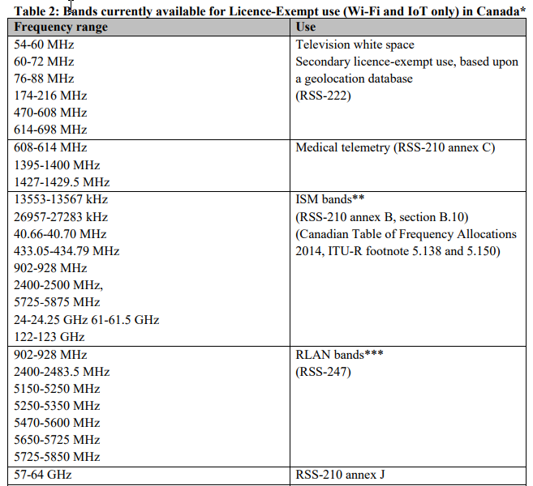

Slide 11
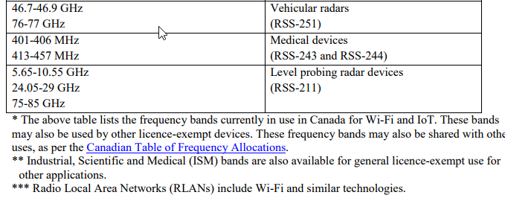

Slide 12
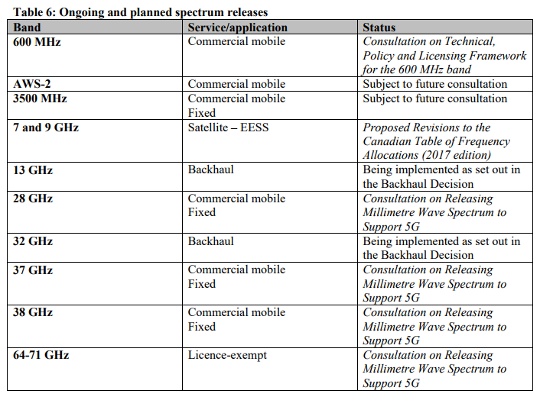

Slide 13
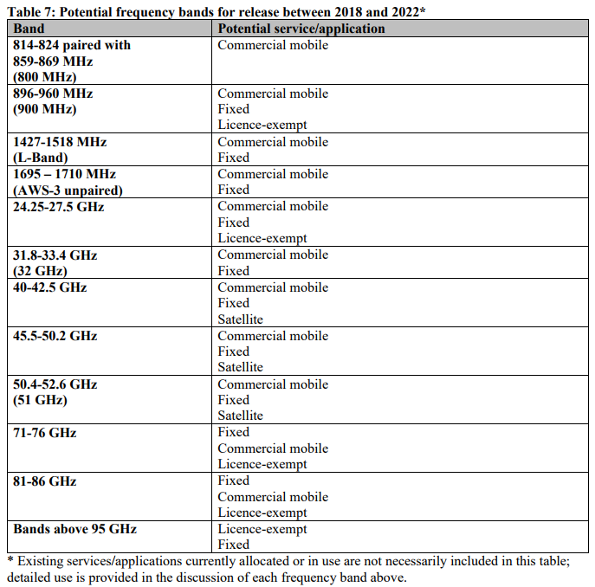

Slide 14
Actions [Required]
TBD

Slide 15
Any Other Business
Next meeting: January 4, 2018 at 2:30pm EDT
Happy Holidays to all!

