Slide 1
FCC Mid-band Spectrum NOI
Response Outline
Date: 2017-08-24
Authors:

Slide 2
Overview
This is the outline for an IEEE 802 response to the FCC Mid-band Spectrum NOI, FCC 17-104.

Slide 3
Introduction
Two independent Spectrum Needs Studies show that unlicensed spectrum congestion will become a serious impediment to growth of Wi-Fi
  IEEE 802.11ax will need more than is available today if it is to live up to its promise
The 5 GHz band opening of 775 MHz of contiguous spectrum has been the plan since the last addition of unlicensed spectrum in 2003
  NTIA has permanently blocked 120 MHz in the middle of the band (5350-5470 MHz)
  Sharing with DSRC in 5850–5925 MHz is still under study after four years
Opening 6 GHz band for unlicensed sharing is the object of an FCC proceeding

Slide 4
Unlicensed Spectrum
The 2.4 GHz band basically has three 20 MHz channels
The 5 GHz band has only five 80 MHz channels
  5350-5470 MHz (U-NII-2b) has been taken off the table
  5850-5925 MHz (U-NII-4) which would be shared with ITS, still uncertain
  New radars could block parts of 5250-5350 MHz and 5470-5725 MHz
The promise of 775 MHz of contiguous unlicensed spectrum in 5 GHz band now is unachievable in the US
  The situation in the EU is the same, and could be worse
The value of 802.11ax could be severely limited by a lack of 80 and 160 MHz channels

Slide 5
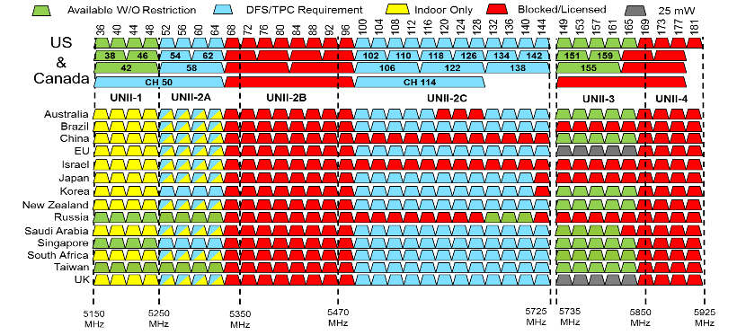
The 5 GHz Band
?

Slide 6
The Proposed 6 GHz Band
Channel 0
59 x 20 MHz
20
20
20
20
20
20
20
20
20
20
20
20
20
20
20
20
20
20
20
20
20
20
20
20
20
20
20
20
20
20
20
20
20
20
20
20
20
20
20
20
20
20
20
20
20
20
20
20
20
20
20
20
20
20
20
20
20
20
20
29 x 40 MHz
40
40
40
40
40
40
40
40
40
40
40
40
40
40
40
40
40
40
40
40
40
40
40
40
40
40
40
40
40
14 x 80 MHz
80
80
80
80
80
80
80
80
80
80
80
80
80
80
7 x 160 MHz
160
160
160
160
160
160
160
U-NII-5
U-NII-6
U-NII-7
U-NII-8
_{5925 MHz}
_{6425 MHz}
_{6525 MHz}
6875 MHz
7125 MHz
Protection of DSRC in U-NII-4 could shift the starting frequency by 10 or 20 MHz

Slide 7
Comments: Band Structure
Part 15.407: The 5.925 GHz to 6.425 GHz and 6.425 GHz to 7.125 GHz bands should be designated as U-NII bands, with limits equal to the U-NII-1 band
  Based on the placement of incumbents operating under different rules, Parts 74, 78 and 101, these bands should be assigned as separate U-NII bands
    U-NII-5: 5.925 GHz to 6.425 GHz (sharing with FS and FSS incumbents)
    U-NII-6: 6.425 GHz to 6.525 GHz (sharing with BAS and CARS)
    U-NII-7: 6.525 GHz to 6.875 GHz (same as U-NII-5)
    U-NII-8: 6.875 GHz to 7.125 GHz (sharing with BAS and CARS)

Slide 8
Comments: Incumbent Protection
It is understood that indoor deployments will not require special mitigation techniques
  Indoor deployments will utilize transmit power control and take advantage of Building Entry Loss (ITU P.2109 formerly P.(BEL)) to limit interference to incumbents
  Database control of access not necessary, but could be employed if higher power is used
Fixed outdoor devices will use geo-location database access to ensure protection of incumbents
  Techniques similar to IEEE 802.11 Enablement mechanisms could be employed to ensure that all devices operate under constraints determined by protection criteria based on ULS data
  Specialized antennas may also be used to control interference
  A Registered Location Secure Server option, may provide enforcement utility

Slide 9
Comments: NPRM Timing
Due to its equivalency with U-NII-5, U-NII-7 should be considered following the opening of U-NII-5, under the same rules
  U-NII-6 and U-NII-8 will take more time to develop
    Mobile FS protection issues need further study

Slide 10
Comments: Data Integrity
In order to guarantee protection for incumbents, it is essential that the FCC ULS database be scrubbed to ensure all entries are correct and current
  Higher Ground has done an exhaustive study of the ULS database, and could be employed in assisting the FCC with this task
  Licensees could be asked to indicate intent to continue use, and present a timeline for any phase out plan
The FCC should also check that the number and location of FSS ground stations is correct and current
  Licensees could be asked to indicate intent to continue use, and present a timeline for any phase out plan

Slide 11
Comments: Other
Global harmonization: The FCC should support efforts to globalize these rules
Urgency: We are specifically avoiding Federal spectrum sharing at this time due to the urgency of the need for additional unlicensed spectrum
  Sharing with Federal users will take more time than with non-Federal
  Two separate spectrum needs studies show serious impairment of expected Wi-Fi connections within the next three years without a spectrum add, affecting consumers and businesses that rely on Wi-Fi

Slide 12
Notes
DFS changes?
  Bi-static radars, Fast FH radars detectability
Any inputs on 3.7-4.2 GHz?

