Slide 1
ITS in 60GHz
- An updated proposal discussed in ETSI TC BRAN and TC ITS
Date: 2017-07-12
Authors:

Slide 2
Introduction
In Europe the CEPT has designated the band 63 GHz to 64 GHz to ITS applications (ECC DEC 09/01)
The ITS channel in 60 GHz overlaps with two RLAN channels defined in ETSI and in ITU
Current situation impacts two operational RLAN channels and is technically complex
No standardized system for the use in ITS in 60 GHz has been specified up to now

Slide 3
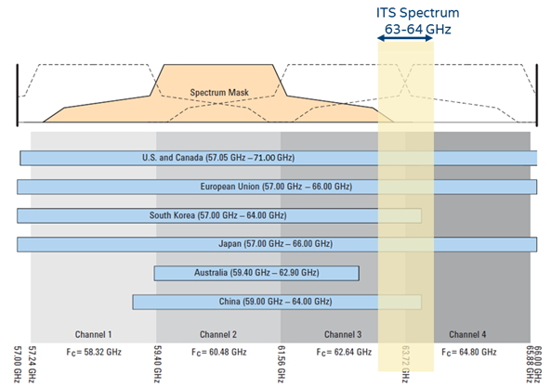

60 GHz band plan world-wide
Other countries do not have such an ITS designation for the 60 GHz band and just use it for RLAN application
Figure shows the band available for the RLAN applications

Slide 4
Proposal
Redefine the ITS 60 GHz allocation by harmonizing the designation with RLAN designation
Move ITS channel up or down to channel 3 or channel 4 of RLAN designation

Slide 5
Advantage for ITS and RLAN
Possible re-use of existing cheap hardware
Simplified sharing operation by common access layer
Possible World-Wide availability of the channel

Slide 6
Further steps
The proposal has been discussed in ETSI TC ITS and TC BRAN
In a next step a common TC BRAN/TC ITS input (System Reference Document) to CEPT WG FM to propose this change in designation will be prepared
Update the corresponding ITS decision on CEPT level
Include that new designation into the ITU-R WRC19 discussions under agenda item 1.12
  Here the 63 GHz to 64 GHz designation is already included in the draft documents

