Slide 1
IEEE 802.18 RR-TAG June 15th Teleconference Agenda
Date: 2017-06-15
Authors:

Slide 2
Agenda
Approve the agenda
Discussion items
Regulatory work in progress
Status of completed work
Actions required
TBD
AOB and Adjourn
Agenda

Slide 3
Administrative Items
Required notices
Affiliation FAQ - http://standards.ieee.org/faqs/affiliationFAQ.html
Anti-Trust FAQ - http://standards.ieee.org/resources/antitrust-guidelines.pdf
Ethics - http://www.ieee.org/portal/cms_docs/about/CoE_poster.pdf
IEEE 802 WG Policies and Procedures - http://www.ieee802.org/devdocs.shtml
Officers
Chair is Rich Kennedy (HP Enterprise)
Vice-chair is Jay Holcomb (Itron)
Secretary: Allan Zhu (Huawei)

Slide 4
Other Guidelines for IEEE WG Meetings
All IEEE-SA standards meetings shall be conducted in compliance with all applicable laws, including antitrust and competition laws.
Don’t discuss the interpretation, validity, or essentiality of patents/patent claims.
Don’t discuss specific license rates, terms, or conditions.
Relative costs, including licensing costs of essential patent claims, of different technical approaches may be discussed in standards development meetings.
Technical considerations remain primary focus
Don’t discuss or engage in the fixing of product prices, allocation of customers, or division of sales markets.
Don’t discuss the status or substance of ongoing or threatened litigation.
Don’t be silent if inappropriate topics are discussed … do formally object.
---------------------------------------------------------------
See IEEE-SA Standards Board Operations Manual, clause 5.3.10 and “Promoting Competition and Innovation: What You Need to Know about the IEEE Standards Association's Antitrust and Competition Policy” for more details.
Notes:
4

Slide 5
March 2017
Participation in IEEE 802 Meetings
Participation in any IEEE 802 meeting (Sponsor, Sponsor subgroup, Working Group, Working Group subgroup, etc.) is on an individual basis
Participants in the IEEE standards development individual process shall act based on their qualifications and experience. (https://standards.ieee.org/develop/policies/bylaws/sb_bylaws.pdf section 5.2.1)
IEEE 802 Working Group membership is by individual; “Working Group members shall participate in the consensus process in a manner consistent with their professional expert opinion as individuals, and not as organizational representatives”. (subclause 4.2.1 “Establishment”, of the IEEE 802 LMSC Working Group Policies and Procedures)
Participants have an obligation to act and vote as an individual and not under the direction of any other individual or group. A Participant’s obligation to act and vote as an individual applies in all cases, regardless of any external commitments, agreements, contracts, or orders.
Participants shall not direct the actions or votes of any other member of an IEEE 802 Working Group or retaliate against any other member for their actions or votes within IEEE 802 Working Group meetings, see https://standards.ieee.org/develop/policies/bylaws/sb_bylaws.pdf section 5.2.1.3 and the IEEE 802 LMSC Working Group Policies and Procedures, subclause 3.4.1 “Chair”, list item x.
By participating in IEEE 802 meetings, you accept these requirements. If you do not agree to these policies then you shall not participate.
(Latest revision of IEEE 802 LMSC Working Group Policies and Procedures: http://www.ieee802.org/devdocs.shtml)
Slide 5
Notes:
5
doc.: ec-16-0149-00-00EC
November 2016
Dorothy Stanley, HP Enterprise
Page 5

Slide 6
NEWS
President Trump has nominated Rosenworcel to return as FCC Commissioner
Jessica Rosenworcel has been a major supporter of unlicensed spectrum
FierceWireless Article
STATEMENT OF COMMISSIONER MIGNON CLYBURN ON PRESIDENT'S INTENT TO NOMINATE JESSICA ROSENWORCEL by Statement. OCMC https://apps.fcc.gov/edocs_public/attachmatch/DOC-345349A1.docx
STATEMENT OF COMMISSIONER MICHAEL O'RIELLY ON ROSENWORCEL NOMINATION by Statement. OCMO . Contact Robin Colwell Robin.Colwell@fcc.gov 202.418.2300 https://apps.fcc.gov/edocs_public/attachmatch/DOC-345351A1.docx
CHAIRMAN PAI STATEMENT ON PRESIDENT'S INTENT TO NOMINATE JESSICA ROSENWORCEL TO THE FCC. FCC Chairman Ajit Pai issued a statement on the President's intent to nominate Jessica Rosenworcel to return to the Commission.. Adopted: 06/14/2017 by Statement. OCHAP https://apps.fcc.gov/edocs_public/attachmatch/DOC-345350A1.docx

Slide 7
Discussion Items
Americas
EU
APAC

Slide 8
Americas Updates
NOI for 3.7-4.2 GHz and 6 GHz bands now expected in July or August
Wi-Fi Alliance meeting with FCC, Congress next week

Slide 9
ISED (Canada) Consultation Decision
http://www.ic.gc.ca/eic/site/smt-gst.nsf/eng/sf11294.html
In light of the discussion [in the Public Notice] above, the Department will authorize the use of higher power RLAN devices (HPODs), both indoor and outdoor, in the 5150-5250 MHz frequency band under a licensed regime.
The licensing application process is described in Annex A.
Applications will be accepted from radiocommunication service providers and radiocommunication users as defined by the Radiocommunication Regulations, but will not be accepted from radiocommunication users who wish to operate HPODs for personal use.
Licensing will be on an all-come all-served basis, and all licences will have equal access to the spectrum.
Licensing for spectrum licences will be issued on a Tier 1 basis (i.e. Canada-wide), and will be given a one-year term.
No licence fee will apply. Fees may be applied in the future should a fee be established following a consultation.
The conditions of licence in annex B will apply to all licences for HPODs in the 5150-5250 MHz band. These conditions include an obligation to comply with technical requirements and with any technical directions issued by the Department during the licence term.

Slide 10
ISED Decision Parameters
Table 1: Technical requirements for HPODs
Type of device | Maximum conducted power | Maximum antenna gain | Maximum power spectral density | Vertical elevation mask (from the horizon) | Maximum out-of-band emission
Outdoor | 1 Watt | 6 dBi | 17 dBm/MHz | Maximum 125 mW (e.i.r.p.) above 30 degrees | -27 dBm/MHz e.i.r.p
Indoor | 1 Watt | 6 dBi | 17 dBm/MHz | N/A | -27 dBm/MHz e.i.r.p
Point-to-Point System | 1 Watt | 23 dBi | 17 dBm/MHz | Maximum 125 mW (e.i.r.p.) above 30 degrees | -27 dBm/MHz e.i.r.p

Slide 11
ISED consultation on 5G
New consultation on 5G
https://mentor.ieee.org/802.18/dcn/17/18-17-0082-00-0000-canada-ised-5g-consultation.pdf
Includes 64-71 GHz
Deadline: August 4, 2017

Slide 12
Amtrak Waiver Request
FCC granted the waiver that Amtrak requested (to use the technical parameters applicable to point-to-point operations in the U-NII-1 and U-NII-3 bands) with these restrictions:
1.) The total number of stations, including both trackside and train-based stations, operating pursuant to the waiver must be fewer than 1,000.
2.) Stations operating under the waiver are only permitted to operate within the right-of-way along the Boston-to-Washington, D.C. segment of Amtrak’s Northeast Corridor.
3.) Communication is only permitted from trackside stations to train-based stations – no direct-to-consumer connections are permitted.
4.) Amtrak must use equipment that is certified to meet the Commission’s technical rules for point-to-point operation.
5.) No data transmission is permitted from a trackside station unless a train is in position to receive the data transmission.
6.) No more than 50 train-based radios are permitted to transmit simultaneously along the entire authorized service area.
7.) Amtrak must report to the Commission any instances of harmful interference and shall be required to cease operations until the conditions causing the interference are corrected.

Slide 13
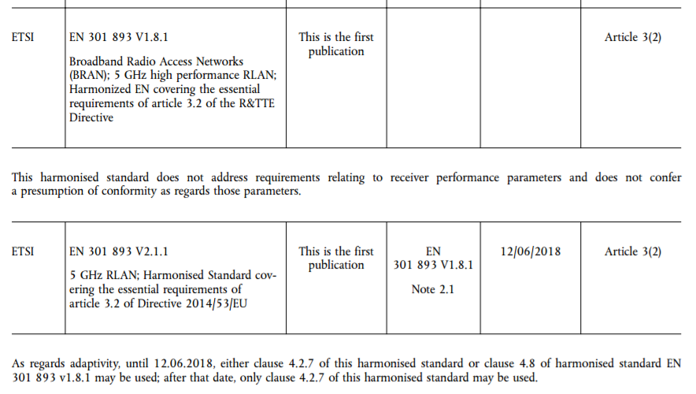
EU Updates
EN 301 893 v2.1.1 is Published in the 9-June OJEU
V1.8.1 still in the OJEU
Note that enables use of v2.1.1 with Adaptivity clause from v1.8.1

Slide 14
APAC Updates
Singapore IMDA’s consultation
5G mobile services and networks
Comments deadline: July 7, 2017
India TRAI’s consultation
Data Speed Under Wireless Broadband Plans
Comments deadline: July 13, 2017
China’s MIIT consultation
The use of 3300-3600 MHz and 4800-5000 MHz frequency bands for the fifth generation international mobile telecommunications systems (IMT-2020)
Comments deadline: July 7, 2017

Slide 15
MIIT Questions
3300-3600 MHz and 4800-5000 MHz as frequency bands for IMT-2020.
In principle, 3300-3400 MHz, when used as frequency band for IMT-2020, is limited to indoor use only. It can be extended for outdoor use if it does not create any interference with radiolocation.
3400-3600 MHz, when used as frequency band for IMT-2020, should not generate interference for fixed satellite service earth stations in the same frequency band. For those frequency bands with expiration but are used for the satellite telemetry and the adjacent earth station, these should be given some protection. Specific measures on the protection are to be discussed and resolved between the IMT-2020 system operators and the relevant satellite operators.
4990-5000 MHz, when used as frequency band for IMT-2020, should not generate interference for radio astronomy stations listed in footnote CHN12 of the Chinese Regulations on the Radio Frequency Allocation.
The above bands are used as IMT-2020 operating frequency bands and are managed by the national radio management authority. Frequency allocation scheme, equipment RF technical indicators and station management specific provisions to be developed and released.
Thanks to Edward Au (Huawei) for this translation

Slide 16
6 GHz Effort Progress
The SRdoc – ETSI TR 103 524 in process
Approval of first draft expected at July ETSI BRAN meeting
To be ready for SE24 meeting in September
EU regulatory scrub in process
FCC has ULS; Incumbent database needed for EU
Additional needed efforts for EC recognition
Informal meeting to be scheduled
Need EC mandate?

Slide 17
Actions Required
IMDA Consultation
ISED 5G Consultation

Slide 18
Any Other Business
Next meeting: June 22, 2017 at 2:30pm EDT

