Slide 1
IEEE 802.18 RR-TAG Daejeon Meeting Agenda
Date: 2017-05-09
2017-05-11
Authors:

Slide 2
Agenda
Meeting Tuesday AM2 and Thursday AM1 [+AM2] in Room 104
Approve Vancouver minutes
Discussion items
Regulatory work in progress
Status of completed work
Actions required
LS from IEEE 802 to the ITU-R on light communications
Advancing the 6 GHz effort in the US and EU
AOB and Adjourn
Agenda

Slide 3
Administrative Items
Required notices
Affiliation FAQ - http://standards.ieee.org/faqs/affiliationFAQ.html
Anti-Trust FAQ - http://standards.ieee.org/resources/antitrust-guidelines.pdf
Ethics - http://www.ieee.org/portal/cms_docs/about/CoE_poster.pdf
IEEE 802 WG Policies and Procedures - http://www.ieee802.org/devdocs.shtml
Officers
Chair is Rich Kennedy (HP Enterprise)
Vice-chair is Jay Holcomb (Itron)
Secretary: Allan Zhu (Huawei)

Slide 4
Other Guidelines for IEEE WG Meetings
All IEEE-SA standards meetings shall be conducted in compliance with all applicable laws, including antitrust and competition laws.
Don’t discuss the interpretation, validity, or essentiality of patents/patent claims.
Don’t discuss specific license rates, terms, or conditions.
Relative costs, including licensing costs of essential patent claims, of different technical approaches may be discussed in standards development meetings.
Technical considerations remain primary focus
Don’t discuss or engage in the fixing of product prices, allocation of customers, or division of sales markets.
Don’t discuss the status or substance of ongoing or threatened litigation.
Don’t be silent if inappropriate topics are discussed … do formally object.
---------------------------------------------------------------
See IEEE-SA Standards Board Operations Manual, clause 5.3.10 and “Promoting Competition and Innovation: What You Need to Know about the IEEE Standards Association's Antitrust and Competition Policy” for more details.
Notes:
4

Slide 5
Participation in IEEE 802 Meetings
All participation in IEEE 802 Working Group meetings is on an individual basis
• Participants in the IEEE standards development individual process shall act based on their qualifications and experience. (https://standards.ieee.org/develop/policies/bylaws/sb_bylaws.pdfsection 5.2.1)
• IEEE 802 Working Group membership is by individual; “Working Group members shall participate in the consensus process in a manner consistent with their professional expert opinion as individuals, and not as organizational representatives”. (subclause 4.2.1 “Establishment”, of the IEEE 802 LMSC Working Group Policies and Procedures)
Participants have an obligation to act and vote as an individual and not under the direction of any other individual or group. A Participant’s obligation to act and vote as an individual applies in all cases, regardless of any external commitments, agreements, contracts, or orders.
Participants shall not direct the actions or votes of any other member of an IEEE 802 Working Group or retaliate against any other member for their actions or votes within IEEE 802 Working Group meetings, see https://standards.ieee.org/develop/policies/bylaws/sb_bylaws.pdf section 5.2.1.3 and the IEEE 802 LMSC Working Group Policies and Procedures, subclause 3.4.1 “Chair”, list item x.
By participating in IEEE 802 meetings, you accept these requirements. If you do not agree to these policies then you shall not participate.
(Latest revision of IEEE 802 LMSC Working Group Policies and Procedures: http://www.ieee802.org/devdocs.shtml and Participation slide: https://mentor.ieee.org/802-ec/dcn/16/ec-16-0180-03-00EC-ieee-802-participation-slide.ppt )
Slide 5
Notes:
doc.: ec-16-0149-00-00EC
November 2016
Dorothy Stanley, HP Enterprise
Page 5

Slide 6
Approve the Vancouver Minutes
Motion: To approve the minutes from the IEEE 802.18 meeting at the Vancouver Plenary in document 18-17/0051r0.
Posted: 30-Apr-2017 23:23:11 ET
Moved by: Stuart
Seconded by: Mike L.
Discussion?
Vote: Unanimous consent

Slide 7
Discussion Items
FCC
EU
Other Regulatory

Slide 8
FCC Updates
Notice of Inquiry prepared for “Below 24 GHz”
Includes 3700-4200 MHz and 5925-7125 MHz
Also includes DoD bands; release held up as a result
Ask for FCC to separate out the non-DoD bands and issue NOI
Failing this, generate a Petition for Rulemaking
Still testing DSRC band coexistence
NTIA wants to enable additional radars in U-NII-2a and U-NII-3
Bistatic: receiver is undetectable
Fast FH: some hops can have one pulse; also undetectable
Could make bands unusable by 802.11

Slide 9
EU Updates
Ofcom 5725-5850 MHz band proposal
Still waiting for Ofcom resolution
EU Radio Equipment Directive & standards updates
See RED slide
6 GHz band sharing
5925 – 6425 MHz
NWI adopted by ETSI TC ERM
WGFM WI FM52 assigned
SRdoc TR 103 524 development started in ETSI TC BRAN

Slide 10
EU Radio Equipment Directive (RED)
The transition has already started
RED in THE LAW as of June 13, 2016
R&TTE expires June 12, 2017
After June 2017, all devices must meet the RED requirements, i.e. R&TTE certifications during the transition must be re-certified
Following the deadline, ALL equipment to be placed on the EU market must meet the RED provisions
EN 300 328 published in the OJEU!
It appears that EN 301 893 will not be not published in time
EC has NOT approved use of v1.8.1 with note that v2.0.7 Receiver Requirements must also be met
Passed ENAP; official publication date in August 19th, but could happen sooner

Slide 11
EN 301 893 Quandary
EN 301 893 v1.8.1 poised to be withdrawn 6/12/17
V2.1.1 could be published in time
Many Wi-Fi devices cannot meet the Adaptivity requirements in v2.1.1
Max TXON can exceed the 10 mSec limit with some silicon
Fix is currently unknown
Best option is v1.8.1 Adaptivity with v2.1.1 Receiver Requirements
No approved document exists with this pairing
V1.9.1 created at BRAN #93 to create this
EC says ETSI should approve without ENAP
ETSI says to do so would violate ETSI rules
Regulators that have to approve v1.9.1 rejecting based on the existence of v2.1.1

Slide 12
EN 301 893
EN 301 893 | Original Adaptivity | New Adaptivity | Receiver Blocking* | New Receiver Requirements* | Date of Withdrawal
v1.8.1 | X
v2.1.1 |  | X | X |  | ?
Proposed
v1.9.1 | X |  | X |  | June 2018
v2.2.1 | X |  | X |  | June 2018
v2.3.1 |  | X |  | X | ?
* RE-D Requirement

Slide 13
Other Regulatory

Slide 14
Actions Required
LS to the ITU-R on light communications
Support for unlicensed sharing in 6 GHz
IEEE 802 positions for WRC-19

Slide 15
Unlicensed Sharing of the 6 GHz Band
Wi-Fi volume growth and technology advancement are hampered by lack of significant 80 and 160 MHz channels
The (near) future demands gigabit speeds to avoid becoming the bottleneck
Sharing with FSS and fixed microwave links
Industry coalition to drive needed regulatory changes
Joint exploration of the 5925-7125 MHz with the intent of obtaining an unlicensed designation
Joint funding of third parties and engineering support to conduct interference analyses (incl. spectrum measurements, sharing studies, and potential mitigations) in support of unlicensed designation
Joint exploration of mitigation techniques and proposals, which may require standards contributions
Drive regulatory changes in the US, EU and globally

Slide 16
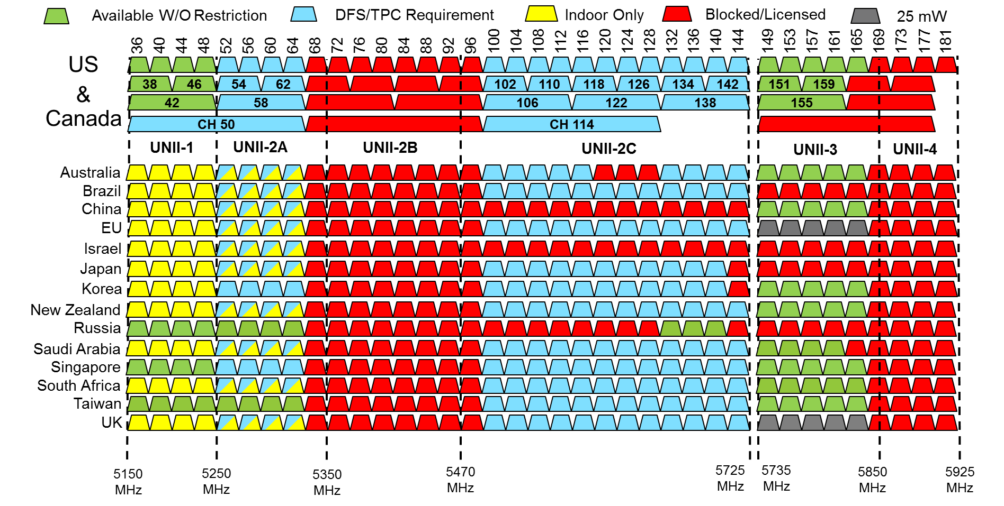
Disappointing 5 GHz Landscape
?

Slide 17
Thursday Agenda
Review and approve the agenda
Review the week
Actions required
Finalize the “LS” on light communications
Approve the 802 positions on WRC-19 AIs
AOB and Adjourn

Slide 18
Input to ITU-R SG1 WP1A
The ITU-R has started a study group to look at light communications
The ITU-R SG1 WP1A is composing a preliminary draft new report ITU-R SM.[VISIBLE-LIGHT], with input from various organizations developing standards for the use of the light spectrum for broadband communications.
The entire draft report from the ITU-R SG1 WP1A is available here:
https://mentor.ieee.org/802.11/dcn/17/11-17-0772-00-00lc-20170505-working-document-itu-r-towards-a-pdnr-on-near-visible-light-vlc-owc.docx
The IEEE 802 submission, approved by both 802.11 and 802.15 WGs, is in:

Slide 19
Motion #1
Approve the proposal in 18-17/75r0 and 18-17/76r2, and send to the EC for approval under OM 8.2.1, granting the 802.18 chair editorial license, and submission to ITU-R SG1 WP1A on or before 30-May-2017.
Moved: Nikola Serafimovski
Seconded: Mike Montemurro
Result: 11/0/0

Slide 20
IEEE 802 positions for WRC-19
Regulators in developing countries are interested in the IEEE 802 positions, to help them formulate their inputs
Applicable agenda items
1.12 ITS harmonization: Drafted
1.13 IMT
1.14 HAPS No IEEE 802 position
1.15 275 GHz Done
1.16 5 GHz Drafted
Issue 9.1.5 Drafted
Formal “Position Paper”
Do we want to submit as a sector member

Slide 21
Any Other Business
Teleconferences: Thursdays at 2:30pm ET through August 31, 2017 (approved in Vancouver)
Next Teleconference: May 25th at 12:30pm EDT

