Slide 1
IEEE 802.18 RR-TAG
San Diego Meeting Agenda
Date: 2016-07-26
Authors:

Slide 2
Agenda
Assign a recording secretary
Review and approve the agenda
Discussion items
  Regulatory work in progress
  Status of completed work
  2.4/5 GHz Spectrum Survey in San Jose, CA
Actions required
  FCC 16-89 mmWave FNPRM
  India Public Wi-Fi consultation
AOB and Adjourn
Agenda

Slide 3
Administrative Items
Required notices
  Affiliation FAQ - http://standards.ieee.org/faqs/affiliationFAQ.html
  Anti-Trust FAQ - http://standards.ieee.org/resources/antitrust-guidelines.pdf
  Ethics - http://www.ieee.org/portal/cms_docs/about/CoE_poster.pdf
  IEEE 802 Policies and Procedures - http://www.ieee802.org/devdocs.shtml
Officers
  Chair is Rich Kennedy (HP Enterprise)
  Vice-chair is Jay Holcomb (Itron)

Slide 4
Other Guidelines for IEEE WG Meetings
All IEEE-SA standards meetings shall be conducted in compliance with all applicable laws, including antitrust and competition laws.
Don’t discuss the interpretation, validity, or essentiality of patents/patent claims.
Don’t discuss specific license rates, terms, or conditions.
  Relative costs, including licensing costs of essential patent claims, of different technical approaches may be discussed in standards development meetings.
    Technical considerations remain primary focus
Don’t discuss or engage in the fixing of product prices, allocation of customers, or division of sales markets.
Don’t discuss the status or substance of ongoing or threatened litigation.
Don’t be silent if inappropriate topics are discussed… do formally object.
---------------------------------------------------------------
If you have questions, contact the IEEE-SA Standards Board Patent Committee Administrator at patcom@ieee.org or visit http://standards.ieee.org/about/sasb/patcom/index.html
See IEEE-SA Standards Board Operations Manual, clause 5.3.10 and “Promoting Competition and Innovation: What You Need to Know about the IEEE Standards Association's Antitrust and Competition Policy” for more details.
This slide set is available at https://development.standards.ieee.org/myproject/Public/mytools/mob/slideset.ppt

Slide 5
Discussion Items
Ofcom 5 GHz Consultation
FCC 5.9 GHz band Public Notice
FCC 16-89 mmWave R&O
ETSI BRAN and ERM TG11 updates
2.4/5 GHz Spectrum Survey in San Jose, CA

Slide 6
Ofcom 5 GHz Consultation
https://mentor.ieee.org/802.18/dcn/16/18-16-0032-00-0000-ofcom-5-ghz-consultation.pdf
Opening more of the 5 GHz band
  Short term 5725-5850 MHz
  Medium term 5150-5350 changes
  Long term 5350-5470 MHz, 5850-5925 MHz
Deadline for comments: July 22, 2016
IEEE 802.18 developed comments; approved by EC

Slide 7
FCC 5.9 GHz Band Public Notice
FCC 16-68
Planning for opening 5850-5925 MHz band for sharing with DSRC
  Testing the two main interference mitigation methods
    Detect and Vacate
    Re-channelization
  Three phase test plan
    Lab testing
    Limited field test
    Full field test
  Closed July 7th

Slide 8
FCC 16-89 R&O
Use of Spectrum Bands Above 24 GHz For Mobile Radio Services
  GN Docket No. 14-177
  64-71 GHz Band
  Comment Date: September 30, 2016
  Reply Comment Date: October 31, 2016
Basic information
  Open 64-71 GHz under Part 15.255
  No increase in EIRP limit
  Reject 60 GHz on board aircraft
  Request to include 71-72.5 GHz to enable 7 (2.16 GHz) channels instead of just 6, and add 72.5-76 GHz indoors, was denied to protect existing fixed links in the 71‑76/81‑86 GHz bands
    Seeking further information on this topic in the FNPRM

Slide 9
FCC 16-89 R&O Other
Upper Microwave Flexible Use Licensing:
  Three licensed bands to make a substantial amount of spectrum available with similar rules tailored to the characteristics of each band; the basis for pursuing flexible use licensing in additional mmW bands going forward
27.5-28.35 GHz and 38.6-40 GHz bands:
  Upper microwave flexible use licenses for mobile operations in these bands using geographic area licensing
    27.5-28.35 GHz band (28 GHz band): county-sized geographic area licenses
    38.6-40 GHz band (39 GHz band): Partial Economic Area (PEA) licenses; co-primary Federal FSS and MSS allocations in the 39.5-40 GHz band, limited to military systems to be maintained
37-38.6 GHz band
  Band plan for continuity of commercial operations between the 37 and 39 GHz bands
    a limited number of Federal military sites across the full 37 GHz band to be protected, while maintaining the existing Federal fixed and mobile allocations throughout the band
    37-37.6 GHz band co-primary shared access between Federal and non-Federal users

Slide 10
ETSI Updates
EN 300 328 ENAP comments addressed
EN 301 893 still resolving issues; trying to complete in September
EN 301 598 (TVWS) – new rapporteur same as the old rapporteur
Technical Reports on 5 GHz band sharing
  TR 103 317 EESS in the 5 350 MHz to 5 470 MHz band
  TR 103 318 Radiolocation Systems in the 5 350 MHz to 5 470 MHz and 5 725 MHz to 5 850 MHz bands
  TR 103 319 Road Tolling and Intelligent Transport systems in the 5 725 MHz to 5 925 MHz band

Slide 11
2.4/5 GHz Spectrum Survey in San Jose, CA
John Notor Research
https://mentor.ieee.org/802.18/dcn/16/18-16-0057-00-0000-2-4-5-ghz-specrum-survey-in-san-jose-ca.pptx

Slide 12
Actions Required
FCC 16-89 FNPRM
India Public Wi-Fi consultation
  13 question on how to grow the public Wi-Fi ecosystem

Slide 13
FCC 16-89 FNPRM
Reconsider at 60 GHz on board aircraft
Propose 3-tier licensing framework for 71-76 and 81-86 GHz
  SAS required for outdoor applications
71-76 GHz and 81-86 GHz indoors, unlicensed
Ask again?
  Increase EIRP limit
  Use onboard aircraft
  OOBE limits

Slide 14
India Public Wi-Fi Consultation
Proliferation of Broadband through Public Wi-Fi Networks
  Comment Date: August 10, 2016
  Counter Comment Date: August 24, 2016
Basic information
  “Wi-Fi networks… offer affordable, scalable and versatile technologies that can facilitate the spread of Internet access in rural and urban areas alike.”
  Ericsson report: Over 85 per cent of data traffic generated by the use of smart phone video apps goes over Wi-Fi
  “[E]stimated that cost per MB in Wi-Fi Network could be less than 2 paise per MB.”
  “[C]onsumers on an average are paying around 23 paise per MB for the data usage in the cellular Network (2G/3G/4G).”
  “[E]xamine the need of encouraging public Wi-Fi networks in the country from a public policy point of view, discuss the issues in its proliferation and find out solutions for the same.”

Slide 15
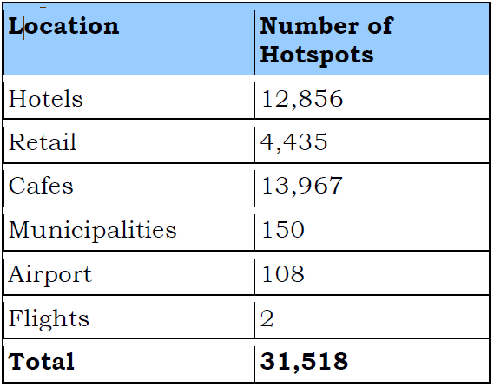
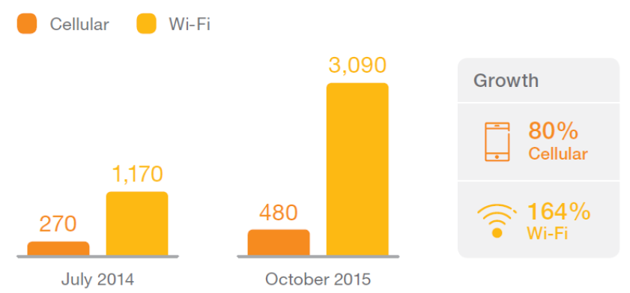
Wi-Fi Today in India
Average Monthly Cellular/Wi-Fi Video Data Use (MB)
[Source: Ericsson]
Wi-Fi Hotspots in India (2016)
[Source: iPass]

Slide 16
Questions
Q1. Are there any regulatory issues, licensing restrictions or other factors that are hampering the growth of public Wi-Fi services in the country?
Q2. What regulatory/licensing or policy measures are required to encourage the deployment of commercial models for ubiquitous city-wide Wi-Fi networks as well as expansion of Wi-Fi networks in remote or rural areas?
Q3. What measures are required to encourage interoperability between the Wi-Fi networks of different service providers, both within the country and internationally?
Q4. What measures are required to encourage interoperability between cellular and Wi-Fi networks?
Q5. Apart from frequency bands already recommended by TRAI to DoT, are there additional bands which need to be de-licensed in order to expedite the penetration of broadband using Wi-Fi technology? Please provide international examples, if any, in support of your answer.

Slide 17
Questions
Q6. Are there any challenges being faced in the login/authentication procedure for access to Wi-Fi hotspots? In what ways can the process be simplified to provide frictionless access to public Wi-Fi hotspots, for domestic users as well as foreign tourists?
Q7. Are there any challenges being faced in making payments for access to Wi-Fi hotspots? Please elaborate and suggest a payment arrangement which will offer frictionless and secured payment for the access of Wi-Fi services.
Q8. Is there a need to adopt a hub-based model along the lines suggested by the WBA, where a central third party AAA (Authentication, Authorization and Accounting) hub will facilitate interconnection, authentication and payments? Who should own and control the hub? Should the hub operator be subject to any regulations to ensure service standards, data protection, etc?
Q9. Is there a need for ISPs/ the proposed hub operator to adopt the Unified Payment Interface (UPI) or other similar payment platforms for easy subscription of Wi-Fi access? Who should own and control such payment platforms? Please give full details in support of your answer.

Slide 18
Questions
Q10. Is it feasible to have an architecture wherein a common grid can be created through which any small entity can become a data service provider and able to share its available data to any consumer or user?
Q11. What regulatory/licensing measures are required to develop such architecture? Is this a right time to allow such reselling of data to ensure affordable data tariff to public, ensure ubiquitous presence of Wi-Fi Network and allow innovation in the market?
Q12. What measures are required to promote hosting of data of community interest at local level to reduce cost of data to the consumers?
Q13. Any other issue related to the matter of Consultation.

Slide 19
Any Other Business
Next meeting: August 4th at 3:00pm ET.

