Slide 1
IEEE 802.18 RR-TAG
Teleconference Plan and Agenda
Date: 2016-06-16
Authors:

Slide 2
Agenda
Assign a recording secretary
Review and approve the agenda
Discussion items
  U-NII-3 OOBE Petition [June 23rd]
  FCC 5.9 GHz Public Notice [July 7th]
  Ofcom 5 GHz consultation [July 22nd]
  EN 300 328 update
  Upcoming ETSI BRAN meeting
AOB and Adjourn
Agenda

Slide 3
Administrative Items
Required notices
  Affiliation FAQ - http://standards.ieee.org/faqs/affiliationFAQ.html
  Anti-Trust FAQ - http://standards.ieee.org/resources/antitrust-guidelines.pdf
  Ethics - http://www.ieee.org/portal/cms_docs/about/CoE_poster.pdf
  IEEE 802 Policies and Procedures - http://www.ieee802.org/devdocs.shtml
Officers
  Chair is Rich Kennedy (HP Enterprise)
  Vice-chair is Jay Holcomb (Itron)

Slide 4
Other Guidelines for IEEE WG Meetings
All IEEE-SA standards meetings shall be conducted in compliance with all applicable laws, including antitrust and competition laws.
Don’t discuss the interpretation, validity, or essentiality of patents/patent claims.
Don’t discuss specific license rates, terms, or conditions.
  Relative costs, including licensing costs of essential patent claims, of different technical approaches may be discussed in standards development meetings.
    Technical considerations remain primary focus
Don’t discuss or engage in the fixing of product prices, allocation of customers, or division of sales markets.
Don’t discuss the status or substance of ongoing or threatened litigation.
Don’t be silent if inappropriate topics are discussed… do formally object.
---------------------------------------------------------------
If you have questions, contact the IEEE-SA Standards Board Patent Committee Administrator at patcom@ieee.org or visit http://standards.ieee.org/about/sasb/patcom/index.html
See IEEE-SA Standards Board Operations Manual, clause 5.3.10 and “Promoting Competition and Innovation: What You Need to Know about the IEEE Standards Association's Antitrust and Competition Policy” for more details.
This slide set is available at https://development.standards.ieee.org/myproject/Public/mytools/mob/slideset.ppt

Slide 5
Discussion Items
  U-NII-3 OOBE Petition
  FCC 5.9 GHz Public Notice
  Ofcom 5 GHz consultation
  EN 300 328 update
  Upcoming ETSI BRAN meeting

Slide 6
U-NII-3 OOBE Petition
Automotive Petition on U-NII-3 OOBE
  http://apps.fcc.gov/ecfs/document/view?id=60001840953
  Deadline June 23, 2016

Slide 7
  FCC 5.9 GHz Public Notice
Testing for sharing efficacy in the 5.9 GHz band
FCC 16-68, Deadline July 7, 2016
  http://transition.fcc.gov/Daily_Releases/Daily_Business/2016/db0601/FCC-16-68A1.pdf
If we want to respond, it must get to the EC by June 28th

Slide 8
Ofcom 5 GHz Consultation
This is the most important proceeding this year (at least)
https://mentor.ieee.org/802.18/dcn/16/18-16-0032-00-0000-ofcom-5-ghz-consultation.pdf
Opening more of the 5 GHz band
  Short term 5725-5850 MHz
  Medium term 5150-5350 changes
  Long term 5350-5470 MHz, 5850-5925 MHz
Deadline for comments: July 22, 2016

Slide 9
Preparing Ofcom Consultation Answers
Collection point
  https://mentor.ieee.org/802.18/dcn/16/18-16-0036-01-0000-ofcom-5-gfhz-consultation-questions.ppt
Please review and help develop answers

Slide 10
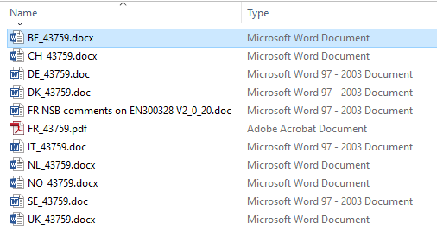
  EN 300 328 Update
EN 300 328 has emerged from the ENAP
Approval rate of 64.55% - failing
Many comments

Slide 11
Upcoming ETSI BRAN Meeting
June 20-24, 2016
Discussions between the warring factions since BRAN#87 may result in agreement on adaptivity method

Slide 12
Any Other Business
Next meeting: June 30th at 3:00pm ET.
  Wi-Fi Alliance meeting next week
Vijay

