Slide 1
IEEE 802.18 RR-TAG Teleconference Plan and Agenda
Date: 2016-06-16
Authors:

Slide 2
Agenda
Assign a recording secretary
Review and approve the agenda
Discussion items
U-NII-3 OOBE Petition [June 23rd]
FCC 5.9 GHz Public Notice [July 7th]
Ofcom 5 GHz consultation [July 122nd]
EN 300 328 update
Upcoming ETSI BRAN meeting
AOB and Adjourn
Agenda

Slide 3
Administrative Items
Required notices
Affiliation FAQ - http://standards.ieee.org/faqs/affiliationFAQ.html
Anti-Trust FAQ - http://standards.ieee.org/resources/antitrust-guidelines.pdf
Ethics - http://www.ieee.org/portal/cms_docs/about/CoE_poster.pdf
IEEE 802 Policies and Procedures - http://www.ieee802.org/devdocs.shtml
Officers
Chair is Rich Kennedy (HP Enterprise)
Vice-chair is Jay Holcomb (Itron)

Slide 4
Other Guidelines for IEEE WG Meetings
All IEEE-SA standards meetings shall be conducted in compliance with all applicable laws, including antitrust and competition laws.
Don’t discuss the interpretation, validity, or essentiality of patents/patent claims.
Don’t discuss specific license rates, terms, or conditions.
Relative costs, including licensing costs of essential patent claims, of different technical approaches may be discussed in standards development meetings.
Technical considerations remain primary focus
Don’t discuss or engage in the fixing of product prices, allocation of customers, or division of sales markets.
Don’t discuss the status or substance of ongoing or threatened litigation.
Don’t be silent if inappropriate topics are discussed… do formally object.
---------------------------------------------------------------
If you have questions, contact the IEEE-SA Standards Board Patent Committee Administrator at patcom@ieee.org or visit http://standards.ieee.org/about/sasb/patcom/index.html
See IEEE-SA Standards Board Operations Manual, clause 5.3.10 and “Promoting Competition and Innovation: What You Need to Know about the IEEE Standards Association's Antitrust and Competition Policy” for more details.
This slide set is available at https://development.standards.ieee.org/myproject/Public/mytools/mob/slideset.ppt

Slide 5
Discussion Items
U-NII-3 OOBE Petition
FCC 5.9 GHz Public Notice
Ofcom 5 GHz consultation
EN 300 328 update
Upcoming ETSI BRAN meeting

Slide 6
U-NII-3 OOBE Petition
Automotive Petition on U-NII-3 OOBE
http://apps.fcc.gov/ecfs/document/view?id=60001840953
Deadline June 23, 2016

Slide 7
FCC 5.9 GHz Public Notice
Testing for sharing efficacy in the 5.9 GHz band
FCC 16-68, Deadline July 7, 2016
http://transition.fcc.gov/Daily_Releases/Daily_Business/2016/db0601/FCC-16-68A1.pdf
If we want to respond, it must get to the EC by June 28th

Slide 8
Ofcom 5 GHz Consultation
This is the most important proceeding this year (at least)
https://mentor.ieee.org/802.18/dcn/16/18-16-0032-00-0000-ofcom-5-ghz-consultation.pdf
Opening more of the 5 GHz band
Short term 5725-5850 MHz
Medium term 5150-5350 changes
Long term 5350-5470 MHz
Deadline for comments: July 22, 2016

Slide 9
Preparing Ofcom Consultation Answers
Collection point
https://mentor.ieee.org/802.18/dcn/16/18-16-0036-01-0000-ofcom-5-gfhz-consultation-questions.ppt
Please review and help develop answers

Slide 10
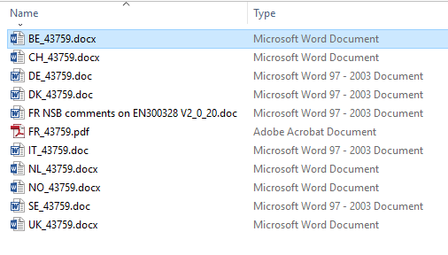
EN 300 328 Update
EN 300 328 has emerged from the ENAP
Approval rate of 64.55% - failing
Many comments

Slide 11
Upcoming ETSI BRAN Meeting
June 20-24, 2016
Discussions between the warring factions since BRAN#87 may result in agreement on adaptivity method

Slide 12
Any Other Business
Next meeting: June 30th at 3:00pm ET.
Wi-Fi Alliance meeting next week
Vijay

