Slide 1
IEEE 802.18 RR-TAG
Teleconference Plan and Agenda
Date: 2016-03-31
Authors:

Slide 2
Agenda
Assign a recording secretary
Review and approve the agenda
Discussion items
  FCC plan for the 5.9 GHz band
  Regulatory Landscape
  Improving Regulatory Efficacy
  IETF 95-Wireless Tutorial: IEEE 802.11
AOB and Adjourn
Agenda

Slide 3
Administrative Items
Required notices
  Affiliation FAQ - http://standards.ieee.org/faqs/affiliationFAQ.html
  Anti-Trust FAQ - http://standards.ieee.org/resources/antitrust-guidelines.pdf
  Ethics - http://www.ieee.org/portal/cms_docs/about/CoE_poster.pdf
  IEEE 802 Policies and Procedures - http://www.ieee802.org/devdocs.shtml
Officers
  Chair is Rich Kennedy (HP Enterprise)
  Vice-chair is Jay Holcomb (Itron)
  ________ will act as recording secretary

Slide 4
Other Guidelines for IEEE WG Meetings
All IEEE-SA standards meetings shall be conducted in compliance with all applicable laws, including antitrust and competition laws.
Don’t discuss the interpretation, validity, or essentiality of patents/patent claims.
Don’t discuss specific license rates, terms, or conditions.
  Relative costs, including licensing costs of essential patent claims, of different technical approaches may be discussed in standards development meetings.
    Technical considerations remain primary focus
Don’t discuss or engage in the fixing of product prices, allocation of customers, or division of sales markets.
Don’t discuss the status or substance of ongoing or threatened litigation.
Don’t be silent if inappropriate topics are discussed… do formally object.
---------------------------------------------------------------
If you have questions, contact the IEEE-SA Standards Board Patent Committee Administrator at patcom@ieee.org or visit http://standards.ieee.org/about/sasb/patcom/index.html
See IEEE-SA Standards Board Operations Manual, clause 5.3.10 and “Promoting Competition and Innovation: What You Need to Know about the IEEE Standards Association's Antitrust and Competition Policy” for more details.
This slide set is available at https://development.standards.ieee.org/myproject/Public/mytools/mob/slideset.ppt

Slide 5
Discussion Items
  FCC plan for the 5.9 GHz band
  Regulatory Landscape
  Improving Regulatory Efficacy
  IETF 95-Wireless Tutorial: IEEE 802.11

Slide 6
FCC 5.9 GHz Sharing Meeting
March 23rd
More than 50 people
  FCC OET
  NTIA
  USDOT
Julie Knapp looking to start a 3-phase test program to show efficacy of sharing protocols
  Phase 1: FCC lab testing of samples
  Phase 2: Limited field testing
  Phase 3: Rigorous field testing
Document “soon”
  Could be NOI, PN or FNPRM

Slide 7
  Regulatory Landscape
Challenges to 802 wireless standards
  Globalstar in the 2.4 GHz band could reduce 2.4 GHz band utility
  LTE-U/LAA-LTE shrinking available spectrum (FCC will not protect Wi-Fi; LTE support much more active than Wi-Fi)
  WRC-15 outcomes (re-studying 5 GHz band/DFS; potential good and bad)
  Satellite industry pressing for less 5 GHz Wi-Fi
What must be understood
  Increased focus on the issues, strong defense for the value Wi-Fi brings the masses is the only way we will preserve a future for our standards
  Significant participation in ITU-R groups addressing 5 GHz band changes is the most critical as we begin to address the WRC-15 requirements for WRC-19
Scorecard
  The Wi-Fi industry is not as well organized as the LTE industry in dealings with regulators and stands to lose the market position our standards have enabled

Slide 8
Ways to Improve our Regulatory Efficacy
Collaboration with other IEEE groups
  …
Collaboration with WLAN industry groups
  Wi-Fi Alliance
  Dynamic Spectrum Alliance
  White Spaces Alliance
  …
Drive regulatory rejection of the IMT-2020 spectrum grab
  Minimize the Wi-Fi spectrum lockout that IMT-2020 can be
  We must show regulators that this is important for their populations
  …

Slide 9
IETF 95-Wireless Tutorial: IEEE 802.11
Prepared by Dorothy Stanley (HPE)
  https://mentor.ieee.org/802.11/dcn/16/11-16-0500-00-0000-ietf-95-wireless-tutorial-802-11-overview.pptx

Slide 10
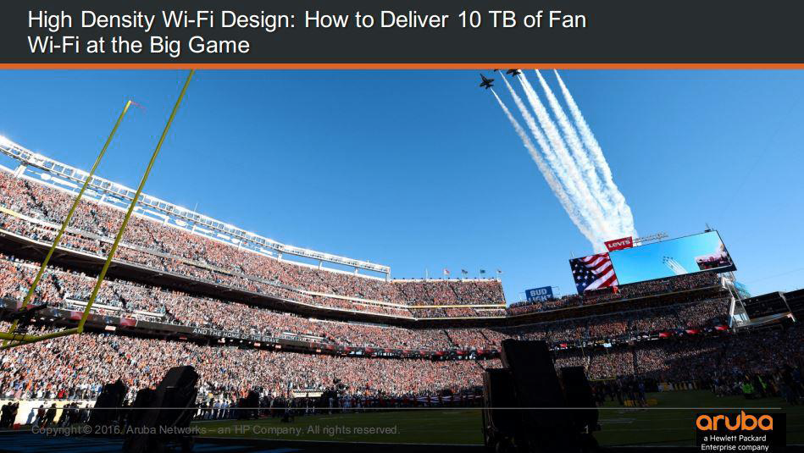
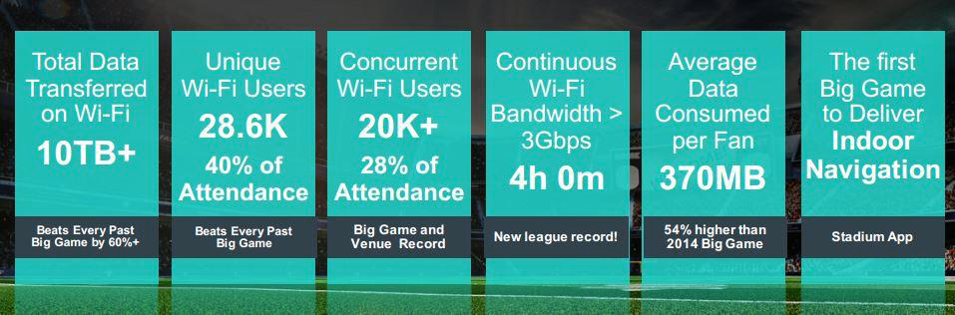
802.11 technology is serving high density applications today
Dorothy Stanley, HP Enterprise

Slide 11
In 2014 Wi-Fi traffic was 16 times cellular one
(2) Spectrum trends below 6GHz
UK Data carried in PB per month
538.5 MHz
available
538.5 MHz
available
602 MHz
available
602 MHz
available
Cisco VNI, 2014 average
Infrastructure Report, June 2014
Source: Andy Gowans (UK regulator) presentation: https://mentor.ieee.org/802.18/dcn/16/18-16-0016-01-0000-ofcom-future-spectrum-requirements.pptx
Notes:
According to Cisco VNI, 3% of all IP traffic is carried by mobile, compared to 49% over Wi-Fi and 48% wired. This is despite Wi-Fi having access to less spectrum (538.5 MHz) compared to mobile (602 MHz).
Source: Cisco VNI, Office of National Statistics, Ofcom CMR 2014 and Ofcom Infrastructure Report 2014
Notes: Infrastructure Report data is based on June 2014 only and assumes 93% use wireless routers (CMR 2014).

Slide 12
Any Other Business

