Slide 1
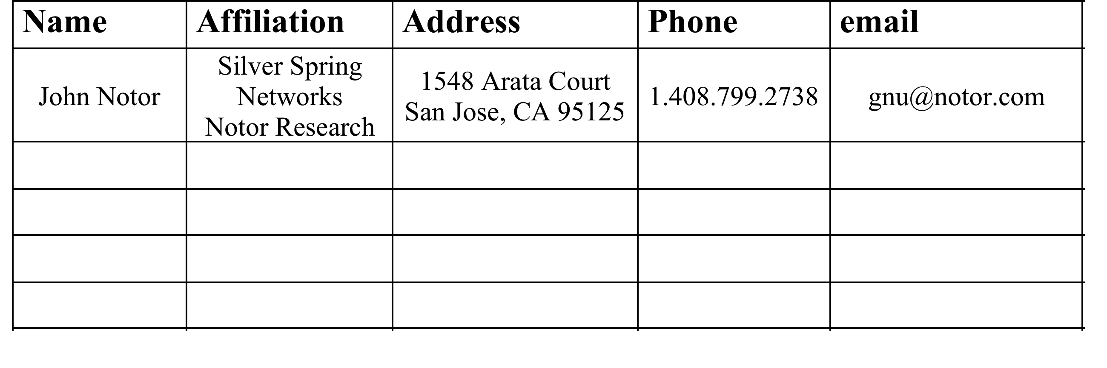
Agenda for 802.18 Teleconference Meetings from February 7 to March 14, 2013
Date: February 1, 2013

Slide 2
Meeting Series Agenda
Time: Thursday, February 7 to March 14, 2013, 3 PM PST, 4 PM MST, 5 PM CST, 6 PM EST
Duration: 2 hour
Agenda:
Identify regulatory proceedings that need response prior to the March 2013 Orlando Plenary, including
TV Band Incentive Auction NPRM Reply Comments.
Expected Unlicensed 5 GHz NPRM (release likely before the end of February)
Other TBD.
Create and edit documents as needed.
Approve edits for submission to the EC for review and approval to submit to the FCC using the 10 day EC ballot procedure.
Adjourn meeting series on or before March 14, 2013.

Slide 3
Teleconference Information Connect by Computer
Topic: 3550
Date: Every Thursday, from Thursday, February 7 to Thursday March 14, 2013.
Time: 3:00 pm, Pacific Standard Time (San Francisco, GMT-08:00)
Meeting Number: 206 419 888
Meeting Password: 3550
-------------------------------------------------------
To join the online meeting (Now from mobile devices!)
-------------------------------------------------------
1. Go to https://ciscosales.webex.com/ciscosales/j.php?ED=215105107&UID=1964932552&PW=NYjdjZjlmYmZm&RT=MiM0
2. Enter your name and email address.
3. Enter the meeting password: 3550
4. Click "Join Now".
To view in other time zones or languages, please click the link:
https://ciscosales.webex.com/ciscosales/j.php?ED=215105107&UID=1964932552&PW=NYjdjZjlmYmZm&ORT=MiM0

Slide 4
Teleconference Information Connect By Telephone
ALERT:Toll-Free Dial Restrictions for (408) and (919) Area Code
The affected toll free numbers are: (866) 432-9903 for the San Jose/Milpitas area and (866) 349-3520 for the RTP area.
Please dial the local access number for your area from the list below:
- San Jose/Milpitas (408) area: 525-6800
- RTP (919) area: 392-3330
-------------------------------------------------------
To join the teleconference only
-------------------------------------------------------
1. Dial into Cisco WebEx (view all Global Access Numbers at
http://cisco.com/en/US/about/doing_business/conferencing/index.html
2. Follow the prompts to enter the Meeting Number (listed above) or Access Code followed by the # sign.
San Jose, CA: +1.408.525.6800 RTP: +1.919.392.3330
US/Canada: +1.866.432.9903 United Kingdom: +44.20.8824.0117
India: +91.80.4350.1111 Germany: +49.619.6773.9002
Japan: +81.3.5763.9394 China: +86.10.8515.5666

