Slide 1
FCC Actions Related to Progeny LMS
Date: November 7, 2011
Authors:
Notice: This document has been prepared to assist IEEE 802.18. It is offered as a basis for discussion and is not binding on the contributing individual(s) or organization(s). The material in this document is subject to change in form and content after further study. The contributor(s) reserve(s) the right to add, amend or withdraw material contained herein.

Slide 2
Abstract
This slide set covers the history of FCC actions related to Progeny LMS that the RR-TAG has addressed in previous submissions.

Slide 3
Summary of Waiver Request
Progeny request waivers of two sections of the Title 47 Part 90 rules:
Section 90.155(e): ‘A multilateration LMS station will be considered constructed and placed in operation if it is built in accordance with its authorized parameters and is regularly interacting with one or more other stations to provide location service, using multilateration technology, to one or more mobile units. Specifically, LMS multilateration stations will only be considered constructed and placed in operation if they are part of a system that can interrogate a mobile, receive the response at 3 or more sites, compute the location from the time of arrival of the responses and transmit the location either back to the mobile or to a subscriber's fixed site.’
Section 90.353(g): ‘Multilateration LMS systems whose primary operations involve the provision of vehicle location services, may provide non-vehicular location services.’

Slide 4
Summary of Waiver Request (2)
Progeny requests expeditious treatment of the request
From the FCC Wireless Telecommunications Bureau document DA 11-446, WT Docket 11-49:
‘Finally, Progeny requests that the Commission provide expedited treatment in addressing its petition for waiver. Progeny states that improved technologies are needed to ensure that emergency service providers can promptly receive accurate and reliable information regarding the locations of wireless callers? In urging expeditious treatment, Progeny states that it "may have a limited opportunity to construct its M-LMS network" due to current build-out obligations.” ’

Slide 5
Purposes of the Part 90 Waiver Requests
Waiver of Section 90.155(e)
From the FCC Wireless Telecommunications Bureau document DA 11-446, WT Docket 11-49:
‘In particular, Progeny is seeking flexibility to satisfy its build-out requirements using "a broadcast-only multilateration network architecture" and seeks to construct a network that involves "only one transmission path (the beacon to mobile device path), rather than multiple transmission paths to and from a base station and mobile devices. Progeny states that mobile devices would use the beacon signals broadcast from fixed base stations to determine their own position without the need for a return transmission path in the M-LMS spectrum band or any other communications with Progeny's M-LMS network.’

Slide 6
Purposes of the Part 90 Waiver Requests (2)
Waiver of Section 90.353(g)
From the FCC Wireless Telecommunications Bureau document DA 11-446, WT Docket 11-49:
‘Progeny requests a waiver in order to permit it to make its M-LMS services equally available to track the location of vehicles and non-vehicular mobile devices. Progeny asserts that the purpose of the rule was to limit the density of signal transmissions in the M-LMS band and, with it, the potential interference to other spectrum users. In its Petition, Progeny states that a "broadcast-only M-LMS network configuration would substantially reduce M-LMS transmissions in the 902-928 MHz band thereby directly serving the underlying goal of the Section 90.353(g) requirement" and that ''the risk of harmful interference to other users of the band would in no way be affected by the number of, or types of, mobile devices utilizing a broadcast-only M-LMS network. Progeny also states that "[e]ven if a return path was desired, non-vehicular wireless devices could transmit on spectrum not designated for M-LMS. In addition; Progeny states that its proposed "broadcast-only multilateration network configuration can be used by an unlimited number of mobile devices without any cumulative impact on other users of M-LMS spectrum.” ’

Slide 7
Other Issues
The proceeding announcement for WT 11-49 was released on March 10, 2011.
The Comment deadline was March 25, 2011.
The Reply Comment deadline was April 4, 2011.
IEEE 802 (or IEEE 802.18) can submit comments as an ‘ex parte’ filing after the official dates.
Note that Progeny LLC submitted a filing on September 27, 2011.

Slide 8
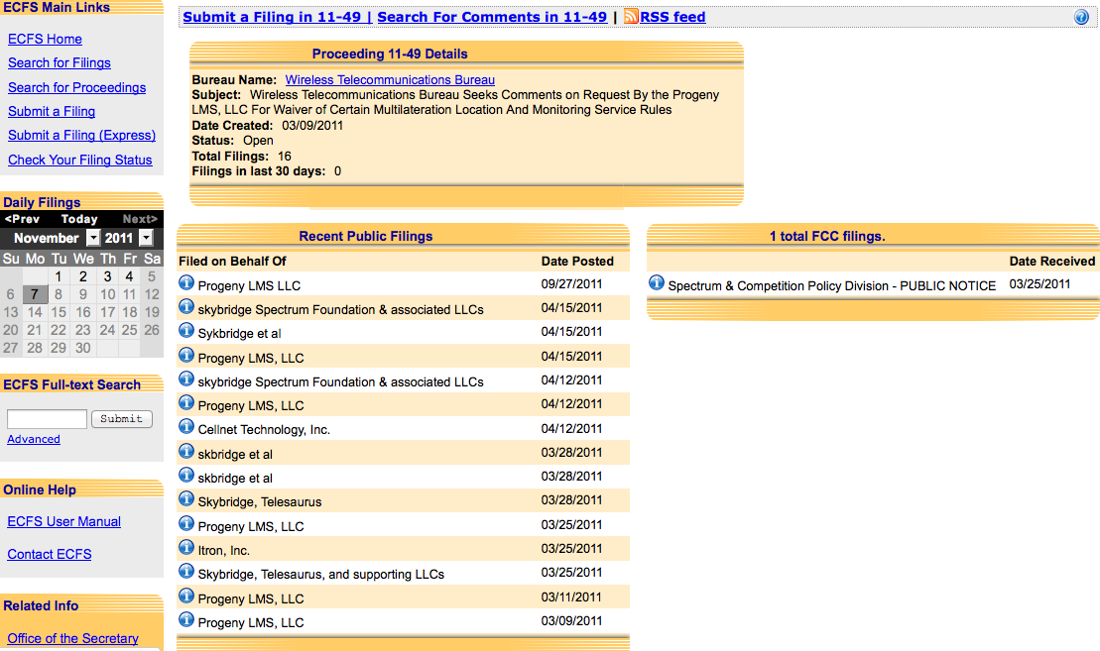
Filings Related to WT 11-39 Link: http://fjallfoss.fcc.gov/ecfs/proceeding/view?z=gzpb9&name=11-49

Slide 9
References
18-11-0083-00-0000-progeny-lms-request-for-waver-of-lms-rules.pdf on IEEE Mentor (this is a copy of the Public Notice).

