Slide 1
Location Monitoring Service (LMS) Background
Date: 2011-10-31
Authors:
Notice: This document has been prepared to assist IEEE 802.18. It is offered as a basis for discussion and is not binding on the contributing individual(s) or organization(s). The material in this document is subject to change in form and content after further study. The contributor(s) reserve(s) the right to add, amend or withdraw material contained herein.

Slide 2
Abstract
An overview of the current activities regarding the Location Monitoring System (LMS)

Slide 3
Location Monitoring Services (LMS) Overview
Conceived in 1995 to provide location monitoring services for vehicles
Limited “store and forward” interconnect to PSTN
Status and Instructional messages, voice or non-voice
A small number of bidders own licenses
Numerous construction extensions have been granted due to claims of “lack of commercially available equipment”
The need for this service has been supplanted by widely-deployed GPS, cellular and Wi-Fi location technologies

Slide 4
LMS Spectrum Allocations
 | LMS Sub-band | Forward Link
Block A | 904.000-909.750 | 927.750-928.000
Block B | 919.750-921.750 | 927.500-927.750
Block C | 921.750-927.250 | 927.250-927.500
 | 30 Watts ERP | 300 Watts ERP
90.351 Forward links for LMS systems may also be contained
within the LMS sub-band. However, the maximum allowable
power in these sub-bands is 30 watts ERP in accordance with
§ 90.205(j).

Slide 5
902-928 MHz Band Priority Order
Government
ISM
LMS
Amateur
Part 15

Slide 6
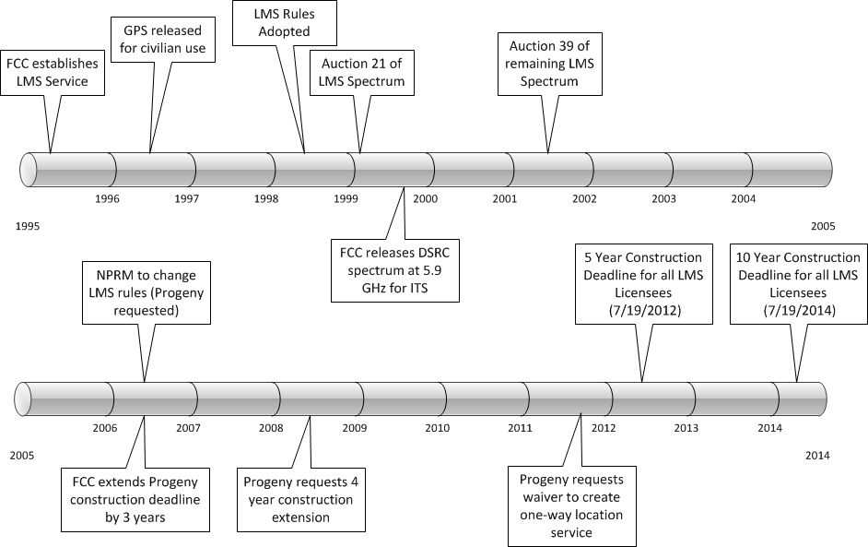
LMS Timeline

Slide 7
LMS License Holders
 |  | Total
FCR, Inc. |  | 13
Progeny LMS |  | 228
Helen Wong-Armijo |  | 84
PCS Partners |  | 32
Warren Havens | Telesaurus Holdings | 129
 | Skybridge Spectrum Foundation | 128

Slide 8
Field Testing Requirement
“Thus, in an effort to ensure that the coexistence of the various services in the band would be as successful as possible, we decided to condition the grant of each MTA multilateration license on the licensee's ability to demonstrate through actual field tests that their systems do not cause unacceptable levels of interference to Part 15 devices.” – Order for Reconsideration, PR Docket No. 93-61, 3/21/1996
LMS licensees are required to field test in each EA where they establish service to verify, with Part 15 users in the area, that there is no unacceptable interference to Part 15 devices
176 EAs
3 licenses per EA

Slide 9
2006 NPRM Overview
Progeny seeks to:
Permit broader applications of LMS
Eliminate or modify restrictions on PSTN interconnect
Remove restriction on vehicular location
Eliminate coexistence testing with Part 15 devices
Would lower LMS power levels from 30 Watts ERP to 6.1 Watts ERP
Allow aggregation of blocks of LMS spectrum
Greater flexibility to provide additional services
NPRM currently in the hands of the FCC

Slide 10
Proceeding 11-49 (March 2011)
Request for Waiver of some LMS rules by Progeny LMS, LLC
Seeks to waive requirement for two-way operation
Utilizes forward link in LMS sub-band
Proposes a “broadcast only” location service
Uses 2 MHz wide transmissions from multiple transmitters
At least 3 transmitters required to be received to fix location in urban areas
No reduction of 30W ERP transmit power is proposed
Request “Expedited Treatment” due to impending construction deadlines

Slide 11
Potential IEEE Standards Interests

Slide 12
IEEE Standards in 902-928
802.11ah
802.15.4
15.4g
15.4k
May touch on uses envisioned by 802.21

Slide 13
Intelligent Transportation System (ITS)
There are some LMS license holders, in particular Warren Havens, that claim that LMS is essential to the deployment of an ITS system
Yet, LMS is not a part of the DOT, standards-based vision of WAVE/DSRC-based ITS:
IEEE P1609
IEEE 802.11p/ASTM 2213
IEEE P1556
GPS

Slide 14
Discussion and Questions

