Slide 1
  IEEE 802.16 Candidate Proposal for IMT-Advanced
IEEE 802.16 Presentation Submission Template (Rev. 9.1)
Document Number:
  IEEE L802.16-09/0114r2
Date Submitted:
  2009-09-23
Source:
  ITU-R Liaison Group Voice:
  E-mail:
Re:
  ITU-R 3rd Workshop on IMT-Advanced http://groups.itu.int/Default.aspx?tabid=574
  IEEE L802.16-09/0077r2 (“Intention to participate in 3rd Workshop on IMT-Advanced”) <http://ieee802.org/16/liaison/#09_0077>
Base Contribution:
  [none]
Purpose:
  [Description of what specific action is requested of the 802.16 Working Group or subgroup.]
Notice:
  This document does not represent the agreed views of the IEEE 802.16 Working Group or any of its subgroups. It represents only the views of the participants listed in the “Source(s)” field above. It is offered as a basis for discussion. It is not binding on the contributor(s), who reserve(s) the right to add, amend or withdraw material contained herein.
Release:
  The contributor grants a free, irrevocable license to the IEEE to incorporate material contained in this contribution, and any modifications thereof, in the creation of an IEEE Standards publication; to copyright in the IEEE’s name any IEEE Standards publication even though it may include portions of this contribution; and at the IEEE’s sole discretion to permit others to reproduce in whole or in part the resulting IEEE Standards publication. The contributor also acknowledges and accepts that this contribution may be made public by IEEE 802.16.
Patent Policy:
  The contributor is familiar with the IEEE-SA Patent Policy and Procedures:
      <http://standards.ieee.org/guides/bylaws/sect6-7.html#6> and <http://standards.ieee.org/guides/opman/sect6.html#6.3>.
  Further information is located at <http://standards.ieee.org/board/pat/pat-material.html> and <http://standards.ieee.org/board/pat >.

Slide 2
IEEE 802.16
Candidate Proposal for IMT-Advanced
ITU-R WP 5D Third Workshop on IMT-Advanced
Focused on Candidate Technologies and Evaluation
Dresden, Germany, 15 October 2009

Slide 3
Outline
IEEE 802.16 Working Group
  IEEE Standard 802.16
  IEEE 802.16m
IEEE 802.16, ITU, and IMT-Advanced
IEEE Candidate RIT
  Description
  Evaluation
Conclusion

Slide 4

IEEE 802.16 is:
A Working Group (WG):
  IEEE 802.16 Working Group on Broadband Wireless Access
  Develops and maintain a set of standards
A standard
  IEEE Standard 802.16: Air Interface for Broadband Wireless Access Systems
  The WirelessMAN® standard for Wireless Metropolitan Area Networks

Slide 5
IEEE 802.16 Working Group
Initiated in 1998
Formalized in 1999 (over 10 years old)
Holds at least six sessions a year
  Session duration: four days
Open process
  Anyone can participate
Members are people
  Membership earned by participation
  Currently: 437 Members, from around the world
NextWave Wireless Proprietary and Confidential
© 2008 NextWave Wireless. All rights reserved.

Slide 6
IEEE 802.16 Session Attendance
(excluding IEEE 802 Plenary)
#33 | Sep | 2004 | Korea | 287
#35 | Jan | 2005 | China | 313
#37 | May | 2005 | Italy | 218
#39 | Sep | 2005 | Taiwan | 225
#41 | Jan | 2006 | India | 111
#43 | May | 2006 | Israel | 122
#45 | Sep | 2006 | Canada | 191
#47 | Jan | 2007 | UK | 274
#49 | May | 2007 | USA | 307
#51 | Sep | 2007 | Spain | 288
#53 | Jan | 2008 | Finland | 303
#55 | May | 2008 | China | 402
#57 | Sep | 2008 | Japan | 415
#59 | Jan | 2009 | USA | 310
#61 | May | 2009 | Egypt | 210
#63 | Sep | 2009 | Korea | 257

Slide 7
IEEE Standard 802.16
“Air Interface for Broadband Wireless Access Systems”
Developed since 1999 by IEEE 802.16 WG
  Evolves by amendments and revision
  Fixed non-line-of-sight OFDMA introduced in 2002
  Mobile-enabled OFDMA introduced in 2005 (“802.16e”)

Slide 8
IEEE 802.16: Key Evolution Steps
IEEE Std 802.16-2001
(fixed access)
+ 802.16a
OFDM/OFDMA
2003
IEEE Std 802.16-2004
+ 802.16e
Mobility
2005
IEEE Std 802.16-2009
+ 802.16j
Multihop Relay
2009

Slide 9
IEEE 802.16m Project
amendment project, initiated 2006
“Advanced Air Interface”
  Amend IEEE 802.16 WirelessMAN-OFDMA specification to provide an advanced air interface
  meet the cellular layer requirements of IMT-Advanced next generation mobile networks
  support for legacy WirelessMAN-OFDMA equipment (i.e., backward compatibility)
  provide performance improvements to support future advanced services and applications

Slide 10
Participation in IEEE 802.16m Development
  Since 802.16m project began, 802.16 WG participation includes:
    Over 1200 individuals
    From about 240 organizations
    From 23 countries
  Contributed documents to 802.16m Task Group
    2007: >300 documents
    2008: >1600 documents
    2009: > 2200 documents

Slide 11
IEEE 802.16m Development Documents
Background documents prior to development of 802.16m draft standard:
  Evaluation Methodology Document (EMD)
  System Requirements Document (SRD)
    Stage 1
  System Description Document (SDD)
    Stage 2

Slide 12
IEEE 802.16m Evaluation Methodology Document (EMD)
Defines link-level and system-level simulation models and associated parameters for evaluation and comparison of technologies for IEEE 802.16m
Highly detailed (199 pages)
Mostly aligned with IMT-Advanced evaluation methodology
First version: March 2008

Slide 13
IEEE 802.16m System Requirements Document (SRD)
High-level system requirements
  Stage 1 Specification
SRD includes advanced features beyond IMT-Advanced requirements
First version: Jan 2007
IEEE 802.16m requirements will be evaluated according to 802.16m EMD
IMT-Advanced requirements were evaluated according to IMT-Advanced methodology

Slide 14
IEEE 802.16m System Description Document (SDD)
System level description of IEEE 802.16m
  Stage 2 Specification
IEEE 802.16m standard is being developed in accordance with the system level description in this document
This document shall be maintained and may evolve.
First version: Jan 2008

Slide 15
IEEE 802.16m SDD: Key Topics
Protocol Structure
Frequency Bands
Convergence Sublayer
Medium Access Control Layer
Physical Layer
Location Based Services
Enhanced Multicast Broadcast Service
Multi-Hop Relay
Femto BS
Self-organization
Multi-carrier Operation
Interference Mitigation
RF Requirements
Inter-BS Synchronization

Slide 16
IEEE 802.16m Draft Standard
Started with an initial working document
Four revisions of the document toward a draft standard were created
First draft standard
  July 2009
  514 pages
Began Working Group Ballot in July 2009

Slide 17
IEEE 802.16, ITU, and IMT-Advanced

Slide 18
IEEE 802.16 and ITU
IEEE: ITU-R Sector Member
  “Regional & other International Organizations”
Relevant ITU-R Engagement
  Fixed Wireless Access
    Rec. F.1763: IEEE 802.16 in the Fixed Service
  Land Mobile Radio:
    Rec. M.1801: IEEE 802.16 in Mobile Service
  IMT-2000
  IMT-Advanced

Slide 19
IEEE 802.16 and IMT-2000
M.1457 Rev. 7 (2007) adds “OFDMA TDD WMAN”
  Based on IEEE Std 802.16 (including 802.16e)
  Implementation profile developed by WiMAX Forum
M.1457 Rev. 9 (2009) completed by WP 5D
  Updates reference to IEEE Std 802.16-2009
  Includes FDD as well as TDD updates

Slide 20
IEEE 802.16 IMT-Advanced
Contributions
Contribution 8F/1083 (Jan 2007) notified ITU-R that 802.16m project is intended for future contributions on IMT-Advanced.
IEEE 802.16 Working Group developed many contributions to WP 5D regarding IMT-Advanced process and technical requirements.
5D/356 (Feb 2009) and 5D/443 (May 2009) provided specific notice of intention to submit IMT-Advanced proposal, with additional details.
  WP 5D response: 5D/TEMP/206
5D/[TBD] to 5D/[TBD] (October 2009): Submission of a Candidate IMT-Advanced RIT based on IEEE 802.16

Slide 21
IEEE 802.16 and IMT-Advanced
Workshops
ITU-R notification of 802.16m progress toward IMT-Advanced in three Workshops
  “Project 802.16m as an IMT-Advanced Technology,” 1st Workshop on IMT-Advanced (Kyoto, 22 May 2007)
  “Project 802.16m as an IMT-Advanced Technology,” 2nd Workshop on IMT-Advanced (Seoul, 7 Oct 2008)
  Presentation at the 3rd Workshop on IMT-Advanced as one of two Technology Proponents (Dresden, 15 Oct 2009)

Slide 22
IEEE Candidate RIT

Slide 23
Development of IEEE 802.16 IMT-Advanced Proposal
Solicited input material towards development of candidate RIT:
  Call for comments and contributions over the past year
  Correspondence Group between IEEE 802.16 sessions
  Liaison activity with external organizations (e.g. WiMAX Forum, ARIB, TTA, and WP 5D)
Contributions received containing calibration/simulation results as well as text for description templates and other elements of the submission from authors affiliated with:
  Alcatel-Lucent Shanghai Bell, Clearwire, ETRI, Fujitsu, Hitachi, Intel, ITRI, KDDI, LG Electronics, MediaTek, Mitsubishi Electric, Motorola, NEC, Samsung Electronics, Toshiba, UQ Communications, WiMAX Forum, and others.

Slide 24
International support for IEEE 802.16 IMT-Advanced Proposal
Cooperating with national standards bodies
Japan’s Contribution 5D/466 (June 2009) notified ITU-R of its IMT-Advanced preparations
  “Japan basically endorses the works of 3GPP and IEEE 802.16 relating to the submission of proposals for candidate radio interface technologies for IMT-Advanced.”
Korea’s TTA organized the “Joint ARIB, IEEE and TTA leadership meeting for IMT-Advanced” in Jeju, Korea, 30 Aug 2009

Slide 25
IMT-Advanced Requirements
IEEE is proposing a single RIT (inclusive of TDD and FDD) to meet or exceed all IMT-Advanced requirements in all test environments
Test Environment/ Deploymnet Scenarios | Proposal Meets IMT-Advanced Requirements
Indoor Hotspot | ✓
Urban Microcell | ✓
Urban Macrocell | ✓
Rural Macrocell | ✓

Slide 26
Contents of IMT-Advanced Submission
Part 1 (5D/xxx): cover page, overview, proposal
Part 2 (5D/yyy): background, future plans, IPR statement, version, references
Part 3 (5D/zzz): general description, technology description templates: characteristics and link budget
Part 4 (5D/ttt): self-evaluation report and compliance templates

Slide 27
IEEE RIT Proposal: Part 1
Proposal:
  This proposal should be assigned for evaluation, in all four test environments, under Step 4 of the IMT-Advanced terrestrial component radio interface development process in Document IMT-ADV/2(Rev.1), during which time the IEEE 802.16 Working Group will support the activities of the independent evaluation groups per Clause 2 of this contribution. This proposal should also proceed to consideration under Steps 5, 6, and 7.

Slide 28
IEEE RIT Proposal: Part 2
1 Introduction and background
  1.1 IMT-2000 Background
  1.2 Prior communications regarding IMT-Advanced Proposal
  1.3 IMT-Advanced Workshop Participation
2 Continuing Development
  2.1 Ongoing Development of 802.16m Project
  2.2 Plans for Step 4 of IMT-Advanced development process
  2.3 IMT-Advanced Evaluation Group Coordination
3 IPR Policy compliance
4 Declaration of version
References
Abbreviations

Slide 29
IEEE RIT Proposal: Part 3
5 General description of the RIT
6 Description templates
  6.1 Description template – characteristics
  6.2 Description template – link budget
Annex 1 – L1/L2 Overhead Calculation
Annex 2 – Stage 2 Specifications - IEEE 802.16m System Description Document (SDD)

Slide 30
IEEE RIT Proposal: Part 4
7 Self-evaluation report
  7.1 Overview
  7.2 Evaluation results
8 Compliance templates
  8.1 Compliance template for services
  8.2 Compliance template for spectrum
  8.3 Compliance template for technical performance
Annex 3 – Simulation Assumptions and Configuration Parameters for IMT-Advanced Test Environments
Annex 4 – Details of Simulation Results in the Compliance Template for Technical Performance

Slide 31
IEEE Candidate RIT
Description

Slide 32
802.16m System Requirements
Additional Requirements | IMT-Advanced | 802.16m
Peak spectral efficiency (b/s/Hz/sector) | DL: 15 (4x4) UL: 6.75 (2x4) | DL: 8.0/15.0 (2x2/4x4) UL: 2.8/6.75 (1x2/2x4)
Cell spectral efficiency (b/s/Hz/sector) | DL (4x2) = 2.2 UL (2x4) = 1.4 (Base coverage urban) | DL (2x2) = 2.6 UL (1x2) = 1.3 (Mixed Mobility)
Cell edge user spectral efficiency (b/s/Hz) | DL (4x2) = 0.06 UL (2x4) = 0.03 (Base coverage urban) | DL (2x2) = 0.09 UL (1x2) = 0.05 (Mixed Mobility)
Latency | C-plane: 100 ms (idle to active) U-plane: 10 ms | C-plane: 100 ms (idle to active) U-plane: 10 ms
Mobility b/s/Hz at km/h | 0.55 at 120 km/h 0.25 at 350 km/h | Optimal performance up to 10 km/h “Graceful degradation” up to 120 km/h “Connectivity” up to 350 km/h Up to 500 km/h depending on operating frequency
Handover interruption time (ms) | Intra frequency: 27.5 Inter frequency: 40 (in a band) 60 (between bands) | Intra frequency: 27.5 Inter frequency: 40 (in a band) 60 (between bands)
VoIP capacity (Active users/sector/MHz) | 40 (4x2 and 2x4) (Base coverage urban) | 60 (DL 2x2 and UL 1x2)
802.16m functional and performance requirements are more
comprehensive and more stringent than IMT-Advanced requirements

Slide 33
802.16m System Requirements (cont.)
Additional Requirements | IMT-Advanced | 802.16m
Antenna Configuration | Not specified | DL: 2x2 (baseline), 2x4, 4x2, 4x4, 8x8 UL: 1x2 (baseline), 1x4, 2x4, 4x4
Cell Range and Coverage | Not specified | Up to 100 km with optimal performance up to 5 km
Multicast and Broadcast Service (MBS) | Not specified | 4 bps/Hz for ISD 0.5 km and 2 bps/Hz for ISD 1.5 km
MBS channel reselection interruption time | Not specified | 1.0 s (intra-frequency) 1.5 s (inter-frequency)
Location based services (LBS) | Not specified | Location determination latency < 30 s MS-based position determination accuracy < 50 m Network-based position determination accuracy < 100 m
Operating bandwidth | Up to 40 MHz (with aggregation) | 5 to 20 MHz (up to 100 MHz through band aggregation)
Duplex scheme | Not specified | TDD, FDD (support for H-FDD terminals)
Operating frequencies | IMT bands | IMT bands (below 6 GHz)
802.16m is suitable for a large set of usage models, applications, and services

Slide 34
OFDMA Parameters
Nominal channel bandwidth (MHz) |  |  | 5 | 7 | 8.75 | 10 | 20
Sampling factor |  |  | 28/25 | 8/7 | 8/7 | 28/25 | 28/25
Sampling frequency (MHz) |  |  | 5.6 | 8 | 10 | 11.2 | 22.4
FFT size |  |  | 512 | 1024 | 1024 | 1024 | 2048
Subcarrier spacing (kHz) |  |  | 10.937500 | 7.812500 | 9.765625 | 10.937500 | 10.937500
Useful symbol time T_{u} (µs) |  |  | 91.429 | 128 | 102.4 | 91.429 | 91.429
Cyclic prefix (CP) T_{g} = 1/8 T_{u} | Symbol time T_{s} (µs) |  | 102.857 | 144 | 115.2 | 102.857 | 102.857
 | FDD | Number of OFDMA symbols per frame | 48 | 34 | 43 | 48 | 48
 |  | Idle time (µs) | 62.857 | 104 | 46.40 | 62.857 | 62.857
 | TDD | Number of OFDMA symbols per frame | 47 | 33 | 42 | 47 | 47
 |  | TTG + RTG (µs) | 165.714 | 248 | 161.6 | 165.714 | 165.714
CP T_{g} = 1/16 T_{u} | Symbol Time T_{s} (µs) |  | 97.143 | 136 | 108.8 | 97.143 | 97.143
 | FDD | Number of OFDMA symbols per frame | 51 | 36 | 45 | 51 | 51
 |  | Idle time (µs) | 45.71 | 104 | 104 | 45.71 | 45.71
 | TDD | Number of OFDMA symbols per frame | 50 | 35 | 44 | 50 | 50
 |  | TTG + RTG (µs) | 142.853 | 240 | 212.8 | 142.853 | 142.853
34

Slide 35
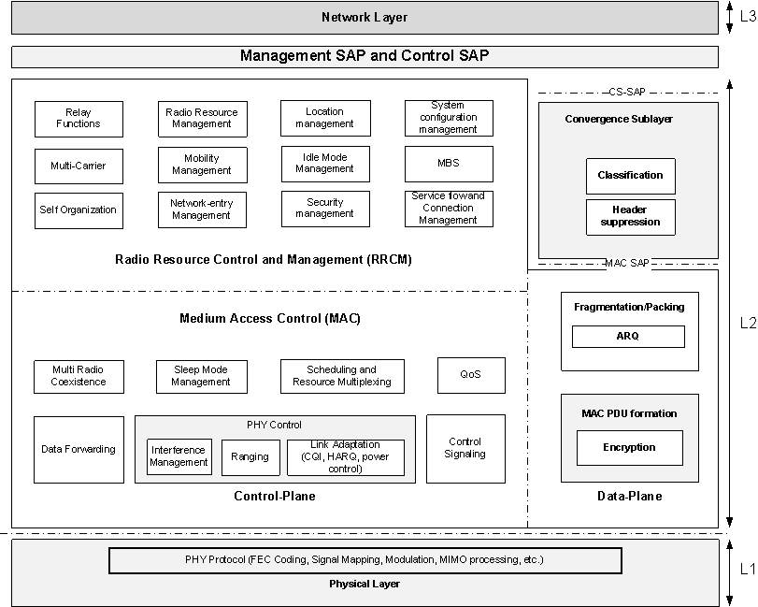
IEEE 802.16m Protocol Structure

Slide 36
Frame Structure
The number of OFDMA symbols per subframe:
Type 1 = 6
Type 2 = 7
Type 3 = 5
Type 4 = 9 (UL only)

Slide 37
Frame Structure with CP=1/16 (DL/UL=5:3)

Slide 38
Resource Mapping

Slide 39
Pilot Structure
The transmission of pilot subcarriers in DL and UL is necessary for enabling channel estimation, measurements of CQI such as the SINR, frequency offset estimation, etc.
A unified pilot pattern design for common (shared)/dedicated pilot
Equal pilot density per stream
Equal number of pilots for each PRUs of a data burst assigned to one MS
For 1 & 2 streams, the pilot overhead is 5.6%
Pilot patterns used for 1 and 2 DL data streams

Slide 40
Advanced Preamble
Advanced Preamble (A-Preamble) is a DL physical channel which provides a reference signal for timing, frequency, and frame synchronization, RSSI estimation, channel estimation, cell identification, etc.
  Primary A-Preamble: For initial acquisition, superframe synchronization, etc.
  Secondary A-Preamble: For fine synchronization, cell identification, etc.

Slide 41
DL Control Channel
Superframe Header (SFH): To carry the system configuration information for cell selection and system access
Advanced MAP (A-MAP)
  Assignment A-MAP (A-A-MAP): To contain resource assignment information
  HARQ Feedback A-MAP (HF-A-MAP): To carry HARQ ACK/NACK information for UL data transmission
  Power Control A-MAP (PC-A-MAP): To carry fast power control command to AMS

Slide 42
MIMO Transmission
SU-MIMO and MU-MIMO
  SU-MIMO: A MIMO transmission scheme in which a single MS is scheduled in one RU
  MU-MIMO: A MIMO transmission scheme in which multiple MSs are scheduled in one RU. Multi-user diversity for DL (SDMA) and collaborative SM for UL
Open-loop and closed-loop
  Open-loop: Transmit diversity with Space-Frequency Block Coding (SFBC) and spatial multiplexing with non-adaptive precoding
  Closed-loop: Codebook-based precoding and sounding/midamble-based precoding
Rank and mode adaptation
Multi-BS MIMO

Slide 43
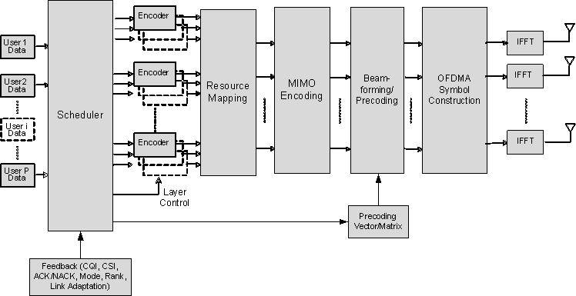
Downlink MIMO Architecture
IEEE 802.16m supports various advanced multi-antenna technologies including open-loop/closed-loop SU-/MU-MIMO schemes, a number of transmit diversity techniques, and transmit beamforming with rank/mode adaptation capability. Multi-cell MIMO technique is also supported.

Slide 44
Multi-Carrier Support
Control Plane
Data Plane
CS SAP
Radio Resource Control
& Management Functions
CS Sublayer
Data and Control Bearers
Medium Access Control Functions
L2
Security Sub-Layer
Dynamic/Static Mapping
MAC Common Part Sublayer
Physical Channels
Physical Channels
Physical Channels
PHY 1
RF Carrier 1
PHY 2
RF Carrier 2
…
PHY n
RF Carrier n
L1
A generalized protocol architecture for support multicarrier operation with single MAC entity
Support of multi-carrier operation in 802.16m basic frame structure
Some MAC messages sent on one carrier may also apply to other carriers. The RF carriers may be of different bandwidths and can be non-contiguous or belong to different frequency bands. The channels may be of different duplexing modes, e.g. FDD, TDD, or a mix of bidirectional and broadcast only carriers. Support of wider bandwidths (up to 100 MHz) through aggregation across contiguous or non-contiguous channels. The RF carriers can be fully or partially configured.

Slide 45
Legacy Support
IEEE 802.16m provides continuing support and interoperability for legacy WirelessMAN-OFDMA MSs and BSs.
802.16m BS supports a legacy MS while also supporting 802.16m MSs on the
same RF carrier, at a level of performance equivalent to that of a legacy BS
802.16m MS operates with a legacy BS on the same RF carrier, at a level of
performance equivalent to that of a legacy MS
802.16m BS supports handover of a legacy MS to and from a legacy BS and
to and from 802.16m BS

Slide 46
IEEE Candidate RIT
Evaluation

Slide 47
Cell Spectral Efficiency

Slide 48
Cell Edge User Spectral Efficiency

Slide 49
Mobility Requirements

Slide 50
VoIP Capacity

Slide 51
Peak Spectral Efficiency
Peak Spectral Efficiency (bps/Hz)
 |  | RIT | Required
FDD | DL | 17.79 | 15
 | UL | 9.40 | 6.75
TDD | DL | 16.96 | 15
 | UL | 9.22 | 6.75

Slide 52
Latency & Handover Interruption Times
The RIT meets all requirements for latencies and handover interruption times (per Part 4 of the submission)

Slide 53
Plans for Step 4 (External Evaluation)
IEEE 802.16 plans to engage with independent evaluation groups, assist in their evaluations, and provide clarifying information.
IEEE 802.16 hopes to benefit from insights gained by the independent evaluation groups, applying that knowledge to the refinement and improvement of the IEEE 802.16m draft standard.
IEEE offers to provide independent evaluation groups with access to updated drafts and invite comments.
IEEE 802.16 IMT-Advanced web site
  <http://WirelessMAN.org/imt-adv>

Slide 54
IEEE 802.16m IMT-Advanced Evaluation Group Coordination Meeting
IEEE 802.16 Working Group invites independent evaluation groups to the “IEEE 802.16m IMT-Advanced Evaluation Group Coordination Meeting.”
  13 January 2010
  San Diego, California, USA, in conjunction with IEEE 802.16 Session #65 <http://ieee802.org/16/meetings/mtg65>.
Overview of the proposal
Update regarding current status of the 802.16m draft
Opportunity for independent evaluation groups to exchange views among each other and with members of the IEEE 802.16 Working Group.
See <http://WirelessMAN.org/imt-adv>

Slide 55
Conclusion
The IEEE 802.16 WirelessMAN standard has been evolving for 10 years to bring the latest technology to the marketplace.
IEEE follows an open, worldwide development process.
IEEE has submitted a complete IMT-Advanced candidate RIT, based on IEEE Std 802.16, including documentation demonstrating that it meets the requirements of Step 3 in all four test environments.
IEEE looks forward to international cooperation for the success of new ICT access opportunities for all.

Slide 56
Resources
IEEE 802.16 web site
  http://WirelessMAN.org
IEEE 802.16 IMT-Advanced web page
  http://WirelessMAN.org/imt-adv

Slide 57
Supporting Slides
Details of IEEE 802.16m project development and status

Slide 58
Advanced Interference Mitigation
  802.16m provides
  Interference-aware BS co-ordination:
  BS exchange information across network backbone to manage radio resources such that inter-cell interference is minimized
  Fractional frequency reuse:
  Multiple reuse settings possible within a cell to improve cell edge capacity and/or average cell capacity. Ex. cell-edge users are assigned reuse 3, while cell-center users benefit from reuse 1
  Interference aware scheduling:
  Scheduler allocates resources based on interference aware CQI metrics
  Uplink power control:
    Subscribers adjust transmit power based on interference caused to other cells
  Interference randomization:
    Transmitted signal is randomly spread the across entire frequency band such that aggregate interference from multiple transmitters on the average looks like Gaussian white noise
  TX Beamforming:
    Transmitter forms spatial beams & nulls to improve SINR particularly for cell-edge users
BS1 forms beam towards MS1 & null towards MS2
RRM
Manager
MS1
BS1
MS2
BS2
  TX Beamforming
  Fractional Frequency Reuse

Slide 59
Support of Femtocells and Self-Organization
Macro-Cell Access
Femtocell
Access
Macro Network
Femto-cells are low power cellular base stations deployed in homes. Mobile stations can be used inside homes with the home broadband connection as backhaul. Femto-cells are an alternative way to deliver the benefits of Fixed Mobile Convergence. The distinction is that most FMC architectures require a new (dual-mode) handset which works with existing home/enterprise Wi-Fi access points, while a femto-cell-based deployment will work with existing handsets but requires installation of a new access point.
Internet
Operator Core Network
Operator Core Network
802.16m provides
1) Very high data rates and service continuity in smaller cells including indoor pico cells, femto cells, and hot-spots. The small cells may be deployed as an overlay to larger outdoor cells.
2) Self-configuration by allowing real plug and play installation of network nodes and cells, i.e. self-adaptation of the initial configuration, including the update of neighbor nodes and neighbor cells as well as means for fast reconfiguration and compensation in failure cases.
3) Self-optimization by allowing automated or autonomous optimization of network performance with respect to service availability, QoS, network efficiency and throughput.

Slide 60
Multi-RAT Operation and Handover
Adjacent Channel Coexistence with UTRA LCR-TDD (TD-SCDMA)
802.16m supports interworking functionality to allow efficient handover to other radio access technologies including 802.11, GSM/EDGE, UTRA (FDD and TDD), E-UTRA (FDD and TDD), and CDMA200
        Adjacent Channel Coexistence with E-UTRA (TD-LTE)

Slide 61
Multi-Radio Coexistence Support
Multi-Radio Device with Co-Located 802.16m MS, 802.11 STA, and 802.15.1 device
802.16m provides protocols for the multi-radio coexistence functional blocks of MS and BS to communicate with each other via air interface.
MS generates management messages to report its co-located radio activities to BS, and BS generates management messages to respond with the corresponding actions to support multi-radio coexistence operation.
The multi-radio coexistence functional block at BS communicates with the scheduler functional block to operate properly according to the reported co-located coexistence activities.

Slide 62
Enhanced Multicast and Broadcast Service
eMBS can be multiplexed with unicast services or deployed on a dedicated carrier

Slide 63
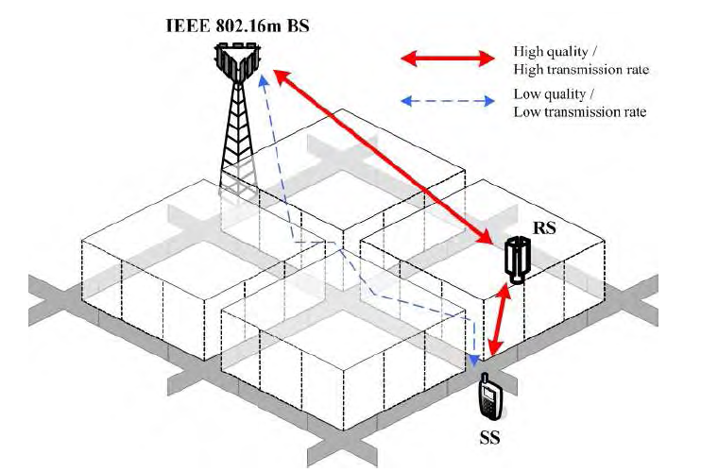
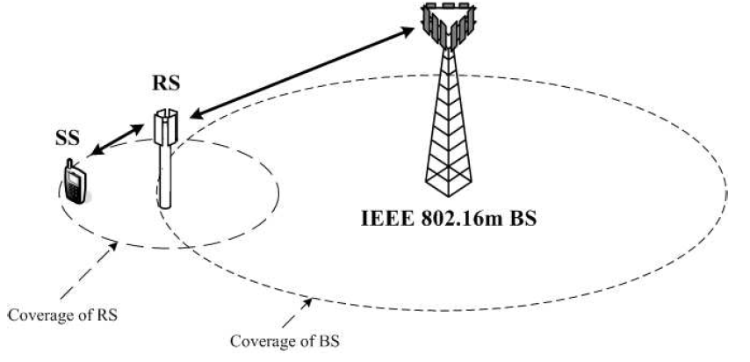
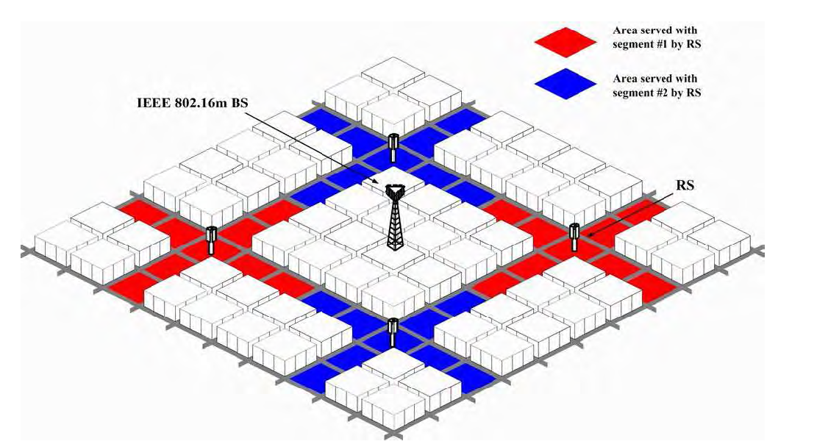
Multihop Relay-Enabled Architecture
Coverage extension by deploying RS in 802.16m network
Relays can enhance transmission rate for the MS located in shaded area or cell boundary
More aggressive radio resource reuse by deploying RS in 802.16m network

