Slide 1
802.16 GRIDMAN Task Group - Session #106
[IEEE 802.16 Mentor Presentation Template (Rev. 0)]
Document Number:
IEEE 802. 16-16-0063-00-000s
Date Submitted:
10-Nov-2016
Source:
Tim Godfrey Voice:
EPRI E-mail:
*<http://standards.ieee.org/faqs/affiliationFAQ.html>
Re:
Base Contribution:
N/A
Purpose:
Session #106 Task Group Closing Report (November 2016)
Notice:
This document does not represent the agreed views of the IEEE 802.16 Working Group or any of its subgroups. It represents only the views of the participants listed in the “Source(s)” field above. It is offered as a basis for discussion. It is not binding on the contributor(s), who reserve(s) the right to add, amend or withdraw material contained herein.
Copyright Policy:
The contributor is familiar with the IEEE-SA Copyright Policy <http://standards.ieee.org/IPR/copyrightpolicy.html>.
Patent Policy:
The contributor is familiar with the IEEE-SA Patent Policy and Procedures:
<http://standards.ieee.org/guides/bylaws/sect6-7.html#6> and <http://standards.ieee.org/guides/opman/sect6.html#6.3>.
Further information is located at <http://standards.ieee.org/board/pat/pat-material.html> and <http://standards.ieee.org/board/pat >.

Slide 2
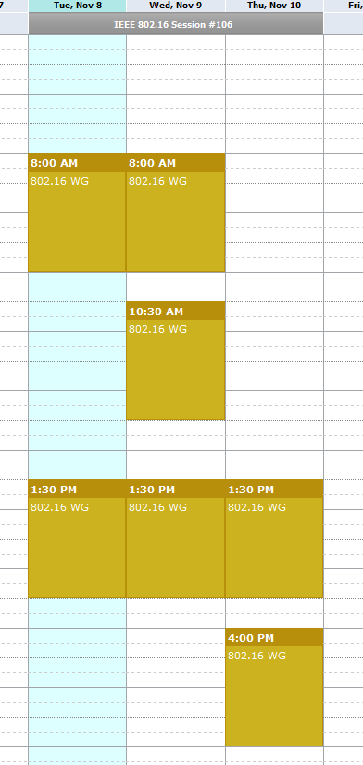
Meeting Plan for Week
802.16 WG
Tuesday AM1
Thursday PM2
GRIDMAN TG (802.16s)
Tuesday PM1
Wednesday AM1, AM2
Wednesday PM1
Thursday PM1

Slide 3
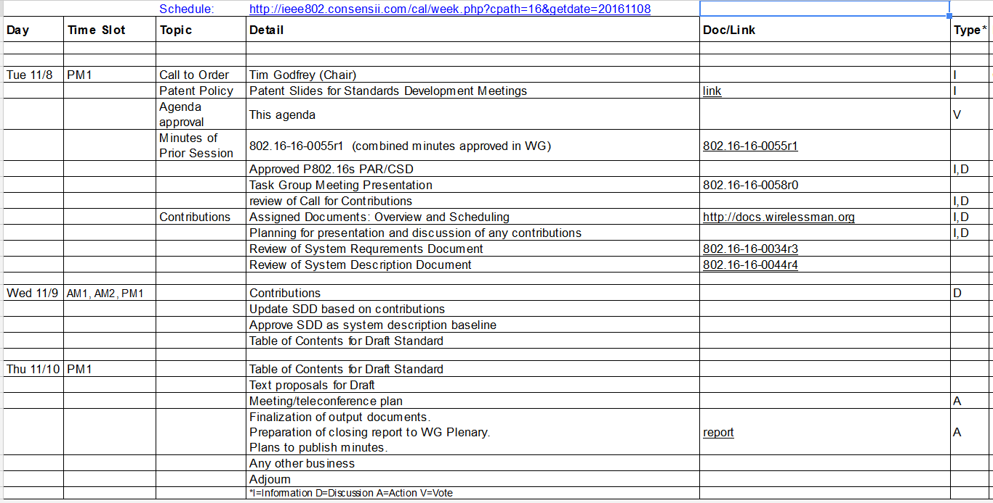
Agenda
From docs.google.com

Slide 4
Project Plan and Milestones
Nov 2016 Complete SDD, Initial Draft Development
Jan 2016 Draft Development, WG Letter Ballot
Mar 2017 Comment Resolution, recirc, Conditional Sponsor Ballot
May 2017 Comment resolution, recirculation
July 2017 Forward to RevCom

Slide 5
Plan for presentation and discussion of contributions
16-16-0059r0 Proposed MAC Layer Overhead Reduction Schemes
Menashe Shahar (Full Spectrum)
16-16-0060r0 Calculator for Proposed MAC Layer Overhead Reduction Schemes
Menashe Shahar (Full Spectrum)
16-16-0047r2 Benefits of Specific PHY Layer Parameters to Support 1MHz Channels
Doug Gray (EPRI)

Slide 6
Presentation of Contributions
Notes on 0059
Discussion on burst geometry
Consider allocating by frequency first on both UL and DL. Potential benefit for lightly loaded network.
Consider maintaining some level of self-configuration and learning of network parameters by remote.

Slide 7
Presentation of Contributions
Notes on 0047r2 PHY Parameters
Discussion on real-world deployments being designed to maintain higher rate modulations to even cell-edge remotes. The assumption of variation of modulation across coverage may be too pessimistic.

Slide 8
SDD Discussion - November
Update draft to 0044r5
Change channel BW to “100 KHz to 1.25 MHz in steps of 50 KHz.”
Develop tables to ultimately insert in clause 12.9 system profile
Determine optimal set of sampling clock choices
To Be Developed
Table for PHY Parameters (Clause 12 Profile Format)
Updated MAC Overhead Calculation

Slide 9
Draft Structure (Nov)
General
Definitions – define Band AMC
Create Clause 12.9 (System Profile)
Introductory section describing purpose of the new profile defined by the amendment
WirelessMAN OFDMA TDD Sub-1.25MHz
Each configuration can have a row in the table
Include introductory text explaining how Sub-1.25 is different
Include normative requirement for Band AMC support
Mandatory Convolutional Turbo Coding (CTC) 64QAM-5/6 Coding
Changes to Clause 8.4 OFDMA
Identify any necessary changes in this clause
Changes in 8.4.2.3 for BW and sampling
Find first definition to Band AMC in 8.4
Relax first zone PUSC requirement 8.4.6.3 for 16s
8.4.6.1.1 Preamble – add new form for configurations with less than 128 subcarriers (not all subcarriers in channel 500KHz and below)
8.4.5.4.1 UIUC allocation: We need to define new UIUC and DIUC code for repetition.

Slide 10
Draft Structure (Nov)
MAC - clause 6.3
6.3.2.3 - For DL MAP and UL MAP MAC messages, the generic MAC Header (6.3.2.1.1) is modified for narrow channel.
In 6.2.3.2.3, define a replacement header for each type of MAP (DL and UL), to be used in place of the generic MAC header.
Modify table 6-53 for MAC overhead reduction
Need to re-define some IE formats (shortened form)
8.4.5.3 DL-MAP IE format
8.4.5.4 UL-MAP IE format

Slide 11
Open Issues
Do we design the profile table with a built-in guard-band?

Slide 12
Approvals
Approve the SRD in document 802.16-16-0034r4 as the requirements for 802.16s
Moved Tim
Second Guy
Approved with unanimous consent
Approve the draft SDD in document 802.16-16-0044r7 as the working technical approach for 802.16s
Moved Harry
Second Menashe
Approved with unanimous consent

Slide 13
Accomplishments at November meeting
Approved SRD : 802.16-16-0034r4
Reviewed contributions
Approved technical approach in Draft SDD
Version at end of meeting 802.16-16-0044r7
Developed Amendment Draft Outline Structure

Slide 14
TG Closing
Assignment of Technical Editor (Doug Gray)
Plan for January (Session #107)
Finalize and approve SDD (802.16-16-0044r7 or subsequent) defining technical approach
Continue refinement of SDD (new tables) on teleconference
Review and Finalize draft
Authorize a WG Letter Ballot
Planned Teleconference
Thursday Dec 8, 11am PST /2pm EST
Thursday Jan 5, 11am PST /2pm EST
Agenda: Draft development from SRD

