Slide 1
[Fully distributed infrastructure-less proximity based direct communication for 802.16]
[IEEE 802.16 Mentor Presentation Template (Rev. 0)]
Document Number:
[IEEE 802.16-12-0000-01-Gcon]
Date Submitted:
[2012-07-05]
Source:
[Chanho Yoon, Seungkwon Cho, Sungkyung Kim, Soojung Jung, Hyungjin Kim, Sungcheol Chang, and Dongseun Kwon]
Voice: [+82-42-860-5872]
[ETRI] E-mail: [chyoon@etri.re.kr]
[218 Gajeong-ro, Yuseong-gu, Daejeon, 305-700, Republic of Korea]
Re:
[IEEE 802.16-12-0384-02-Gdoc]
Base Contribution:
[None]
Purpose:
[To instigate discussion regarding a new project for the IEEE 802.16 Working Group, and to propose a development on infrastructure-independent direct communications for proximity-based services]
Notice:
This document does not represent the agreed views of the IEEE 802.16 Working Group or any of its subgroups. It represents only the views of the participants listed in the “Source(s)” field above. It is offered as a basis for discussion. It is not binding on the contributor(s), who reserve(s) the right to add, amend or withdraw material contained herein.
Copyright Policy:
The contributor is familiar with the IEEE-SA Copyright Policy <http://standards.ieee.org/IPR/copyrightpolicy.html>.
Patent Policy:
The contributor is familiar with the IEEE-SA Patent Policy and Procedures:
<http://standards.ieee.org/guides/bylaws/sect6-7.html#6> and <http://standards.ieee.org/guides/opman/sect6.html#6.3>.
Further information is located at <http://standards.ieee.org/board/pat/pat-material.html> and <http://standards.ieee.org/board/pat >.

Slide 2
Proximity based applications (aforementioned in [1])
What can we get with proximity based applications?
Cellular traffic offloading (or data content sharing)
Proximity based P2P (device/service) discovery feature
Proximity based social commerce and advertisement
Proximity based social networking service (gaming, chatting, etc.)
Etc.
Current issues/trends of 3GPP LTE (ProSe)
Network controlled proximity service
Discussions on supporting proximity based service are active (D2D direct discovery & local routing)
Proximity service for public safety
Out of BS coverage case

Slide 3
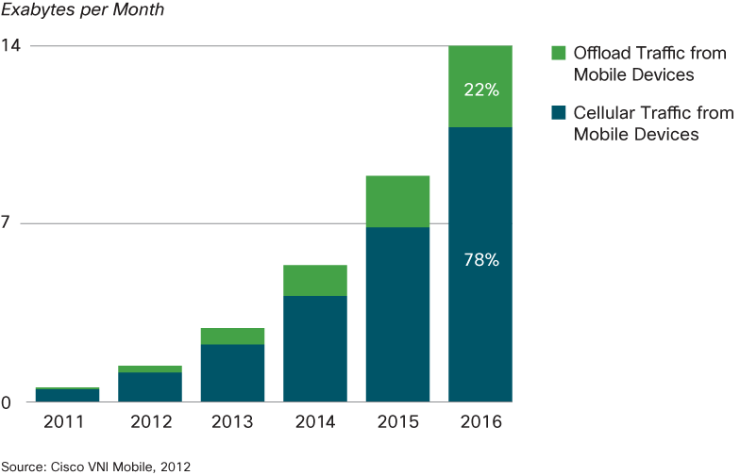
Proximity based applications via Direct Communication
Why traffic offloading?
Expected exponential increase of mobile traffic

Slide 4
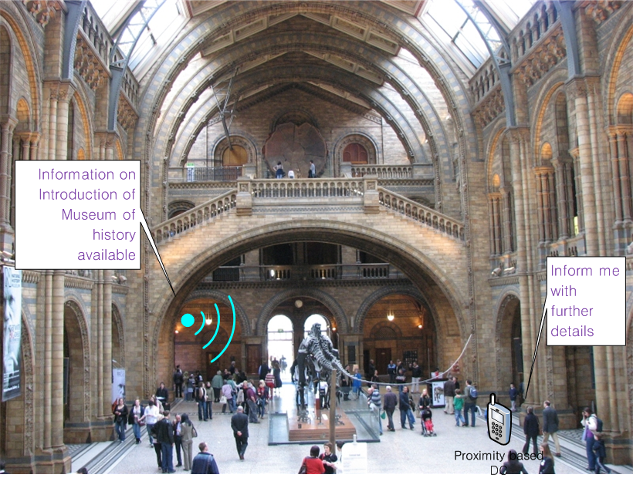
Proximity based applications via Direct Communication
Benefits of proximity based service
Public information service: the MS initiates direct device/service discovery

Slide 5
Proximity based applications via Direct Communication
Business model of proximity based service
Social commerce and advertisement: the MS initiates device/service discovery

Slide 6
Thoughts on current 802.16.1/1a standard
Can IEEE 802.16 GRIDMAN TG’s BS-controlled/talk-around communication support proximity based services?
1) Cellular traffic offloading (Inter-BS data content sharing)
BS-controlled DC:
Limited to a single BS service area (not specifically defined for inter-BS case)
Talk-around DC:
Focused on voice application (low capacity)
2) Proximity based P2P (device/service) discovery
BS-controlled:
No MS initiated proximity discovery
No support for device/service discovery in idle mode (before MS network entry)
Talk-around DC:
Not considered, no MS initiated proximity discovery

Slide 7
New amendments for 802.16 standard
In order to support proximity based direct communication (DC) services in the current 802.16 standard, we need a new amendment (not a revision of GRIDMAN TG).
The intent of DC feature in GRIDMAN TG is primarily focused on enhancing the link reliability, not for proximate based services.
Undoubtedly, the GRIDNMAN’s schedule for sponsor balloting is approaching in a few months.
Therefore, the DC feature for supporting proximity based service needs a new approach/enhancement different from GRIDMAN’s.

Slide 8
New amendments for 802.16 standard
Technically, we can think of two hierarchically top level ways
a) BS dependent way: D2D communication with the help of BS or network
b) BS independent way: let D2D communication do discovery, resource allocation, and scheduling independently. In addition, we can extend the coverage of proximity based services.
In this contribution, we suggest proximity based DC PHY/MAC protocols as an 802.16 enhancement.
In this contribution, we suggest infrastructure-independent mode
In the other contribution, BS dependent mode will be presented

Slide 9
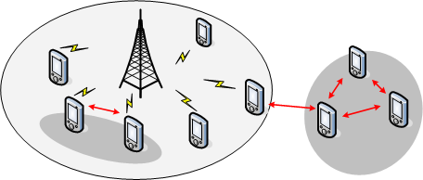
New amendments for 802.16 standard
We primarily focus on BS-dependent DC. However, technically this feature extends to out of BS coverage (infrastructure-less) situation
Why not exploit the licensed band for out of BS coverage area cases?
Can setup D2D links where an MS is located out of BS coverage area (the corresponding pair is in the BS’s coverage)
Can apply to the case of infrastructure failure due to disasters

Slide 10
New amendments for 802.16 standard
1) Infrastructure-independent proximity based DC’s enhanced features:
Direct device/service discovery
Within BS coverage: BS assists finding peers
Out of BS coverage: devices independently finds peers

Slide 11
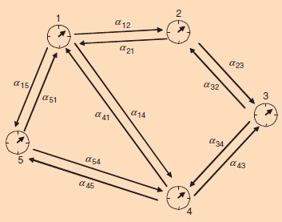
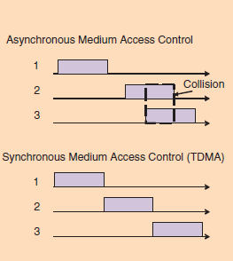
New amendments for 802.16 standard
1) Infrastructure-independent proximity based DC’s enhanced features: (cont.)
Out of BS service area case
Distributed synchronization
Distributed multiple access coordination

Slide 12
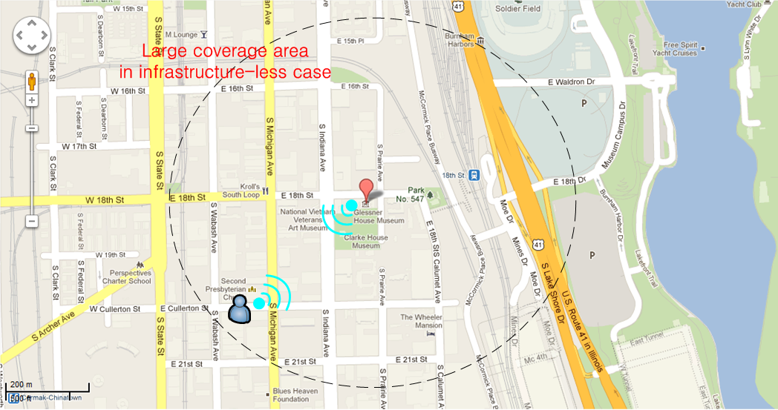
New amendments for 802.16 standard
1) Infrastructure-independent proximity based DC’s enhanced features: (cont.)
Out of BS service area case
Basic large link coverage
Multi-hop functionality

Slide 13
New amendments for 802.16 standard
1) Infrastructure-independent proximity based DC’s enhanced features: (cont.)
Power saving features
A fixed frame structure is preferred
Resource reuse
Spatial reuse with transmit power control
To be added…

Slide 14
New amendments for 802.16 standard
2) Compatibility to current standard?
Backward compatibility with 802.16 OFDMA based standard? Yes
No change required for legacy 802.16m PHY/MAC specification, but some additional amendments for proximate DC PHY/MAC protocol.
Amendment to the 802.16 could make above possible
A comprehensive standard of BS dependent DC for proximity based applications supporting use cases:
MS to MS associated with BSs
MS to MS, only one of the pair is associated with a BS
MS to MS not associated with any BSs (out of BS coverage)

Slide 15
Proposal of new PAR & 5C for proximate direct communication (PDC)
Need for a new TG
To fully support the aforementioned proximity based applications and new features currently unavailable in the latest 802.16.1/1a standard
To develop a distinctive infrastructure-dependent and/or infrastructure-independent direct communication standard with backward compatibility to existing 802.16 protocols
To define 802.16 enhancements to support proximity based direct communication.

Slide 16
Suggested Tentative Timeline for TG PDC
Forward draft PAR and 5C statement to IEEE 802 Sept. 2012
Submit PAR and 5C to NesCom Nov. 2012
PAR approval by IEEE-SA Standards Board Dec. 2012
TG formation (IEEE 802.16 WG #83) Jan. 2013
IEEE 802.16 WG #84 Mar. 2013
IEEE 802.16 WG #85 May 2013
IEEE 802.16 WG #86 July 2013

Slide 17
References
[1] W. Shin, J. Cha, A. Lee, E. Kim, and K. Lim, “802.16 enhancements to support direct communications for proximity-based applications”, IEEE 802 doc. 16-12-0353-01-Gcon.
[2] K. Doppler, M. Rinne, C. Wijting, C. Ribeiro, and K. Hugi, “Device-to-device communication as an underlay to LTE-advanced networks”, Communications Magazine, IEEE, vol.47, no. 12, pp.42-49, Dec. 2009.
[3] P. Janis, V. Koivunen, C. Ribeiro, J. Korthonen, K. Doppler, and K. Hugi, “Interference-aware resource allocation for device-to-device radio underlaying cellular networks”, IEEE VTC Spring 2009, IEEE 69th, pp.1-5.
[4] T. Chen, G. Charbit, and S. Hakola, “Time hopping for device-to-device communication in LTE cellular system” IEEE WCNC 2010, pp.1-6.

Slide 18
Thank You!

