Slide 1
Project: P802.15 Working Group for Wireless Specialty Networks
Submission Title: A lower pulse repetition frequency proposal for New Standard UWB
Date Submitted: April 15th, 2025
Source: Menghuan Yang; Baoguo Yu; Yachuan Bao
Company: (State Key Laboratory of Satellite Navigation System and Equipment Technology)
Address: 589 Zhongshan West Road, Shijiazhuang, Hebei Province, China
E-Mail: nkyangmh@foxmail.com
Abstract: Proposal for a lower pulse repetition frequency for NS UWB and show the performance comparison with HRP UWB. This contribution was supported by National Key Research and Development Program (2021YFB3900800) in China.
Purpose: In response to the call for proposal.
Notice: This document has been prepared to assist P802.15. It is offered as a basis for discussion and is not binding on the contributing individual(s) or organization(s). The material in this document is subject to change in form and content after further study. The contributor(s) reserve(s) the right to add, amend or withdraw material contained herein.
Release: The contributor acknowledges and accepts that this contribution becomes the property of IEEE and may be made publicly available by P802.15.

Slide 2
A Lower pulse repetition frequency Proposal for NS-UWB
Menghuan Yang; Baoguo Yu; Yachuan Bao
State Key Laboratory of Satellite Navigation System and Equipment Technology (SKL-SatNav)

Slide 3
Background
IEEE Std 802.15.4 is overly complex and has become extremely difficult to understand, amend or enhance.
The PAR&CSD for New Standard UWB have been approved by IEEE 802 EC （DCN:15-21-0278 & 15-21-0274）
The New Standard UWB specifies the PHY and MAC layer for impulse radio ultra wideband (UWB) wireless ad hoc connectivity with fixed, portable, and moving devices with limited energy consumption requirements, and supports real time precision ranging capability that is accurate to within a few centimeters.

Slide 4
Motivations
For the NS-UWB, the primary focus on the physical layer should be the improvement of the ranging ability for higher precision ranging or longer-range coverage, particularly in dense multipath environment.
    Trade off between ranging and communication
    Trade off between pilot and data
The New Standard UWB specifies the PHY and MAC layer for impulse radio ultra wideband (UWB) wireless ad hoc connectivity with fixed, portable, and moving devices with limited energy consumption requirements, and supports real time precision ranging capability that is accurate to within a few centimeters.
In this contribution, we propose a lower pulse repetition frequency (PRF) to enhance accurate ranging capability, improve link budget, and reduce receiver complexity.

Slide 5
Why a lower PRF?
A lower Pulse repetition frequency (PRF) is desirable as it helps with:
Reducing the inter pulse interference
Improve the link budget
Low complexity incoherent reception

Slide 6
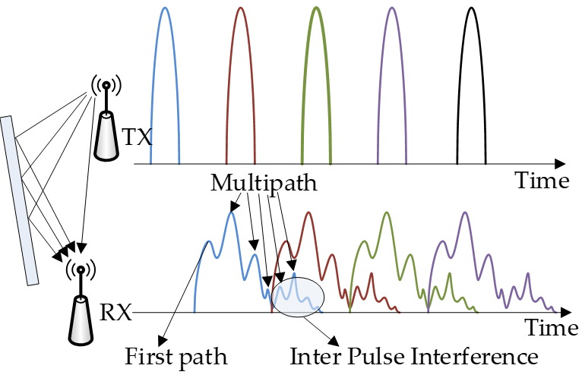
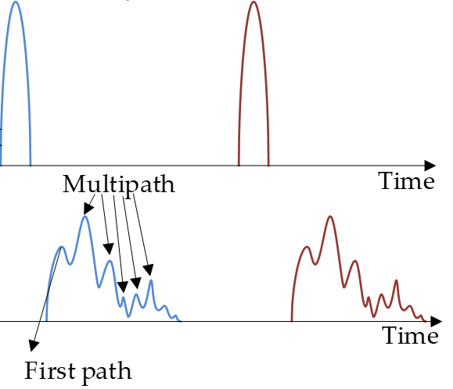
Inter pulse interference in dense multipath
In dense multipath environment, the NLOS signal of the previous pulse may superimpose onto LOS signal of current pulse, resulting in false detection of LOS signal.
A lower pulse repetition frequency leads to a larger pulse interval, reducing the probability of inter pulse interference.
High repetition pulse
Lower repetition pulse

Slide 7
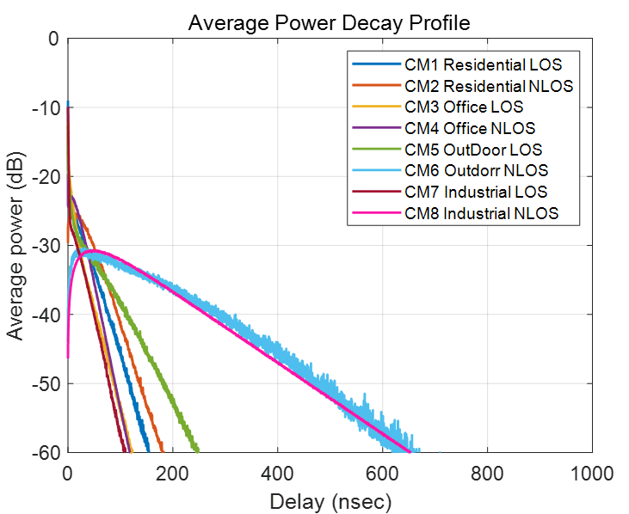
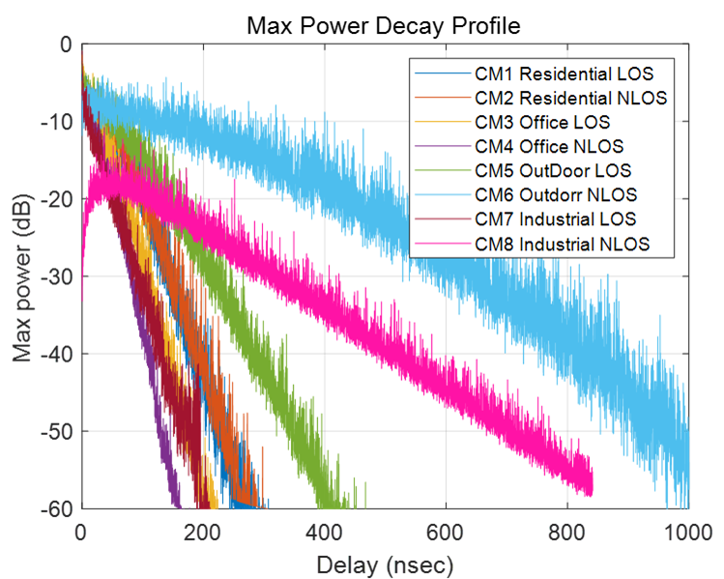
PDP in dense multipath
In dense multipath environment, the multipath delay could be over 1000ns under extreme conditions. Assuming that when the energy of multipath signals exceeds -20dB, it will have a significant impact on the determination of the direct path. The
Ref：IEEE 802.15.4a channel model- final report (DCN:#15-04-0662)

Slide 8
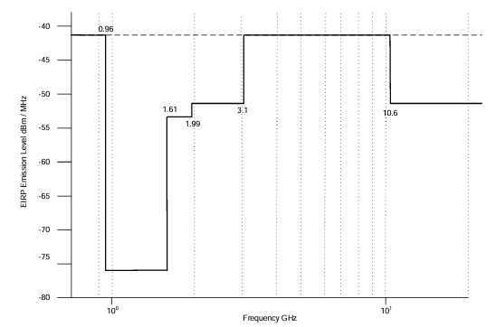
Mean & Max E.I.R.P
The regulatory authorities (FCC, MIIT, CEPT, etc.) have constituted UWB emission limits on Mean EIRP and max EIRP. The Mean EIRP should be less than -41.3dBm/MHz, and the max EIRP should be less than 0dBm/MHz.

Slide 9
Link budget
TX |  | HRP | HNav
PRF |  | 62.4MHz | 918KHz
SYNC | N symbol | 64 | 128
 | N pulse | 4096 | 128
 | Time | 65.128us
SFD | N symbol | 8 | 64
 | N pulse | 4*64 | 64
 | Time | 8.141us
PHR | Data rate | 0.85 | ——
 | N pulse | 21*64 | ——
 | Time | 21.538us | ——
PSDU | Data rate | 6.81 | 0.459
 | N pulse | (112+48)*8 | 224
 | Time | 20.513us
Total | N pulse | 6976 | 416
 | Time | 115.32us | 453.33us
 | Energy per pulse | 0.62pJ | 40.8pJ
RX | HRP | HNav
N sym in SFD | 8 | 1
N pulse per symbol | 32 | 64
Nominal processing gain | 3.01dB | 2.25dB
Processing gain | 15.05dB | 13.5dB
Engrgy per symbol | 19.8pJ | 913pJ
Receiver SNR | 96.5dB | 113dB
threshold | 10dB | 10dB
Noise Figure | 5dB | 5dB
Quantization noise |  | 5dB
Link budget | 81.5dB | 93dB
Distance(@3993.6MHz) | 71.1m | 267m

Slide 10
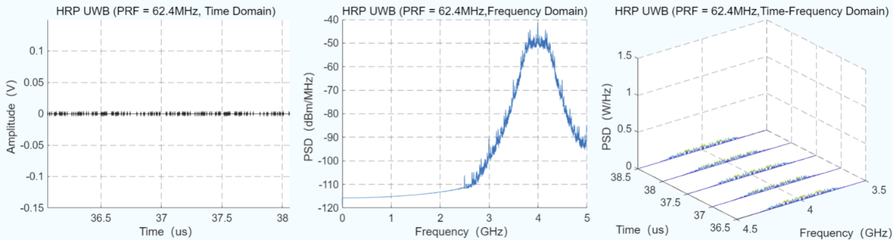
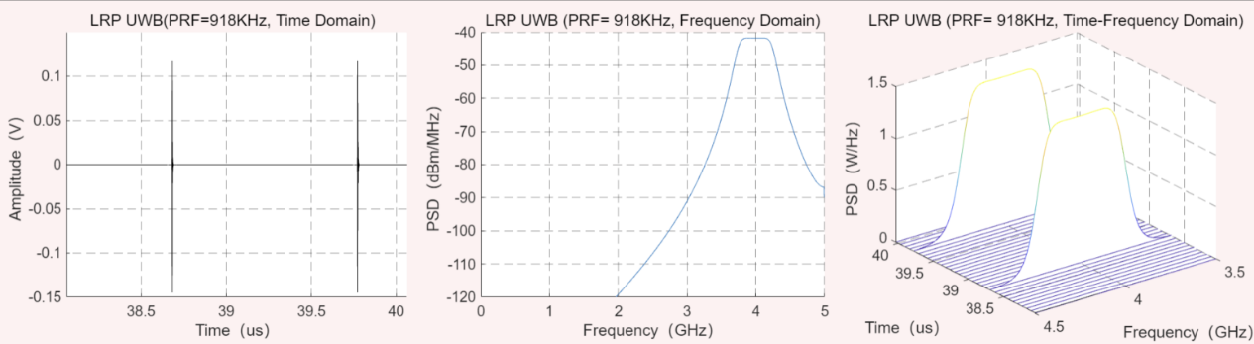
Simulation: Charactstic
Under the constraint of E.I.R.P., the lower the PRF, the larger the amplitude of the pulse, and the stronger the anti-interference ability.

Slide 11
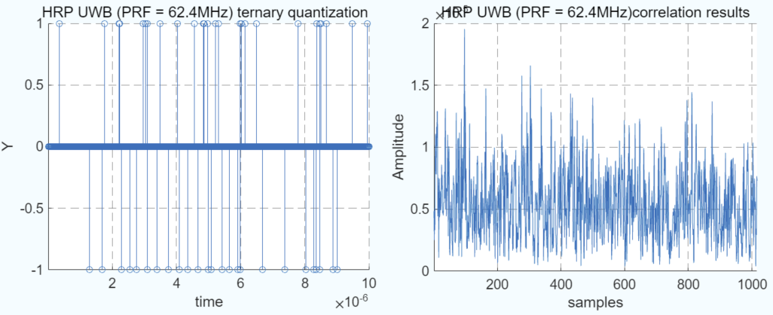
Simulation: Coverage
The distance between the receiver and the transmitter is 100 meters
When PRF = 62.4MHz, the signal cannot be detected through the correlation peak.

Slide 12
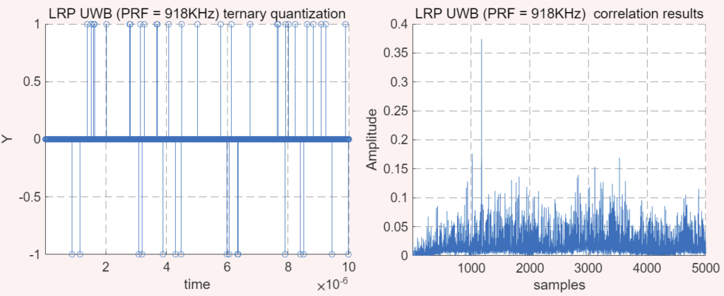
Simulation: Coverage
The distance between the receiver and the transmitter is 100 meters
When PRF = 918KHz, the signal can be detected through the correlation peak.

Slide 13
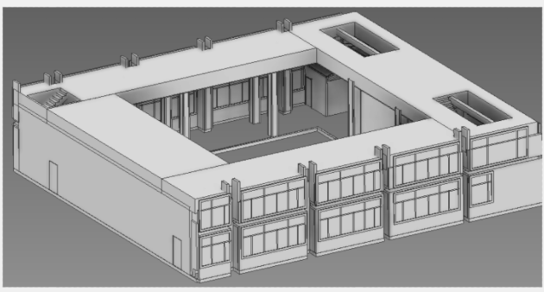
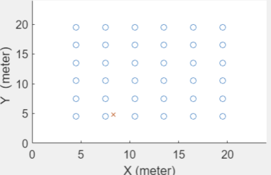
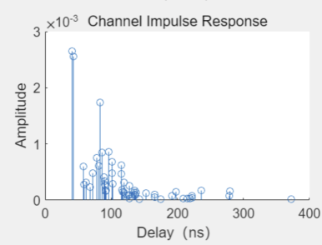
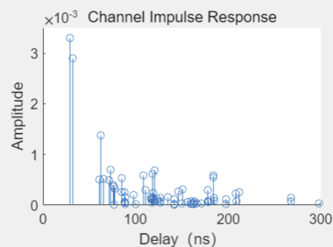
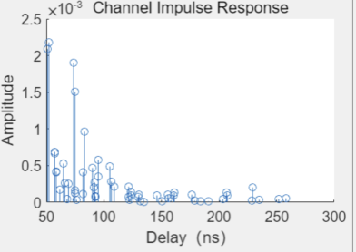
Simulation: Ranging in Dense multipath
In typical indoor multipath scenarios, using ray tracing for channel modeling

Slide 14
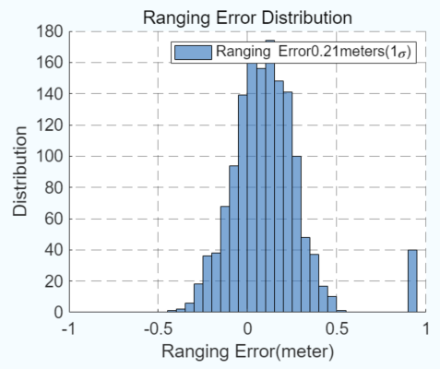
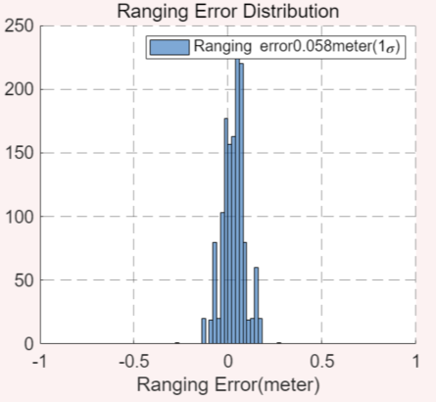
Simulation: Ranging in Dense multipath
When PRF = 62.4MHz, the ranging error is 0.21 meter(1σ)
When PRF = 918KHz, the ranging error is 0.058 meter(1σ).

Slide 15
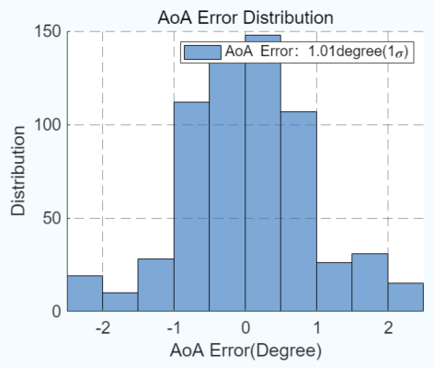
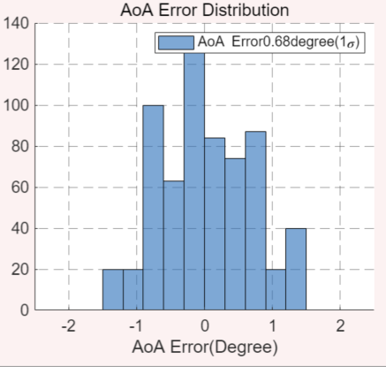
Simulation: AoA in Dense multipath
When PRF = 62.4MHz, the Angle of Arrival error is 0.21 meter(1σ)
When PRF = 918KHz, the Angle of Arrival error is 0.058 meter(1σ).

Slide 16
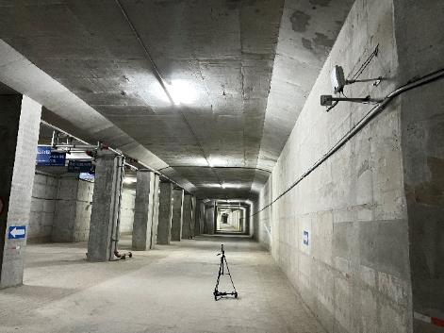
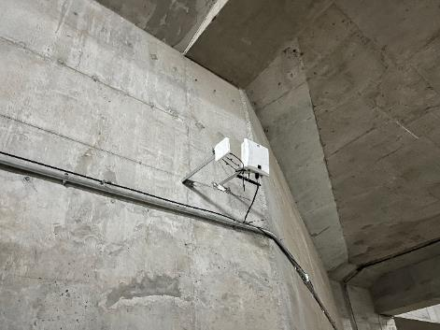
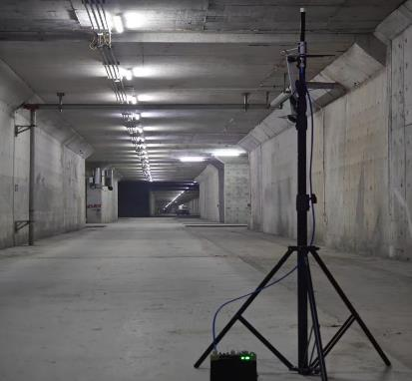
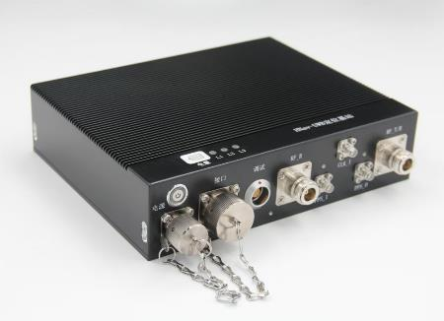
Underground Trail
We conducted field tests in an underground environment using two different devices, one with a PRF of 62.4MHz and the other with a PRF of 918KHz.

Slide 17
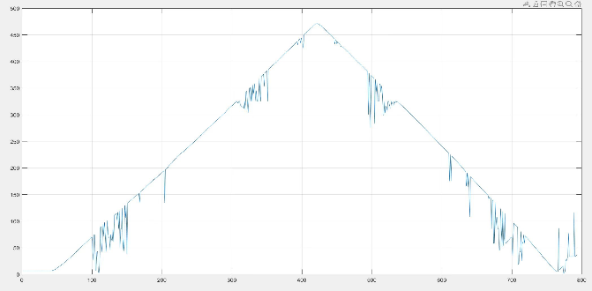
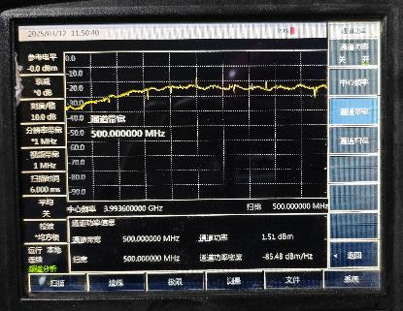
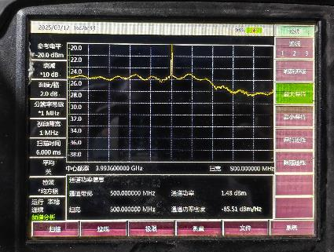
Underground Trail
The transmission power of two sets of devices has been adjusted to similar values, one is 1.51dBm（PRF=62.4MHz） and the other is 1.48dBm（PRF = 918KHz）
When PRF = 62.4MHz, the maximum coverage distance is about 470meters
When PRF = 918KHz, the maximum coverage distance is about 768meters.

Slide 18
Conclusion
In this contribution, we propose a lower pulse repetition frequency (PRF) to enhance accurate ranging capability in dense multipath environment.
The simulation results show the lower PRF is better with more coverage and higher measurement accuracy
Field testing further confirmed the above viewpoint, especially when the mean E.I.R.P. is equal.

Slide 19
Thank you!

