Slide 1

155th Session of meetings of the
IEEE 802.15 Working Group for Wireless Specialty Networks (WSN)
Closing Report
March 9-14, 2024
Held in Atlanta & Hybrid via Webex

Slide 2
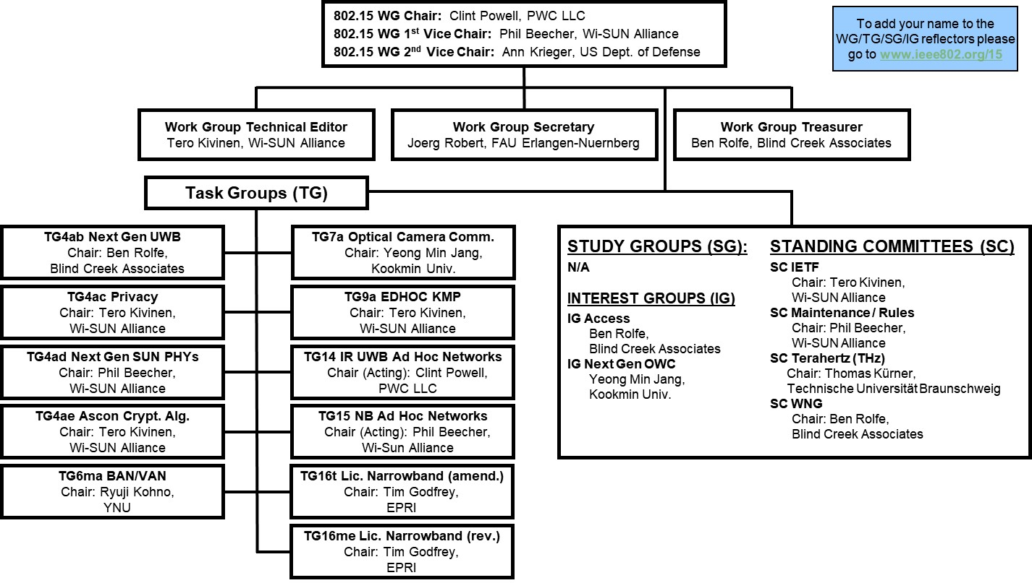
802.15 WG Org. Chart

Slide 3
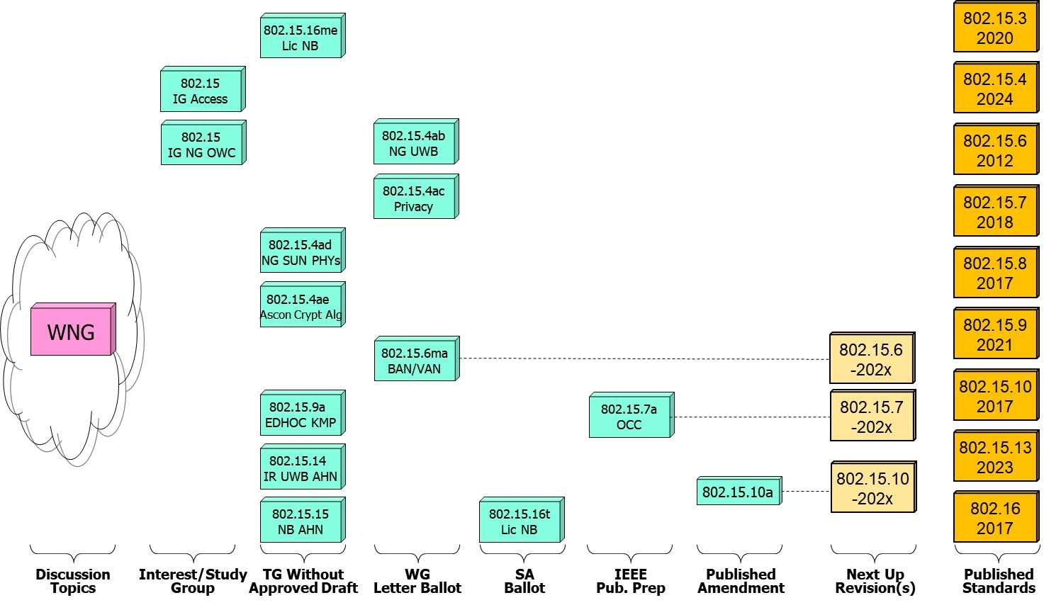
802.15 WG Standards Pipeline

Slide 4
WG15 LB Closings Update
WG15 Letter Ballots closing since the start of the previous session
  Project P802.15.4ac P802.15.6ma
  Draft / LB # D0/LB211 D4/LB212
  VOTERS 116 124
  VOTED 85 102
  YES 76 93
  ABSTAIN 6 7
  NO 3 2
  % VOTERS 73.28 82.26
  % YES 96.20 97.89
  % ABSTAIN 7.06 6.86
  Did Not Vote 31 22
  Did Not Vote % 26.7 17.7
  Open Date 1/23/25 2/18/25
  Close Date 2/22/25 3/5/25

Slide 5
WG15 Active PARS
  Project Project Status Approval Date Expiration Date
  P802.15.14 In Hibernation 9/23/21 12/31/25
  P802.15.15 In Hibernation 9/23/21 12/31/25
  P802.15.4ab Active 9/23/21 12/31/25
  P802.15.6 Active 5/13/22 12/31/26
  P802.15.4ac Active 6/5/23 12/31/27
  P802.15.4ad Active 3/21/24 12/31/28
  P802.15.4ae Active 11/12/24 12/31/28
  P802.15.9a Active 11/12/24 12/31/28

Slide 6
802.15 WG Administrative
Voting members: 116
Nearly voting members: 17
Aspirant voting members: 23
Membership roster: 802.15 WG Membership Status
802.15 WG Officers - Elected March 2024
Clint Powell - Chair
Phil Beecher - 1st Vice-Chair
Ann Krieger - 2nd Vice-Chair
Joerg Robert - Secretary (appointed)
Tero Kivinen - Tech. Editor (appointed)
Ben Rolfe - Treasurer (appointed)

Slide 7
802.15 WG Operations
802.15 Operations Manual - covering Membership rules, Voting in the subgroup, Parliamentary procedures for approval to move any deliverables to the Standards Committee for action, officer scope of duties and much more…
WG15 Op's Manual
802 Operations Links
802 LMSC Op’s Manual
802 LMSC P&P
802 LMSC Chairs Guidelines
802 WCSC Op’s Manual

Slide 8
802 LMSC Annual Review of 802.15
Scope
  The 802.15 Working Group (WG) on Wireless Specialty Networks (WSN) focuses on the development of open consensus standards addressing wireless networking for the emerging Internet of Things (IoT), allowing these devices to communicate and interoperate with one another, mobile devices, wearables, etc.
    The goal of 802.15 is to publish standards, recommended practices, or guides that have broad market applicability and deal effectively with the issues of coexistence and interoperability with other wired and wireless networking solutions.
Duties
  Maintain and revise the 802.15 standards, amendments, and recommended practices
  Develop new standards when a PAR is approved by IEEE SASB and is assigned to the 802.15 WG by the IEEE 802 LMSC
  Maintain liaisons with other groups within IEEE 802 LMSC, and other relevant standards setting bodies and radio spectrum regulatory bodies
Membership
See slide 6

Slide 9
March 2025 802.15 WG Agenda

Slide 10
2.6a: Designation of Individual Experts
for this Session
Individual experts who attend electronically for a specific purpose/presentation can be designated as such by the WG Chair and receive a registration fee waiver and limited attendance rights.
See section 5 in https://mentor.ieee.org/802-ec/dcn/17/ec-17-0090-26-0PNP-ieee-802-lmsc-operations-manual.pdf.
  The Working Group Chair may designate specific individual experts who are allowed to participate in Working Group discussions via electronic means during an in-person meeting for the benefit of the group. These individuals are not considered to be attending the meeting and so they are not required to pay meeting fees and they do not get participation credit. The participation of these individuals should be limited to specific technical topics. Such participation shall be documented in the minutes of the Working Group meeting.
The individuals listed below are hereby designated as specific individual experts on their respective topics and subject to the restrictions and benefits described in the 802 OM.
  Expert: Micah Givens (Heinwave LLC); Topic: Waveform-Embedded Cryptographic Security;
  Mtg.: WG15 WNG
  n/a
  n/a
  n/a
  n/a
For WNG, attendance for each is limited to the WNG timeslot in which the respective presentation is scheduled.

Slide 11
















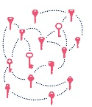
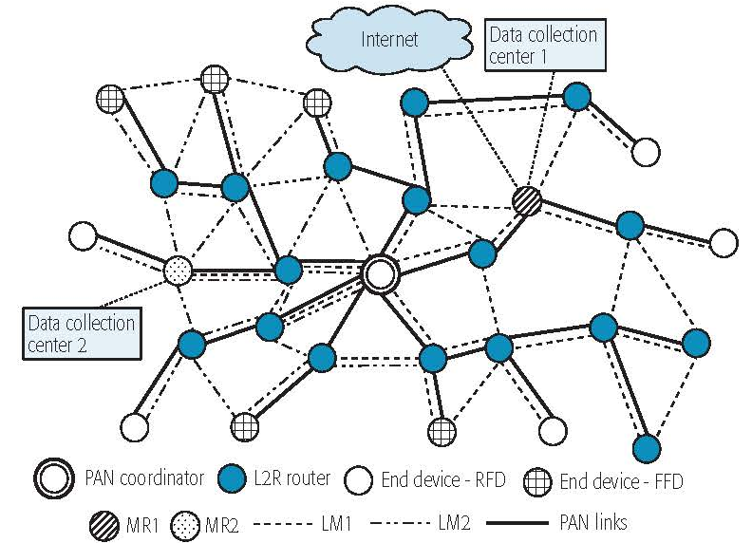

IEEE 802.15 Standards & their Applications
Locating and Tracking
Ultra-low Power Sensors
Automotive
802.15.16
802.15.4
FAN/MAN/RAN
Industrial Networks
Multi-media networks
&
High Speed
Interconnect
802.15.4
802.15.3
Structural Monitoring
802.15.7
802.15.13
802.15.6
Medical
802.15.9
802.15.10
Optical
Communications
Key
Management
Layer 2
Routing
Agricultural Monitoring
Consumer Devices
11

Slide 12
IEEE 802.15
Subgroups Objectives

Slide 13
TG4ab (NG UWB) -
Next Gen. Ultra WideBand Amendment
Chair: Ben Rolfe
Objective:
Enhancements to 802.15.4 Ultra Wideband (UWB) physical layers (PHYs) media access control (MAC), and associated ranging techniques while retaining backward compatibility with enhanced ranging capable devices (ERDEVs).
TG4ab Webpage
Areas being worked on include:
Ranging
Link budget improvements
Improvements to accuracy, precision and reliability
Sensing
Pulse shape improvements
Channel impulse response reporting to support multistatic sensing
To better support presence detection, environment mapping and other uses
Data
Higher data rates for shorter transmission duration and power savings
Channel coding and packet format improvements for robustness
Additional options for even greater power savings
Protocol enhancements to support very low latency, low energy communications
Interference mitigation techniques to support:
Greater device density
Coexistence in the presence of other users
This amendment builds on top of the existing 802.15.4 standard and the 802.15.4z amendment.

Slide 14
TG4ac (Privacy) - Privacy Amendment
Chair: Tero Kivinen
Objective:
This amendment specifies modifications to the IEEE Std 802.15.4 MAC specification to specify mechanisms that address and improve user privacy. These mechanisms include randomized addresses, and exchanges that support session continuity. This amendment maintains backward compatibility with the base standard.
TG4ac Webpage
This amendment builds on top of the existing 802.15.4 standard.

Slide 15
TG4ad (NG SUN PHYs) -
Next Gen. SUN PHYs Amendment
Chair: Phil Beecher
Objective:
The amendment specifies modifications for the development of a second-generation physical layer (PHY) for Smart Utility Networks (SUN). The primary focus is the improvement of the OFDM (Orthogonal Frequency Division Multiplexing) modes for higher data rates and longer-range communication, particularly in congested license-exempt frequency bands.
TG4ad Webpage
Areas being worked on include:
Definition of use-cases
Number of devices in given area
Max. payload bit-rate
Latency requirements
Definition of frequency bands
…
Channel Models
Channel models for indoor and outdoor use
Interference models for license-exempt band operation
…
This amendment builds on top of the existing 802.15.4 standard.

Slide 16
TG4ae (Ascon Crypt. Alg.) - Amendment
Chair: Tero Kivinen
Objective:
This amendment adds the use of Ascon-128 and Ascon-128a cryptographic algorithms to the IEEE Std 802.15.4.
Ascon-128 and Ascon-128a: Ascon is a family of lightweight authenticated ciphers that has been selected by US National Institute of Standards and Technology (NIST) for future standardization of the lightweight cryptography. Ascon provides the same Authenticated Encryption with Associated Data (AEAD) functionality as Advanced Encryption Standard (AES), allowing an Ascon algorithm to be a drop-in.
TG4ae Webpage
This amendment builds on top of the existing 802.15.4 standard.

Slide 17
TG6ma (BAN/VAN) - BAN with Enhanced Dependability Revision
Chair: Ryuji Kohno
Objective:
Enhancements to the Body Area Networks (BAN) Ultra Wideband (UWB) physical layer (PHY) and media access control (MAC) to support enhanced dependability to a human BAN (HBAN), adding support for vehicle BAN (VBAN.
TG6ma Webpage
Areas being worked on include:
Channel Modeling
Precise modeling of radio propagation of implant and wearable human BANs and around vehicle BANs for dependable data transmission
Classified modeling of multiple BANs and coexistence with other radios for resolution in PHY and MAC
Data transmission
Cognition of channel environment and coexistence
Initial acquisition and synchronization in coexisting BANs
FEC and hybrid ARQ according to QoS levels of data packets for various channel models and coexistence classes
Packet contention
Control and data channels, superframe formant, and MAC function to avoid packet contention in various classes of coexistence
Hybrid protocol of contention-free and contention access according to required QoS levels of data packets
Inter coordinators or hubs negotiation among coexisting BANs
Interference mitigation in coexistence
Interference surprising and canceling technologies for theoretical and feasible implementation in coexistence
Result in simpler classes of coexistence by mitigation of interference from non-BAN
Ranging
Optional ranging for cognition of dynamism of coexisting BANs
This revision builds on the existing 802.15.6 standard with enhanced dependability for human BAN and additional vehicle BAN.

Slide 18
TG7a (OCC) - Higher Rate, Longer Range Optical Camera Comms. Amendment
Chair: Yeong Min Jang
Objective:
This standard offers a global, secure, high-speed optical communication solution up to 100 Mbps and 200 m, with advantages like access to unlicensed spectrum, inherent security, and AI-enhanced features, promising for commercial and business markets.
TG7a Webpage
Areas being worked on include:
Wavelength range: 10000 nm to 190 nm in optically transparent media.
Data rate: Capable of delivering up to 100 Mbit/s.
Communication types: Designed for point-to-point and point-to-multipoint communication.
Adaptation features:
Adaptation to varying channel conditions.
Maintaining connectivity during high mobility (up to 350 km/h).
Flicker mitigation.
Radio Frequency (RF) co-existence.
Communication range: Up to 200 m.
Technology utilized:
Multiple-Input-Multiple-Output (MIMO).
MIMO-Orthogonal frequency-division multiplexing (MIMO-OFDM) for dealing with high levels of optical interference while maintaining high-rate data transmission.
Additional mechanisms:
Relaying mechanisms for enabling heterogeneous operation with existing RF wireless data communications standards.
Safety and regulation: Adheres to applicable eye safety regulations.
This amendment builds on top of the existing 802.15.7 standard.

Slide 19
TG9a (EDHOC KMP) - Amendment
Chair: Tero Kivinen
Objective:
This amendment specifies the use of EDHOC (RFC 9528) KMP for the IEEE Std 802.15.9. This standard describes support for transporting KMP datagrams to support the security functionality present in IEEE Std 802.15.4.
TG9a Webpage
This amendment builds on top of the existing 802.15.4 standard.

Slide 20
TG14 (IR UWB AHN) - Impulse Radio UWB Wireless Ad Hoc Networks
Chair: Clint Powell
Objective:
Focused on impulse radio (IR) Ultra Wideband (UWB) PHY and MAC providing precision ranging capability that is accurate to the centimeter level by including (via. referencing) the 802.15.4 IR UWB functionality into a simple focused specification.
TG14 Webpage
Objective
This TG is currently in hibernation awaiting the outcome/conclusion of the TG4me revision, to see if has satisfied the objective of this project.
This project is for a new standard that references the 802.15.4 standard.

Slide 21
TG15 (NB AHN) - Narrow Band Wireless Ad Hoc Networks
Chair: Phil Beecher
Objective:
Focused on narrow band ad hoc network PHY and MAC by including (via referencing) functionality and features of 802.15.4 into a simple focused specification.
TG15 Webpage
Objective
This TG is currently in hibernation awaiting the outcome/conclusion of the TG4me revision, to see if has satisfied the objective of this project.
This project is for a new standard that references the 802.15.4 standard.

Slide 22
TG16t (Lic NB) - Licensed Narrowband Amendment
Chair: Tim Godfrey
Objective:
Enhancements to IEEE 802.16-2017 physical layer (PHYs) and media access control (MAC) to enable operation in licensed spectrum with channel bandwidths greater than or equal to 5 kHz and less than 100 kHz. The amendment is frequency independent but focuses on spectrum less than 2 GHz. The range and data rate supported by the narrower channels are commensurate with those of the base standard, as scaled by the reduced channel bandwidth. The project also amends IEEE Std 802.16 as required to support aggregated operation in adjacent and non-adjacent channels.
TG16t Webpage
Areas being worked on include:
Definition of the Wireless MAN-NB PHY to enable operation in narrow channels
Aggregation of non-contiguous narrow channels to provide higher capacity
Enhancements to MAC to improve efficiency and reduce control overhead
Definition of a Direct Peer-to-Peer (DPP) mode to support operation without fixed infrastructure
Updates to security protocols
This amendment builds on top of the existing 802.16 standard.

Slide 23
TG16me (Lic NB) - Licensed Narrowband Revision
Chair: Tim Godfrey
Objective:
802.16-2017 is coming up on it’s 10-year anniversary and as such a revision needs to be started to incorporate any amendments (802.16t) since the 802.16-2017 standard.
TG16me Webpage
Areas being worked on include:
Roll up of 802.16t amendment
Address any issues
This is a revision to the 802.16-2017 standard.

Slide 24
IG Access -
WG15 Access Techniques
Chair: Ben Rolfe
Objective:
Determine interest in starting efforts for development of projects on 802.15 Access Techniques.

Slide 25
IG (NG-OWC) - Next Gen. Optical Wireless Communication
Chair: Yeong Min Jang
Objective:
Determine interest in next-generation optical wireless communication (NG-OWC) characteristics and its future applications.
Areas being worked on include:
Artificial Intelligence (AI) for NG-OWC
Integration of various AI technologies into the OWC system
Lightweight AI utilization for each developed AI technology
Channel modelling for NG-OWC
Integration of machine-learning for channel estimation
Utilization of machine learning for channel estimation for dynamic and complex channel conditions
Future applications of NG-OWC
NG-OWC encompasses fields such as IoT, underwater communication, joint communication, sensing, and localization (V2V, M2M, Drone/UAV, etc.)
NG-OWC for OWC based drone Networks
NG-OWC for Indoor/Outdoor Positioning through OWC and LiDAR integration
Deep learning-based OWC to support high mobility vehicle
Preferred camera types for OWC
Resolution: Minimum 720x540 (single-link), maximum 3840 x 2160 (multi-link)
Frame rate: Minimum 30 FPS, preferred more than 120 FPS
Spectrum: Mono, color
Light sources: IR, VL, and UV
This group will evaluate the interest in developing Next Gen OWC capabilities

Slide 26
SC IETF -
Internet Engineering Task Force
Chair: Tero Kivinen
Objective:
This standing committee brings in the information from the Internet Engineering Task Force (IETF) to the 802.15 working group. It concentrates on the IETF working groups that might be of interest to the 802.15 working group members.
SC IETF Webpage
IETF working groups followed include:
6lo, lake, suit

Slide 27
SC MAINT -
802.15 Maintenance Activities
Chair: Phil Beecher
Objective:
The Standing Committee Maintenance (SCM) has the following roles:
Reviewing comments related to possible errata on 802.15 standards and making recommendations to 802.15 Working Group
Managing and maintaining the 802.15 Operations Manual
Managing and maintaining the 802.15 Motion templates and project checklist template
Reviewing 802 PARs and ICAIDs on behalf of 802.15 Working Group
SC MAINT Webpage
SCM meets at least once during every 802 plenary and 802 wireless interim session

Slide 28
SC THz -
THz Standing Committee
Chair: Thomas Kürner
Objective:
The IEEE 802.15 Standing Committee Terahertz is chartered to explore the feasibility of Terahertz for wireless communications. The Terahertz frequency band runs roughly from 300 GHz to 3 THz, a staggering 2700 GHz of bandwidth.
SC THz Webpage
Areas being worked on include:
The IEEE 802.15 Standing Committee Terahertz is soliciting, and hearing, contributions that address numerous THz issues.
There are no immediate plans to transition the group to a study group or a task group; rather, we want to fully understand the technology status in regards to a further amendment of IEEE Std. 805.15.3-2023 or a completely new standard.
Apart from the implementation aspects of THz Communications there are important regulatory aspects to be considered. For example the allocation and identification of THz spectrum especially in conjunction with the agenda items at WRC-27 and WRC-31 are topics of the THz standing committee.

Slide 29
SC WNG -
Wireless Next Generation
Chair: Ben Rolfe
Objective:
The IEEE 802.15 Standing Committee Wireless Next Generation is chartered to facilitate discussions on new Wireless related Technologies that may be of interest to the 802.15 community, and that may lead to new 802.15 standardization projects. The WNG also provides the opportunity to address the whole 802.15 work group with issues or concerns with current techniques or technologies.
SC WNG Webpage
Areas being worked on include:
WNG topics are not limited to only the PHY layer and/or the MAC sublayer since information on the layers above the MAC including the application is very important to making sure that the PHY and MAC are appropriate, especially in the WSN environment.
Presenters in WNG are usually asked to relate the material presented and/or discussed to the work of the WG via the “usual question”:
  What do you propose the Working Group do next?
The answer usually falls into one of these categories:
Information for the group
Form an interest group to pursue
Consider in the future a new project

Slide 30
Subgroups Objectives this Session
TG 4ab (NG UWB) Amendment
  Conduct comment resolution for the Initial Letter Ballot
  Determine whether or not to start a Letter Ballot Recirc.
  Update timeline of TG
TG 4ac (Privacy) Amendment
  Conduct comment resolution for the Initial Letter Ballot
  Determine whether or not to start a Letter Ballot Recirc.
  Update timeline of TG
TG 4ad (NG SUN PHYs) Amendment
  Continue hearing presentations on technical areas
  Update timeline of TG
TG 4ae (Ascon Crypt. Alg.) Amendment
  Continue hearing presentations on technical areas to include in the draft
  Update timeline of TG

Slide 31
Subgroups Objectives this Session
TG 6ma (Revision + BAN/VAN) Revision
  Conduct comment resolution for the Initial Letter Ballot
  Determine whether or not to start a Letter Ballot Recirc.
  Update timeline of TG
TG 7a (OCC) Amendment
  Review any feedback from IEEE Tech Editors
TG 9a (EDHOC KMP) Amendment
  Continue hearing presentations on technical areas to include in the draft
  Update timeline of TG

Slide 32
Subgroups Objectives this Session
TG 14 (IR UWB AHN) – in hibernation, no meetings
TG 15 (NB AHN) – in hibernation, no meetings
TG 16t (Lic NB) Amendment
  Conduct comment resolution on latest SA Ballot Recirc
  Determine whether or not to start next SA Ballot Recirc. or to move to RevCom
  Update timeline of TG
TG 16me (Lic NB) Revision
  Begin discussing approach to the revision
  Develop preliminary timeline for project

Slide 33
Subgroups Objectives this Session
Joint 802.1/802.15
  Give progress update on mutual activities
Joint 802.11/802.15
  Discuss opportunities for coordination of coexistence alignment
IG Access
  Continue hearing presentations on technical areas
IG NG OWC
  Continue hearing presentations
  Determine next steps

Slide 34
Subgroups Objectives this Session
SC MAINTENANCE
  Review draft PARs from other WG’s and provide feedback
  Review draft of detailed development process steps checklist
  Review list of all templates for WG15 Subpage for completeness
  Review WG15 P&P for any updates
SC IETF
  Discuss IETF activities related to 802/802.15 at WG15 mid-week
SC THz
  Not meeting this session
SC WNG
  Hear presentations on future potential WG15 topics

Slide 35
TG4ab (NG-UWB)
March 2025
Closing Report

Slide 36

Agenda
https://mentor.ieee.org/802.15/dcn/25/15-25-0090-07-04ab-tg4ab-detailed-agenda-march-2025.xlsx

Slide 37
Project Information

Slide 38
5.2.b Scope of the project (As approved):
This amendment enhances the Ultra Wideband (UWB) physical layers (PHYs) medium access control (MAC), and associated ranging techniques while retaining backward compatibility with enhanced ranging capable devices (ERDEVs).
Areas of enhancement include:
  additional coding, additional coding, preamble and modulation schemes to support improved link budget and/or reduced air-time relative to IEEE Std 802.15.4 UWB;
  additional channels and operating frequencies;
  interference mitigation techniques to support greater device density and higher traffic use cases relative to the IEEE Std 802.15.4 UWB;
  improvements to accuracy, precision and reliability and interoperability for high-integrity ranging; schemes to reduce complexity and power consumption;
  definitions for tightly coupled hybrid operation with narrowband signaling to assist UWB;
  enhanced native discovery and connection setup mechanisms;
  sensing capabilities to support presence detection and environment mapping;
  and mechanisms supporting low-power low-latency streaming as well as high data-rate streaming allowing at least 50 Mb/s of throughput.
Support for peer-to-peer, peer-to-multi-peer, and station-to-infrastructure protocols are in scope, as are infrastructure synchronization mechanisms. This amendment includes safeguards so that the high throughput data use cases do not cause significant disruption to low duty-cycle ranging use cases.
https://development.standards.ieee.org/myproject-web/app#viewpar/9081

Slide 39
SA Ballot and Beyond
 | Current Schedule
First SA-Ballot | November 2025
SA-Ballot comment resolution | January 2026
First recirculation | April 2026
Recirculation comment resolution | May 20256
Second recirculation | July 2026
Recirculation comment resolution | August 2026
Third recirculation | November 2026
Final comment resolution | January 2027
LMSC approval | March 2027
REVCOM and SASB | June 2027
New and… Improved??
Update!

Slide 40
Goals for the week
Note: Recirculation on Draft D02 in progress
Review and improve draft D02
  Early comment submissions will be reviewed
  Collaboration to prepare good, useful comments
Work on outstanding issues
  Separate out those that got caught in the crossfire from issues
  Filter out comments with no proposed change
  Address the elephant in the room

Slide 41

Next Steps

Slide 42
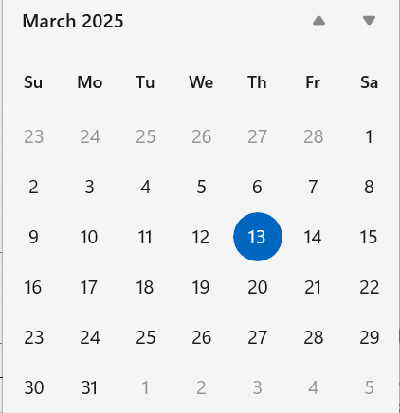
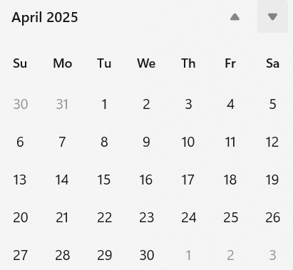
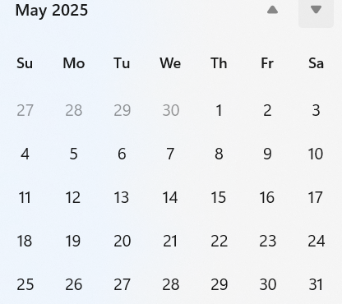
Telecom/Webex Schedule
Interim session starts 12-May
First call 25-March or 1-April depending on when the ballot closes
  Twice weekly, 1 hour each,
  Tuesday 06:00 and Thursday 14:00

Slide 43
TG4ac (Privacy)
March 2025
Closing Report

Slide 44
Agenda for March
Process letter ballot comments
Create new draft
Start recirculation
Slide 44

Slide 45
Detailed Agenda for March
Monday 10th of March 13:30-15:30
  Opening slides
  Approve agenda (this document)
  Approve minutes 15-25-0058-00
  Process letter ballot comments
Wednesday 12th of March 13:30-15:30
  Review draft ready for the recirculation ballot
  Do motion to start recirculation ballot
  Do motion to form a CRG
  Get ready for SA ballot
    Start forming a SA ballot pool
    Start MEC
  Update project task list
  Closing report
Slide 45

Slide 46
More information
Project tasklist 15-23-0397-05
Letter ballot comments 15-25-0107-03
Slide 46

Slide 47
LB211 results
Draft |  | D0
Open Date | 2025-01-23 | Close Date | 2025-02-22
Voters | 116
Voted | 85 | % Voters | 73.28%
Yes | 76 | % Yes | 96.20%
Abstain | 6 | % Abstain | 7.06%
No | 3
Did not vote | 31 | Did not vote % | 26.7%
Slide 47

Slide 48
LB211 comments
Comments
Total | 131
Editorial | 94 | Accepted | 71
Technical | 29 | Revised | 33
General | 8 | Rejected | 27
Slide 48

Slide 49
TG motion:
Draft ready for recirculation
Move that TG4ac formally request that 802.15 WG start a WG recirculation requesting approval of document P802.15.4ac_D01 and to forward document P802.15.4ac_D01, to Standards Association ballot.
Moved by: Tero Kivinen
Seconded by: Ann Krieger
Result: Motion passes
Slide 49

Slide 50
WG motion:
Draft ready for recirculation
Move that 802.15 WG start a WG recirculation requesting approval of document P802.15.4ac_D01 and to forward document P802.15.4ac_D01, to Standards Association ballot.
Moved by:
Seconded by:
Result:
Slide 50

Slide 51
TG motion:
CRG formation for LB
Move that TG4ac requests that 802.15 WG approve the formation of a Comment Resolution Group (CRG) for the WG balloting of the P802.15.4ac_D01 with the following membership: Tero Kivinen (Chair), Ann Krieger, Alex Krebs, and Peter Yee. The 802.15.4ac CRG is authorized to approve comment resolutions, edit the draft according to the comment resolutions, and to approve the start of recirculation ballots of the revised draft on behalf of the 802.15 WG. Comment resolution on recirculation ballots between sessions will be conducted via reflector email and via teleconferences announced to the reflector as per the LMSC 802 WG P&P.
Moved by: Tero Kivinen
Seconded by: Ann Krieger
Result: Motion passes
Slide 51

Slide 52
WG motion:
CRG formation for LB
Move that 802.15 WG approve the formation of a Comment Resolution Group (CRG) for the WG balloting of the P802.15.4ac_D01 with the following membership: Tero Kivinen (Chair), Ann Krieger, Alex Krebs, and Peter Yee. The 802.15.4ac CRG is authorized to approve comment resolutions, edit the draft according to the comment resolutions, and to approve the start of recirculation ballots of the revised draft on behalf of the 802.15 WG. Comment resolution on recirculation ballots between sessions will be conducted via reflector email and via teleconferences announced to the reflector as per the LMSC 802 WG P&P.
Moved by:
Seconded by:
Result:
Slide 52

Slide 53
Timeline
Finalize the list of issues to be solved | Jan 2024
First version of the draft for WG pre-ballot commenting | Nov 2024
Draft ready for letter ballot | Jan 2025
Letter ballot recirculation | Mar 2025
Draft ready for SA ballot | May 2025
SA ballot start | Jun 2025
SA ballot done | Jul 2025
Submit to RevCom | Sep 2025
Standard published | Jan 2026
Slide 53

Slide 54
Meeting achievements
Processed all letter ballot comments
Prepared draft for recirculation
Start recirculation ballot after this session
Form a CRG
Get ready for SA ballot before May session
  Start forming a SA ballot pool
  Start MEC
Slide 54

Slide 55
Agenda of TG4ac for May
Two meetings
Not overlapping with TG9a, or TG4ae.
Process comments received in the letter ballots
Form a CRG
Forward draft to standard association ballot
Slide 55

Slide 56
TG4ad (NG-SUN PHY)
March 2025
Closing Report

Slide 57
Agenda
Monday PM1:
Policies and guidelines
Call for Patents
Approval of the agenda
Approval of minutes
  https://mentor.ieee.org/802.15/dcn/25/15-25-0036-00-04ad-802-15-tg4ad-minutes-january-2024.docx
  https://mentor.ieee.org/802.15/dcn/25/15-25-0084-01-04ad-ieee-802-15-4ad-conference-call-minutes.docx
Hear updated proposals
Recess
Tuesday AM1:
Hear updated proposals
Recess
Tuesday PM1:
Hear updated proposals
Recess
Wednesday PM1:
Hear updated proposals
Recess
Thursday AM1:
Hear updated proposals
Recess
Thursday AM2:
Hear updated proposals
Next Steps and Timeline
AoB
Adjourn
Slide 57

Slide 58
Achievements
Approval of January 2025 minutes
Presentations:
15-24-0651-01-4ad
15-25-0135-01-04ad
15-25-0139-000-04ad
15-25-0007-03-04ad
15-25-0148-00-04ad
15-25-0158-00-04ad
15-25-0150-01-04ad
15-25-0046-03-04ad
March meeting minutes posted as 15-25-0134-00
Slide 58

Slide 59
Conference Call Schedule
Wednesday 16 April 22:00 JST, 15:00 CEST, 14:00 BST, 08:00 CDT, 06:00 PDT
Goals: Remaining Initial simulation results from presentations.
Wednesday 30 April 22:00 JST, 15:00 CEST, 14:00 BST, 08:00 CDT, 06:00 PDT
Goals:
1) Remaining Initial simulation results from presentations
2) Checklist of presentations w.r.t. technical guidance document
Slide 59

Slide 60
Proposed Timeline
2024
November: Approve Technical Guidance Document
Issue call for proposals (next week)
2025
January: Hear initial proposals
March: Hear updated proposals
March to May – 2 conference calls
  simulation results of remaining proposals not yet provided
  Prepare table of proposals for analysing against technical guidance document
May: Hear final proposals
July and beyond: Merging and start drafting the standard

Slide 61
TG4ae (ASCON)
March 2025
Closing Report

Slide 62
Agenda for March
Go through comments to NIST IPD on ASCON
Prepare test vectors for draft
Finalize draft
Slide 62

Slide 63
Detailed Agenda for March
Tuesday 11th of March 13:30-15:30
  Opening slides
  Approve agenda (this document)
  Approve minutes 15-25-0041-00
  Go through comments NIST received in IPD
  Work on the test vectors
Thursday 13th of March 10:30-12:30
  Review the draft
  Closing report
Slide 63

Slide 64
More information
Project tasklist 15-24-0466-01
Comments NIST received during IPD:
  https://csrc.nist.gov/pubs/sp/800/232/ipd
  sp800-232-ipd-public-comments-received.pdf
Slide 64

Slide 65
Timeline
Finalize the list of issues to be solved | Nov 2024
First version of the draft for WG pre-ballot commenting | Mar 2025
Draft ready for letter ballot | Jul 2025
Draft ready for SA ballot | Sep 2025
SA ballot start | Nov 2025
SA ballot done | Jan 2026
Submit to RevCom | Mar 2026
Standard published | Jul 2026
Slide 65

Slide 66
Meeting achievements
Reviewed comments NIST received
Created draft ready for letter ballot
  Created test vectors
Start pre-letter ballot comment collection after this session
Slide 66

Slide 67
Agenda of TG4ae for May
Two meetings
Not overlapping with TG4ac, or TG9a.
Process comments received in the pre-letter ballot comment collection period
Finalize draft
Start initial letter ballot
Slide 67

Slide 68
TG6ma (BAN/VAN)
March 2025
Closing Report

Slide 69
Objectives of TG 6ma – Enhanced Dependability Body Area Network (ED-BAN)
Objective: Enhancements to the BAN Ultra Wideband (UWB) physical layer (PHY) and media access control (MAC) to support enhanced dependability to a human BAN (HBAN) and adds support for vehicle body area networks (VBAN), a coordinator in a vehicle with devices around the vehicular cabin.
Action:
•Comments Resolutions for LB212 recirculation of LB210
•Review of Comments for draft D04
•Necessary Process and Documentation for Recirculation Letter Ballot such as Coexistence Assurance Document, Progess Report, Project Task List
•Performance Evaluation of Technologies in PHY; Channel Coding According to 8 QoS Levels of Packets and Coexistence Levels, Interference.
•Performance Evaluation of Technologies in MAC; Channel Management, CCA, Hybrid Contention Free/Access Protocol According to 8 QoSs and Coexistences.
•Harmonization or Commonality with 4ab in Coexistence and Feasible Implementation of 6ma and 4ab
•Feasibility of TSN of 802.1 in MAC
•WG Motion to Recirculation
Next Things to Do： Recirculation of draft D05 for 3rd Letter Ballot

Slide 70
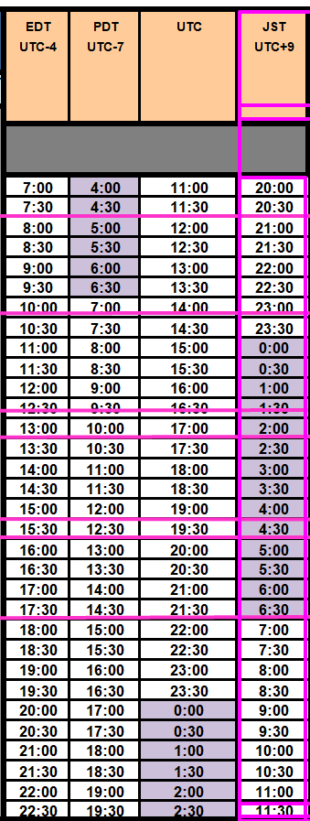
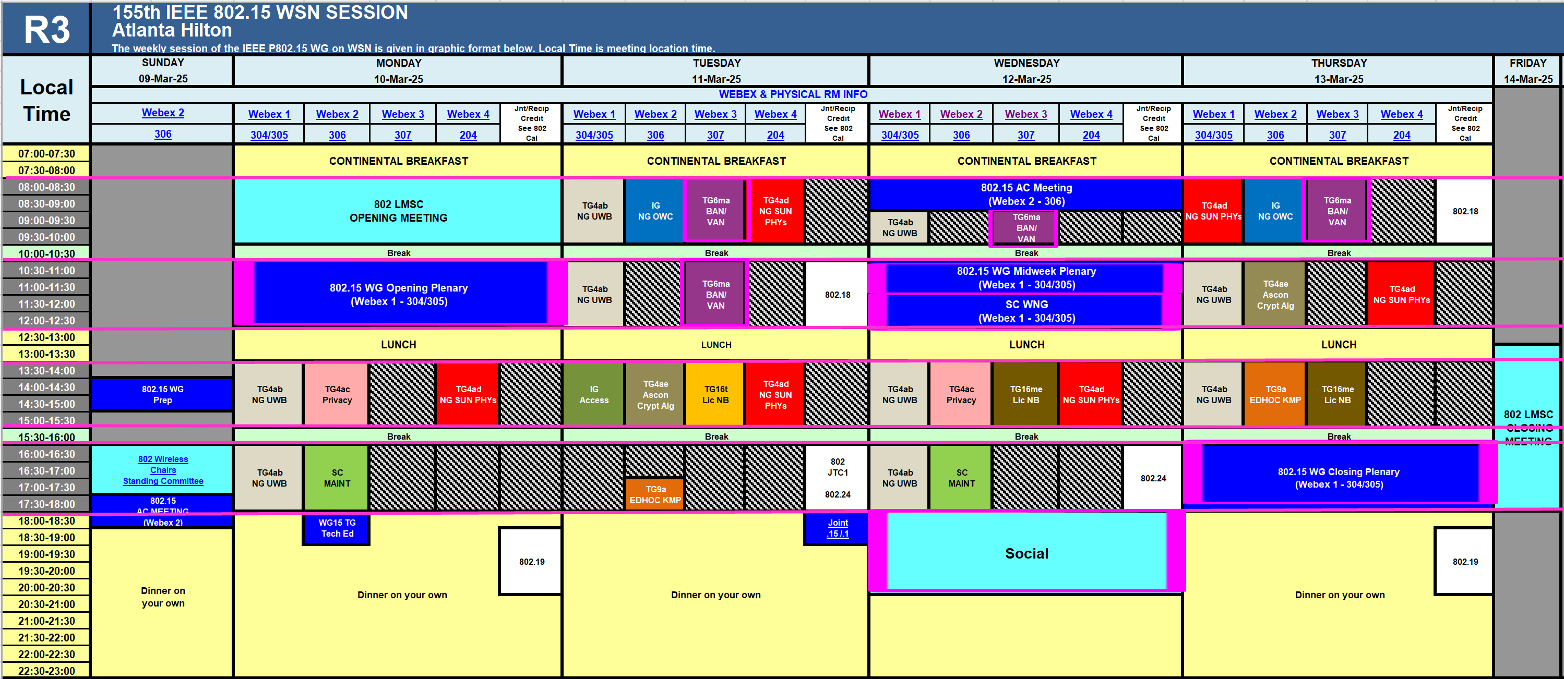
TG15.6ma Plenary Session Schedule for 9th-14th, March 2025
TG15.6ma has three own sessions such as
Session1(Virtual RM#3) AM1 8:00-10:00 March 11(TUE) in Atlanta time, 9:00-11:00AM March 11(TUE) in JST/KST
Session2(Virtual RM#3) AM2 10:30-12:30 March 11(TUE) in Atlanta time, 10:30-12;30AM March 11(TUE) in JST/KST
Session3(Virtual RM#3) AM1 9:00-10:00 March 12(WED) in Atlanta time, 10:00-11:00AM March 12(WED) in JST/KST Session1(Virtual RM#3) AM1 8:00-10:00 March 13(THU) in Atlanta time, 9:00-11:00AM March 13(THU) in JST/KST
Slide 70

Slide 71
Agenda items for the week
TG15.6ma meeting call to order
Call for essential patents and policies & procedures reminder doc.#15-25-0113-02-06ma
Approve last meeting minutes: TG 15.6ma Meeting Minutes for March 2025 doc.#15-25-0064-00-06ma
Agenda of TG15.6ma March 2025 doc.#15-25-0112-08-06ma
Review and Summary
  Overview of IG, SG, TG15.6ma doe Dependable BAN Revision of IEEE802.15.6-2012 doc.#15-25-0033-01-06ma
  Basic Consensus in MAC and PHY of Revision of IEEE802.15.6-2012(IEEE802.15.6ma) doc.#15-23-0557-07-06ma
  Review of Letter Ballot(LB)210 for draft D04 doc.#15-25-0115-03-06ma
  Consolidated comments & resolutions LB212 doc.#15-25-0138-04-06ma
  Rescheduling Timeline doc.#15-23-0361-10-06ma
  Draft P802.15.6ma_D04
  Presentation
  1.. Selection of Suitable Preamble Sequence Sets in UWB Wireless Communications in the Presence of Multiple Coexisting VBANs doc.#15-25-0002-01-06ma
  2. Hybrid ARQ Scheme for High QoS Packets in High Class of Coexistence of IEEE 802.15.6ma #15-23-0576-07-06ma 3. Evaluation of IEEE 802.15.6 Ultra-wideband Physical Layer Utilizing Super Orthogonal Convolutional 22-0562-14-06ma
  4. Ranging Accuracy Evaluation under TG6ma Communication Senarios doc.#15-24-0248-06-06ma
  5. MAC Performance Evaluation of Multiple BAN Coexistence Under TG6ma Channel doc.#15-24-0246-05-06ma
  7 MAC superframe structure and frames doc.#15-24-0573-03-06ma
  8 15.6ma MAC time reference base for superframe and group superframe structure d0c.#15-25-0132-00-06ma
  9 MAC Service Feature doc.#15-24-0356-02-06ma
  10. TG Motion to Recirculation doc.#15-25-0161-00-06ma
  11. Interference Mittigation Schemes in Class 3, 5, 6, and 7 of Coexisitence in TG6ma doc.#15-24-0074-07-06ma
  12. Coordinator-to-Coordinator(C2C) Ranging and Communication for Multiple BAN Coexistence 15-25-0vvv-00-06ma
  13. TG15.6ma Coexistence Assessment Document doc.#15-24-0348-04-06ma
  14 MAC services support for IEEE P802.1ACea doc.#15-24-0594-01-006a
  15..TG6ma Channel Model Document for Enhanced Dependability doc.#15-22-0519-09-06ma
  16. Comments to channel-model-document doc.#15-24-0073-04-06ma
  17. Progress Report of TG6ma doc8#15-23-0056-12-06ma
  18. Timeline of TG6ma doc.#15.23-0056-11-06ma
  19. TG15.6ma Closing Report for March 2025 doc.#15-25-0151-00-06ma
  20. TG15.6ma Meeting Minutes for March 2025 doc.#15-25-0152-00-06ma

Slide 72
Preparation for 2nd Recirculation
TG motion: Approval of Comment Resolutions 25-0161-00
TG Motion to approve the formation of CRG 25-0161-00
TG6ma Coexistence Assurance Document 24-0348-04
Project Task List of 802.15.6ma 25-0062-01
Progress report of 802.15.6ma 23-0056-12

Slide 73
TG motion:
Approval of comment resolutions
TG6ma Approves comment resolutions in document 15-25-0138-04-006a.
Moved by: Ryuji Kohno
Seconded by: Marco Hernandez
Result: Anonymously approved
Slide 73

Slide 74
TG Motion to approve the formation of CRG
Move that 802.15 WG approves the formation of a Comment Resolution Group (CRG) for the WG balloting of P802.15.6ma with the following membership: Ryuji Kohno (YNU/YRP-IAI), Marco Hernandez(CWC), Huan-Bang Li(NICT), Takumi Kobayashi (Nitech), Seong-Soon Joo (NHT). The 802.15.6ma CRG is authorized to approve comment resolutions, edit the draft according to the comment resolutions, and to approve the start of recirculation ballots of the revised draft on behalf of the 802.15 WG. Comment resolution on recirculation ballots between sessions will be conducted via reflector email and via teleconferences announced to the reflector as per the LMSC 802 WG P&P.
Moved By: Ryuji Kohno
Seconded By: Takumi Kobayashi
Motion; Anonymously approved

Slide 75
WG Motion to approve the formation of CRG
Move that 802.15 WG approves the formation of a Comment Resolution Group (CRG) for the WG balloting of P802.15.6ma with the following membership: Ryuji Kohno (YNU/YRP-IAI), Marco Hernandez(CWC), Huan-Bang Li(NICT), Takumi Kobayashi (Nitech), Seong-Soon Joo (NHT). The 802.15.6ma CRG is authorized to approve comment resolutions, edit the draft according to the comment resolutions, and to approve the start of recirculation ballots of the revised draft on behalf of the 802.15 WG. Comment resolution on recirculation ballots between sessions will be conducted via reflector email and via teleconferences announced to the reflector as per the LMSC 802 WG P&P.
Moved By: Ryuji Kohno
Seconded By: Phil Beecher
Motion; Approved
Yes 33 100.0%
No 0 0.0%
Abstain 0 0.0%
Valid 33
Unexercised 0
Total 33
Slide 75

Slide 76
WG Motion to start Recirculation Letter Ballot
Move that 802.15 WG start a WG Letter Ballot requesting approval of CA document 15-24-0348-04 and document P802-15-6ma_D04 (as edited in accordance with the instructions in document 15-25-0138-04) and to forward document P802-15-6ma_D05, as edited in accordance with the instructions in document 15-25-0138-04, and CA document 15-24-0348-04 to Standards Association ballot pending the completion and inclusion of the edits in the draft.
Moved by: Ryuji Kohno
Seconded by: Phil Beecher
Result: Approved
Yes 38 100.0%
No 0 0.0%
Abstain 0 0.0%
Valid 38
Unexercised 0
Tota 38
Slide 76

Slide 77
TG 6ma Timeline(expected)
Tech Req Doc July 2022
Presentation of proposals
May 2023
Comment Resolutionfor LB
Nov. 2024
Comment Resolutionfor LB2
Jan. 2025
EC approval to SA, SA submission
March 2025
SA recirculation
May 2025
WG PreBallot submission for Draft2.5 August 2024
SA recirculation if required
July 2025
Revcom Approve
Sept 2025
^{Draft V1,18 Com}
May. 2024
Recirculation (LB2)
Dec. 2024
RevcomSubmission
August 2025
Comment Resolution fo Draft v2.3 on WG for PreBallot July 2024
1st Letter Ballot(LB)
Sept. 2024
Conditional approval for Standard Association Ballot (SA)
February 2025
TRD,CMD
Call Proposals Sept 2022
Std. Draf V1.9 Proposals
Nov. 2023
Notes: SASB/RevCom scheduled for 2024 a guess
Slide 77

Slide 78
Expecting Timeline detail
Topic item | Deadline | Action items | Notes
Std Draft D2_3 WG pre-ballot recirculation. | July/2024 |  | Editorial comments from 802.15 technical editor were addressed. Still missing cross-references.
Towards the July 2024 meeting | July/2024 | Adding MAC text. Revise PHY text. Editorial revisions.
Target WG letter ballot (LB) submission: submit draft to TEG | August/2024 | Disposition of comments. | 1. Based on pre-ballot resolutions, prepare Draft D2_4 2. Request LB submission before the September meeting. Consequently, the July meeting is used to resolve comments.
TG and WG Motion to letter ballot (LB) submission: submit draft to EC | Sep/2024 | TG and WG Motion to LB | Prepare all necessary documents: Project Task List, Progress Repor, Coexistence Assurance(CA) document, TG Motion to LB, WG Motion to LB
1st LB circulation | Sep/2024 |  | Comment-resolutions to LB recirculation.
Comment Resolution for LB | Nov/2024 |  | Comment-resolutions to LB recirculation.
2nd LB recirculation | Nov/2024 |  | Comment-resolutions to LB recirculation.
Conditional approval for Stanadard Association(SA Ballot | Nov/2024 |  | Seek conditional approval for SB by the Executive Committee.
Final LB recirculation. | Jan/2025 |  | WG approval to request SB submission.
Request EC approval for SA Ballot | Jan/2025 |  | Request SB approval by the EC (conditional or not)
IEEE Standard Association(SA) Ballot submission | March/2025 |  | One month for IEEE SA editorial review.
1st SA recirculation | May/2025 |  | Comment-resolutions to SB and recirculation.
2nd SA recirculation | Jun/2025 |  | Comment-resolutions to SB and recirculation.
Request conditional/unconditional approval to RevCom | Jun/2025 |  | Submission to SASB agenda
Final SB recirculation, if required. Submission to RevCom | July/2025 |  | Submission to SASB
RevCom submission | July/2025 |  | RevCom approval
Note: the deadlines are subject to change.
Reference: doc.#15-23-0369-09-06ma
Slide 78

Slide 79
Contributions
・TG15.6ma opening report for March 2025 meeting 15-25-0113-02-06ma
・TG15.6ma Agenda of March 2025 Meeting 15-25-0112-08-06ma
・Progress report of 802.15.6ma 15-23-0056-08-06ma
・Consolidated comments resolutions LB212 15-25-0138-04-06ma
・Overview of IG-DEP, SG6a, TG6a ＆ TG15.6ma BAN with Enhanced Dependability15-25-0033-01-06ma
・Review of Letter Ballot(LB)212 for draft D04 15-24-0xxx-00-06ma
・Propagation Channel Parameters of UWB for Human BAN (HBAN) Use Cases 15-24-0145-04-06ma
・15.6ma MAC time reference base for superframe and group superframe structure 15-25-0132-00-06ma
・MAC Performance Evaluation of Multiple BAN Coexistence Under TG6ma Channel Model 24-246-05
・Performance Evaluation of Channel Coding with Interleaver for Some Classes of Coexistence 24-247-05
・Ranging Accuracy Evaluation under TG6ma Communication Senarios 15-24-0248-06-06ma
・Interference Mittigation Schemes in Class 3, 5, 6, and 7 of Coexisitence in TG6ma 15-24-0073-07-06ma
・Hybrid ARQ Scheme for High QoS Packets in High Class of Coexistence of IEEE 802.15.6ma 23-0576-07
・Evaluation of IEEE 802.15.6 UWB PHY Utilizing Super Orthogonal Convolutional Code 15-22-0562-11
・Coordinator-to-Coordinator(C2C) Ranging and Communication for Multiple BAN Coexistence24-0406-00・
・TG15.6ma Coexistence Assessment Document 15-24-0348-04-06ma
・Interference Mittigation Schemes in Class 3, 5, 6, and 7 of Coexisitence in TG6ma 15-24-0073-07-06ma
・Project Task List of TG6ma 15-25-0062-01-06ma
・Progress Report of TG6ma 15-23-0056-12-06ma
・Timeline of TG6ma 15.2-0361-11-06ma
・TG15.6ma Closing Report for March 2025 15-25-0151-00-06ma
・TG15.6ma Meeting Minutes for March 2025 15-25-0152-00-06ma

Slide 80
TG9a (EDHOC)
March 2025
Closing Report

Slide 81
Agenda for March
Go through pre-letter ballot comments
Prepare draft ready for letter ballot
Start letter ballot
Slide 81

Slide 82
Detailed Agenda for March
Tuesday 11th of March 17:00-18:00
  Opening slides
  Approve agenda (this document)
  Approve minutes 15-25-0045-00
  Go through pre-letter ballot comments
Thursday 13th of March 13:30-15:30
  Review draft ready for the letter ballot
  Do motion to start letter ballot
  Update the project task list
  Closing report
Slide 82

Slide 83
More information
Project tasklist 15-24-0468-02
Slide 83

Slide 84
TG motion:
Draft ready for LB
Move that TG9a formally request that the 802.15 WG start a WG Letter Ballot requesting approval of document P802-15-9a_D00 and to forward document P802-15-9a_D00, to Standards Association ballot.
Moved by: Ben Rolfe
Seconded by: Ann Krieger
Result:
Slide 84

Slide 85
WG motion:
Draft ready for LB
Move that 802.15 WG start a WG Letter Ballot requesting approval of document P802-15-9a_D00 and to forward document P802-15-9a_D00, to Standards Association ballot.
Moved by:
Seconded by:
Result:
Slide 85

Slide 86
Timeline
Finalize the list of issues to be solved | Nov 2024
First version of the draft for WG pre-ballot commenting | Jan 2025
Draft ready for letter ballot | Mar 2025
Draft ready for SA ballot | Jul 2025
SA ballot start | Sep 2025
SA ballot done | Nov 2025
Submit to RevCom | Dec 2025
Standard published | Jan 2026
Slide 86

Slide 87
Meeting achievements
Created draft ready for letter ballot
Start letter ballot after this session
Slide 87

Slide 88
Agenda of TG9a for May
Two meetings
Not overlapping with TG4ac, or TG4ae.
Process comments received in the initial letter ballot
Form a CRG
Start recirculation ballot
Slide 88

Slide 89
TG16t (LIC-NB)
March 2025
Closing Report

Slide 90
TG16t March Plenary Agenda
Introductions, Secretary, Review and Approve Agenda
Policy Review
Review and resolve comments from SA recirculation ballot on D7.0
Motion to RevCom
Adjourn
Slide 90

Slide 91
Plan for week
Tuesday PM1 1:30pm EDT
Slide 91

Slide 92
March Meeting Start Status
SA Ballot 2nd recirculation on P802.16t D6.0 closed Jan 10th.
  New “No” vote from Roger Marks
CRG Meeting Held Jan 20th
  https://mentor.ieee.org/802.15/dcn/25/15-25-0075-00-016t-minutes-of-crg-2025-01-23.docx
CRG Meeting Held Feb 12th
  Minutes: 15-25-0092-00-016t-minutes-of-tg16t-2st-SA-Recirc-Ballot-2nd crg-teleconference-2025-02-12.docx
Comment Resolution Spreadsheet in 802.15-25-0076r2
SA Ballot 3rd recirculation on P802.16t D7.0 Closed March 3rd
Slide 92

Slide 93
Plan for RevCom
Resolved 1 comment on recirculation of D7.0
  One new comment – rejected – out of scope, comment on unchanged text.
  Comment resolutions in 15-25-0143-00-016t-tg16t-3rd-SA-Recirc-Ballot-comments-and-resolutions
Conduct motion to forward to RevCom
  Unconditional if no new comments
Slide 93

Slide 94
TG motion:
RevCom unconditional submittal
Move that TG16t requests that 802.15 WG reviews and approves the CSD [802.24-19-0030r1] and requests unconditional approval from the IEEE 802 LMSC to submit P802.16t-D7.0 to RevCom.
Moved by: Tim Godfrey
Seconded by: Menashe Shahar
Result: Passes 5 / 0 / 0
Slide 94

Slide 95
WG motion:
RevCom unconditional submittal
Move that 802.15 WG has reviewed and approves the CSD [802.24-19-0030r1] and requests unconditional approval from the IEEE 802 LMSC to submit P802.16t-D7.0 to RevCom.
Moved by: Tim Godfrey
Seconded by:
Result:
Slide 95

Slide 96
Formation of Comment Resolution Group
Move that 802.15 WG approve the formation of a Comment Resolution Group (CRG) with the following membership: Tim Godfrey (Chair), Vishal Kalkundrikar, Harry Bims, Tero Kivinen, and Joerg Robert. The 802.15.16 CRG is authorized to approve comment resolutions, edit the draft according to the comment resolutions, and to approve the start of recirculation ballots of the revised draft on behalf of the 802.15 WG. Comment resolution on recirculation ballots between sessions will be conducted via reflector email and via teleconferences announced to the reflector as per the LMSC 802 WG P&P.
TG Vote
  Unanimous Consent
Slide 96

Slide 97
Teleconference / CRG Meeting
Wednesday April 2, 2025 ⁻⁻ 8am Pacific, 11am Eastern, 8:30pm India
Slide 97

Slide 98
RevCom Package
Package in document 15-25-0144-00-016t-ieee-802-16t-to-revcom-package
Slide 98

Slide 99
Project Timeline
Milestone | Date
Task Group Start | Jan 2020
SRD Approval | April 2021
SDD Approval | Jan 2022
Draft Development
Informal TG review of draft | Mar 2023
Working Group Letter Ballot | Nov 2023
Working Group Recirculation Letter Ballot | March 2024
SA Ballot | Sept 2024
SA Recirc | Nov 2024
Forward to RevCom | March 2025
Slide 99

Slide 100
TG16me (LIC-NB)
March 2025
Closing Report

Slide 101
TG16me March Plenary Agenda
Introductions, Secretary, Review and Approve Agenda
Policy Review
Review of contributions
Discussion on Revision Project timeline
Adjourn
Slide 101

Slide 102
Plan for week
Wednesday PM1 1:30pm PST
Thursday PM1 1:30pm PST
Slide 102

Slide 103
Prior Documents related to revision
2024 | 519 | 3 | TG16t (LIC-NB) Amend | Draft Revision PAR for 802.16-2017
16-May-2024 ET | 2024 | 308 | 0 | TG16t (LIC-NB) Amend | IEEE802.16 RevisionProposal | Menashe Shahar (Ondas)
Slide 103

Slide 104
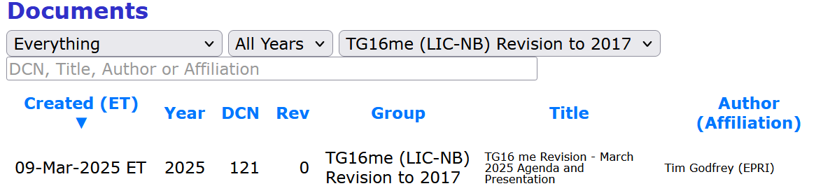
New Contributions
Remember to use new Mentor section for TG16me Revision documents
11-Mar-2025 ET | 2025 | 140 | 0 | TG16t (LIC-NB) Amend | ieee802.16 Revision | Menashe Shahar (Ondas Networks)
Slide 104

Slide 105
Discussion on new concepts for revision
BSC API and ICIC=-like features
Improvement in mobility – some thing like 802.11r Fast BSS transition
  Centralize association with mobile device.
Coex with voice on same channel (gray channel)
  Issue is analog voice could block channel for extended time (seconds)
Possible definition of a “short message” mode?
Support for Static Radio and Handheld Radios ?
Slide 105

Slide 106
Process for Revision integration of amendment
First, bring base up to current practices for headers, figures, etc.
Then merge in 802.16t amendment
Then consider changes for revision
Discuss and develop set of desired changes.
Agree on that set, vote to approve.
Implement changes in draft.
First step, talk to staff. Get database of figures. Create plan for updating figures that are not in Framemaker formats.
  Talk to Michell Turner and Christy Bahn.
Slide 106

Slide 107
Discussion on issues with existing base standard
Changes to standards that would affect the standard over the past 8 years.
Remove MW theory
Update covers – (post approval)
Wireless MAN logo can remain
Historical Participants add new
Clause 1 – add a “word usage clause” after Purpose – Michelle will send to include in draft before balloting.
Normative References need updating or remove those that are no longer applicable. Add revision dates or remove date as applicable. If no date, latest version.
  IEEE Std 802.16.1™-2012, may be withdrawn
  Do we want to add 802.16.3 channel models as a reference?
Fix hanging paragraphs.
Explanation of how to interpret tables with embedded bit fields (bitmap vs value)
Review table numbering – do unnumbered tables need to have them, or are they not referenced from text?
Make sure images are searchable. Any JPG images should be done in EMF or Visio. Tool called “PDF Images” can list locations of any non-searchable images.
Any other stylistic changes in base standard? Michelle says no.
Slide 107

Slide 108
16t amendment roll-in
Michelle Turner will roll in amendment at IEEE
Send email to Michelle cc Christy
Once 16t is published she will roll in to the base file.
Slide 108

Slide 109
Project Timeline
Milestone | Date
Task Group Start | March 2025
Draft Development | May – Sept 2025
Informal TG review of draft | Nov 2025
Working Group Letter Ballot | March 2026
Working Group Recirculation Letter Ballot | May 2026
SA Ballot | Sept 2026
SA Recirc | Jan 2027
Forward to RevCom | March 2027
Slide 109

Slide 110
Future Meetings
May 12-15, 2025 - Interim
  Warsaw, Poland
July 28-31, 2025 - Plenary
  Madrid, Spain
Slide 110

Slide 111
IG Access
March 2025
Closing Report

Slide 112
Agenda
Opening and Meeting Reminders
Overview of Interest Group
Technical Presentation(s) and Discussion(s)
  MAC for SUN FSK in Japanese VHF-High band, Susumu Ishihara
Next Steps
Any other business
Adjourn
Slide 112

Slide 113
Call for contributions and
Proposed Direction for IG
Consider spectrum access recommendations within the scope of 802
  Can be “above the MAC” (e.g. 802.15.5 and 802.15.10) and/or spanning use of multiple standards (e.g. 802.19.3)
    How to use features of the MAC to achieve a specific function
    How to use features of the MAC to address different optimization scenarios
  Can be recommendations for new features in 802 MACs
    Recommend a project in WG 15
    Recommend a project in WG 11
  Think beyond “one size fits all”
  Think beyond “what we already have done”
Slide 113

Slide 114
IG NG-OCC
March 2025
Closing Report

Slide 115
Session Objectives
Present Five contributions related to the future of next generation OWC(OCC, FSO) technology
Prepared Call for Applications on NG OWC
Slide 115

Slide 116
Session Schedule
IG NG-OWC scheduled 2 time slots in this week meeting
- Tue. AM1 and Thur. AM1
Slide 116

Slide 117
Accomplishment for the meeting
1st Slot: Tue. AM1
  Meeting Objectives and Agenda Approval (109-01)
  Discussion and Approval of IG NG-OWC March 2025 Meeting Minutes(650-00)
  Present and accept the presentation from Kookmin University titled "Future direction of NG-OWC Network Technologies (123-00)
  Present and accept the presentation from Kookmin University titled "Discussion on Free Space Optics for Drone Network (124-00)
  Present and accept the presentation from Kookmin University titled "Future Direction of NG OCC MAC Technologies (125-00)
  Present and accept the presentation from Kookmin University titled "Future Directions of NG FSO Technologies for Drone Application (126-00)
  Present and accept the presentation from Kookmin University titled "Current Status of Existing FSO Technologies (128-00)
  Recess
Slide 117

Slide 118
Accomplishment for the meeting
2nd Slot: Thur. AM1
  Meeting Objectives and Agenda Approval (109-01)
  IEEE 802.15 IG NG OWC Call For Applications (162-01)
  https://mentor.ieee.org/802.15/dcn/25/15-25-0162-01-07ma-ieee-802-15-ig-ng-owc-call-for-applications.doc
  Plan for May meeting: May meeting will be skipped
  Plan for IG NG-OWC
  Adjourn
Slide 118

Slide 119
Plan for May Meeting
May meeting will be skipped
Slide 119

Slide 120
  Plan for IG NG-OWC
Invite experts from other countries.
Invite contributors from research institute and companies
IEEE 802.15 IG NG OWC Call For Applications (162-01)
https://mentor.ieee.org/802.15/dcn/25/15-25-0162-01-07ma-ieee-802-15-ig-ng-owc-call-for-applications.doc
Slide 120

Slide 121
SC IETF
March 2025
Closing Report

Slide 122
Agenda for March
Discuss what will be happening in IETF 122 Bangkok (March 15 – 21, 2025)
Slide 122

Slide 123
IETF 122
IETF 122 will be held in Bangkok, March 15 – 21, 2025
  Registration is open
  Registration
  There is registration fee waivers program
    Almost all remote participation requests are accepted.
    https://www.ietf.org/meeting/registration-fee-waivers/
Slide 123

Slide 124
Working groups to cover
6lo – Ipv6 over Networks of Resource-constrained Nodes
Lake – Lightweight Authenticated Key Exchange
Suit – Software Updates for Internet of Things
Slide 124

Slide 125
6lo – Ipv6 over Networks of Resource-constrained Nodes
Will meet in 122
  Agenda
  Ipv6 Neighbor discovery prefix registration, path-aware semantic addressing, generic address assignment, SCHC-compressed Packets over IEEE 802.15.4, Ipv6 packets over short-range OWC
Slide 125

Slide 126
6lo – Work in progress
Published as RFC
  RFC 9685 – Listener Subscription for IPv6 Neighbor Discovery Multicast and Anycast Addresses, 2024-11
WG documents
  Path-Aware Semantic Addressing (PASA) for Low power and Lossy Networks
    draft-ietf-6lo-path-aware-semantic-addressing
  Transmission of SCHC-compressed packets over IEEE 802.15.4 networks
    draft-ietf-6lo-schc-15dot4
  Transmission of IPv6 Packets over Short-Range Optical Wireless Communications
    draft-ietf-6lo-owc
  Generic Address Assignment Option for 6LowPAN Neighbor Discovery
    draft-ietf-6lo-nd-gaao
  IPv6 Neighbor Discovery Prefix Registration
    draft-ietf-6lo-prefix-registration
Slide 126

Slide 127
Lake – Lightweight Authenticated Key Exchange
Will meet in 122
  Agenda
  Authz, app profiles, implementation considerations, grease, remote attestation, PSK, QR discussion
Slide 127

Slide 128
Lake – Work in progress
WG documents
  Coordinating the Use of Application Profiles for Ephemeral Diffie-Hellman Over COSE (EDHOC)
    draft-ietf-lake-app-profiles
  Lightweight Authorization using Ephemeral Diffie-Hellman Over COSE (ELA)
    draft-ietf-lake-authz
  Implementation Considerations for Ephemeral Diffie-Hellman Over COSE (EDHOC)
    draft-ietf-lake-edhoc-impl-cons
  Remote attestation over EDHOC
    draft-ietf-lake-ra
  EDHOC Authenticated with Pre-Shred Keys (PSK)
    draft-ietf-lake-edhoc-psk
  Applying Generate Random Extensions And Sustain Extensibility (GREASE) to EDHOC Extensibility
    draft-ietf-lake-edhoc-grease
Slide 128

Slide 129
Suit – Software Updates for Internet of Things
Will meet in 122
  Agenda
  Suit manifest, trust domains, firmware encryption, report, mud, mti, update management
Slide 129

Slide 130
Suit – Work in progress
RFC Editor Queue
  A Concise Binary Object Representation (CBOR)-based Serialization Format for the Software Updates for Internet of Things (SUIT) Manifest
    draft-ietf-suit-manifest
  Strong Assertions of IoT Network Access Requirements
    draft-ietf-suit-mud
IESG Evaluation
  Encrypted Payloads in SUIT Manifests
    draft-ietf-suit-firmware-encryption
  SUIT Manifest Extensions for Multiple Trust Domains
    draft-ietf-suit-trust-domains
AD Evaluation
  Secure Reporting of Update Status
    draft-ietf-suit-report
  Mandatory-to-Implement Algorithms for Authors and Recipients of Software Update for the Internet of Things manifests
    draft-ietf-suit-mti
WG documents
  Update Management Extensions for Software Updates for Internet of Things (SUIT) Manifests
    draft-ietf-suit-update-management
Slide 130

Slide 131
BOFs
nasr – Network Attestation for Secured foRwarding
skex – Symmetric Key Establishment and Exchange
Slide 131

Slide 132
nasr – Network Attestation for Secured foRwarding
In the current network deployments, communicating entities implicitly rely on peer entities and use paths as determined by the control plane. These available path(s) are implicitly trusted.
Communicating entities have very little information about the entities in the paths over which their traffic is carried, and have no available means to audit the entities and paths, beyond basic properties like latency, throughput, and congestion.
However, increased demand in network security, privacy, and robustness makes tools for enabling visibility of the entities' security posture a necessity.
With additional security and privacy requirements, there is a need to provide enhanced or added services beyond the pure encryption-based data security; requiring better visibility of the security posture of the underlying network elements.
Specifically, to satisfy the visibility of the network elements' security state, proof that data is traversed through network elements (devices, links and services) that satisfy security posture claims to avoid exposure of unqualified elements is needed.
WG Forming
Slide 132

Slide 133
skex – Symmetric Key Establishment and Exchange
Symmetric key establishment systems can be used to semi-statically and dynamically provide or supplement keys for existing protocols that accept pre-shared or pre-positioned keys independent of a public key and so might create hybrid keys. For example TLS 1.3 (RFC 8446 and RFC 8773), IPsec (RFC 8784) and MACsec (draft-hb-intarea-eap-mka-00).
Asymmetric-key cryptography, while powerful and often convenient, has limitations, including being computationally intensive and potentially vulnerable to quantum computing or mathematical attacks, thus not fully addressing all security needs. This emphasises the need for symmetric-cryptography-based key establishment mechanisms that don't rely on asymmetric algorithms. Such systems can provide keys for secure internet communications.
Proposed solutions must address not only the secure transport of symmetric keys but also the mechanisms needed to ensure that only authenticated and authorised peers can securely access these keys. Identifying the peers is part of the enrolment process.
The proponents' goal is to create a framework for secure establishment of symmetric keys to match security requirements, and to streamline their integration into applications. The second objective is to propose one or multiple protocols for symmetric key establishment.
WG Forming
Slide 133

Slide 134
SC MAINT
March 2025
Closing Report

Slide 135
SC Meeting Objectives – Agenda
    Meetings 1&2 (Monday and Tuesday)
    Policy and Procedure
    Approve Agenda
    PAR reviews
    Recess
    Meeting 3 Wednesday
    Review comments received from IEC/ISO/JTC1/SC6 (none)
    Review any comments or questions on existing or new standards (none)
    Review any change requests for Operations Manual (none)
    Motion templates (none)
    Review Project Checklist (none)
    Adjourn
Slide 135
Notes:
March 25
Page 135

Slide 136
802 PARs for Review
Information at https://www.ieee802.org/PARs.shtml
Mar 10-15, 2025 Atlanta, Georgia, USA
P802.1AS - Standard - timing and Synchronization for Time-Sensitive Applications - Revision to IEEE Standard 802.1AS-2020, PAR
P802.3dp - Amendment - Cabling Restrictions for Single Pair Power over Ethernet (SPoE), PAR and CSD
P802.11br - Amendment - Enhanced Light Communications, PAR and CSD
P802.15.4-2024/Cor 1 - Standard for Low Rate Wireless Networks - Corrigendum to IEEE Standard
PAR
Slide 136
Notes:
March 25
Page 136

Slide 137
Achievements
    Reviewed PARs / CSDs
    Resolved comments received on 802.15.4 Corrigendum PAR
    Agreed to forward Stds 802.15.7a and Stds 802.15.13
Slide 137
Notes:
March 25
Page 137

Slide 138
SC WNG
March 2025
Closing Report

Slide 139
802.15 WNG Agenda
Topic | Presenter | Time
WNG Open | Ben Rolfe | 0:05
Group Association for IEEE 802.15.4 | Jianlin Guo | 0:25
Waveform compression and its role in Low Power Network security and efficiency | Micah Givens | 0:30
WNG Close | Ben Rolfe | 0:05

