Slide 1
Project: IEEE P802.15 Working Group for Wireless Specialty Networks (WSN)
Submission Title: TG4ab Meeting Slides January 2025
Date Submitted: 13 March 2025
Source: Benjamin A. Rolfe (Blind Creek Associates)
Contact:
Voice: [deprecated],
E-Mail: ben.rolfe @ ieee.org
Re: Task Group 4ab: 802.15.4 UWB Next Generation
Abstract: Closing report March 2025
Purpose: Continue project progress and continue the illusion of organization
Notice: This document has been prepared to assist the IEEE P802.15. It is offered as a basis for discussion and is not binding on the contributing individual(s) or organization(s). The material in this document is subject to change in form and content after further study. The contributor(s) reserve(s) the right to add, amend or withdraw material contained herein.
Release: The contributor acknowledges and accepts that this contribution becomes the property of IEEE and may be made publicly available by P802.15.

Slide 2


Task Group 15.4ab
Next Generation UWB Amendment
March 2025
802 Plenary Session
Mixed Mode
Live from
Atlanta, GA, USA

Slide 3

Agenda
https://mentor.ieee.org/802.15/dcn/25/15-25-0090-07-04ab-tg4ab-detailed-agenda-march-2025.xlsx

Slide 4
Project Information

Slide 5
5.2.b Scope of the project (As approved):
This amendment enhances the Ultra Wideband (UWB) physical layers (PHYs) medium access control (MAC), and associated ranging techniques while retaining backward compatibility with enhanced ranging capable devices (ERDEVs).
Areas of enhancement include:
  additional coding, additional coding, preamble and modulation schemes to support improved link budget and/or reduced air-time relative to IEEE Std 802.15.4 UWB;
  additional channels and operating frequencies;
  interference mitigation techniques to support greater device density and higher traffic use cases relative to the IEEE Std 802.15.4 UWB;
  improvements to accuracy, precision and reliability and interoperability for high-integrity ranging; schemes to reduce complexity and power consumption;
  definitions for tightly coupled hybrid operation with narrowband signaling to assist UWB;
  enhanced native discovery and connection setup mechanisms;
  sensing capabilities to support presence detection and environment mapping;
  and mechanisms supporting low-power low-latency streaming as well as high data-rate streaming allowing at least 50 Mb/s of throughput.
Support for peer-to-peer, peer-to-multi-peer, and station-to-infrastructure protocols are in scope, as are infrastructure synchronization mechanisms. This amendment includes safeguards so that the high throughput data use cases do not cause significant disruption to low duty-cycle ranging use cases.
https://development.standards.ieee.org/myproject-web/app#viewpar/9081

Slide 6
SA Ballot and Beyond
 | Current Schedule
First SA-Ballot | November 2025
SA-Ballot comment resolution | January 2026
First recirculation | April 2026
Recirculation comment resolution | May 20256
Second recirculation | July 2026
Recirculation comment resolution | August 2026
Third recirculation | November 2026
Final comment resolution | January 2027
LMSC approval | March 2027
REVCOM and SASB | June 2027
Update!
New and… Improved??

Slide 7
Goals for the week
Note: Recirculation on Draft D02 in progress
Review and improve draft D02
  Early comment submissions will be reviewed
  Collaboration to prepare good, useful comments
Work on outstanding issues
  Separate out those that got caught in the crossfire from issues
  Filter out comments with no proposed change
  Address the elephant in the room

Slide 8

Next Steps

Slide 9
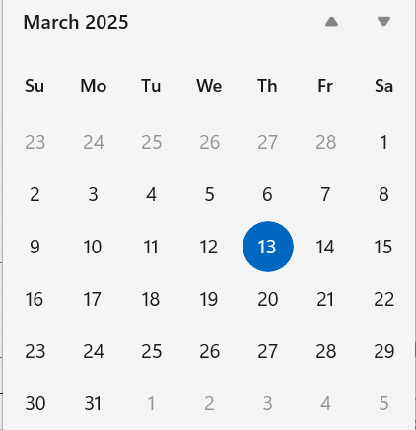
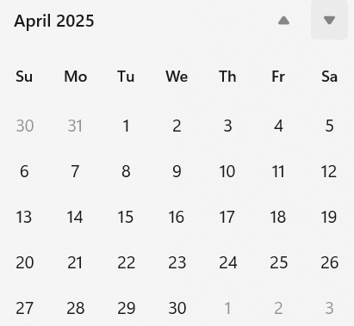
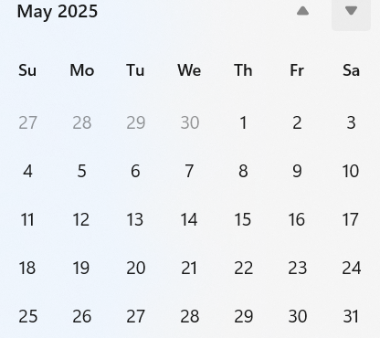
Telecom/Webex Schedule
Interim session starts 12-May
First call 25-March or 1-April depending on when the ballot closes
  Twice weekly, 1 hour each,
  Tuesday 06:00 and Thursday 14:00

Slide 10

Thank you for listening!

