Slide 1
Project: IEEE P802.15 Working Group for Wireless Personal Area Networks (WPANs)
Submission Title: [Coexistence of SUN FSKs in the Japanese VHF-High band]
Date Submitted: [12 Mar. 2025]
Source: [Susumu Ishihara¹, Masakatsu Ogawa², Tetsushi Ikegami³, Shugo Kajita⁴, Arata Kato⁴, Mineo Takai⁵]
Company [¹Shizuoka University, ²Sophia University, ³Meiji University, ⁴Space-Time Engineering Japan, Inc., ⁵Space-Time Engineering, LLC]
Address []
Voice:[], FAX: [], E-Mail:[ishihara.susumu@shizuoka.ac.jp, m-ogawa@sophia.ac.jp, ikegami@meiji.ac.jp, skajita@spacetime-eng.com, akato@spacetime-eng.com, mineo@ieee.org]
Re: []
Abstract: [This document includes a revision to the MAC protocol for Coexistence of SUN FSKs in Japanese VHF high band.]
Purpose: [Present a revised MAC for Coexistence of SUN FSKs in the Japanese VHF high band ]
Notice: This document has been prepared to assist the IEEE P802.15. It is offered as a basis for discussion and is not binding on the contributing individual(s) or organization(s). The material in this document is subject to change in form and content after further study. The contributor(s) reserve(s) the right to add, amend or withdraw material contained herein.
Release: The contributor acknowledges and accepts that this contribution becomes the property of IEEE and may be made publicly available by P802.15.

Slide 2
Background
Japanese VHF-High Band
The Ministry of Internal Affairs and Communications (MIC) is in the process of initial round of rule-making to introduce Narrowband IoT Communication Systems in the Japanese VHF-High band (170 – 177.5 and 217.5 – 222 MHz). One of their primary use cases is public safety applications including disaster response and recovery operations.
SUN FSK and SUN OFDM already defined in other frequency bands are being considered as the foundation for the initial rules [1].
In [2], Kajita, et al., proposed a partial proposal on adding SUN FSK to the Japanese VHF-High band (IEEE 802.15-25/007r2) .
This partial proposal aims to extend the existing SUN FSK MCSs, which are supported by many off-the-shelf radio modules, to two Japanese VHF bands where the use of SUN PHYs has not yet been defined.

Slide 3
Proposed Modulation and Channel Parameters for the VHF-High Band (Citation from [2])
Two data rates are defined for each channel spacing in the VHF-High Band. Both rates are modulated with 2-FSK for the 12.5 kHz channel spacing, where the lower rate is defined for long-range communications.
For all other channel spacings, the lower rate utilizes 2-FSK while the higher rate uses 4-FSK. The 4-FSK modulation requires a higher SNR but delivers a higher data rate within the same bandwidth.
Frequency band (MHz) | Parameter | Operating mode
 |  | #1 | #2 | #3 | #5 | #7 | #9 | #11
170 – 177.5 217.5 – 222 | Data rate (kb/s) | 5 | 10 | 20 | 40 | 75 | 150 | 300
 | Modulation | 2-FSK | 2-FSK | 2-FSK | 2-FSK | 2-FSK | 2-FSK | 2-FSK
 | Modulation index | 0.5 | 0.5 | 0.5 | 0.5 | 0.5 | 0.5 | 0.5
 | Channel spacing (kHz) | 12.5 | 12.5 | 25 | 50 | 100 | 200 | 400
 |  |  |  | #4 | #6 | #8 | #10 | #12
 | Data rate (kb/s) |  |  | 25 | 50 | 100 | 200 | 400
 | Modulation |  |  | 4-FSK | 4-FSK | 4-FSK | 4-FSK | 4-FSK
 | Modulation index |  |  | 0.33 | 0.33 | 0.33 | 0.33 | 0.33
 | Channel spacing (kHz) |  |  | 25 | 50 | 100 | 200 | 400

Slide 4
Problem in CCA in the SUN FSK Japanese VHF high band
In part of the VHF-high band, Energy detection (ED)-based CCA does not work due to severe out-of-band emission from the neighboring service.
Carrier sense (CS)-based CCA is effective for media access control with other devices that use the same channel and the same modulation.
However, other services that share the same operation frequency and use different modulation and bandwidth may exist.
Energy detection (ED) with a sufficiently high threshold will work to avoid contention with such services.
Ego Channel
Operating Mode #1 (5 kbps/Channel Spacing 12.5 kHz)
Carrier Sense CCA
Co-Existing Channel covering the ego channel
E.g. Operating Mode #9 (150 kbps/Channel Spacing 200 kHz)
or Other services
Freq.
Energy Detection (ED) –based CCA

Slide 5
Key Ideas
Combination of ED (Mode 1) and CS-based (Mode 2) CCA.
Problem: It leads to long lead time before the frame transmission.
The device needs to change its bandwidth to perform carrier sense for the specified channel and energy detection in the wider bandwidth covering the channel. The switching time for changing the bandwidth is required.
The original CSMA-CA of IEEE 802.15.4 leads to low throughput in congested channels.
Use of suspendable CSMA-CA introduced in IEEE 802.15.4-2024.
Suspendable CSMA-CA enables CCA during backoff slots to quickly detect the channel BUSY and avoids frame transmission failure especially in highly congested situations.

Slide 6
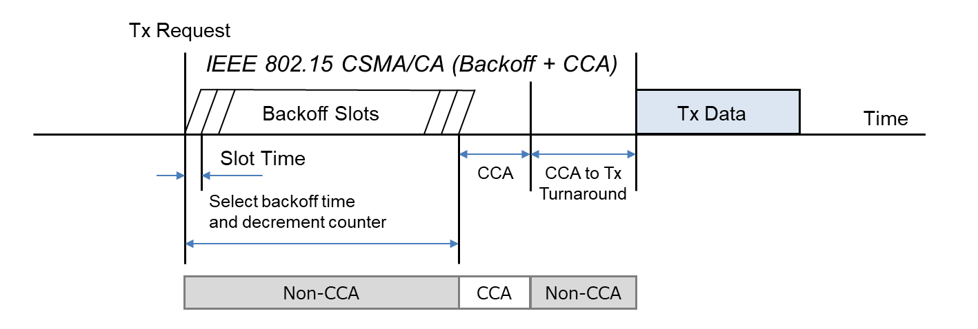
IEEE 802.15.4 CSMA-CA
IEEE 802.15.4 CSMA-CA does not perform carrier sense to minimize power consumption until the CCA (Clear Channel Assessment) period just before transmission, while IEEE 802.11 CSMA/CA always performs carrier sense during the backoff slots.
Cited from IEEE 802.19-25/0006r0 [4]

Slide 7
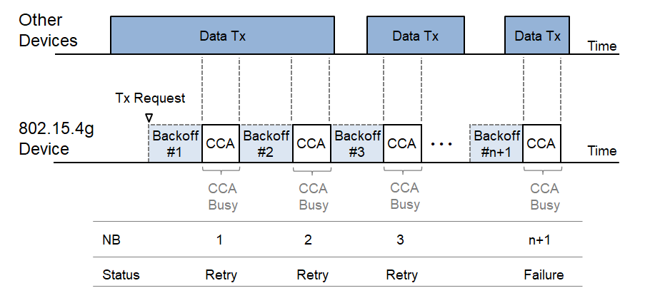
IEEE 802.15.4 CSMA-CA leads to low throughput
IEEE 802.15.4 CSMA-CA does not suspend backoff during the backoff slots.
CCA Busy is found after the backoff slots.
If the network is congested, Number of Backoffs (NB) tends to reach the specified threshold macMaxCSMABackoffs, and leads to backoff failure.
This leads to low throughput [4].
Cited from IEEE 802.19-25/0006r0 [4]

Slide 8
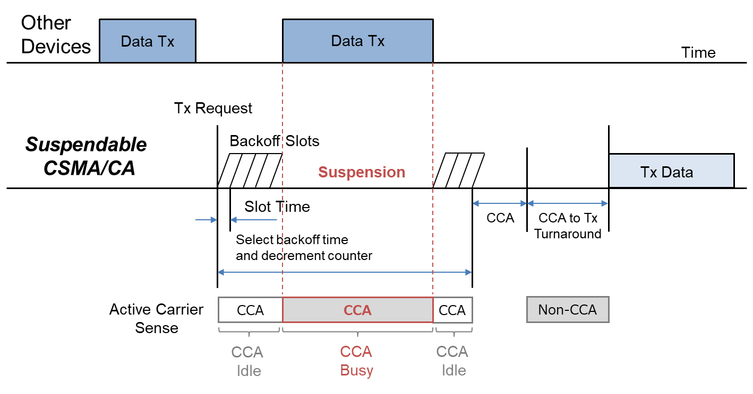
Suspendable CSMA-CA introduced in IEEE 802.15.4-2024 [3]
If CCA is busy during the backoff delay period, the backoff timer shall be suspended until sensing the channel indicates that the channel is clear or macSuspendedCsmaMaxTime is exceeded. Upon CCA detecting clear, the backoff time shall resume.
If macSuspendedCsmaMaxTime is exceed, backoff ends in ”Failure” and CSMA-CA algorithm terminates with a channel access failure.
Cited from IEEE 802.19-25/0006r0 [4]

Slide 9
Proposed MAC Strategy for Japanese VHF-High band
ED (Mode 1) and CS-based (Mode 2) CCA + Suspendable CSMA-CA
After the carrier sense-based CCA, perform ED-based CCA. If the final CCA succeeded, the device starts the frame transmission.
Other Devices
operating in different modulation
Data Tx
Other Devices
operating in the same channel
Data Tx
TX Request
Busy
TX-Data
Time
CCA
(CS)
CCA
(ED)
Active Carrier Sense
If fails, restart from CS backoff
Switch to
ED in the
wider bandwidth
CCA to TX
Turn Around
Suspendable
CSMA/CA

Slide 10
Discussion
This proposed MAC enables devices working in the proposed SUN FSK in Japanese VHF-High band to detect co-existing transmissions on channels sharing the same frequency band and using different modulation.
Additional turn around time is introduced between the carrier sense-based CCA and ED-based CCA. This leads to a long delay before Data TX or detection of BUSY.
Suspendable CSMA-CA works to shorten the delay.
Issues
Selection of the threshold value for ED according to the ED bandwidth
The ED bandwidth depends on the standardization process of the VHF-High band.
Confirmation for the compatibility with existing devices
Parameter configuration
Turn around time from the narrow ego channel to the ED mode
Turn around time from ED-CCA to TX (on the narrow ego channel)

Slide 11
Summary
A revised MAC protocol for co-existing of SUN FSKs in Japanese VHF-High band has been presented.
We will conduct a simulation study for verifying the effect of the proposed MAC.

Slide 12
References
[1] Ministry of Internal Affairs and Communications, “Consultation on the regulatory rules of the VHF-High Band,” (Japanese).
[2] S. Kajita, S. Kitazawa, T. Ikegami, S. Ishihara, A. Kato, T. Matsuda, R. Miura, M. Ogawa, M. Takai, M. Uno, “Partial proposal on adding SUN FSK to two Japanese VHF bands,” DCN: 802.15-25/0007r2.
[3] IEEE Standard for Low‐Rate Wireless Networks, IEEE Std 802.15.4-2024.
[4] T. Sumi, Y. Nagai, J. Guo, P. Orlik, K. Parsons, IEEE 802.11ah and IEEE 802.15.4g SUN OFDM PHY Coexistence Simulation for Case 1-3 with Suspendable CSMA/CA, DCN: 802.19-25/0006r0

