Slide 1
Project: IEEE P802.15 Working Group for Wireless Personal Area Networks (WPANs)
Submission Title: IG agenda opening and closing report and Minutes
Date Submitted: 11 March 2025
Source: Benjamin A. Rolfe (Blind Creek Associates)
Contact:
Voice: +1 408 395 7207, E-Mail: ben.rolfe @ ieee.org
Re: Wireless Next Generation
Abstract: Closing report and minutes for the March Plenary Session.
Purpose: Support the illusion of organization.
Notice: This document has been prepared to assist the IEEE P802.15. It is offered as a basis for discussion and is not binding on the contributing individual(s) or organization(s). The material in this document is subject to change in form and content after further study. The contributor(s) reserve(s) the right to add, amend or withdraw material contained herein.
Release: The contributor acknowledges and accepts that this contribution becomes the property of IEEE and may be made publicly available by P802.15.
Notes:
Jul 12, 2010
Page 1

Slide 2
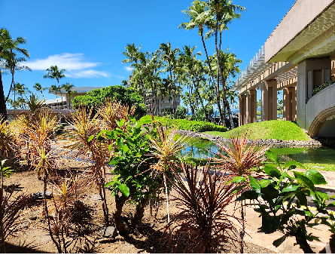
March 2025 Plenary Session Interest Group, Spectrum Access

Slide 3
Agenda
Opening and Meeting Reminders
Overview of Interest Group
Technical Presentation(s) and Discussion(s)
MAC for SUN FSK in Japanese VHF-High band, Susumu Ishihara
Next Steps
Any other business
Adjourn

Slide 4
Call for contributions and Proposed Direction for IG
Consider spectrum access recommendations within the scope of 802
Can be “above the MAC” (e.g. 802.15.5 and 802.15.10) and/or spanning use of multiple standards (e.g. 802.19.3)
How to use features of the MAC to achieve a specific function
How to use features of the MAC to address different optimization scenarios
Can be recommendations for new features in 802 MACs
Recommend a project in WG 15
Recommend a project in WG 11
Think beyond “one size fits all”
Think beyond “what we already have done”

